Slide 1
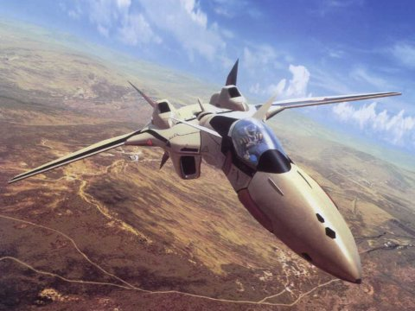
Physics 7B-1 (A/B)
Professor Cebra
Winter 2010
Lecture 9
Kinematics

Slide 2
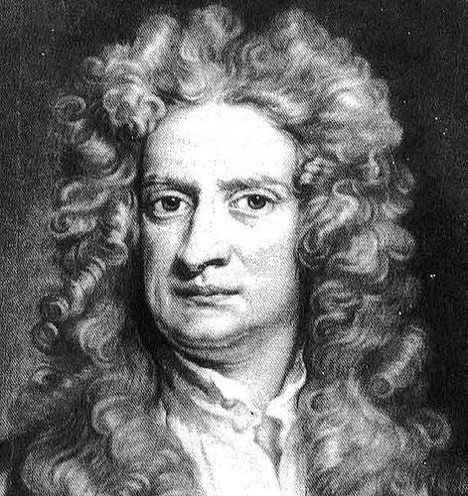
Newton’s Laws of Motion
1st Law: The velocity of an object will not change unless acted upon by a force
2nd Law: The net force on an object is equal to the rate of change of momentum
3rd Law: For every force there is an equal but opposite force

Slide 3
Newton’s First Law -- Statics
Long Range Forces
Act on the center of gravity
Gravitational Force
Electrical Force
Contact Forces
Act the point of contact
Consider every point of Contact
Normal Forces (Perpendicular to Surface)
Can take any value needed
Frictional Forces (Parallel to surface)
Can take any value up to μ_{s}N
Dynamic friction = μ_{D}N
No Motion
or
Constant Motion
Do sample problems here

Slide 4
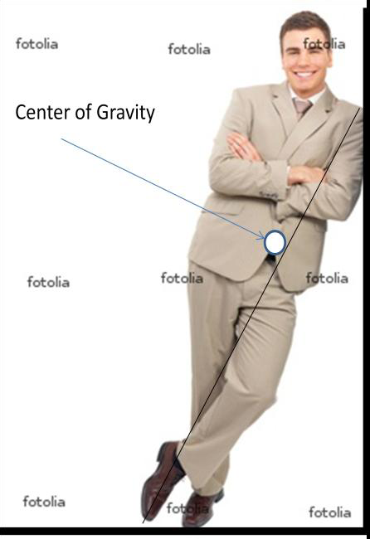
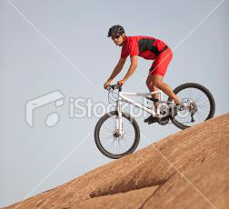
Newton’s First Law -- Statics

Slide 6
Newton’s Second Law -- Dynamics
Talk about vectors
F
R
v
F
When do we use force/torque? When do we use impulse?

Slide 7
Constant Acceleration
Rotational Motion (α = constant) | Linear Motion (a = constant)
ω = ω₀ + αt | v = v₀ + at
θ = (1/2)(ω₀ + ω)t | y = (1/2)(v₀ + v)t
θ = θ₀ + ω₀t + (1/2)αt² | y = y₀ + v₀t + (1/2)at²
ω² = ω₀² + 2αθ | v² = v₀² + 2ay

Slide 8
Applying the Kinematics Equations
Make a drawing to represent the system being studied
Decide which directions will be called positive and which negative
In an organized way, write down the values for any of the kinematic variables (x, y, v , a, t and initial values). Be alert for the implied meaning in the phrasing of the problem. For example, the phrase “starts at rest” implies that v₀ = 0.
Determine which equation will provide the required answer using the information given.

Slide 9
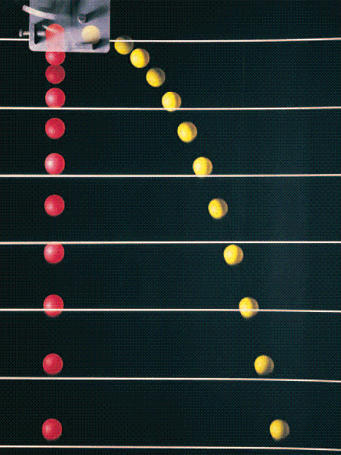
Independence of Directions
Demo: Ball Drop
V_{x}
mg
mg
x = x₀ + v_{x0}t + (1/2)a_{x}t²
x = x₀ + v_{x0}t + (1/2)a_{x}t²
y = y₀ + v_{y0}t + (1/2)a_{y}t²
F = mg = ma_{y}

Slide 10
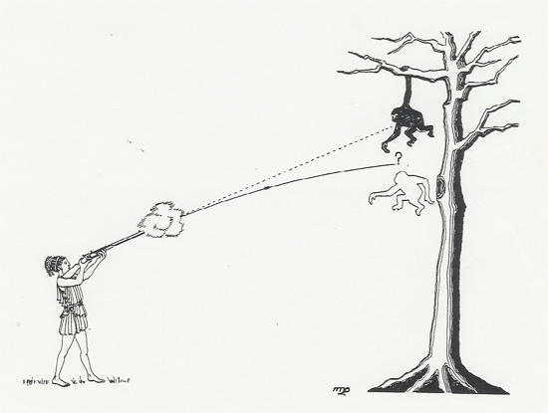
The Monkey Hunter
The monkey drops from the tree the moment that the rifle is fired. Where should one aim to hit the monkey as it falls?

Slide 11
The Monkey Hunter
y_{m} = h + v_{y0}t + (1/2)gt²
DEMO: Monkey Hunter
y_{b} = 0 + v sin θ_{r} t + (1/2)gt²
h
v
θ = arctan(h/x)
x
t = x/(v cos θ_{r})
y_{b} = y_{m} ➔ h = vt sinθ_{r}
sinθ_{r} = (h/vt) = (h/x)cosθ_{r}
tanθ_{r} = h/x

Slide 12
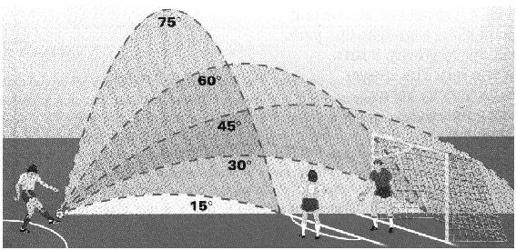
Maximum Trajectory
A projectile will follow a parabolic trajectory.
Which firing angle will travel the furthest?
Flight time:
Demo: Water Rockets
y = y₀ + v_{y0}t + (1/2)a_{y}t² ➔ 0 = 0 + v sinθ t – (1/2)gt² ➔ t = (2v/g) sinθ
Distance traveled:
x = x₀ + v_{x0}t + (1/2)a_{x}t² ➔ x = 0 + v cosθ t + 0
x = v² 2sinθcosθ/g
x = v² sin(2θ)/g
Maximum range when θ=45

Slide 13
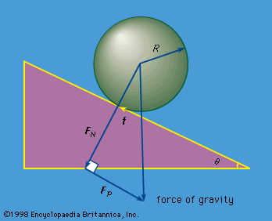
Rolling Bodies
Frictional Force:
f < μ_{s}F_{N} = μ_{s}mg cosθ
Angular Acceleration
= I α
= fR
Linear Acceleration
F_{tot} = ma
F_{tot} = mg sinθ – f
α = a/R
θ
Normal Force:
F_{N} = mg cosθ
mg
Parallel Force:
F_{P} = mg sinθ

Slide 14
Inclined Planes
Which will go higher? A hoop or a frictionless puck?
Linear motion: s = 0 + v₀t – (1/2) ((mg sinθ - f)/m) t²
Demo: Inclined Planes
Consider conservation of energy

Slide 15
Rotating Projectiles
A body can rotate about a fixed pivot point.
A free body rotates about it center of gravity
DEMO: Center of Gravity

Slide 16
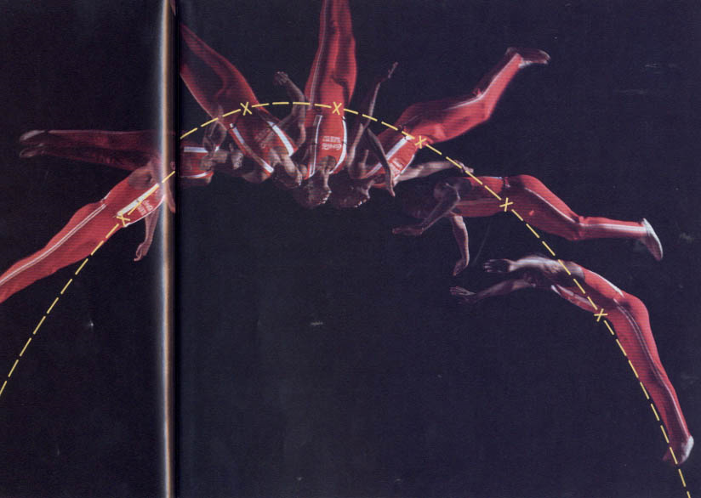
Center of Gravity
Extended body rotating with constant angular velocity
Parabolic trajectory of the center of mass
The center of gravity (or Center of mass) is the point about which an object will rotate. For a body under goes both linear projectile motion and rotational motion, the location of the center of mass will behave as a free projectile, while the extended body rotates around the c.o.m.

Slide 17
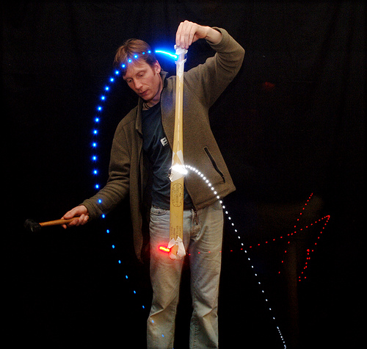
Center of Gravity
Parabolic trajectory of the center of mass
Angular impulse

Slide 18
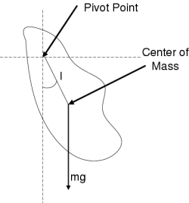
Rotating Off Axis

Slide 19
Pendulum System
θ
θ
F_{tension}
F_{gravity}

Slide 20
Announcements
The final exam will be Wednesday March 17th 3:30 – 5:30
Bring a student ID with picture
Final Exam Room | Last Name Begins With:
198 Young | N - Z
1100 Social Sciences | C - M
55 Roessler | A - B

Slide 21
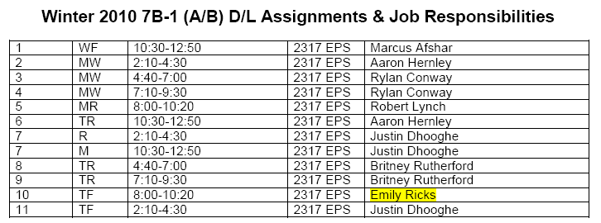
DL Sections

Slide 22
