Slide 1
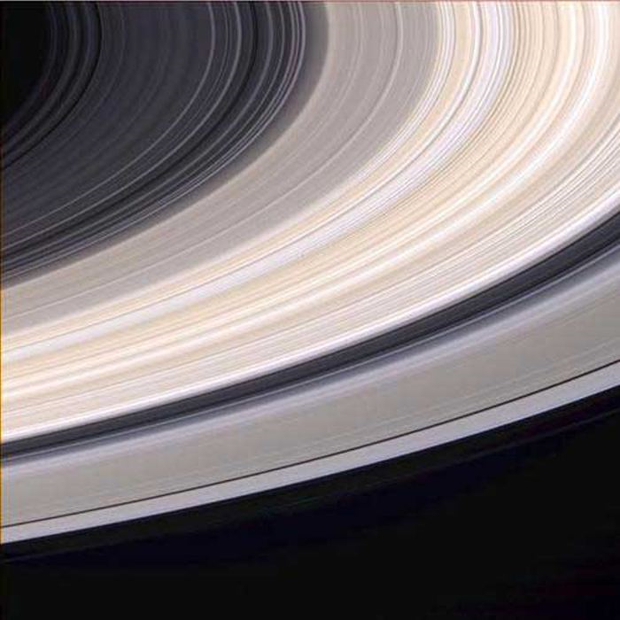
Physics 7B-1 (A/B)
Professor Cebra
Winter 2010
Lecture 8
Rotational Kinematics and Angular Momentum Conservation

Slide 2
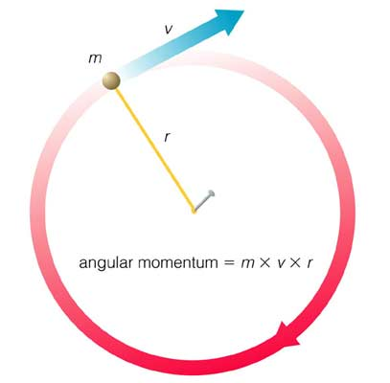
Rotational Motion
If the force is always perpendicular to the direction of the velocity, then only the direction changes.
Centripetal Acceleration
Centripetal Force
F_{c} = ma_{c}=mv²/r
v = 2πr/T
F_{C}

Slide 3
Angular Quantities
There is an analogy between objects moving along a straight path and objects moving along a circular path.
Linear |  | Rotational
Position (x) | ↔ | Angle (θ)
Velocity (v) | ↔ | Angular Velocity (ω)
Acceleration (a) | ↔ | Angular Acceleration (α)
Momentum (p) | ↔ | Angular Momentum (L)
Force (F) | ↔ | Torque (τ)
Mass (m) | ↔ | Moment of Inertia (I)

Slide 4
Angular Displacement
By convention, θ is measured clockwise from the x-axis.
θ

Slide 5
Angular Velocity
Angular velocity is a vector:
Right hand rule to determines direction of ω
Velocity and radius determine magnitude of ω
r
v_{t}

Slide 6
Angular Velocity
What’s the angular velocity of a point particle?
v
θ
r
r┴

Slide 7
Angular Acceleration
Angular Acceleration: Rate of change in angular velocity
A stationary disk begins to rotate. After 3 seconds, it is rotating at 60 rad/sec. What is the average angular acceleration?

Slide 8
Rotational Kinematics
Rotational Motion (α = constant) | Linear Motion (a = constant)
ω = ω₀ + αt | v = v₀ + at
θ = (1/2)(ω₀ + ω)t | x = (1/2)(v₀ + v)t
θ = θ₀ + ω₀t + (1/2)αt² | x = x₀ + v₀t + (1/2)at²
ω² = ω₀² + 2αθ | v² = v₀² + 2ax

Slide 9
Rotational Kinematics
A commercial jet airplane is idling at the end of the run way. At idle, the turbo fans are rotating with an angular velocity of 175 rad/sec. The Tower gives the jetliner permission to take-off. The pilot winds up the jet engines with an angular acceleration of 175 rad/s². The engines wind up through an angular displacement of 2000 radians. What is the final angular velocity of the turbo-fan blades?
Solution:
ω² = ω₀² + 2αθ
= (175 rad/s)² + 2(175 rad/s²)(2000 rad)
= 7.00 x 10⁵ rad²/s²
ω = 837 rad/s

Slide 10
Angular Momentum
What’s the momentum of a rolling disk?
Two types of motion:
Translation:
Rotation:
v

Slide 11
Angular Momentum
Angular Momentum: Product of position vector and momentum vector
Why is angular momentum important? Like energy and momentum, angular momentum is conserved.
Angular Impulse: Change in angular momentum vector

Slide 12
Angular Momentum
What’s the angular momentum of a point particle?
p
θ
r
r┴

Slide 13

Torque
Which way will the scale tip?
Rotation of scale is influenced by:
Magnitude of forces
Location of forces
1 kg
1.5 kg
1 kg
1.5 kg

Slide 14
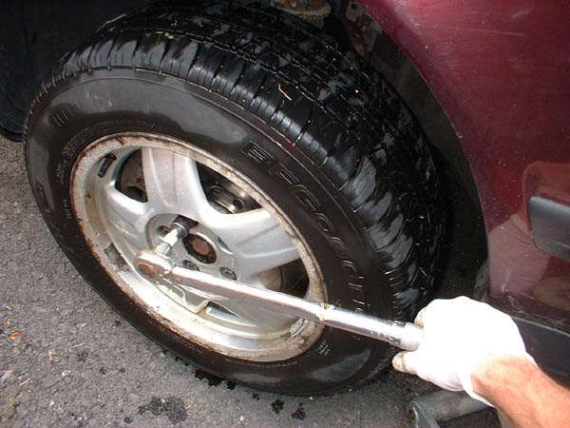
Torque
Which is more effective?
Rotation of wrench is influenced by:
Magnitude of forces
Location of forces
Direction of forces
F₁
F₁
F₂
F₂
DEMO: Torque Meter

Slide 15
Torque
Torque: The cause or agent of angular acceleration
The angular velocity of an object will not change unless acted upon by a torque
The net torque on an object is equal to the rate of change of angular momentum

Slide 16
Newton’s Second Law - Rotation
τ = Iα
Angular impulse = τΔt = ΔL

Slide 17
Torque
What’s the torque on a point particle?
F
θ
r
r┴

Slide 18
Rotational Kinetic Energy
What’s the kinetic energy of a rolling disk?
Two types of motion:
Translation:
Rotation:
v

Slide 19
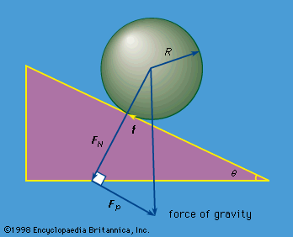
Rolling Bodies
Frictional Force:
f < μ_{s}F_{N} = μ_{s}mg cosθ
Angular Acceleration
= I α
= fR
Linear Acceleration
F_{tot} = ma
F_{tot} = mg sinθ – f
α = a/R
θ
Normal Force:
F_{N} = mg cosθ
mg
Parallel Force:
F_{P} = mg sinθ

Slide 20
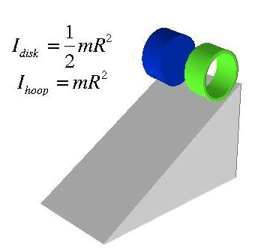
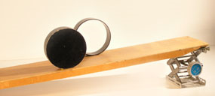
Angular Acceleration
= I α
= fR
Linear Acceleration
F_{tot} = ma
F_{tot} = mg sinθ – f
α = a/R
Moment of Inertia
Demo: Crazy Rollers
As I increases, a decreases

Slide 21
Moment of Inertia
Let’s use conservation of energy

Slide 22
Moment of Inertia
Which will have the greater acceleration?
Which will have the greater angular acceleration?
F = 5 N
F = 5 N
m₁ = 1 kg
m₂ = 2 kg
F = ma
Fr = mra
= mr²α
= Ι α
Ι = mR²
F = 5 N
F = 5 N
m = 1 kg
m = 1 kg
r₁ = 1 m
r₂ = 2 m

Slide 23
Moment of Inertia
What’s the moment of inertia of an extended object?

Slide 24


Slide 25
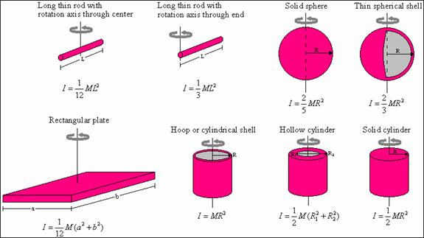
Moment of Inertia

Slide 26
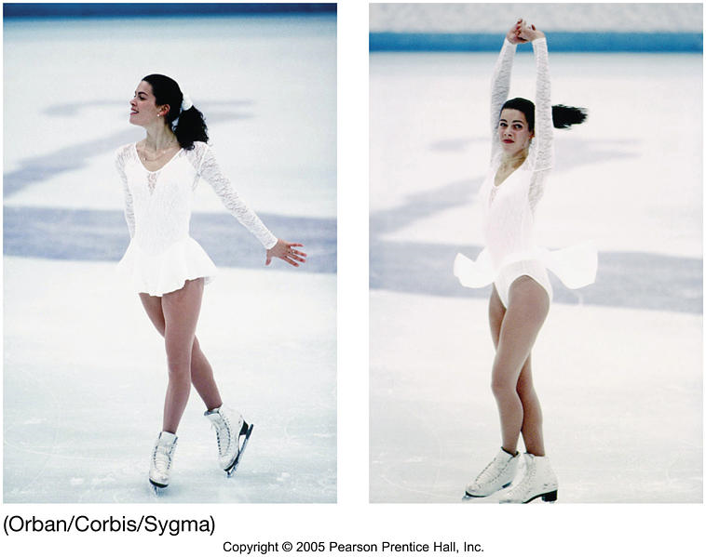
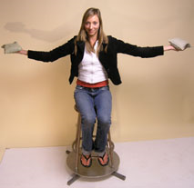

Conservation of Angular Momentum
Conservation of L:
L = Iω
If moment of inertia goes own, then angular velocity must go up.
Demo: Rotation with Weights

Slide 27
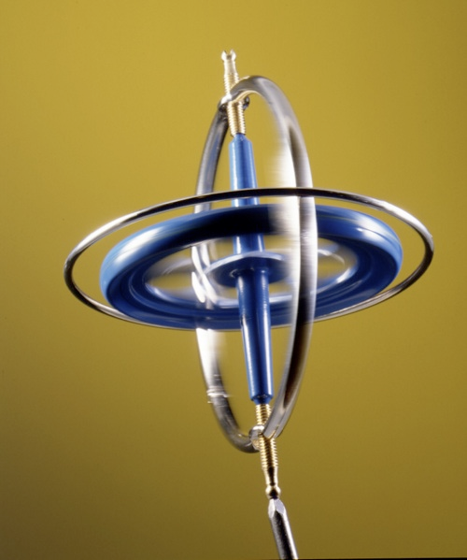
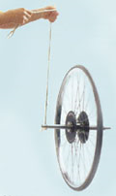
Conservation of Angular Momentum
Demo: Wheel on a string
Demo: Gyro in a can
Demo: Gyroscope

Slide 28
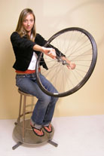
Conservation of Angular Momentum
The total angular momentum vector must be conserved. If you flip the spinning wheel, then something else must create an angular momentum vector.
DEMO: Spinning Wheel and rotation chair

Slide 29
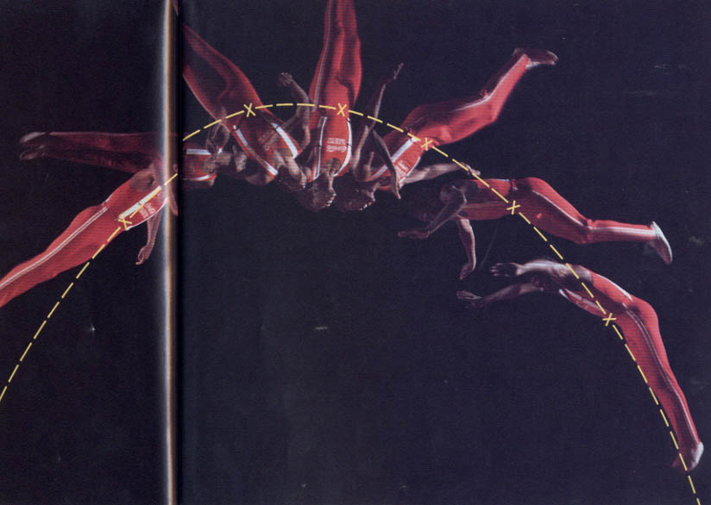
Center of Gravity
Extended body rotating with constant angular velocity
Parabolic trajectory of the center of mass
The center of gravity (or Center of mass) is the point about which an object will rotate. For a body under goes both linear projectile motion and rotational motion, the location of the center of mass will behave as a free projectile, while the extended body rotates around the c.o.m.

Slide 30
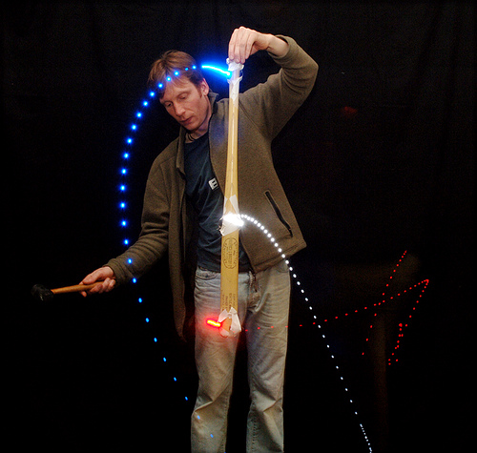
Center of Gravity
Parabolic trajectory of the center of mass
Angular impulse

Slide 31
Summary of Angular Equations
Magnitude of ω
For extended body
Direction of ω
Point particle or extended body
Same direction as Δω
Same direction as ΔL
For point particle
For extended body

Slide 32
Announcements

Slide 33
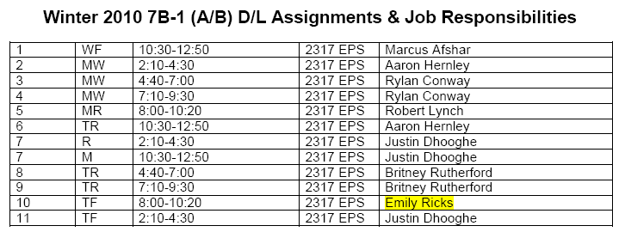
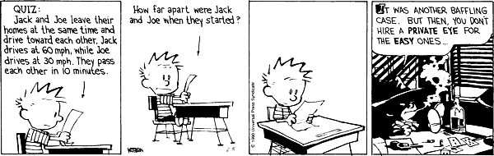
DL Sections

Slide 34
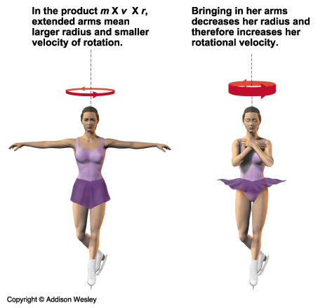
Conservation of Angular Momentum

Slide 35
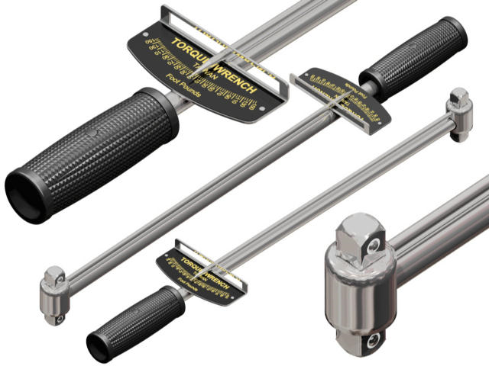
Torque

