Slide 1
Physics 7B-1 (C/D)
Professor Cebra (Guest Lecturer)
Winter 2010
Lecture 7
Review of Linear Momentum
And
Rotational Motion

Slide 2
Slides 3-19 were discussed in the 7:30 Lecture
Slides 6-27 were discussed in the 9:00 Lecture

Slide 3

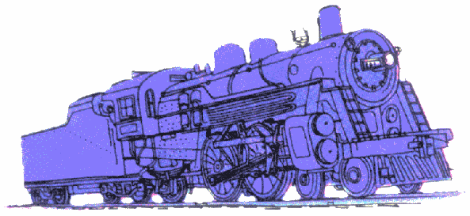
Momentum
Choose: Which would you rather be hit by? A tennis ball going 1m/s or a tennis ball going 10m/s. Which would transfer more momentum to you?
Choose: Which would you rather be hit by? A train going 1 m/s or a tennis ball going 1 m/s. Which would transfer more momentum to you?
Momentum is proportional to the mass and the velocity of an object
Momentum has direction and therefore is a vector!
v
v
v
v

Slide 4

Momentum and Impulse
Q: How would you give an object momentum?
We must apply a force for a given amount of time. The greater the force, the greater the change in momentum. The longer we apply the force, the greater the change in momentum.
A change in momentum is called an impulse J
Momentum has direction and therefore is a vector! Impulse is also a vector.
F=1N
Δt=.1s
Q: Find the impulse the player gives to the ball. If the mass of the basketball is 0.5 kg, what is the speed the ball leaves the player’s hand with?

Slide 5
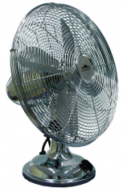
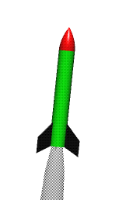

Conservation of Momentum
The other big law after conservation of Energy.
Q: If there is a system with no external force acting upon it, what is the change in momentum of the system?
Q? Will the boat move?
Q: Take a compressed fuel rocket. Which fuel would be better for this rocket, water or air?
Q: Why does the tank feel a recoil?

Slide 6
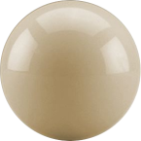
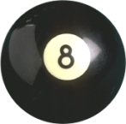

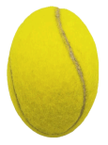



Collisions:
Type of Collision | Description | Example | Momentum (p_{tot}) | Kinetic Energy (Ke_{tot})
Elastic | Perfectly bounce off each other – no deformation | Billiard Balls | Conserved | Conserved
Inelastic | Bounce with some Deformation | Tennis Balls | Conserved | Not Consv’d
Perfectly Inelastic | Stick to each other | Play-doh Balls | Conserved | Not Consv’d
BEFORE
AFTER
m=0.17kg
m=0.16kg
Elastic
Inelastic
Perfectly
Inelastic
v₈=0
v_{C}=8m/s
v_{C}=?
v₈=?
m=0.05kg
m=0.05kg
v₂=0
v₁=10m/s
v₁=?
v₂=?
m=0.1kg
m=0.1kg
v₂=0
m=0.2kg
v₁=10m/s
v₁₊₂=?

Slide 7
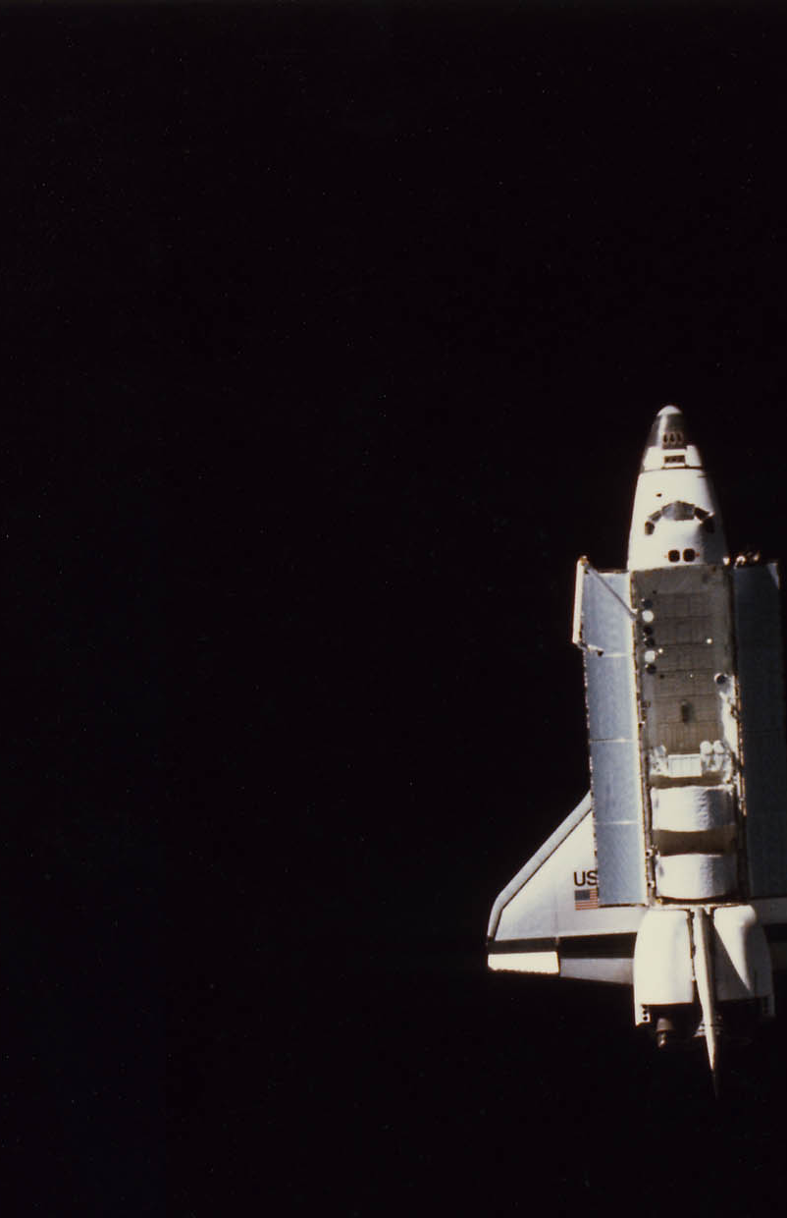
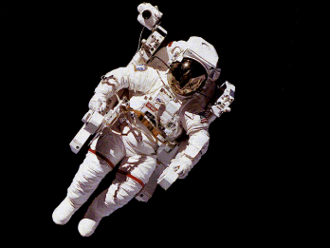
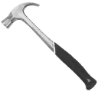
Q: An astronaut is performing a spacewalk when his tether breaks. He happens to be holding a 1kg tool. Because the astronaut was paying attention in his physics class, he knows that he can use conservation of momentum to his advantage. How?

Slide 8
Q: An astronaut is performing a spacewalk when his tether breaks. He happens to be holding a 1kg tool. Because the astronaut was paying attention in his physics class, he knows that he can use conservation of momentum to his advantage. How?
He can manage to throw the tool at 10m/s
If the astronaut is 10m away from the space shuttle and his mass is 100kg, find the time it takes for him to get back to the Space Shuttle.

Slide 9
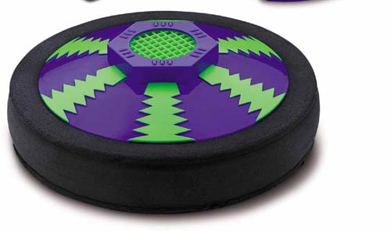
The Definition of Impulse
Recall that work was resulted in a change in energy, where work is
We can similarly define a quantity called the impulse, which is the time integral o f the applied force
J is a vector quantity, which is applied to the vector p.

Slide 10
Conservation of Momentum
If the net external impulse in a given direction acting on the system is zero, then there is no change in the linear momentum of the system in that direction; Otherwise there is a change in the momentum equal to the net external impulse.
Conservation of Momentum!
Compare to conservation of Energy

Slide 11
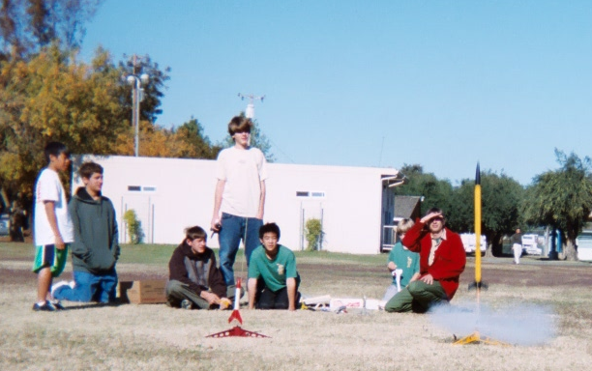
Rockets
Consider a model rocket. How high will a 0.2 kg model rocket fly if your install a class “C” Estes rocket engine? An Estes “C” engine provide 8.0 Newton-seconds of impulse.

Slide 12
Collisions
A collision occurs when two free bodies make contact. The contact results in a repulsive normal force. The magnitude of the force and the duration of the contact will determine the resulting impulse. Newton’s 3rd law indicates that each of the two participating bodies will experience an equal but opposite impulse.
All collisions conserve both energy and momentum, however we classify collisions as being either elastic on inelastic based upon whether kinetic energy is conserved.
Elastic collisions conserve both momentum and kinetic energy.
In an inelastic collision some of the energy of the collisions is dissipated as internal energy within the bodies.
In a completely inelastic collision, the two bodies stick together and there is only center of mass motion remaining after the collision

Slide 13
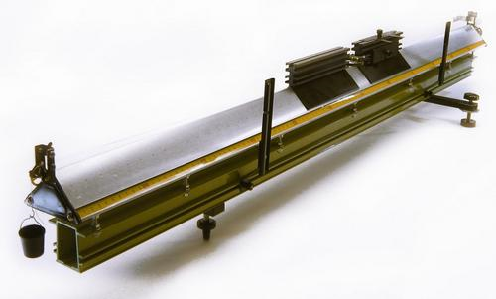
1D Elastic Collisions
Elastic Collisions:
Try cases of:
m1=m2
M1=2m2
m1=(1/2)M2
v1>v2
v1<v2
Demo: collision table

Slide 14
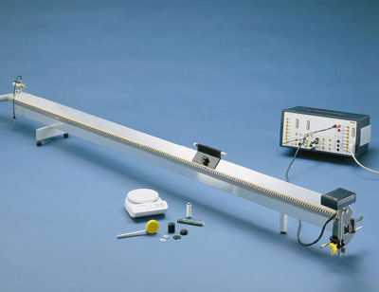
1D Inelastic Collisions
Inelastic Collisions:
Try cases of:
Equal masses
m1=m2
M1=2m2
m1=(1/2)M2
v1>v2
v1<v2
Demo: collision table

Slide 15
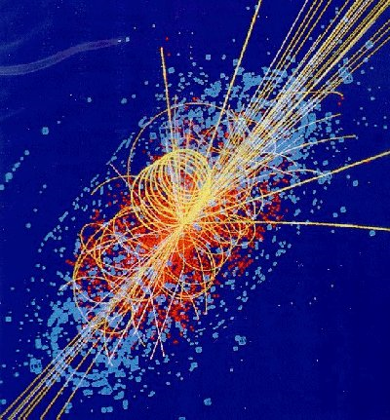
A Particle Physics Collision
Is this an elastic on inelastic collision?

Slide 16
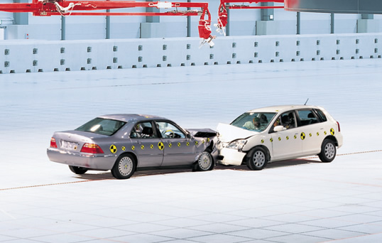
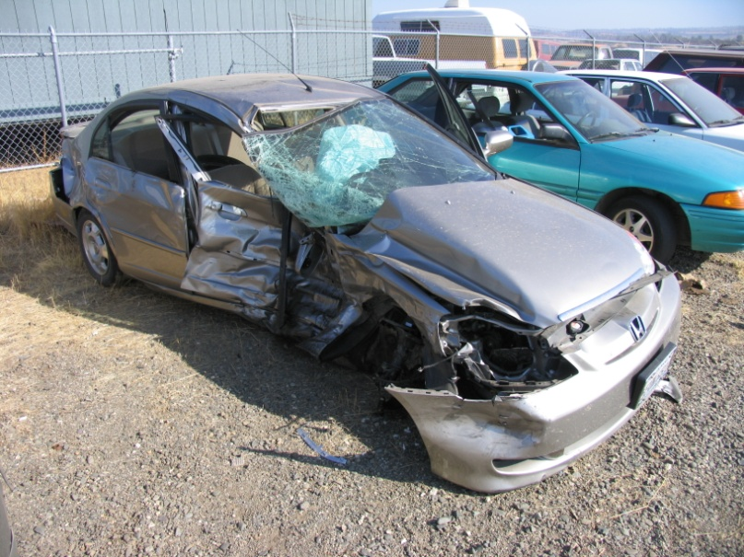
Inelastic Collisions
Why do cars have crumple zones?
Consider an older model car with a 5 cm bumper and a rigid frame.
Compare to a more model car with a 25 cm crumple zone.

Slide 17
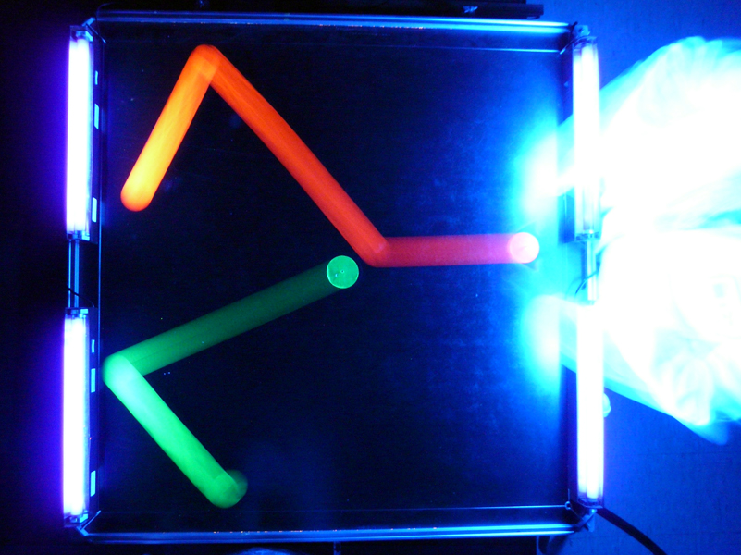
2D Collisions
Must conserve P_{x} and P_{y}
Elastic collisions conserve kinetic energy
When m₁=m₂, then the angle between p₁ and p₂ will be 90 degree.
Demo: Air puck

Slide 18
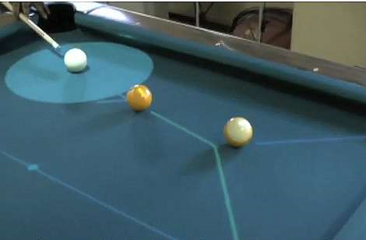
2D Collisions
Where will the cue ball end up?
Where do you aim the 1 (yellow) with respect to the 9 (yellow stripe)?

Slide 19
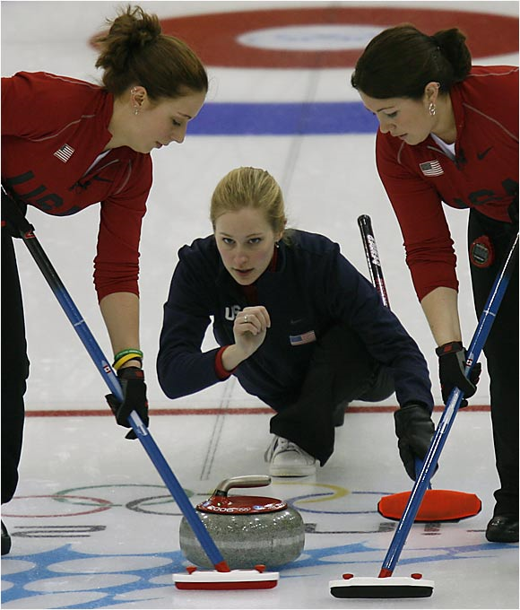
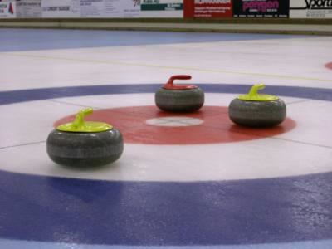
2D Collisions
Can the American Curling team knock out both the yellow stones?
Where should they aim their stone?

Slide 20
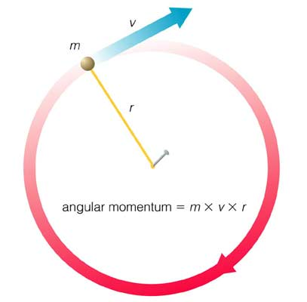
Rotational Motion
Can an object be continually accelerating without gaining any speed?
If the force is always perpendicular to the direction of the velocity, then only the direction changes.
“centripetal acceleration”
v = 2πr/T

Slide 21
Rotational Motion
Centripetal Force
F_{c} = ma_{c}=mv²/r
F
Spin the ball, then let it go. Due to conservation of momentum, it must go in the straight line
P
Demo: Ball on a string

Slide 22
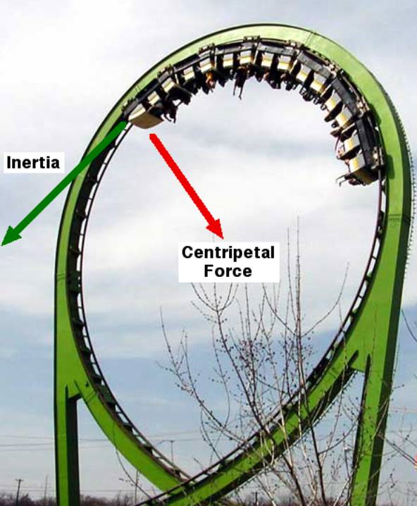
Centripetal Force
How fast must the roller coaster be going so that the riders still feel a 0.5 g force even at the top of the 10 meter radius loop-the-loop?
F_{c} = (3/2)mg = mv²/r
v² = (3/2)rg = (3/2)(10)(10)
v = 12.2 m/s = 27.5 mph
What provides the centripetal force?

Slide 23
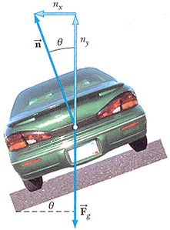
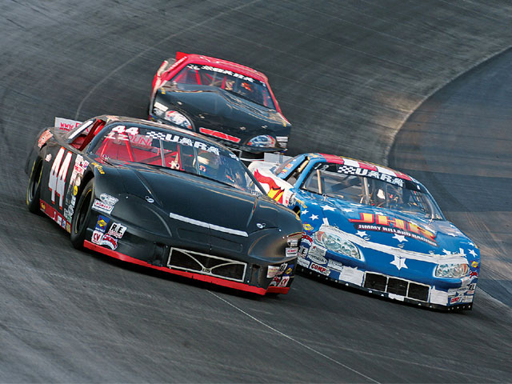
Centripetal Force
What is the centripetal force needed to keep the NASCAR 1000 kg cars on the track when taking an R = 200 m curve at 200 mph (320 km/hour)?
F = mv²/r
= (1000)(88.9)²/200
= 3.95x10⁴ N
What provides this centripetal force?

Slide 24
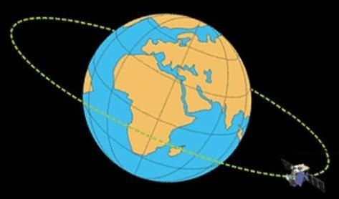
Centripetal Force
How far above the surface of the earth must one launch a communications satellite to achieve an geosynchronous orbit?
r = 42,164 km
Note R_{E} = 6378 km
=> Launch altitude above 36000 km
Note also, low earth orbit is anything less than 200 km above the surface of the earth
What provides the centripetal force?

Slide 25
Angular Quantities
There is an analogy between objects moving along a straight path and objects moving along a circular path.
Position | ↔ | Angle
Velocity | ↔ | Angular Velocity
Acceleration | ↔ | Angular Acceleration
Momentum | ↔ | Angular Momentum
Force | ↔ | Torque

Slide 26
Angular Velocity
How do we represent the motion of a rotating disk?
Demo: Accelerometer

Slide 27
Angular Velocity
Angular velocity is a vector:
  Right hand rule to determines direction of ω
  Velocity and radius determine magnitude of ω

Slide 28
Angular Velocity
What’s the angular velocity of a point particle?
v
θ
r
r┴

Slide 29
Angular Acceleration
Angular Acceleration: Rate of change in angular velocity
A stationary disk begins to rotate. After 3 seconds, it is rotating at 60 rad/sec. What is the average angular acceleration?
Demo: Atwood Machine

Slide 30
Angular Momentum
Angular Momentum: Product of position vector and momentum vector
Why is angular momentum important? Like energy and momentum, angular momentum is conserved.
Angular Impulse: Change in angular momentum vector

Slide 31
Angular Momentum
What’s the angular momentum of a point particle?
p
θ
r
r┴

Slide 32

Torque
Which way will the scale tip?
Rotation of scale is influenced by:
  Magnitude of forces
  Location of forces
1 kg
1.5 kg
1 kg
1.5 kg

Slide 33
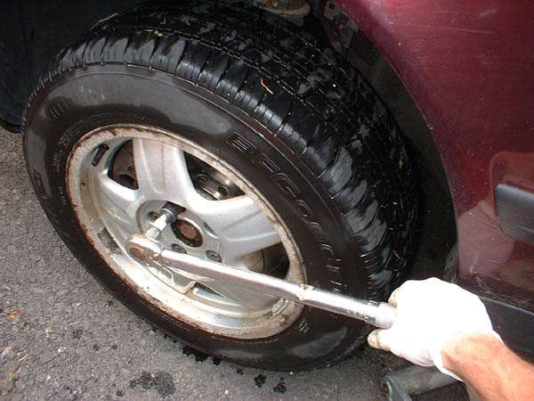
Torque
Which is more effective?
Rotation of wrench is influenced by:
  Magnitude of forces
  Location of forces
  Direction of forces
F₁
F₁
F₂
F₂

Slide 34
Torque
Torque: The cause or agent of angular acceleration
The angular velocity of an object will not change unless acted upon by a torque
The net torque on an object is equal to the rate of change of angular momentum

Slide 35
Torque
What’s the torque on a point particle?
F
θ
r
r┴

Slide 36
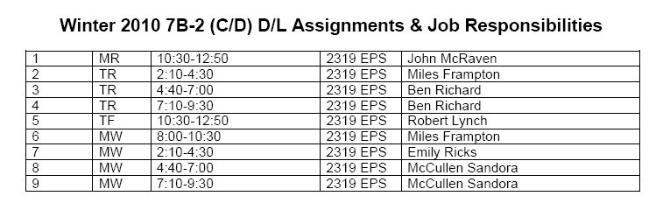
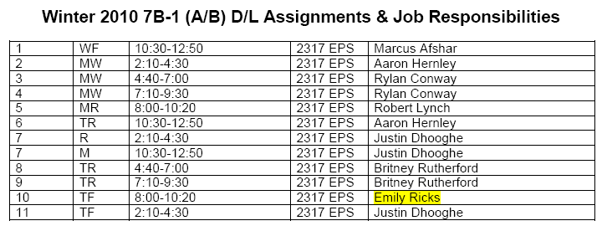
DL Sections

