Slide 1
Lecture 6 Chapters 6,7: Forces, Momentum and Conservation of Momentum
By Orpheus Mall Feb 4th, 2010

Slide 2
I'm also forwarding my last lecture to you. I did not cover slides19-24 during the 7:30 section. You may leave the problem on slides 23-24 as a problem for them to do at home. As it is, the 7:30 lecture starts 5min late which is when I give the quiz. The 9:00 lecture was on time and complete.

Slide 3
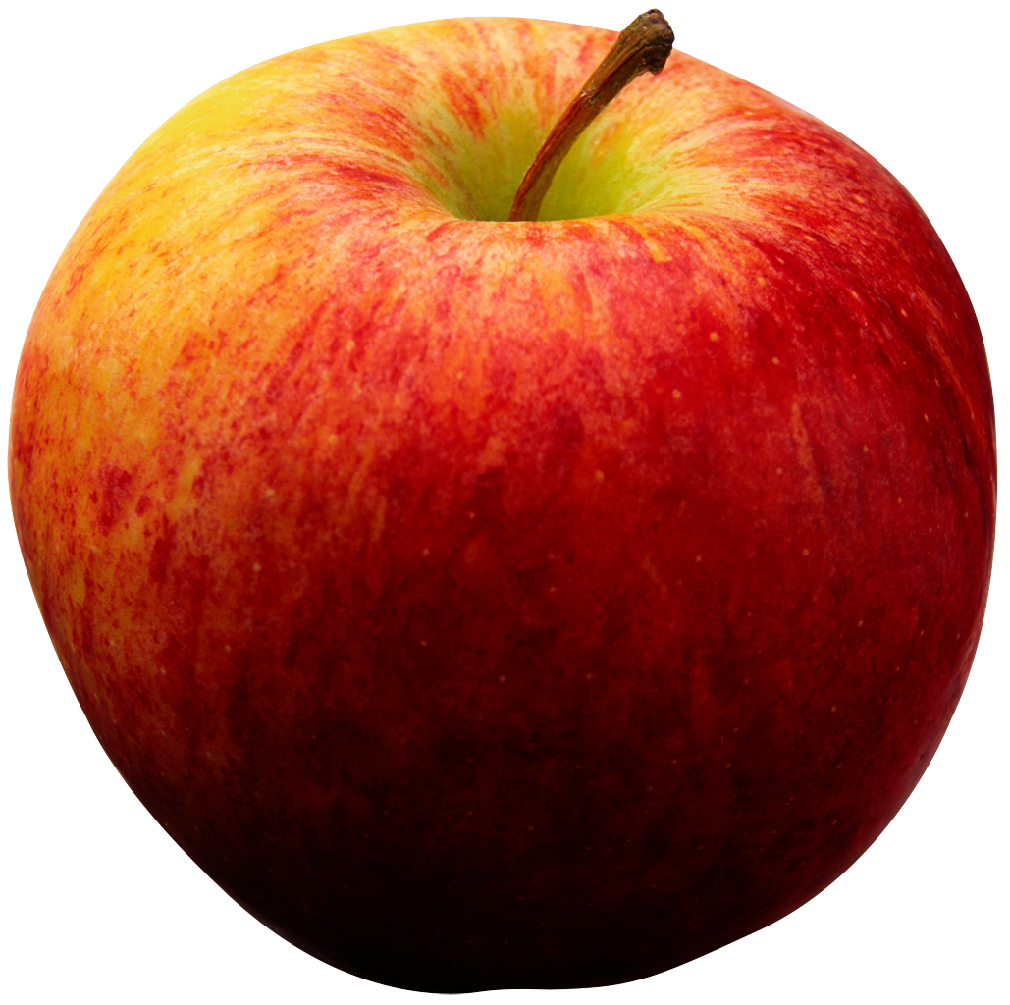
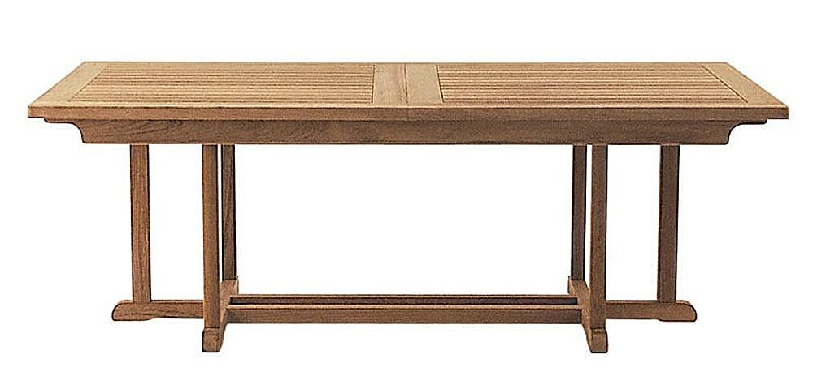
Dynamics: Force – The agent of change in motion
A Force is a push or pull interaction, either through direct contact or through space, that has the potential of changing an object’s motion.
An apple falls from a tree, what interaction does it have with the Earth? How does the interaction change the motion?
What interaction does the apple have with the table, what interaction does it have with the earth. We can picture these interactions with force vectors!
Q: For the apple are the forces causing any change in motion? Why or Why not?
For the person falling with a parachute at constant velocity, Are the forces causing any change in motion?
F_{TABLE}
F_{GRAVITY}
F_{GRAVITY}
F_{DRAG}
v_{terminal}
F_{GRAVITY}

Slide 4
Newton’s Laws – N1: Law of Inertia
If the Sum of Forces on an object is zero, there will be no change in the motion of that object, or vice versa.
This is the law of inertia
Mass is the measure of inertia, the greater the mass of an object, the lower it’s inclination to change it’s motion
F_{TABLE}
F_{GRAVITY}
F_{DRAG}
v_{terminal}
F_{GRAVITY}

Slide 5
Newton’s Laws – N2: Definition of Force
If the Sum of Forces on an object is non-zero, there will be a change in motion (acceleration). This motion is related to the Sum of Forces acting upon the object and the mass of the object.
Warning: never ever write F=ma, each force will not have it’s own a, it is only the sum of forces, or the net force that is related to the acceleration.
F_{GRAVITY}
Q: If the force of gravity is 1N, and the acceleration of gravity is 10m/s², what is the mass of the apple

Slide 6
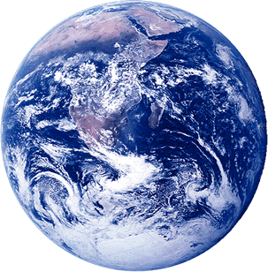
Newton’s Laws – N3: Law of Action-Reaction
Newton’s third law states every action has an equal and opposite reaction. That if object A exerts a force on object B, then object B exerts an equal and opposite force on object A
The apple exerts a force on the Table and that the table exerts a force on the apple, these are equal and opposite and form an action-reaction pair
Do the forces on the apple to to gravity and the table form an action-reaction pair?
Does this law make sense? It states that the force that the entire giant earth exerts on the tiny apple is equal and opposite to the force the tiny apple exerts on the earth?
F_{TABLE on APPLE}
F_{earth on apple}
F_{apple on earth}
F_{APPLE ON TABLE}

Slide 7
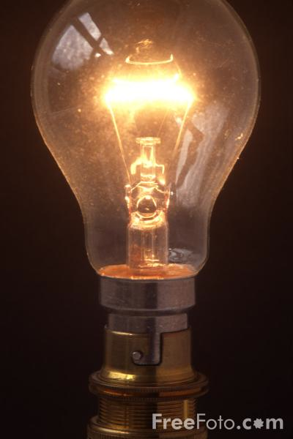
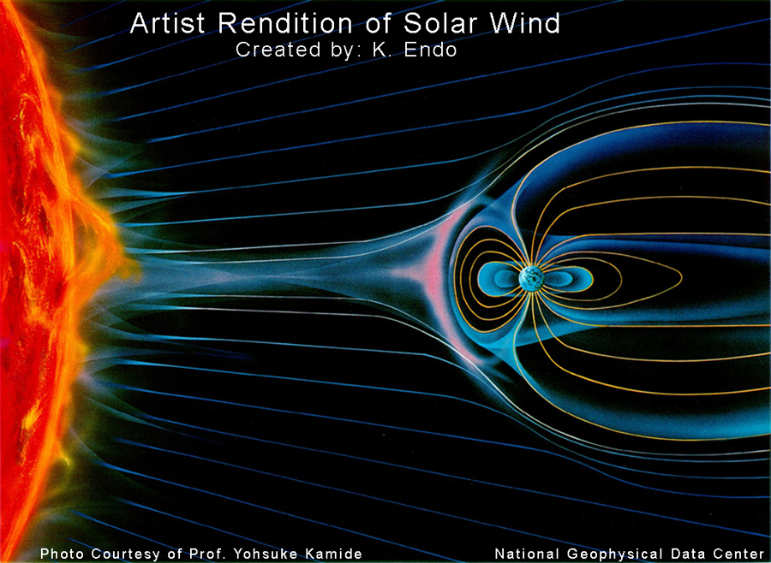
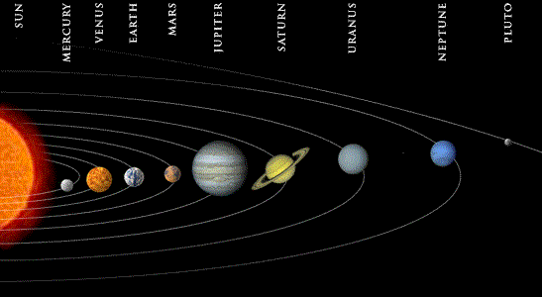
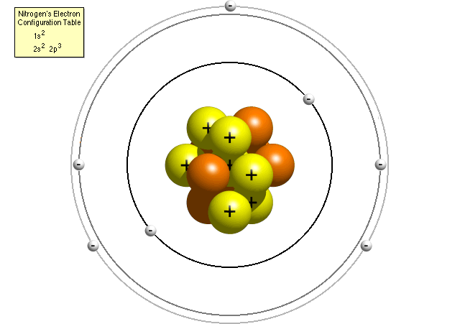
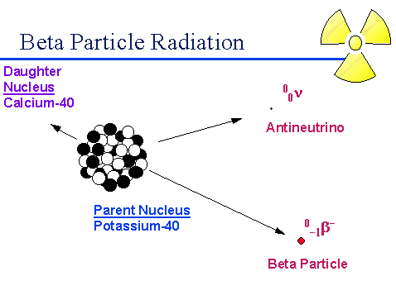
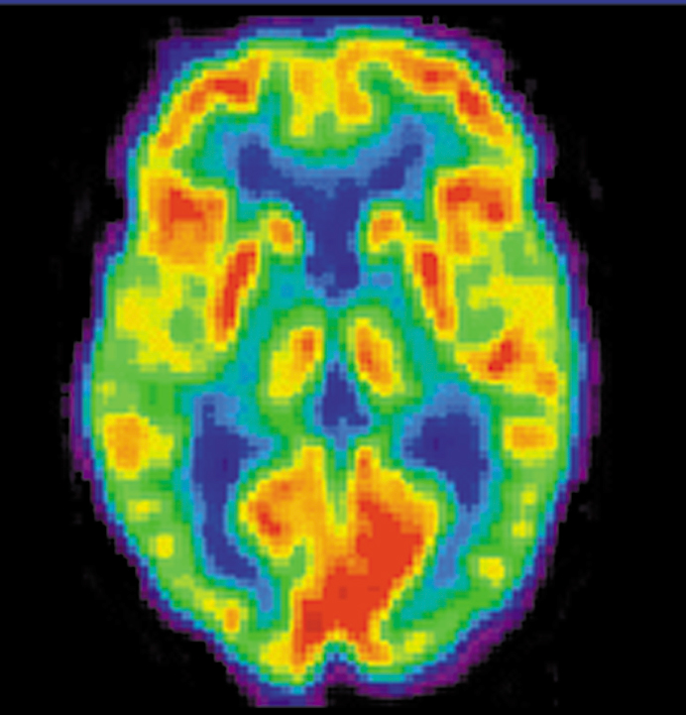
Fundamental Forces of the Universe
There are 4 fundamental forces of the universe:
Electricity
Magnetism
Electromagnetism
Gravity
Weak Force
Strong Force

Slide 8
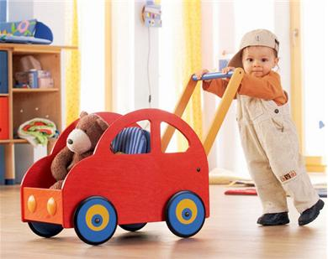
Force Diagrams
A little girl is pushing a cart, what are the forces on the cart? What are the forces on the little girl?
Does the cart experience an acceleration? Does the girl?
What can you say about the sum of forces on the cart? What can you say about the sum of forces on the little girl?

Slide 9
Force Diagrams
A little girl is pushing a cart, what are the forces on the cart? What are the forces on the little girl?
Does the cart experience an acceleration? Does the girl?
What can you say about the sum of forces on the cart? What can you say about the sum of forces on the little girl?

Slide 10
Some Forces to know:
Fundamental Forces
Gravitational Force
Electric Force
Magnetic Force
Dissipative Forces
Kinetic Frictional Force
Static Frictional Force
Drag Force
Miscellaneous Forces
Normal Force
Tension
Spring Force
Buoyant Force
etc.

Slide 11
Forces: Gravitational Force (F_{g})
The gravitational force between any two objects is given by:
But we recall, for near the surface of the earth, The gravitational force was just:
Given the Radius of the Earth, and the mass of the earth, find g near the surface of the earth.
F_{earth on apple}
F_{apple on earth}
R
Gravitational Field of Earth
at the surface.
R_{E} = 6370 km
M_{E} = 6x10²⁴kg

Slide 12
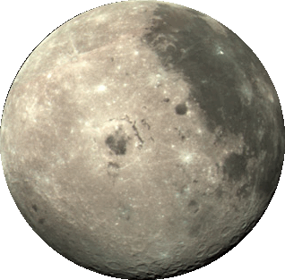
Forces: Gravitational Force: Tides
Find F_{net} for the water droplet on the left. Find F_{net} for the water droplet on the right. The mass of each droplet is 10g.
Q: Where is the Sun (Spatial Cognition)? Will it be important in this problem?
For making calculations easier we can note that R_{OM}=60R_{E} and M_{M}=M_{E}/100
Q: What is the total gravitational field for the drop on the right? the drop on the left?
 | Mass ~ | Radius ~ | Orbit ~
Sun | 2x10³⁰kg | 1.4x10⁶km | 2.5x10¹⁷km
Earth | 6x10²⁴kg | 6.4x10³km | 1.5x10⁸km
Moon | 7x10²²kg | 1.7x10³km | 4x10⁵km

Slide 13
Forces: Gravitational Force: Tides
Find F_{net} for the water droplet on the left. Find F_{net} for the water droplet on the right. The mass of each droplet is 1g.
Q: Where is the Sun (Spatial Cognition)? Will it be important in this problem?
For making calculations easier we can note that R_{OM}=60R_{E} and M_{M}=M_{E}/100
Q: What is the total gravitational field for the drop on the right? the drop on the left?
 | Mass ~ | Radius ~ | Orbit ~
Sun | 2x10³⁰kg | 1.4x10⁶km | 2.5x10¹⁷km
Earth | 6x10²⁴kg | 6.4x10³km | 1.5x10⁸km
Moon | 7x10²²kg | 1.7x10³km | 4x10⁵km

Slide 14
Forces: Electric Force (F_{E})
The electric force between any two objects is given by:
Just like gravity we can write the force in terms of the electric field E:
Q: Find the electric force of attraction between the proton and the electron in the hydrogen atom:
Q
q
R
Electric Field of a Dipole
Electric Field of a Charge at a distance R
Electric Field lines: always out
of +q and into −q
Q_{p}=−q_{e} =1.6x10⁻¹⁹C R_{Bohr} =0.5Å=.05nm

Slide 15
Forces: Normal Force (N)
A Normal force is a force of contact. It comes from objects pushing on each other. The direction of the Normal force is always perpendicular to the direction area of contact.
F_{TABLE}
F_{GRAVITY}
Q: What is the normal force on the Block on this inclined plane, find the acceleration of the block, find v_{f}
Must use sum of forces in direction
perpendicular to area of contact to
determine the Normal force.
10m
θ=30º

Slide 16
Forces: Normal Force (N)
A Normal force is a force of contact. It comes from objects pushing on each other. The direction of the Normal force is always perpendicular to the direction area of contact.
F_{TABLE}
F_{GRAVITY}
Q: What is the normal force on the Block on this inclined plane, find the acceleration of the block, find v_{f}
N
Must use sum of forces in direction
perpendicular to area of contact to
determine the Normal force.
10m
θ=30º
mg

Slide 17
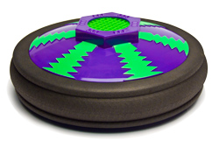
Frictional Force: Kinetic Friction (F_{k})
Kinetic Friction:
The dissipative force experienced when two surfaces are sliding against each other.
It is proportional to the normal force.
Its direction is always opposes the direction of motion
Kinetic Energy is lost to thermal energy
On: Slides without friction (μ_{k} small or 0)
F_{k}
v
Off: Slides with friction (μ_{k} large)
F_{k}
v
μ_{k}=0.5
Q: Find the acceleration of the puck in both cases:

Slide 18
Frictional Force: Static Friction (F_{s})
N
Static Friction:
The dissipative force experienced when two surfaces in contact (but not sliding) with each other
It is proportional to the normal force
Its direction is always opposing any force being applied parallel to it.
Static Friction force will increase to cancel out any force being applied. There will not be any motion until you overcome the maximum
Q: For this block, find the force you must apply to get the block moving.
1kg
No Push
No F_{s}
mg
μ_{s}=0.4
N
Q: F_{s}=?
1kg
1N
F_{s}
mg
μ_{s}=0.4
N
Q: F_{s}=?
1kg
3N
F_{s}
mg
μ_{s}=0.4

Slide 19
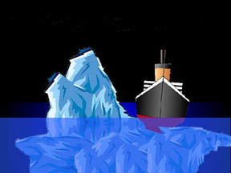
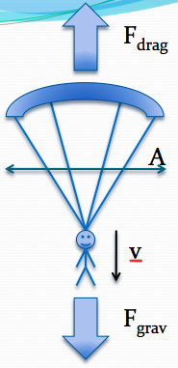
Forces Continued
Tension
Tension in a rope (or cable, rod, etc.) is due to the bond forces keeping the rope together. We will not solve for it directly, it will either be given or we must use Newton’s laws to solve for it.
Spring Force
The spring force is proportional to the displacement (x) and the tightness of the spring (k) called the spring constant. It opposes the displacement.
Buoyant Force
The buoyant force is equal to the weight of the fluid displaced.
Q: Find out how much of the iceberg is underwater if density of ice is 900 kg/m³
Drag Force
The Drag force is proportional to the cross sectional area (the profile the drag force sees) the velocity of the object, and the density of the fluid you’re passing through.

Slide 20
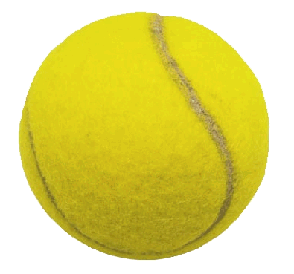
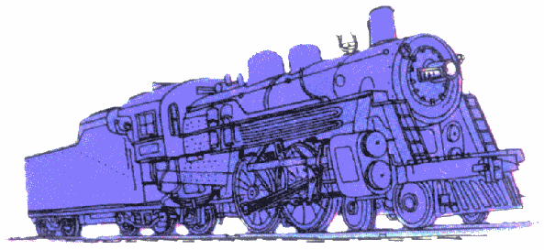
Momentum
Choose: Which would you rather be hit by? A tennis ball going 1m/s or a tennis ball going 10m/s. Which would transfer more momentum to you?
Choose: Which would you rather be hit by? A train going 1 m/s or a tennis ball going 1 m/s. Which would transfer more momentum to you?
Momentum is proportional to the mass and the velocity of an object
Momentum has direction and therefore is a vector!
v
v
v
v

Slide 21
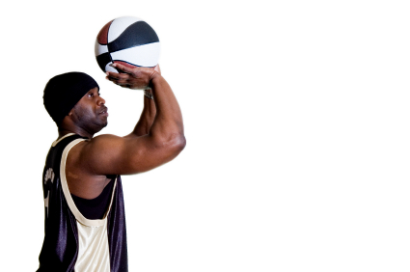
Momentum and Impulse
Q: How would you give an object momentum?
We must apply a force for a given amount of time. The greater the force, the greater the change in momentum. The longer we apply the force, the greater the change in momentum.
A change in momentum is called an impulse J
Momentum has direction and therefore is a vector! Impulse is also a vector.
F=1N
Δt=.1s
Q: Find the impulse the player gives to the ball. If the mass of the basketball is 0.5 kg, what is the speed the ball leaves the player’s hand with?

Slide 22
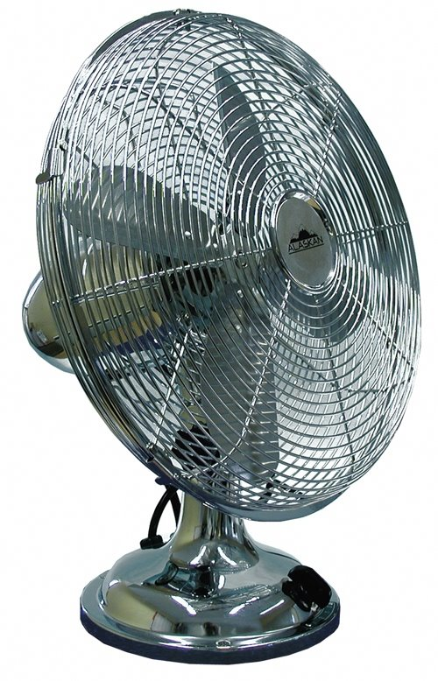
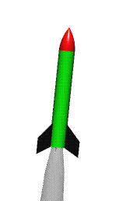
Conservation of Momentum
The other big law after conservation of Energy.
Q: If there is a system with no external force acting upon it, what is the change in momentum of the system?
Q? Will the boat move?
Q: Take a compressed fuel rocket. Which fuel would be better for this rocket, water or air?
Q: Why does the tank feel a recoil?

Slide 23
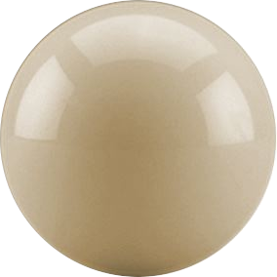
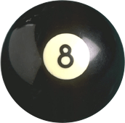
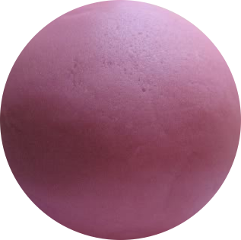
Collisions:
Type of Collision | Description | Example | Momentum (p_{tot}) | Kinetic Energy (Ke_{tot})
Elastic | Perfectly bounce off each other – no deformation | Billiard Balls | Conserved | Conserved
Inelastic | Bounce with some Deformation | Tennis Balls | Conserved | Not Consv’d
Perfectly Inelastic | Stick to each other | Play-doh Balls | Conserved | Not Consv’d
BEFORE
AFTER
m=0.17kg
m=0.16kg
Elastic
Inelastic
Perfectly Inelastic
v₈=0
v_{C}=8m/s
v_{C}=?
v₈=?
m=0.05kg
m=0.05kg
v₂=0
v₁=10m/s
v₁=?
v₂=?
m=0.1kg
m=0.1kg
v₂=0
m=0.2kg
v₁=10m/s
v₁₊₂=?

Slide 24
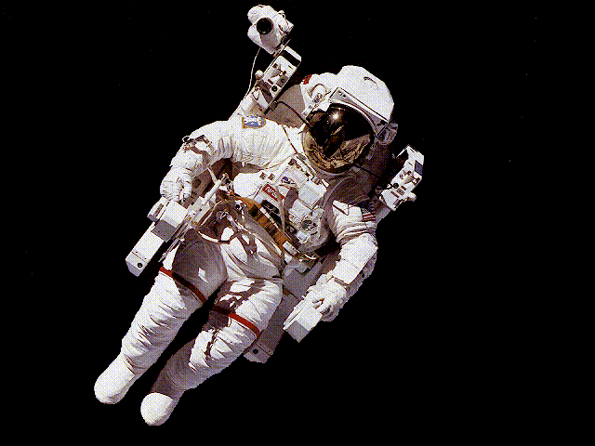
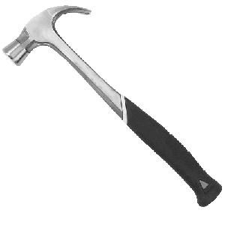
Q: An astronaut is performing a spacewalk when his tether breaks. He happens to be holding a 1kg tool. Because the astronaut was paying attention in his physics class, he knows that he can use conservation of momentum to his advantage. How?

Slide 25
Q: An astronaut is performing a spacewalk when his tether breaks. He happens to be holding a 1kg tool. Because the astronaut was paying attention in his physics class, he knows that he can use conservation of momentum to his advantage. How?
He can manage to throw the tool at 10m/s
If the astronaut is 10m away from the space shuttle and his mass is 100kg, find the time it takes for him to get back to the Space Shuttle.

