Slide 1
Physics 7B-1 (A/B)
Professor Cebra
Winter 2010
Lecture 6
Review of Forces
and
Conservation of Momentum

Slide 2
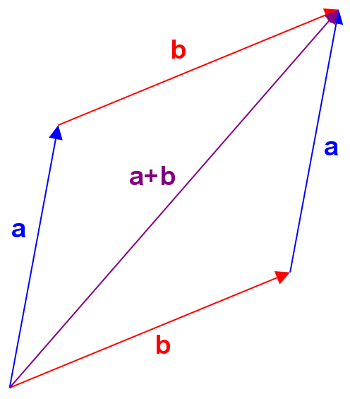
Vector Addition and Subtraction
Vectors are added head to tail
Note: a+b = b+a
Vectors are subtracted by added –b to vector a
Note: a-b does not equal b-a
(a-b) = -(b-a)
-b
a
a-b

Slide 3
The Vectors of Kinematics
Position:
Velocity:
Acceleration:
Momentum:
Force:

Slide 4
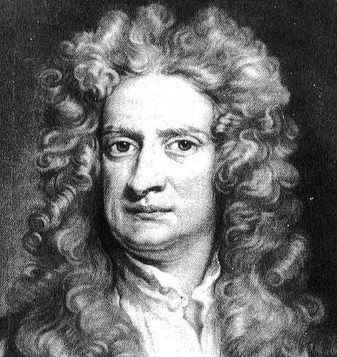
Newton’s Laws of Motion
1st Law: The velocity of an object will not change unless acted upon by a force
2nd Law: The net force on an object is equal to the rate of change of momentum
3rd Law: For every force there is an equal but opposite force

Slide 5
Types of Force
Contact forces: Require physical contact between two objects (action and reaction)
Friction force: Acts parallel to contact surface
Normal force: Acts perpendicular to contact surface
Long-range forces: Require presence of a field between two objects (action at a distance)
Gravitational force: Exerted by one massive object on another massive object
Electrostatic force: Exerted by one charged object on another charged object

Slide 6
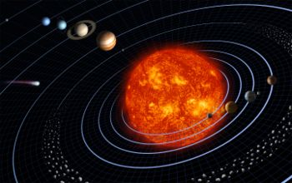
Long Range Force -- F_{g}= Gm₁m₂/r² – Gravitational
m
F
M
r
Note: Gravity is always attractive
G = 6.67 x 10⁻¹¹ Nm²/kg² “universal gravitational constant”
M = mass of the object which creates the field
m = mass of the object which experiences the field
r = distance between m and M (pointing from M to m)

Slide 7
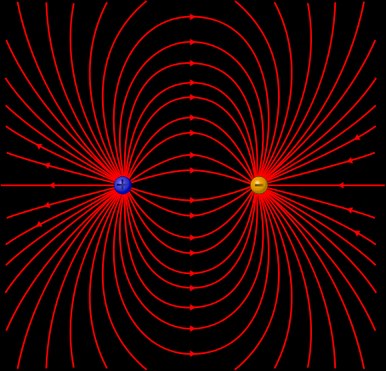
Long Range Force -- F_{e}=kq₁q₂/r² -- Electromagnetic
q
F
Q
r
Note: Opposites attract, like signs repel
k = 9.0 x 10⁹ Nm²/C² “universal electric constant”
Q = charge of the object which creates the field
q = charge of the object which experiences the field
r = distance between q and Q

Slide 8
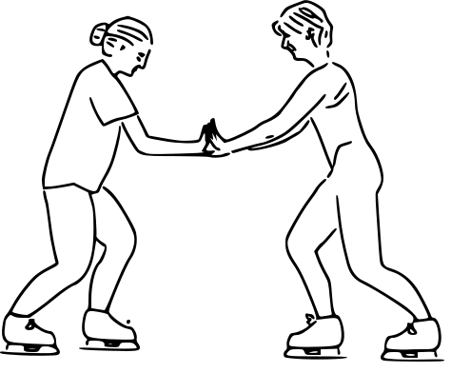
Force Diagram
What are the forces on Alice?
What are the forces on Bob?
F_{normal on A}
F_{B on A}
F_{A on B} = -F_{B on A}
F_{gravity on A}
F_{friction on A}

Slide 9
Definition of Momentum
Definition of Impulse
Net force and Net Impulse
Momentum of a system of particles
Momentum Conservation
Collisions
Elastic
Newton’s 3rd Law
Inelastic
Relationships
Representations
Introduction of Angular Momentum
Demos:
Cart track
Water Rockets
Cart with fan
Ball on a string
Hockey pucks
Rubber Ball/Clay Ball
Newton’s Cradle

Slide 10
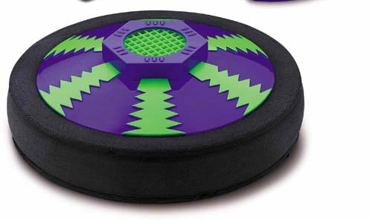
The Definition of Momentum
Previously we considered forces. Newton’s first law or Gallileo’s law of inertia states that in the absence of external forces, a body at rest will stay at rest and a body in motion will continue to move with the same inertia.
Here will define the unchanged quantity to be the momentum (p), where
Note that p is a vector
with three components.
Demo: Air puck
Recall that energy = (1/2)mv²

Slide 11
The Definition of Impulse
Recall that work was resulted in a change in energy, where work is
We can similarly define a quantity called the impulse, which is the time integral o f the applied force
J is a vector quantity, which is applied to the vector p.
Demo: Air puck

Slide 12
Conservation of Momentum
If the net external impulse in a given direction acting on the system is zero, then there is no change in the linear momentum of the system in that direction; Otherwise there is a change in the momentum equal to the net external impulse.
Conservation of Momentum!
Compare to conservation of Energy
Demo: Cart with sail

Slide 13
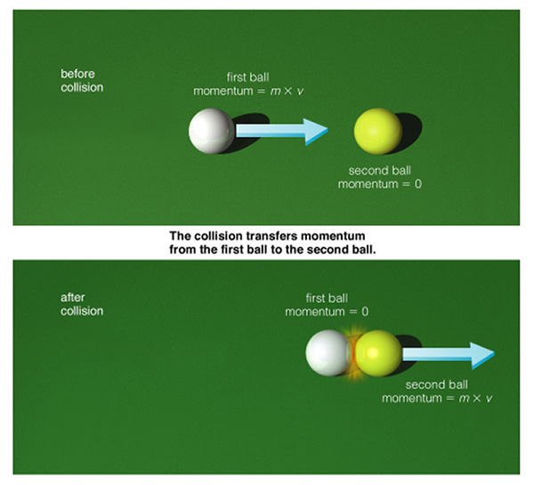
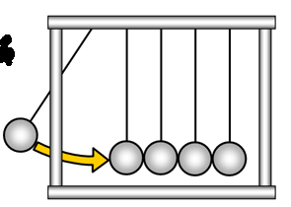
The Newton’s Cradle
Conservation of momentum
Newton’s 3rd Law

Slide 14
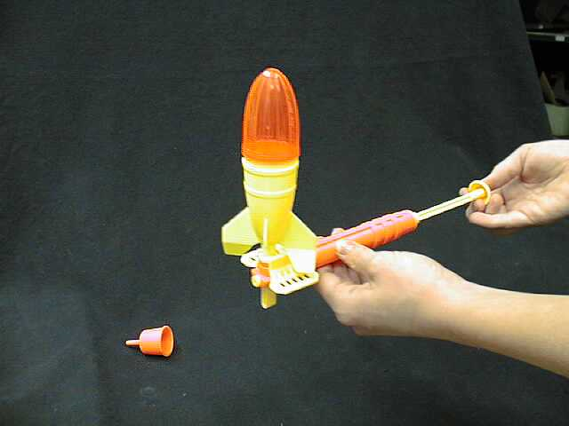
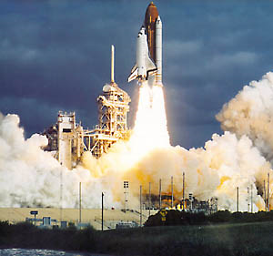
Rockets
How does a rocket exhibit conservation of momentum?
No external forces – shouldn’t Δp = 0?
The rocket expels propellant at a high velocity backwards.
Net forward p of the rocket must equal the net backward p of the propellant.
Discuss pressure
Bernoulli’s principle
Add water to rocket
Demo: Rockets

Slide 15
Collisions
A collision occurs when two free bodies make contact. The contact results in a repulsive normal force. The magnitude of the force and the duration of the contact will determine the resulting impulse. Newton’s 3rd law indicates that each of the two participating bodies will experience an equal but opposite impulse.
All collisions conserve both energy and momentum, however we classify collisions as being either elastic on inelastic based upon whether kinetic energy is conserved.
Elastic collisions conserve both momentum and kinetic energy.
In an inelastic collision some of the energy of the collisions is dissipated as internal energy within the bodies.
In a completely inelastic collision, the two bodies stick together and there is only center of mass motion remaining after the collision
Demo: Rubber Ball and Clay Ball

Slide 16
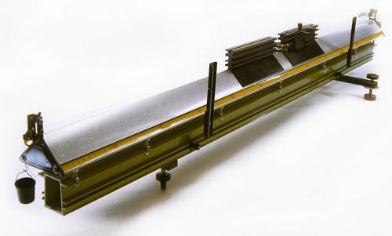
1D Elastic Collisions
Elastic Collisions:
Try cases of:
Equal masses
M1>m2
m1<M2
v1>v2
v1<v2
Demo: collision table

Slide 17
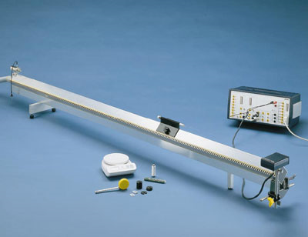
The Definition of Momentum
Inelastic Collisions:
Try cases of:
Equal masses
M1>m2
m1<M2
v1>v2
v1<v2
Demo: collision table

Slide 18
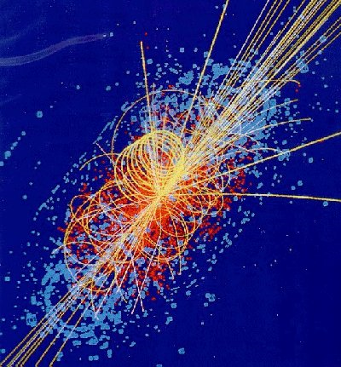

Slide 19
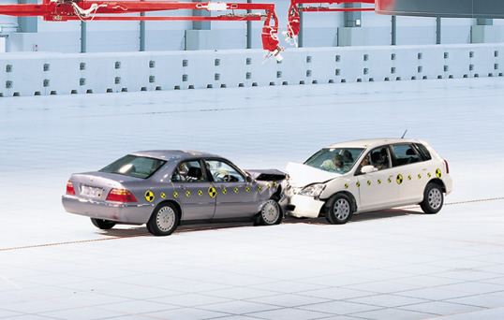
Inelastic Collisions

Slide 20
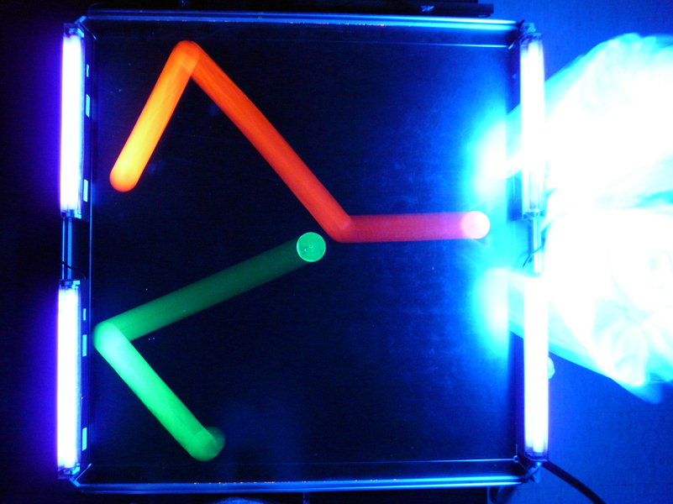
2D Collisions
Demo: Air puck

Slide 21
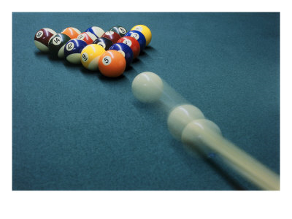
Many Body Problem

Slide 22
Angular Momentum
F_{c} = mv²/r
F
Spin the ball, then let it go. Due to conservation of momentum, it must go in the straight line
P
Demo: Ball on a string

Slide 23
Announcements
President’s day Holiday - Monday

Slide 24
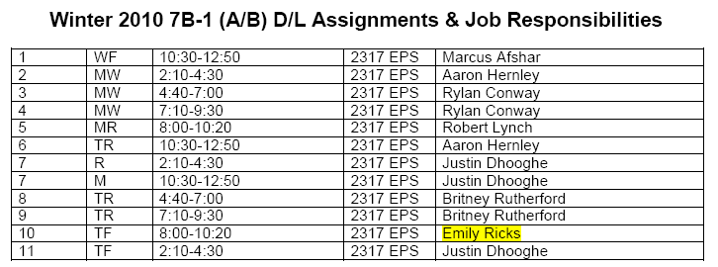
DL Sections

