Slide 1
Physics 7B-1 (A/B)
Professor Cebra
Winter 2010
Lecture 5
Review of Exponential Change Model
and
Forces

Slide 2
Exponential Growth

Slide 4
Exponential decay

Slide 5
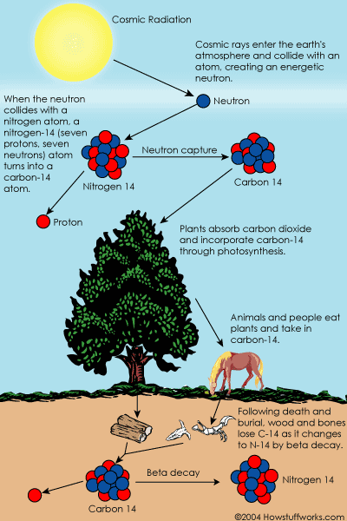
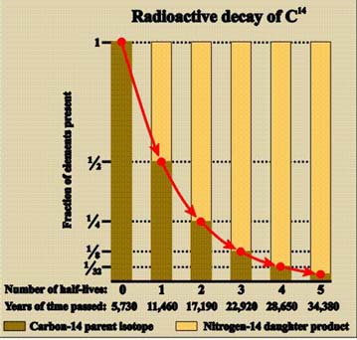
The half lie of carbon-14 is 5730 years. How old a sample that has only 10% of its original carbon-14?

Slide 6
The Parallel Plate Capacitor
ε = dielectric constant
A = Area of plates
+Q = stored charge
V = voltage across plates
C = κε₀A/d
-Q = stored charge
C = Q/V
d = separation of plates
Electrical Capacitance is similar to the cross sectional area of a fluid reservoir or standpipe. Electrical charge corresponds to amount (volume) of the stored fluid. And voltage corresponds to the height of the fluid column.

Slide 7
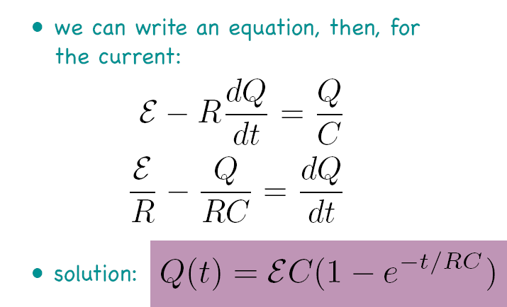
Exponential Change in Circuits: Capacitors - Charging
V = Q/C
I = dQ/dt
Q=CV_{C}
V_{R}=IR
ε=20V
Current I (A) = dQ/dt
Voltage V_{C} (V) = (Q/C)
ε/R
ε
Time t (s)
Time t (s)

Slide 8
Exponential Change in Circuits: Capacitors - Discharging
V = Q/C
I = dQ/dt
V_{B}=IR_{B}
Q=CV_{C}
ε=20V
Current I (A)
Voltage V_{C} (V)
V₀/R_{B}
V₀
Time t (s)
Time t (s)

Slide 9
V_{B}=IR_{B}
The switch is closed at time t=0. Make a plot of current as a function of time in R1. Then make a plot of the voltage across the capacitor as a function of time.
Q=CV_{C}
Current I (A) = dQ/dt
R1
ε=20V
I
V
Time t (s)
I(t=0)=E/R1 I(t=infinity)= E/(R1+RB) VC(t=infinity)= E-ER1/(R1+RB)

Slide 10
Capacitors in Series and Parallel
Circuit Diagrams: Capacitors
Capacitors in parallel (~2xA)
Capacitors in series (~2xd)
Circuit Diagrams: Resistors
Resistors in Series (~2xL)
Resistors in parallel (~2xA)
10

Slide 11
Capacitors: Energy Stored in a capacitor
Because resistors dissipate power, we wrote a an equation for the power dissipated in a Resistor:
Because capacitors are used to store charge and energy, we concentrate on the energy stored in a capacitor.
We imagine the first and the last electrons to make the journey to the capacitor. What are their ΔPE’s? ΔPE_{first}=qΔV ,ΔV=20 ΔPE_{last} =qΔV , ΔV=0 Thus on average for the whole charge:
Note: Since I is same for resistors in series, identical resistors in series will have the same power loss.
Since V is the same for resistors in parallel, identical resistors in parallel will have the same power loss
Q=CV_{C}
V_{R}=IR
ε=20V

Slide 12
Outline
Galilean Space-time; Galilean Relativity
Vectors – Vector Addition and Subtraction – r, v, a
Forces
Newton’s 3rd law – Equal and opposite forces
Net Force – SF
Force Diagrams – center of mass
Long range vs. contact forces
Balanced forces – Inertia, Newton’s 1st Law
Two Fundamental Forces Fe and Fg
Fe=kq1q2/r2 Fg=Gm1m2/r2
ke=9x109 Nm2/C2 G=6.672x10-11 Nm2/kg2
qe=1.602x10-19 C
Forces we feel – gravity of the earth
Contact forces – electromagnetic
Little g → g=GME/rE2
Orbits – Big Gravity
Springs – Hooke’s Law F=-kx
Normal Force – Perpendicular contact force – Parallel contact force, friction
Drag forces

Slide 13
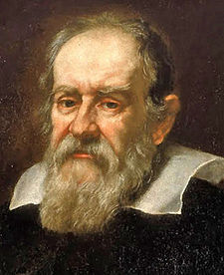
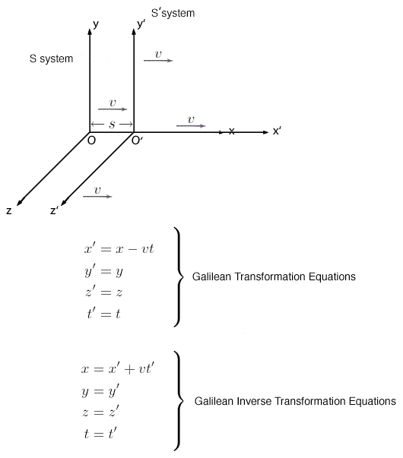
Galilean Space-time and Galilean Relativity
The motion of uniformly accelerated objects was studied by Galileo as the subject of kinematics.
Galileo's Principle of Inertia stated: "A body moving on a level surface will continue in the same direction at constant speed unless disturbed." This principle was incorporated into Newton's laws of motion (first law).
Galileo’s concept of inertia refuted the generally accepted Aristotelian hypothesis that objects generally slow down.
Galileo 1564-1642
Galileo introduced space-time and the concept of an inertial reference frame.

Slide 14
Vector - Definition
Merriam-Webster defines vector as:
a quantity that has magnitude and direction and that is commonly represented by a directed line segment whose length represents the magnitude and whose orientation in space represents the direction
an organism (as an insect) that transmits a pathogen
an agent (as a plasmid or virus) that contains or carries modified genetic material (as recombinant DNA) and can be used to introduce exogenous genes into the genome of an organism
Vectors will either be written in bold (v) or with an overstrike ( )

Slide 15
Vector - Applications
Vectors are used to represent:
Position of an object
Velocity of an object
Acceleration of an object
Force on an object
Two representations of vectors:
Cartesian Coordinates
Polar Coordinates

Slide 16
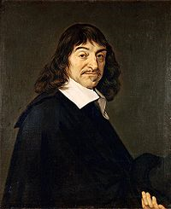
Cartesian Coordinates
y
Y Component
x
Rene Descartes
1596-1650
X Component

Slide 17
Polar Coordinates
Magnitude
r
Direction
θ

Slide 18
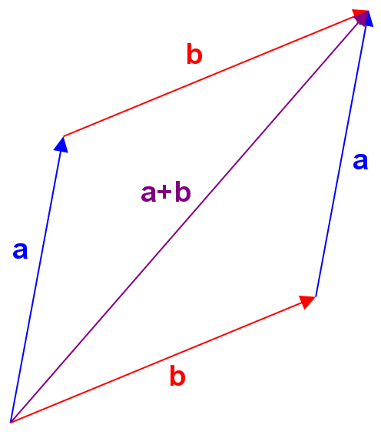
Vector Addition and Subtraction
Vectors are added head to tail
Note: a+b = b+a
Vectors are subtracted by added –b to vector a
Note: a-b does not equal b-a
(a-b) = -(b-a)
-b
a
a-b

Slide 19
Consider two vectors; the first vector (A) has a magnitude of 10 and a direction 60 degrees counter clockwise form the x-axis. The second vector (B) has magnitude 5 and is directed in the positive x direction.
What is the magnitude and direction of A-B?
Draw the resulting vectors.
Magnitude of A-B is direction is in the y direction. Magnitude is 8.66.

Slide 20
The Vectors of Kinematics
Position:
Velocity:
Acceleration:
Momentum:
Force:

Slide 21
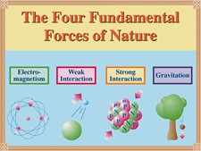
The Four Fundamental Forces

Slide 22
Newton’s Laws of Motion
1st Law: The velocity of an object will not change unless acted upon by a force
2nd Law: The net force on an object is equal to the rate of change of momentum
3rd Law: For every force there is an equal but opposite force

Slide 23
Newton’s First Law of Motion
1st Law: The velocity of an object will not change unless acted upon by a net force
When F_{Net on Object} = 0 ,
an object at rest continues to stay at rest
an object in motion continues to move at constant speed along a straight path
a.k.a. The Law of Inertia

Slide 24
Newton’s Second Law of Motion
2nd Law: The net force on an object is equal to the rate of change of momentum
Force is proportional to acceleration:
a.k.a. The Law of Resultant Force

Slide 25
Newton’s Third Law of Motion
3rd Law: For every force there is an equal but opposite force
F_{A on B} and F_{B on A} are referred to as an action-reaction pair.
They act on different objects
a.k.a. The Law of Reciprocal Actions

Slide 26
Net Force – ΣF
In the previous few slides, we have discussed F_{net} but what is the “net force”?
The net force is a vector sum of all the different forces that are acting upon the object of interest.
Although each force acts independently, that final results is just the sum of the various contributions.

Slide 27
Types of Force
Contact forces: Require physical contact between two objects (action and reaction)
Friction force: Acts parallel to contact surface
Normal force: Acts perpendicular to contact surface
Long-range forces: Require presence of a field between two objects (action at a distance)
Gravitational force: Exerted by one massive object on another massive object
Electrostatic force: Exerted by one charged object on another charged object

Slide 28
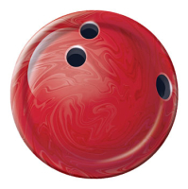
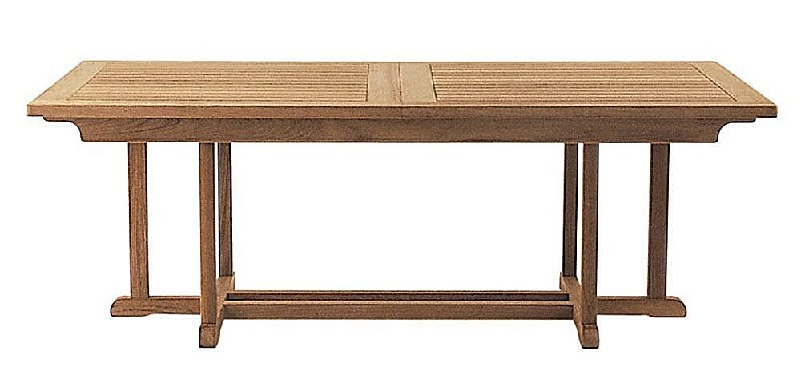
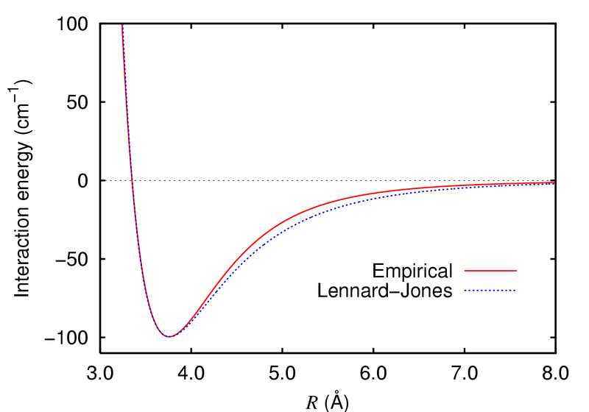
Contact forces – Normal Force (electromagnetic)
The downward gravitational force causes the bowling ball to compress the surface of the table. A very small compression will result in a very large repulsive force
Normal force
mg

Slide 29
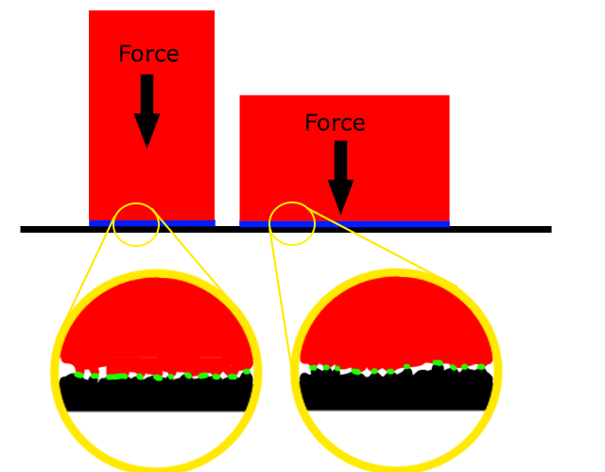
Contact forces – Friction (electromagnetic)
When you try to slide one object parallel to another the microscopic surface features will get compressed (Lennard-Jones) and will generate a frictional force to oppose any motion
External Force
Friction

Slide 30
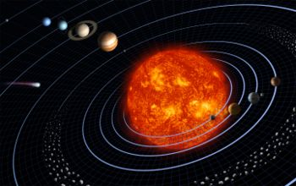
Long Range Force -- F_{g}= Gm₁m₂/r² – Gravitational
m
F
M
r
Note: Gravity is always attractive
G = 6.67 x 10⁻¹¹ Nm²/kg² “universal gravitational constant”
M = mass of the object which creates the field
m = mass of the object which experiences the field
r = distance between m and M (pointing from M to m)

Slide 31
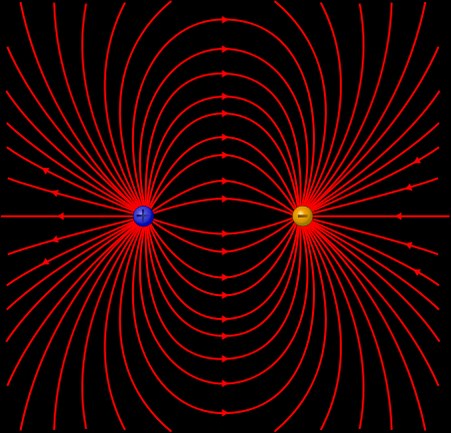
Long Range Force -- F_{e}=kq₁q₂/r² -- Electromagnetic
q
F
Q
r
Note: Opposites attract, like signs repel
k = 9.0 x 10⁹ Nm²/C² “universal gravitational constant”
Q = charge of the object which creates the field
q = charge of the object which experiences the field
r = distance between q and Q

Slide 32
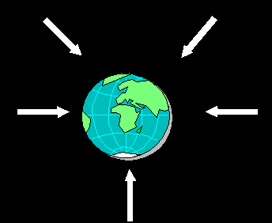
Forces we feel – gravity of the earth
In our everyday lives, we are aware of the long range force of gravity. If you try to jump up, gravity will pull you back down.
We are aware of friction, especially when you are sliding something across a floor.
We do not really appreciate the normal force; we tend to think of ourselves pushing down on the chair, rather than the chair pushing up.
And we almost never experience the long range electric force – because it is SO strong, that electric charges always want to move to neutralize any local excess.
At the fundamental level, the electric force is 10³⁶ times stronger than the gravitational force!

Slide 33
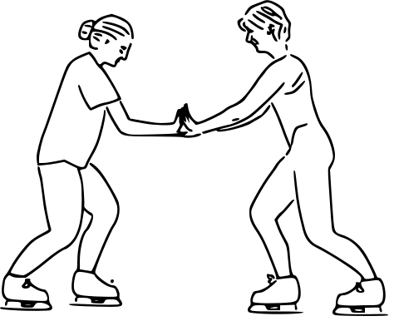
Force Diagram
What are the forces on Alice?
What are the forces on Bob?
F_{normal on A}
F_{B on A}
F_{A on B} = -F_{B on A}
F_{gravity on A}
F_{friction on A}

Slide 34
Little g → g=GM_{E}/r_{E}²
We know that:
We also know that:
Therefore, we can define the acceleration due to gravity at the surface of the earth as g:

Slide 35
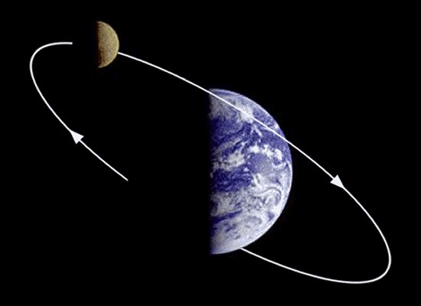
Orbits – Big Gravity
It is only on the astronomical scale that we experience the 1/r² dependence of gravity (on the surface of the earth, the acceleration due to gravity is always g).
Let’s you what we know about the moon to determine the weight of the Earth.

Slide 36
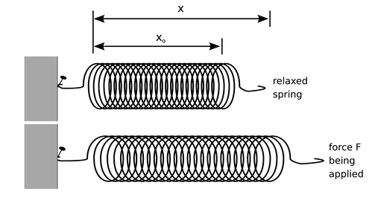
Springs – Hooke’s Law F=-kx
There are other forces that we have talked about in physics 7A, for example the force of an extended or compressed spring (given by Hooke’s Law).
Fundamentally, like friction, this is an electric force coming from the microscopic compressions or stretches of the inter-atomic spacing in the metallic lattice of the spring steel.

Slide 37
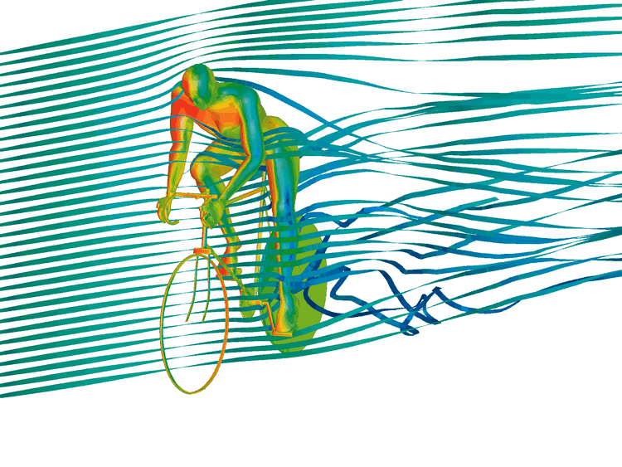
Drag Forces
In fluid dynamics, drag (sometimes called air resistance or fluid resistance) refers to forces that oppose the relative motion of an object through a fluid (a liquid or gas).
Drag forces act in a direction opposite to the oncoming flow velocity.
Unlike other resistive forces such as dry friction, which is nearly independent of velocity, drag forces depend on velocity.

Slide 38
Announcements

Slide 39
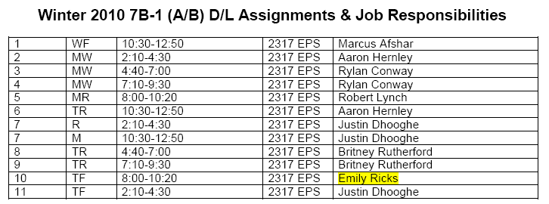
DL Sections

Slide 40
Vector Addition – Geometric Method
w
Place tail of w on tip of v.
Connect tail of v to tip of w.
v+w
w
v
Notes:
The resultant points to the second vector.

Slide 41
Vector Subtraction – Geometric Method
Place tail of w on tail of v.
Connect tip of w to tip of v.
v-w
w
w
v
Notes:
The resultant points to the first vector.

Slide 42
Addition & Subtraction – Algebraic Method
w
v-w
v+w
v
w
v
Notes:
Must use Cartesian coordinates for the algebraic method.

Slide 43
Vector Multiplication
Multiplying a vector by a scalar:
Multiplying a vector by another vector:
Dot product (a.k.a. scalar product)
Cross product (a.k.a. vector product)

Slide 44
Position
Position Vector: Indicates location of an object with respect to an origin
Important: Position vector depends on origin
Displacement: Change in position vector
Units: [r] = m
Notes:
What is the location of your camp site? Same location has different position vectors for different origins.
Δr=r(t₂)-r(t₁).
Note that displacement is also a vector.

Slide 45
Velocity
Velocity: Rate of change in position vector
Includes both speed of motion (magnitude of v) and direction of motion (direction of v)
Two types of velocity:
Units: [v] = m / s
Notes:
Velocity = how fast the position vector is changing.
Draw two velocity vectors, one twice as long as the other, and both pointing in the same direction.
Draw a roller coaster with a sine wave, a loop-de-loop, and a Gaussian.

Slide 46
Acceleration
Acceleration: Rate of change in velocity vector
Two types of acceleration:
Units: [a] = m / s²
Notes:
Acceleration = how fast the velocity vector is changing.
a=dv/dt=d²r/dt²
One could define the rate of change of acceleration, but this is rarely necessary.

Slide 47
Momentum
Momentum: Product of mass and velocity vector
Why is momentum important? Like energy, momentum is conserved.
Impulse: Change in momentum vector
Units: [p] = kg m / s
Notes:
Δp=p(t₂)-p(t₁).

Slide 48
Force
Force: The cause or agent of acceleration resulting from the interaction of two objects
A force always involves two objects:
Units: [F] = kg m / s² = N
Notes:
Explain labeling of forces.

Slide 49
Friction and Normal Forces
Friction force:
Normal force:

Slide 50
Force Diagram
What are the forces acting on the block?
F_{friction on block}
F_{normal on block}
F_{gravity on block}
Notes:
a.k.a. free body diagram
F_{gravity on block} = F_{earth on block}
What’s the net force on the block?

