Slide 1
Lecture 4 Linear Transport Model Non-Linear phenomenon Exponential Change Capacitors
Orpheus Mall – Physics 7B
Notes:
11

Slide 2
Linear Transport Model: Flux = j
Flux is the Amount of stuff (Fluid, Current, Thermal Energy, Particles, Fields – 7C) passing through a given area in a given amount of time. More simply, flux is the flow per unit area.

Slide 3
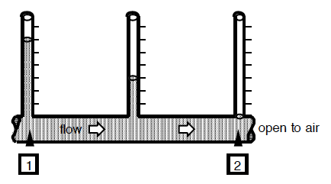
Linear Transport Model: Fluids
Q: What causes flow in fluids? Δ(head)
Q: What resists/allows flow? R_{f} / k_{f}
Q: What flows? Vol. of fluid: V/Δt = I_{f}
Thus Flux should be a property of these values
Relating all these we already have:
From here we can determine flux through any point of the pipe using:
We get:
What is the flux at this point?
However, that’s for a section of the pipe, we want the flux at any point in the pipe. Thus we take the limit as ΔL becomes small:
This equation is simply Bernoulli's principle, but at a point rather than comparing two points!

Slide 4
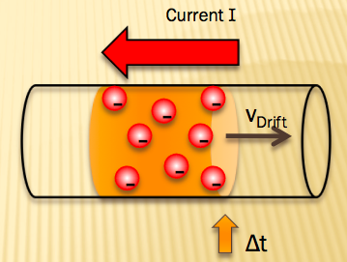
Linear Transport Model: Electricity
Q: What causes flow in a wire? ΔV
Q: What resists/allows flow? R_{e} / k_{e}
Q: What flows? – Charge: Q/Δt = I_{e}
Thus Flux should be a property of these values
Relating all these we have:
From here we can determine flux through any point of the resistor using:
We get:
What is the flux at this point:
However, that’s for a section of the pipe, we want the flux at any point in the pipe. Thus we take the limit as ΔL becomes small:
This is simply ohm’s law, but at a point rather than comparing two points.

Slide 5
Heat: Conduction
Heat always flows from areas of high T to areas of low T
Conductors – Metals: High heat conduction
Insulators – Wood, Ceramics: Low heat conduction
Typically materials that are good electric conductors are good heat conductors as well
Some notable exceptions:
Silver – has high electric conductivity but lower heat conductivity than diamond
Diamond – great conductor of heat, but has low electric resistivity
High Temperature
Low Temperature
Q
Heat transferred via thermal motion of electrons or atoms (oscillations – Phy-7A)

Slide 6
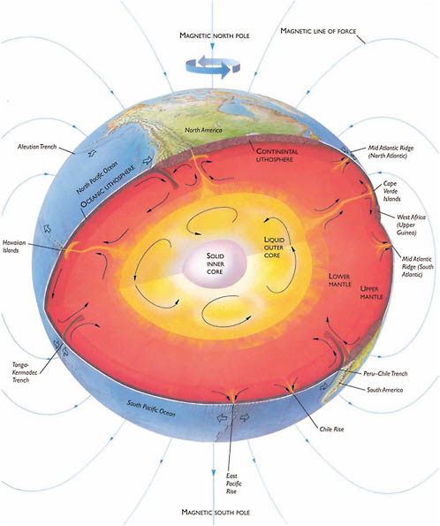
Heat: Convection
Heat always flows from areas of high T to areas of low T
Heat is carried through motion of the medium (fluid motion) itself.
Thus viscosity has an effect on convection
The earth’s liquid iron outer core is responsible for the earth’s magnetic field that protects us from solar and cosmic radiation (Phy-7C) this convection is due to the heat transfer from the hot solid inner core to the cool lower mantle
Heat transferred via fluidic motion
http://www.nap.edu/books/12161/xhtml/images/p20015561g37001.jpg

Slide 7
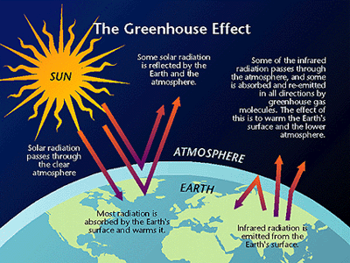
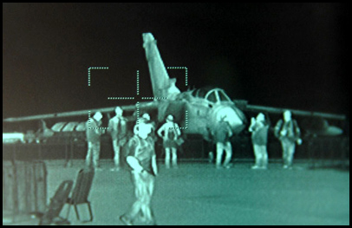
Heat: Radiation
Everything warm emits Infrared Radiation
Radiative heat needs no medium for transfer – can easily travel through space, i.e. heat from the sun.
Is part of the Electromagnetic spectrum: Infrared (IR)
Global warming is the reflection of IR radiation from atmospheric greenhouse gasses that otherwise would escape the earth.
IR is used in many applications such as military FLIR imaging systems
Heat transferred via infrared radiation
http://therawfeed.com/pix/thermal_imaging_camera.jpg
http://energysavingclub.files.wordpress.com/2007/01/greenhouse_effect.gif

Slide 8
Linear Transport Model: Heat
Q: What causes flow in a rod? ΔT
Q: What resists/allows flow? R_{t} / k_{t}
Q: What flows? – Heat: E_{th}/Δt = I_{t}
Thus Flux should be a property of these values
Relating all these we have:
From here we can determine flux through any point of the rod using:
We get:
High Temperature
Low Temperature
Q
What is the flux at this point?
However, that’s for a section of the pipe, we want the flux at any point in the pipe. Thus we take the limit as ΔL becomes small:
This is simply ohm’s law, but at a point rather than comparing two points.

Slide 9
http://www.youtube.com/watch?v=H7QsDs8ZRMI

Slide 10
Linear Transport Model: Diffusion
Q: What causes flow in a wire? Δc
Q: What resists/allows flow? R_{d} / D
Q: What flows? Particles: #part/Δt = I_{d}
Thus Flux should be a property of these values
Relating all these we have:
From here we can determine flux through any point of the tube using:
We get:
High conc. of Br₂
Low conc. of Br₂
What is the flux of particles at this point?
However, that’s for a section of the tube, we want the flux at any point in the tube. Thus we take the limit as ΔL becomes small:
This is known as Fick’s law where D is the diffusion constant.
http://www.youtube.com/watch?v=H7QsDs8ZRMI

Slide 11
Q: Why is it called the Linear Transport Model?
ϕ
The generalized Linear Transport Model equation for flux due to a potential difference phi is:
Where ϕ may stand for head, voltage, temperature, concentration, etc. What is ϕ as a function of x?
ϕ₀
−j/k = slope
x
Q: What assumptions did we make in order to make the flow linear and the flow rate constant over time?
Infinite Source: Source doesn’t run out, so potential doesn’t change with time, so far we’ve assumed a steady-state. No dependence of flow on time.
Ideal flow (Laminar vs. Turbulent), negligible viscosity
Resistance is not dependent on the potential

Slide 12
Non-Linear Phenomenon – Non Ohmic Resistors
v_{drift}
V_{applied}
-
-
-
-
Ohmic resistors
-
-
-
-
-
-
-
-
-
-
-
-
-
-
-
Ohm’s Law:
For a realistic Resistor thermal motion is dependent upon the current.
Current heats up resistor > higher thermal motion > lesser increase in current per increase in voltage.
Example: Computer Overheating
I_{measured}
V_{applied}
Non-ohmic resistors
Semiconductors
I_{measured}

Slide 13
Non-Linear Phenomenon – Dependence on source
Recall Toricelli's result
Note, for a realistic tank, the v_{B} depends on the height of the fluid in the tank. Thus the flow rate changes with time!
More specifically we can say that the current depends upon the volume of fluid in the tank.
What function is it’s own derivative?
Note V is volume not potential and the negative sign is for decrease in volume with time.
Notes:
Actually it’s proportional to a power of the

Slide 14
Exponential Change: Population Growth
The rate of increase of a population is proportional to the population.
Where p₀ is the population at time t = 0
Note: the time it takes for the population to double is known as doubling time, shown as t₂ on the plot
Note: sometimes you’ll see equation 2 with the Greek letter tau τ known as the time constant. τis the amount of time it takes for the population to increase by a factor of e = 2.7183
Population p
ep₀
2p₀
p₀
t₂
τ
Time t
Note that there is an asymptote along the x axis
It’s a good idea to know these!

Slide 15
Exponential Change: Nuclear Decay
The rate of decay of a Radioactive isotope is proportional to the amount of material remaining
Note: the time it takes for the material to be reduced by ½ is called the half life, denoted by t_{½}
Note: sometimes you’ll see equation 2 with the Greek letter tau τ known as the time constant. τis the amount of time it takes for the material to decrease by a factor of e = 2.7183
Amount N
N₀
Note that there is an asymptote along the x axis
N₀/2
N₀/e
t_{1/2}
τ
Time t
It’s a good idea to know these!

Slide 16
Exponential Change: Newton’s Law of Cooling
The rate of cooling of a warm beverage at room temperature is proportional to the temperature difference between the beverage and the room.
Note: the time it takes for the beverage to be cooled by ½ is called the half life, denoted by t_{½}
Note: sometimes you’ll see equation 2 with the Greek letter tau τ known as the time constant. τis the amount of time it takes for the temperature difference to decrease by a factor of e = 2.7183
Temperature T
ΔT₀
Note that there is an asymptote at T_{rm}
ΔT₀/2
ΔT₀/e
T_{rm}
t_{1/2}
τ
Time t
Notes:
NO

Slide 17
Exponential Change in Circuits: Capacitors
A parallel plate capacitor consists of two metallic plates, with area A, separated a distance d by a ‘dielectric’ insulator in the middle.
Q: What happens when we plug these plates into opposite terminals of a battery?
Charge starts to build up on the opposite plates. Thus the capacitance (capacity) of a capacitor is equal to the charge accumulated per voltage applied.
The build up of charge allows a capacitor to behave like a battery
Q: In which direction would a charged capacitor like to push the current?
A
| | | | |
| | | | |
-Q
+ + + + +
+ + + + +
+Q
d
-
ε
+
Recall: Ohm’s Law
Recall: for a resistor R was also dependent upon geometry
Note that this is not the same ε as the battery

Slide 18
Exponential Change in Circuits: Capacitors
Circuit Diagrams: Capacitors
Capacitors in parallel (~2xA)
Capacitors in series (~2xd)
Circuit Diagrams: Resistors
Resistors in Series (~2xL)
Resistors in parallel (~2xA)

Slide 19
Exponential Change in Circuits: Capacitors - Charging
A Capacitor is a bit like a rechargeable battery once the switch is closed current rushes to charge the capacitor.
Q: As the Capacitor charges up, what direction does it try to push the current?
Q: When will the charging stop?
Q: Initially what is the voltage in the capacitor? What is the voltage in the resistor? What is the current in the circuit?
Q: At the end, what is the voltage in the capacitor? What is the current in the circuit? What is the voltage in the resistor?
Q=CV_{C}
V_{R}=IR
ε=20V
Current I (A)
Voltage V_{C} (V)
ε/R
ε
Time t (s)
Time t (s)

Slide 20
Exponential Change in Circuits: Capacitors - Discharging
Now we use the charge stored up in the battery to light a bulb
Q: As the Capacitor discharges, what is the direction of the current? What happens after some time?
Q: Initially what is the voltage in the capacitor V₀? What is the voltage in the bulb? What is the current in the circuit?
Q: At the end, what is the voltage in the capacitor? What is the current in the circuit? What is the voltage of the resistor?
V_{B}=IR_{B}
Q=CV_{C}
ε=20V
Current I (A)
Voltage V_{C} (V)
V₀/R_{B}
V₀
Time t (s)
Time t (s)

Slide 21
Exponential Change in Circuits: Capacitors
Charging and Discharging a capacitor: Summary
Charging: | Initial ( I = Max , Q = 0 ) | Final ( I = 0 , Q = Max )
ε | 20V | 20V
C | 0V (V=Q/C) | 20V (V=Q/C)
R | 20V (V=IR) | 0V (V=IR)
Discharging: | Initial ( I = Max , Q = Max ) | Final ( I = 0 , Q = 0 )
C | 20V (V=Q/C) | 0V (V=Q/C)
R_{B} | 20V (V=IR) | 0V (V=IR)

Slide 22
Capacitors: Energy Stored in a capacitor
Because resistors dissipate power, we wrote a an equation for the power dissipated in a Resistor:
Because capacitors are used to store charge and energy, we concentrate on the energy stored in a capacitor.
We imagine the first and the last electrons to make the journey to the capacitor. What are their ΔPE’s? ΔPE_{first}=qΔV ,ΔV=20 ΔPE_{last} =qΔV , ΔV=0 Thus on average for the whole charge:
Note: Since I is same for resistors in series, identical resistors in series will have the same power loss.
Since V is the same for resistors in parallel, identical resistors in parallel will have the same power loss
Q=CV_{C}
V_{R}=IR
ε=20V

