Slide 1
Physics 7B-1 (A/B)
Professor Cebra
Winter 2010
Lecture 4
Review of Linear Transport Model and Exponential Change Model

Slide 2
Linear Transport Model
Starting with Ohm’s Law (ΔV = -IR), which we had derived from the Energy Density Model, we can rewrite this to solve for current (I = -(1/R)ΔV
Using our definition of R from the previous slide [R = ρ(L/A) or (1/R) = k (A/L)],
We get
I = -k (A/L) ΔV
If we let ΔV → Δφ, then we get
I = -k (A/L) Δφ
Divide through by area A,
j = -k (1/L) Δφ
Let L become an infinitesimal
j = -kdφ/dx ⬅ Transport Equation

Slide 3
Linear Transport
Which statement is not true about linear transport systems?
If you double the driving potential (voltage, temperature difference,...) , the current doubles.
If you double the resistance, the current is halved.
In linear transport systems, the driving potential varies linearly with the spatial dimension.
For both fluid flow and electrical circuits, the continuity equation requires that the current density is independent of position.
All of the other statements are true.

Slide 4
Application of Linear Transport Model
Fluid Flow
ϕ=Head and j=mass current density
Electric Current (Ohm’s Law)
ϕ=Voltage and j=charge current density
Heat Conduction
ϕ=Temperature and j=heat current density
Diffusion (Fick’s Law)
ϕ=Concentration and j=mass current density

Slide 5
Fluid Flow and Transport
j = -kdφ/dx
Which curve best describes the pressure in the above pipe as a function of position along the direction of laminar flow?
a
Pressure
b
c
d
The correct answer is “c”
x (cm)

Slide 6
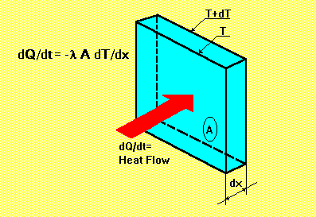
Heat Conduction – Fourier’s Law
Suppose you lived in a 10’ x 10’ x 10’ cube, and that the wall were made of insulation 1’ thick. How much more insulation would you have to buy if you decided to expand your house to 20’ x 20’ x 20’, but you did want your heating bill to go up?
Twice as much
Four times as much
Eight times as much
Sixteen times as much
Answer:
d) The area went up by a factor of four, therefore you will need four times as much thickness => sixteen times the total volume of insulation
j_{Q} = (dQ/dt)/A = -kdT/dx

Slide 7
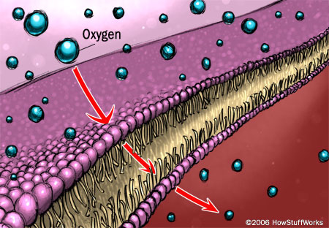
Diffusion – Fick’s Laws
j = -D dC(x,t)/dx
Where j is the particle flux and C in the concentration, and D is the diffusion constant

Slide 8
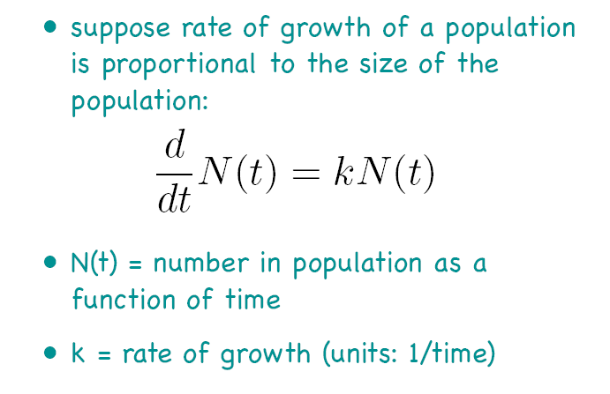
Exponential Growth

Slide 9
Exponential Growth

Slide 10
Exponential Growth

Slide 12
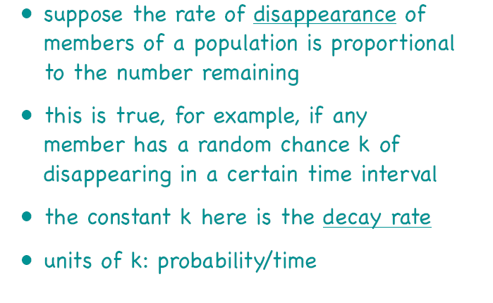
Exponential Decay

Slide 13
Exponential decay

Slide 15
The Parallel Plate Capacitor
ε = dielectric constant
A = Area of plates
+Q = stored charge
V = voltage across plates
C = κε₀A/d
-Q = stored charge
C = Q/V
d = separation of plates
Electrical Capacitance is similar to the cross sectional area of a fluid reservoir or standpipe. Electrical charge corresponds to amount (volume) of the stored fluid. And voltage corresponds to the height of the fluid column.

Slide 16
Non-Linear Phenomenon – Dependence on source
Note, for a realistic tank, the v_{B} depends on the height of the fluid in the tank. Thus the flow rate changes with time!
More specifically we can say that the current depends upon the volume of fluid in the tank.
What function is it’s own derivative?
y_{A}
Note V is volume not potential and the negative sign is for decrease in volume with time.
y_{B}

Slide 17
Fluid Reservoir
h
What will increase the time constant?
Cross section area of the reservoir
Resistance of the outlet
t

Slide 18
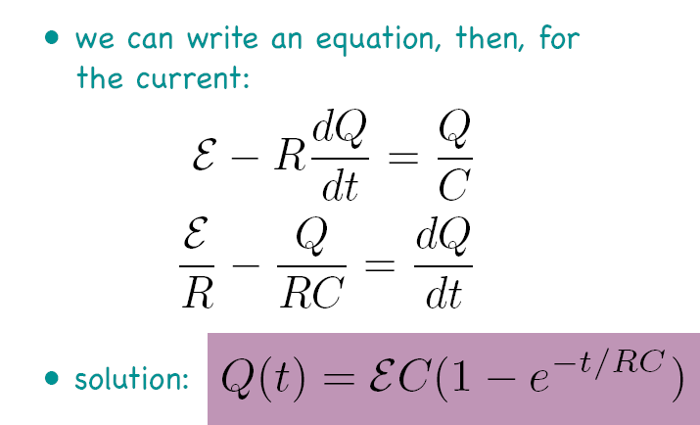
Exponential Change in Circuits: Capacitors - Charging
V = Q/C
I = dQ/dt
Q=CV_{C}
V_{R}=IR
ε=20V
Current I (A) = dQ/dt
Voltage V_{C} (V) = (Q/C)
ε/R
ε
Time t (s)
Time t (s)

Slide 19
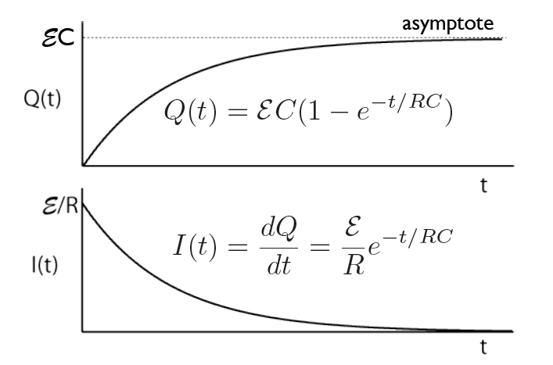
Charging a Capacitor

Slide 20
Exponential Change in Circuits: Capacitors - Discharging
Now we use the charge stored up in the battery to light a bulb
Q: As the Capacitor discharges, what is the direction of the current? What happens after some time?
Q: Initially what is the voltage in the capacitor V₀? What is the voltage in the bulb? What is the current in the circuit?
Q: At the end, what is the voltage in the capacitor? What is the current in the circuit? What is the voltage of the resistor?
V_{B}=IR_{B}
Q=CV_{C}
ε=20V
Current I (A)
Voltage V_{C} (V)
V₀/R_{B}
V₀
Time t (s)
Time t (s)

Slide 21
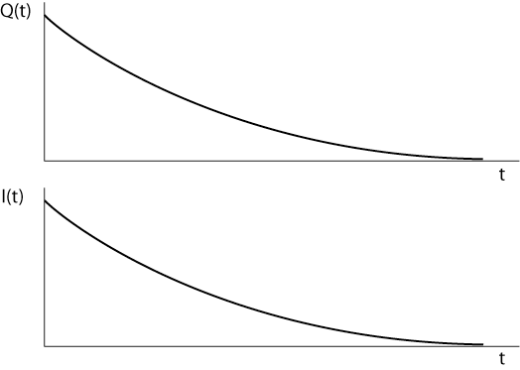
Discharging a Capacitor

Slide 22
Capacitors in Series and Parallel
Circuit Diagrams: Capacitors
Capacitors in parallel (~2xA)
Capacitors in series (~2xd)
Circuit Diagrams: Resistors
Resistors in Series (~2xL)
Resistors in parallel (~2xA)
22

Slide 23
Capacitors: Energy Stored in a capacitor
Because resistors dissipate power, we wrote a an equation for the power dissipated in a Resistor:
Because capacitors are used to store charge and energy, we concentrate on the energy stored in a capacitor.
We imagine the first and the last electrons to make the journey to the capacitor. What are their ΔPE’s? ΔPE_{first}=qΔV ,ΔV=20 ΔPE_{last} =qΔV , ΔV=0 Thus on average for the whole charge:
Note: Since I is same for resistors in series, identical resistors in series will have the same power loss.
Since V is the same for resistors in parallel, identical resistors in parallel will have the same power loss
Q=CV_{C}
V_{R}=IR
ε=20V

Slide 24
Announcements

Slide 25
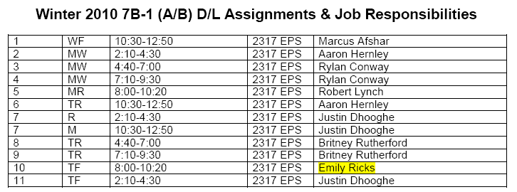
DL Sections

