Slide 1
Physics 7B-1 (A/B)
Professor Cebra
Winter 2010
Lecture 3
Review of Circuits
and the
Linear Transport Model

Slide 2
Basic Circuit Theory
Potential (Voltage): V Volts (V)
Current: I Amps (A)
Resistance: R Ohms (Ω)
Capacitance: C Farads (F)
Power: P Watts (W)
Ohm’s law: V = IR
Power: P = IV = I²R = V²/R

Slide 3
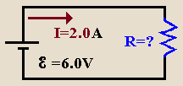
Example
Question A battery of 6.0V is connected to a purely resistive lamp and a current of 2.0 A flows. All the wires are resistance-free. What is the resistance of the lamp?
Hints
Where in the circuit does the gain in potential energy occur?
Where in the circuit does the loss of potential energy occur?
What is Ohm's Law?
12 W
12 Ω
3.0 Ω
(1/3) W
36 Ω
Solution: V =IR ➔ R = V/I = 6.0 V/2.0 A = 3.0 Ω

Slide 4
Series and Parallel
Complicated circuits can be simplified.
Resistors in series:
Resistors in parallel:
R
R
2R
is equivalent to
R
R/2
R
is equivalent to

Slide 5
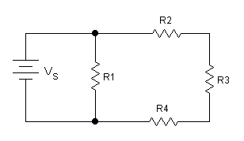
Example
Consider the circuit show below. Vs = +12V, R1 = 6Ω, R2 = 1Ω, R2 = 2Ω, R3 = 3Ω.
What is the current flowing through the battery?
1A
2A
3A
4A
6Α
Solution: R2 + R3 + R4 = 6Ω. Two parallel 6Ω resistors have an equivalent resistance of 3W. The current through the battery we get from Ohm’s law, I = V/R = 12V/3Ω = 4A

Slide 6
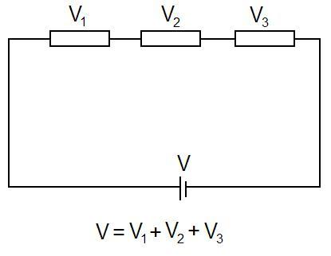
The Loop Rule
For any closed loop that one can draw on a circuit, no matter how complex, the sum of the voltage drops must be equal to the sum of the voltage rises (forward biased batteries).
ΣE = Σ I R_{i}
Conservation of energy

Slide 7
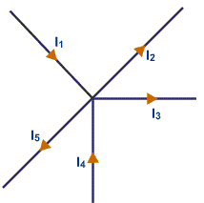
The Junction Rule
At any junction (or node), the sum of the incoming currents must be equal to the sum of the outgoing currents.
Σ I _{in} = Σ I _{out}
Conservation of charge

Slide 8
Example
Question
Find V5 given that V1=12V, R2 = 6Ω, R3 = 12Ω, R4 = 10Ω, R5 = 2Ω.
1 V
2 V
3 V
(1/2) V
6 V
Solution: V5 = 1V

Slide 9
Linear Transport Model
Current density: The amount of material passing through an aperture of unit area per unit time ➔ j = I/A
Linear transport equation: Describes the flow of something (j) as a result of change in a potenial (ϕ) with position(i.e. the gradient of the potential)➔ j = -kdφ/dx The constant of proportionality, k, is the conductivity.

Slide 10
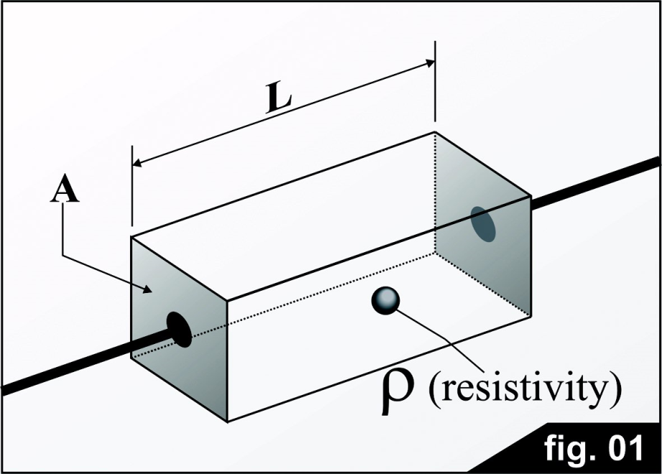
Ohm’s Law - Resistivity
The resistance of a piece of material is given by its intrinsic resistivity (ρ), times the Length (L), divided by the area (A).
R = ρ (L/A)
The resistivity (ρ) is the inverse of the conductivity (k or σ).

Slide 11
Linear Transport Model
Starting with Ohm’s Law (ΔV = -IR), which we had derived from the Energy Density Model, we can rewrite this to solve for current (I = -(1/R)ΔV
Using our definition of R from the previous slide [R = ρ(L/A) or (1/R) = k (A/L)],
We get
I = -k (A/L) ΔV
If we let ΔV → Δφ, then we get
I = -k (A/L) Δφ
Divide through by area A,
j = -k (A/L) Δφ
Let L become an infintesmal
j = -kdφ/dx ⬅ Transport Equation

Slide 12
Application of Linear Transport Model
Fluid Flow
ϕ=Head and j=mass current density
Electric Current (Ohm’s Law)
ϕ=Voltage and j=charge current density
Heat Conduction
ϕ=Temperature and j=heat current density
Diffusion (Fick’s Law)
ϕ=Concentration and j=mass current density

Slide 13
Fluid Flow and Transport
The resistance of pipes to fluid transport has a very strong dependence on the radius of the pipe.
R = (Fluid properties) x (geometric properties)
= (8η/r²) x (L/A)
= 8ηL/(πr⁴)
The Reynolds number is a dimensionless quantity that indicates when flow will transition from laminar to turbulent. This occurs for Reynolds numbers between 2000 and 3000.

Slide 14
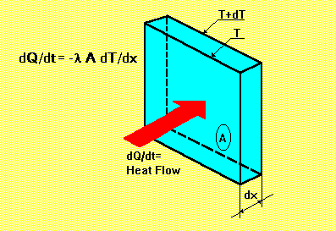
Heat Conduction – Fourier’s Law
Thermal conductivity, k, is the property of a material that indicates its ability to conduct heat. It appears primarily in Fourier's Law for heat conduction. Thermal conductivity is measured in watt per kelvin per meter (W·K⁻¹·m⁻¹). Multiplied by a temperature difference (in Kelvin, K) and an area (in square meters, m²), and divided by a thickness (in meters, m) the thermal conductivity predicts the energy loss (in watts, W) through a piece of material.
The reciprocal of thermal conductivity is thermal resistivity, usually measured in kelvin-meters per watt (K·m·W⁻¹). When dealing with a known quantity of material, its thermal conductance and the reciprocal property, thermal resistance, can be described.
j_{Q} = (dQ/dt)/A = -kdT/dx

Slide 15
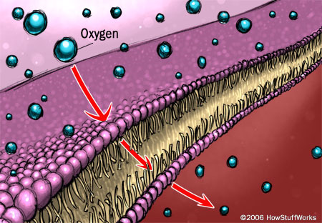
Diffusion – Fick’s Laws
Diffusion can be defined as the random walk of an ensemble of particles from regions of high concentration to regions of lower concentration. Diffusion is describes by Fick’s Laws.
Fick’s First Law relates the transfer of material to the gradient:
j = -D dC(x,t)/dx
Where j is the particle flux and C in the concentration, and D is the diffusion constant
From the Conservation of mass, we know that dC/dt = -dj/dx, if we combine this constraint with Fick’s First Law, we get the Second Law:
dC/dt = D d²C/dx²

Slide 16
Announcements

Slide 17
Test

