Slide 1
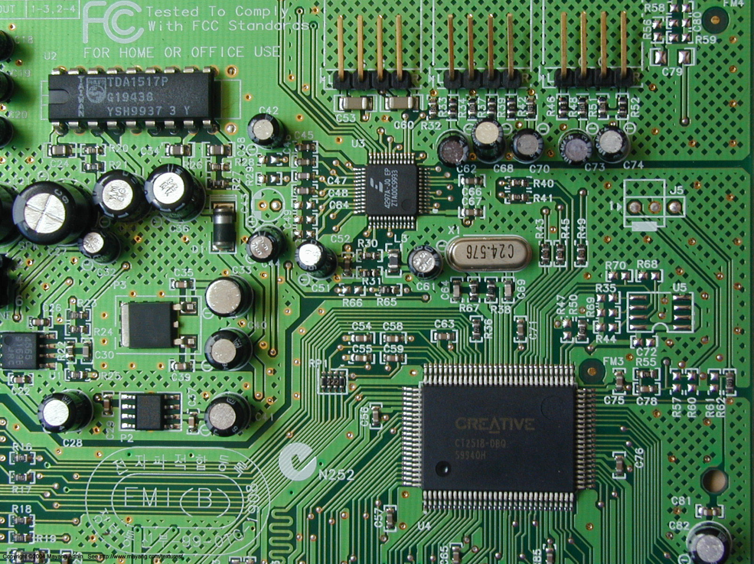
Physics 7B-1 (A/B)
Professor Cebra
Winter 2010
Lecture 2
Simple Circuits

Slide 2
Conservation of Energy Density
In the First lecture, we started with energy conservation. We divided by volume (making conservation intensive rather than extensive) to get an energy density conservation equation.
For the non-isolated system, we added in pumps and resistance from the pipes to get a more general equation which describes the general features of fluid systems:
In this lecture, instead of dividing by volume, we will divide the energy by the electric charge. This again gives us an intensive energy density equation which now describes the behavior of electrical circuits.

Slide 3
Comparison of Fluids to Electricity
Fluid systems and electrical circuits are analogous:
Pipe
Wire
Friction
Battery
Pump
Voltage
Head
Resistance
Fluid
Charge
Flow Rate
Current

Slide 4
Units of Electrical Circuits
Quantity | Unit | Definition | Dimensions
Electric Charge (q) | Coulomb (C) | 1 e = 1.6 x 10⁻¹⁹ C | 1 C
Energy (E) | Joule (J) | 1 Nm | 1 kg m² / s²
Electric Potenial (V) | Volt (V) | 1 V = 1 J/C | 1 kg m² / s² C
Electric Resistance (R) | Ohm (Ω) | 1 Ω = 1 V/A | 1 kg m² / sC²
Electric Current (I) | Ampere (A) | 1A = 1 C/s | 1 C/s
Power (P) | Watt (W) | 1 W = 1 J/s | 1 kg m² / s³
Energy (E) | kiloWatt-Hour (kW-hr) | 3.6 x 10⁶ J

Slide 5
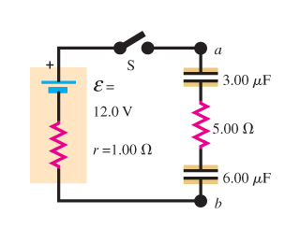
What is a Circuit?
An electrical device that provides a path for electrical current to flow
Conservation of charge requires that the circuit must be complete, i.e. it must be continuous.
A circuit that does not have a complete conducting path is said to be an open circuit.
In the diagram at the right, the switch opens the circuit.
A component can be in a condition where the current has alternative and lower resistance conducting path. This is known as a short circuit.
Often a circuit will connect to ground. Ground is the reference voltage defined as the electric potential of the surface of the earth.
DEMO: Circuit Board

Slide 6
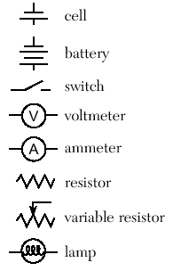
Circuit Components and Symbols
AA
Wire – Carries electric charge
Battery – Provides power
Resistor – Uses/dissipates power
Capacitor – Stores charge
Voltmeter – Measures voltage
Ammeter – Measures current
A cell is maintains a defined voltage across its two terminals
A battery is a collection of two or more cells
A switch can be set to open on close the circuit
A voltmeter measures the potential between two points
An ammeter measures the current flowing through it
A resistor impedes the flow of current
A variable resistor has an adjustable resistance
A lamp is a resistor that produces light
V
A

Slide 7
Electric Energy per Charge -- Voltage
Voltage: Electrical potential energy per unit charge.
In fluid systems:
In electrical circuits:

Slide 8
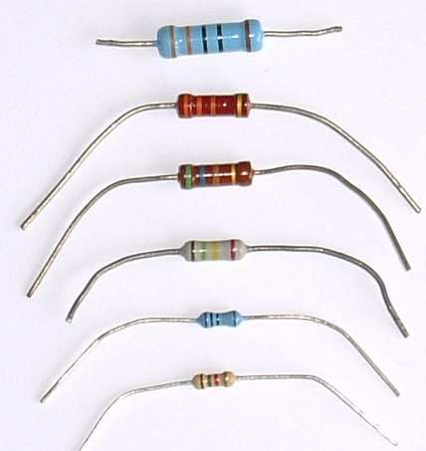
Definition of a Resistor
Resistor: Any circuit component that
Opposes current
Produces a voltage drop
Resistors use/dissipate power:
DEMO: Resistor Model
A conductor with zero resistance is a wire

Slide 9
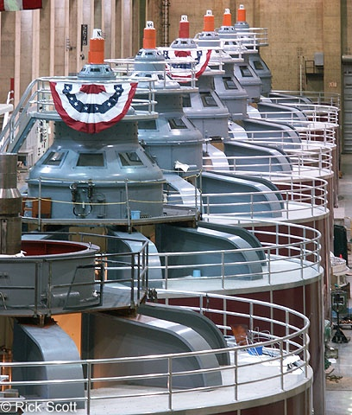
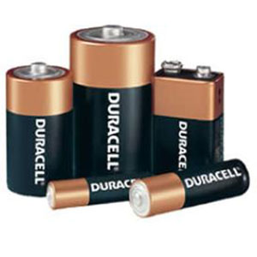
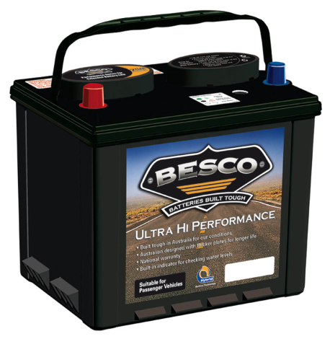
Batteries and Power Supplies
Batteries, generators, or power supplies are able to maintain a defined electric voltage (energy per charge) across its two terminals. To do this, these devices must convert energy from some other form.
Batteries use chemical energy (E_{bond}) and convert this to electric energy.
Generators convert mechanical energy.
Power supplies convert the AC line
power into another form of electric
Energy.
Batteries have a characteristic electro-
motive force (E), measured in volts.

Slide 10
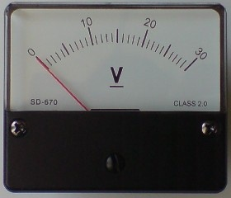
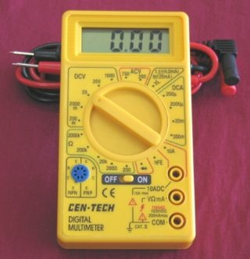
Meters
A voltmeter is an instrument used for measuring the electrical potential difference between two points in an electric circuit.
An ammeter measures the electric current flowing through its leads.
An ohmmeter uses a battery to run a small current through an unknown resistor. By measuring the battery voltage and the current and using Ohm’s Law, the device determines the resistance.

Slide 11
Ohm’s Law (V = IR)
In electrical circuits, Ohm's law states that the current through a component between two points is directly proportional to the potential difference or voltage across the two points, and inversely proportional to the resistance between them.
DEMO: Single Resistor and Meters

Slide 12
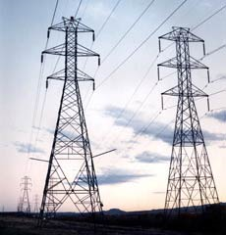
Electrical Power
In resistive circuits, electrical power is calculated using Joule's law:
where P is the electric power, V the potential difference, and I the electric current.
In the case of resistive (Ohmic, or linear) loads, Joule's law can be combined with Ohm's law (I = V/R) to produce alternative expressions for the dissipated power:
DEMO: Single Light Bulb

Slide 13
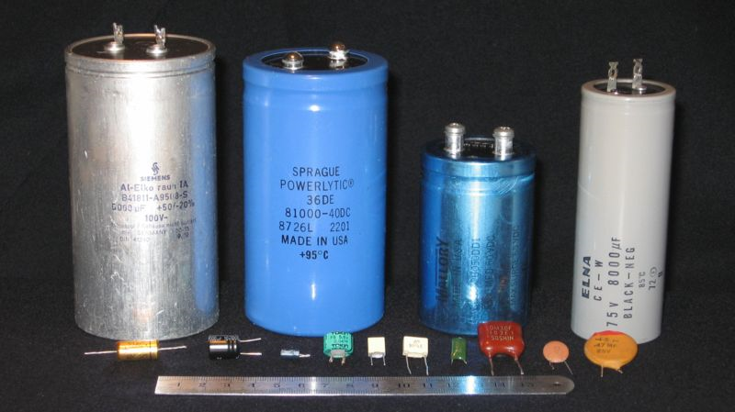
Capacitor
Capacitor: Any circuit component that
Stores charge
Produces a voltage drop
Capacitors can behave like rechargeable batteries

Slide 14
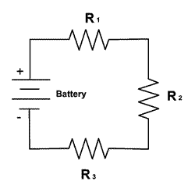
Series Circuits
A series circuit in one in which there is only a single conducting path. There are no branches and all components come one after another.
The current will flow around the circuit form the positive to the negative terminal of the battery.
All the components will experience the same current, however each will have a voltage drop determined by the size of its resistor.
E
I
E = IR₁ + IR₂ + IR₃

Slide 15
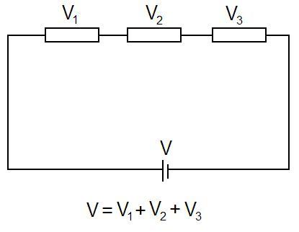
The Loop Rule
For any closed loop that one can draw on a circuit, no matter how complex, the sum of the voltage drops must be equal to the sum of the voltage rises (forward biased batteries).
ΣE = Σ I R_{i}
Conservation of energy

Slide 16
Simple Flow Exercise
Suppose current I flows through point 1 and consider a battery with emf ε and resistor with resistance R.
Calculate the current through point 2, 3 and 4.
Calculate voltage change between points 1&2, 2&3 and 3&4.
Calculate power used/dissipated by resistor.
ε
I
R
1
2
3
4

Slide 17
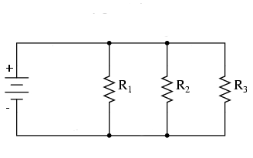
Parallel Circuits
A parallel circuit is one in which the leads of the components are joined by a common wire which is then connected across the battery or other voltage source.
The current will be split between the parallel components, however they will all have the same voltage drop.
V = I₁R₁ = I₂R₂ = I₃R₃
V

Slide 18
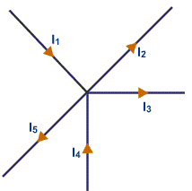
The Junction Rule
At any junction (or node), the sum of the incoming currents must be equal to the sum of the outgoing currents.
Σ I _{in} = Σ I _{out}
Conservation of charge

Slide 19
Series and Parallel
Complicated circuits can be simplified.
Resistors in series:
Resistors in parallel:
R
R
2R
is equivalent to
R
R/2
R
is equivalent to
DEMO: Series Light Bulbs

Slide 20
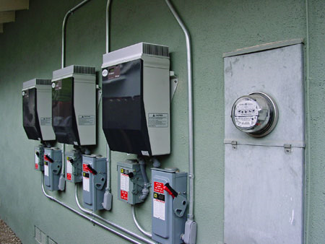
Household Electrical Power
Household power is delivered as AC power.
In the North America, standard electrical outlets have 110 V_{rms} at 60 Hz.
Much of the rest of the world uses 220 V at 50 Hz.
Transmission lines carry power from plants at several thousand volts. This is stepped down at a series using a series of transformers. The final stage is in your breaker box at the power meter. There is a center tapped transformer. Taking either lead to ground gets the 110 V. For more energy demanding appliances, one can wire both leads to get 220 V.
DEMO: Utility Box

Slide 21
Announcements
Remember the MLK day Holiday.
Section 01 (Marcus) does not meet on Friday. No sections meet on Monday or Tuesday.

Slide 22
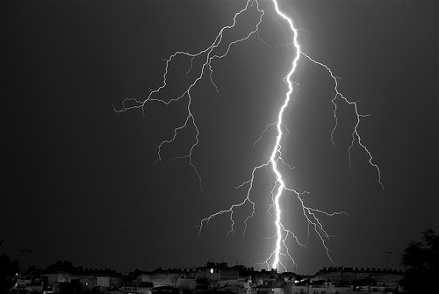
Death by Electricity
It’s the current that kills not the voltage

