Slide 1
Physics 7B-1 (A/B)
Professor Cebra
Winter 2010
Lecture 10
Simple Harmonic Motion

Slide 2
Announcements
Final exam will be next Wednesday 3:30-5:30
A Formula sheet will be provided
Closed-notes & closed-books
One single-sided 8 ½ X 11 Formula Sheet allowed
Bring a calculator
Bring your UCD ID (picture and student number)
Practice problems – Online
Formula sheet – Online
Review Sessions – Online
Final Exam Room | Last Name Begins With:
198 Young | N - Z
1100 Social Sciences | C - M
55 Roessler | A - B

Slide 3
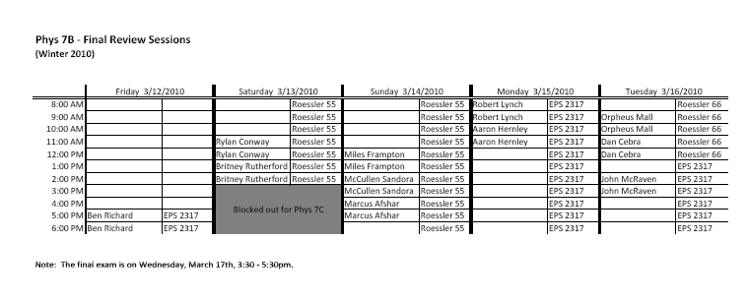

Slide 4
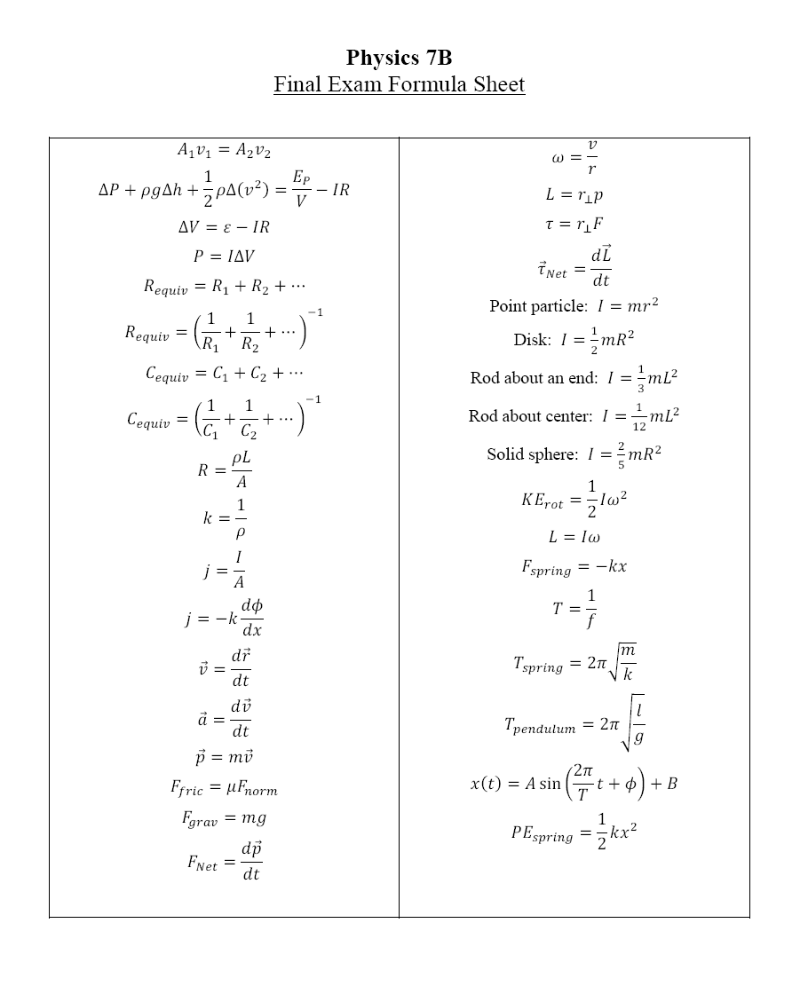

Slide 5
Grading Status

Slide 6
Extended Objects - Center of Gravity
Two masses
N
x₂
Balance forces and Torques
x_{f}
x₁
m₁g
fulcrum
m₂g
Discrete masses
Distribution of mass

Slide 7
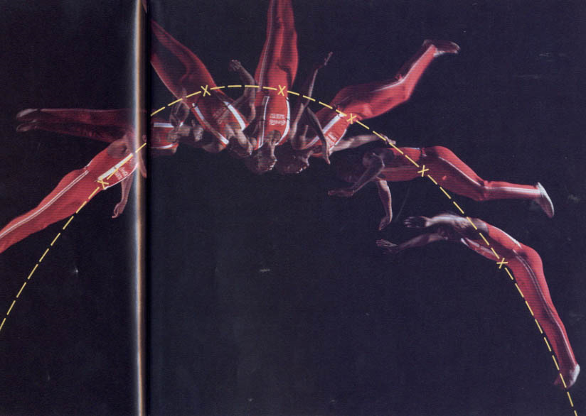
Center of Gravity
Extended body rotating with constant angular velocity
Parabolic trajectory of the center of mass
The center of gravity (or Center of mass) is the point about which an object will rotate. For a body under goes both linear projectile motion and rotational motion, the location of the center of mass will behave as a free projectile, while the extended body rotates around the c.o.m.

Slide 8
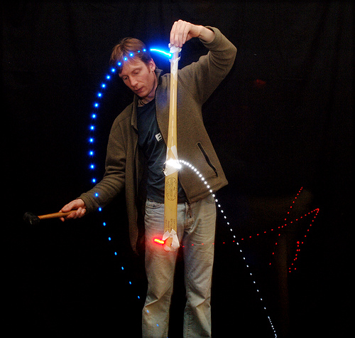
Center of Gravity
Rotation
Parabolic trajectory of the center of mass
Linear Impulse
and
Angular Impulse
Rotation

Slide 9
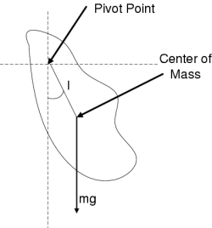
Rotating Off Axis vs On Axis
When can a body rotate about an arbitrary pivot point and when must it rotate about its center of gravity?
First, consider a free body (define free to mean no contact forces – i.e. Normal forces or frictions). For an object to rotate, there must be Centripetal forces – since these are all internal forces, they must add to zero.
The body must rotate about its center of gravity.
For a body with an external fixed pivot point, normal forces at the pivot can provide an external centripetal force.
Demo: Center of Gravity

Slide 10
Rotating Off Axis
When rotating off axis, in a uniform gravitational field:
Is the motion circular? ➔ Yes
Is the angular velocity uniform? ➔ No
Is there a net torque? ➔ Yes
Is the angular acceleration uniform? ➔ No
Is the torque uniform? ➔ No
Is there a net linear motion? ➔ Yes
Is there a net force? ➔ Yes
Is it uniform? ➔ No
Demo: Center of Gravity

Slide 11
Oscillating Off Axis
There is an oscillation between kinetic energy ( ½ mv² and ½ Iω²) and potential energy (mgh).
Where it KE maximum? ➔ The bottom
Where is PE maximum? ➔ The top
What happens is KE_{max} < ΔPE? ➔ The motion is no longer circular! Instead, the body will oscillate.
Can we describe oscillatory motion?
Demo: Center of Gravity

Slide 12
Oscillatory Motion
Oscillation: Periodic displacement of an object from an equilibrium point
Periodic or Oscillatory Motion
Equilibrium Position: The position at which all forces acting on an object sum to zero.
Restoring Force : Force driving the object towards equilibrium point
if restoring force is proportional to displacement => S.H.M.
i.e. Hooke’s Law ➔ F_{restore} = -kx
Period (T) : Interval of time for each repetition or cycle of the motion. Frequency (f = 1/T)
Amplitude (A) : Maximum displacement from equilibrium point
Phase (φ): Describes where in the cycle you are at time t = 0.

Slide 13
Examples of Oscillating Systems
Vertical
Mass-Spring
Pendulum
Horizontal
Mass-Spring

Slide 14
Horizontal Mass-Spring
F_{normal}
Spring Extended:
F_{spring}
F_{gravity}
Spring in Equilibrium:
Spring Compressed:

Slide 15
Vertical Mass on Spring System
Force from a Spring:
F_{spring} = -kx (upwards)
At Equilibrium:
ΣF = - kx₀+ mg = 0
Away from Equilibrium:
ΣF = - kx +mg = - k(x-x₀) = -kx
Newton’s 2nd Law (F=ma):
F_{tot} = - kx(t) = ma(t) = m (d²x(t)/dt²)
x
-kx
x_{o}
mg
Relaxed
Spring
Let x = (x-x₀)
Differential
Equation...
Equilibrium
Position
DEMO: Spring w/ mass

Slide 16
How to solve this differential equation?
Differential Equation for Simple Harmonic Oscillation
Do we know any function whose second derivative is itself times a constant?
➔ Let
Period:
sine function repeats when
bt = 2π
therefore,
T=2π/b
General Solution: x(t) = A sin (2πt/T + φ) or x(t) = A cos (2πt/T + φ)

Slide 17
Simple Harmonic Motion
Simple Harmonic Motion: Oscillatory motion in which the restoring force is proportional to displacement
Restoring Force = Constant X Displacement
Displacement vs. Time:

Slide 18
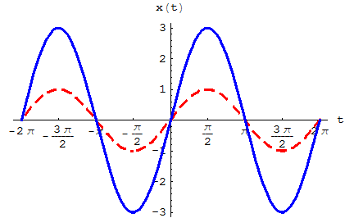
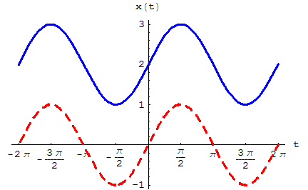
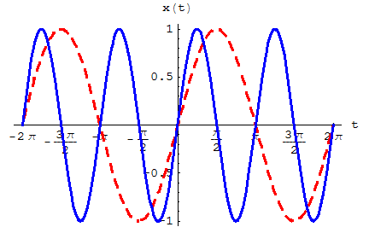
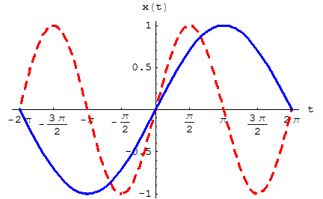
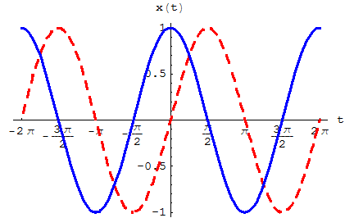
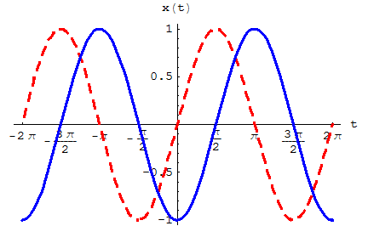
Practice With SHM Equation
sin(t) , 3 sin(t)
sin(t) , sin(t)+2
sin(t) , sin(2t)
sin(t) , sin(0.5 t)
sin(t) , sin(t + 0.5 π)
sin(t) , sin(t - 0.5 π)

Slide 19
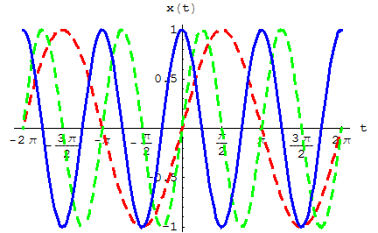
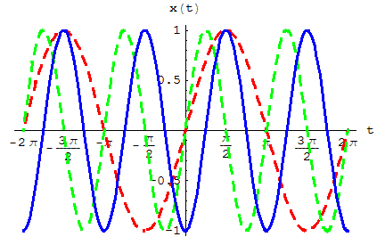
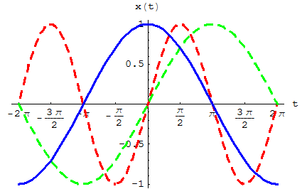
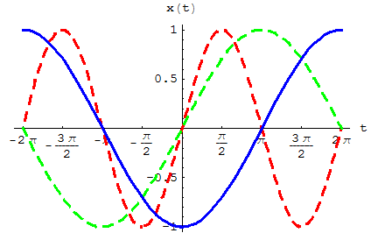
Practice With SHM Equation
sin(t) , sin(2t) , sin(2t+0.5 π)
sin(t) , sin(2t) , sin(2t-0.5 π)
sin(t),sin(0.5t),sin(0.5t+0.5 π)
sin(t),sin(0.5t),sin(0.5t-0.5 π)

Slide 20
Pendulum System
θ
θ
F_{tension}
F_{gravity}

Slide 21
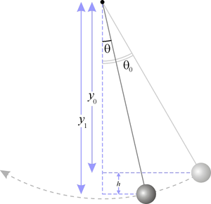
Pendulum System
Really a rotational problem…
τ = F_{tan} L = mgsinθ L
τ = I α = mR² α
−mgLsinθ = mL² d²θ/dt²
For small θ, sinθ = θ (good to about 10 degrees)
−mgLθ(t) = mL² d²θ/dt²
- (g/L)θ(t) = d²θ/dt²
L
mg
DEMO

Slide 22
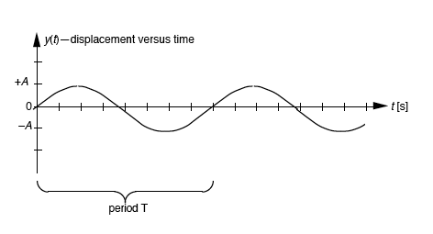
SHM - Recap
The generalized solution
is of the form:
Pendulum:
π
2π
Mass/Spring:
How is the frequency f
of the oscillations related
to the period T?
Period:

Slide 23
Energy in SHM
Consider mass on a spring:
PE = (1/2) k x²
KE = (1/2) mv² v = dx/dt x(t) = A sin(2πt/T + φ)
PE = (1/2) kA² sin² (2πt/T + φ)
KE = (1/2) m [(2π/T)Acos(2πt/T + φ)]²
remember… (2π/T) = sqrt(k/m) => (2π/T)² = k/m
=> KE = (1/2) A² k cos² (2πt/T + φ)
E_{total} = PE + KE = (1/2)kA²[sin² (2πt/T + φ)+ cos² (2πt/T + φ)]
KE_{peak} = PE_{peak}
➔ Energy is conserved with time!
And Energy is proportional to A²
1

Slide 24
Topics (1/4)
Fluids
Continuity Eq.
Energy Density Eq.
Steady-state Flow
Flow Line
Pressure
Electrical Circuits
Batteries
Resistors
Capacitors
Power
Voltage
Current
Equivalent Circuits
Linear Transport Model
Linear Transport Eq.
Current Density
Exponentials

Slide 25
Topics (2/4)
Vectors
Addition
Subtraction
Cartesian Coords.
Polar Coords.
Position Vector
Velocity Vector
Acceleration Vector
Momentum Vector
Conservation of Momentum
Force Vector
Friction
Normal
Gravity
Spring

Slide 26
Topics (3/4)
Newton’s Laws
Force & Acceleration
Force & Momentum
Collisions
Momentum Cons.
Elastic vs. Inelastic
Rotational Motion
Ang. Velocity
Ang. Acceleration
Ang. Momentum
Torque
Right Hand Rule
Conservation of Ang. Momentum
Moment of Inertia
Rotational Kin. Energy

Slide 27
Topics (4/4)
Oscillations
Period
Amplitude
Mass-spring system
Pendulum
Simple Harmonic Motion
Phase Constant

Slide 28
Evaluations

Slide 32
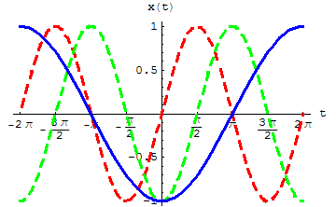
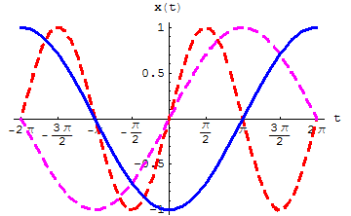
Practice With SHM Equation

