Slide 1
Quantum Chromodynamics (QCD)
Main features of QCD
Confinement
At large distances the effective coupling between quarks is large, resulting in confinement.
Free quarks are not observed in nature.
Asymptotic freedom
At short distances the effective coupling between quarks decreases logarithmically.
Under such conditions quarks and gluons appear to be quasi-free.
(Hidden) chiral symmetry
Connected with the quark masses
When confined quarks have a large dynamical mass - constituent mass
In the small coupling limit (some) quarks have small mass - current mass

Slide 2
Confinement
The strong interaction potential
Compare the potential of the strong & e.m. interaction
Confining term arises due to the self-interaction property of the color field
QED QCD
Charges electric (2) colour (3)
Gauge boson γ (1) g (8)
Charged no yes
Strength
q₁
q₂
a) QED or QCD (r < 1 fm)
r
q₁
q₂
b) QCD (r > 1 fm)

Slide 3
Asymptotic freedom - the coupling “constant”
It is more usual to think of coupling strength rather than charge
and the momentum transfer squared rather than distance.
In both QED and QCD the coupling strength depends on distance.
In QED the coupling strength is given by:
where α = α(Q² → 0) = e²/4π = 1/137
In QCD the coupling strength is given by:
which decreases at large Q² provided n_{f} < 16.
eμ → eμ
Q²»m²
Q² = -q²

Slide 4
Asymptotic freedom - summary
Effect in QCD
Both q-qbar and gluon-gluon loops contribute.
The quark loops produce a screening effect analogous to e⁺e⁻ loops in QED
But the gluon loops dominate and produce an anti-screening effect.
The observed charge (coupling) decreases at very small distances.
The theory is asymptotically free → quark-gluon plasma !
“Superdense Matter: Neutrons or Asymptotically Free Quarks”
J.C. Collins and M.J. Perry, Phys. Rev. Lett. 34 (1975) 1353
Main points
Observed charge is dependent on the distance scale probed.
Electric charge is defined in the long wavelength limit (r → ∞).
In practice α_{em} changes by less than 1% up to 10²⁶ GeV !
In QCD charges can not be separated.
Therefore charge must be defined at some other length scale.
In general α_{s} is strongly varying with distance - can’t be ignored.

Slide 5
Quark deconfinement - medium effects
Debye screening
In bulk media, there is an additional charge screening effect.
At high charge density, n, the short range part of the potential becomes:
and r_{D} is the Debye screening radius.
Effectively, long range interactions (r > r_{D}) are screened.
The Mott transition
In condensed matter, when r < electron binding radius
⇒ an electric insulator becomes conducting.
Debye screening in QCD
Analogously, think of the quark-gluon plasma as a color conductor.
Nucleons (all hadrons) are color singlets (qqq, or qqbar states).
At high (charge) density quarks and gluons become unbound.
⇒ nucleons (hadrons) cease to exist.

Slide 6
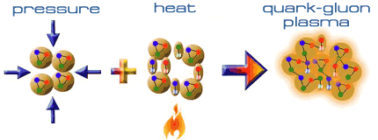
Debye screening in nuclear matter
High (color charge) densities are achieved by
Colliding heaving nuclei, resulting in:
1. Compression.
2. Heating = creation of pions.
Under these conditions:
1. Quarks and gluons become deconfined.
2. Chiral symmetry may be (partially) restored.
Note: a phase transition is not expected in binary nucleon-nucleon collisions.
The temperature inside a heavy ion collision at RHIC can exceed
1000 billion degrees !! (about 10,000 times the temperature of the sun)

Slide 7
Chiral symmetry
Chiral symmetry and the QCD Lagrangian
Chiral symmetry is a exact symmetry only for massless quarks.
In a massless world, quarks are either left or right handed
The QCD Lagrangian is symmetric with respect to left/right handed quarks.
Confinement results in a large dynamical mass - constituent mass.
➔ chiral symmetry is broken (or hidden).
When deconfined, quark current masses are small - current mass.
➔ chiral symmetry is (partially) restored
Example of a hidden symmetry restored at high temperature
Ferromagnetism - the spin-spin interaction is rotationally invariant.
In the sense that any direction is possible the symmetry is still present.
Below the Curie temperature the underlying rotational symmetry is hidden.
Above the Curie temperature the rotational symmetry is restored.

Slide 8
Chiral symmetry explained ?
Chiral symmetry and quark masses ?
a) blue’s velocity > red’s
b) red’s velocity > blue’s
Lab frame
Red’s rest frame
Blue’s handedness changes depending on red’s velocity
Lab frame
Red’s rest frame

Slide 9
Modelling confinement: The MIT bag model
Modelling confinement - MIT bag model
Based on the ideas of Bogolioubov (1967).
Neglecting short range interactions, write the Dirac equation so that the mass of the quarks is small inside the bag (m) and very large outside (M)
Wavefunction vanishes outside the bag if M → ∞
and satisfies a linear boundary condition at the bag surface.
Solutions
Inside the bag, we are left with the free Dirac equation.
The MIT group realized that Bogolioubov’s model violated E-p conservation.
Require an external pressure to balance the internal pressure of the quarks.
The QCD vacuum acquires a finite energy density, B ≈ 60 MeV/fm³.
New boundary condition, total energy must be minimized with respect to the bag radius.
B

Slide 10
Confinement Represented by Bag Model

Slide 11
Bag Model of Hadrons

Slide 12
Comments on Bag Model

Slide 13
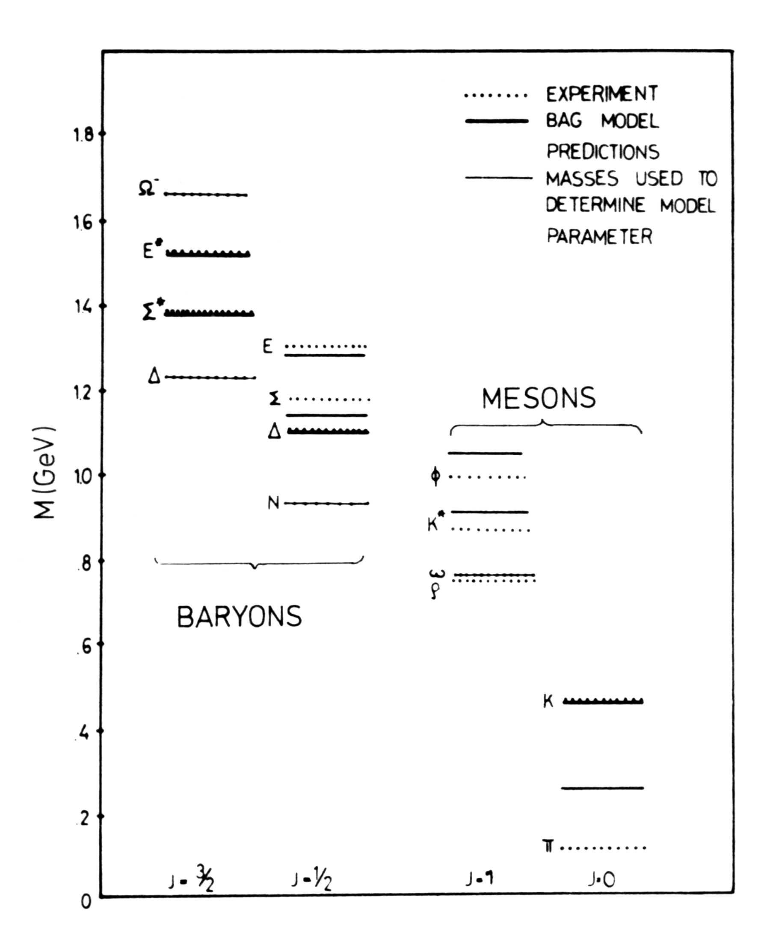
Bag model results
Refinements
Several refinements are needed to reproduce the spectrum of low-lying hadrons
e.g. allow quark interactions
Fix B by fits to several hadrons
Estimates for the bag constant
Values of the bag constant range from B^{1/4} = 145-235 MeV
Results
Shown for B^{1/4} = 145 MeV and α_{s} = 2.2 and m_{s} = 279 MeV
T. deGrand et al, Phys. Rev. D 12 (1975) 2060

Slide 14
Summary of QCD input
QCD is an asymptotically free theory.
In addition, long range forces are screened in a dense medium.
QCD possess a hidden (chiral) symmetry.
Expect one or perhaps two phase transitions connected with deconfinement and partial chiral symmetry restoration.
pQCD calculations can not be used in the confinement limit.
MIT bag model provides a phenomenological description of confinement.

Slide 15
Still open questions in the Standard Model

Slide 16
Chirality: Why Resonances ?
Resonances are:
Excited state of a ground state particle.
With higher mass but same quark content.
Decay strongly → short life time
(~10⁻²³ seconds = few fm/c ),
width = natural spread in energy: Γ = h/t.
Breit-Wigner shape
Broad states with finite Γ and t,
which can be formed by collisions between
the particles into which they decay.
Why Resonances?:
Surrounding nuclear medium may change
resonance properties
Chiral symmetry breaking:
Dropping mass -> width, branching ratio
K*⁻(892)
Number of events
Luis Walter Alvarez
1968 Nobel Prize for
“ resonance particles ”
discovered 1960
0 2 4 6 8 10
640 680 720 760 800 840 880 920
Invariant mass (K⁰+π⁻) [MeV/c²]
K* from K⁻+p collision system
K⁻ + p ◊ Κ^{∗−}+ p
 K⁰ + π⁻
Bubble chamber, Berkeley
M. Alston (L.W. Alvarez) et al., Phys. Rev. Lett. 6 (1961) 300.
Notes:
Let me at first explain what a resonance is.
It is an exited state of a ground state particle with higher mass but same quark content.
It decays strongly with in a short lifetime on the order of a few fm/c which results in a width a natural spread of energy which can be described by at breit-wigner shape.
This resonances can be formed by their decay particles due to their finite width and lifetime.
The first resonance was discovered by Alvarez in 1968 by reconstructing the K*- from a K0 and a negative pion.
The surrounding hot and dense medium change due to Chiral symmetry breaking
Way do we measure resonances in relativistic heavy ion collisions?
The resonance lifetime is on the order of the lifetime of a heavy ion reaction.
The surrounding hot and dense medium change due to Chiral symmetry breaking
the resonance properties.
We expect at higher temperature a dropping of the mass which would result in a with broadening
and branching ratio changing

Slide 17
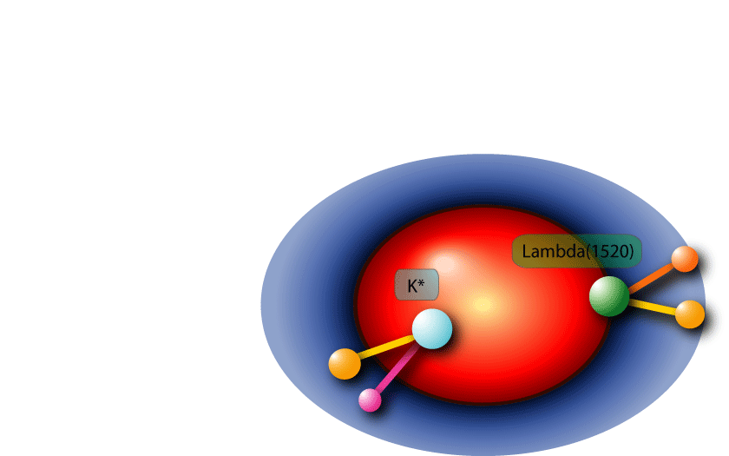
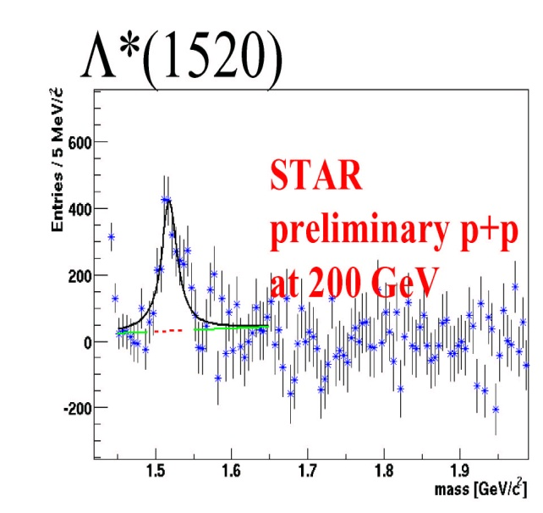

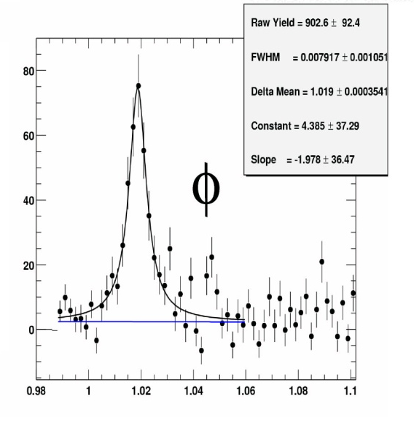
Strange resonances in medium
Short life time [fm/c]
K* < Σ*< Λ(1520) < φ
4 < 6 < 13 < 40
Rescattering vs.
Regeneration ?
Red: before chemical freeze out
Blue: after chemical freeze out
Medium effects on resonance and their decay products before (inelastic) and after chemical freeze out (elastic).

Slide 18
Electromagnetic probes - dileptons
Dilepton production in the QGP
The production rate (and invariant mass distribution) depends on the momentum distribution of q-qbar in the plasma.
Reconstruct the invariant mass, M, of the dilepton pair’s hypothetical parent.
Dilepton production from hadronic mechanisms
1. Drell-Yan high Mass
2. Annihilation and Dalitz decays low Mass
3. Resonance decays discrete
4. Charmed meson decays low Mass
γ∗
l⁺
The momentum distributions f(E₁) and f(E₂) depend on the thermodynamics of the plasma.
The cross-section for the sub-process σ (M) is calculable in pQCD.
q
l⁻

Slide 19
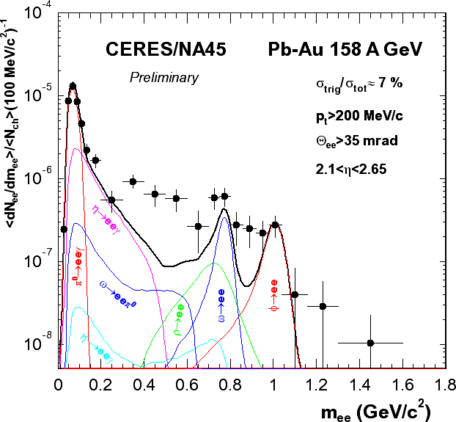
CERES low-mass e⁺e– mass spectrum
Results from the 2000 run Pb+Au at 158 GeV per nucleon
comparison to the hadron decay cocktail
Enhancement over
hadron decay cocktail
for m_{ee} > 0.2 GeV:
2.43±0.21 (stat)
for 0.2 GeV<m_{ee}< 0.6 GeV:
2.8±0.5 (stat)
Absolutely normalized spectrum
Overall systematic uncertainty of
normalization: 21%

Slide 20
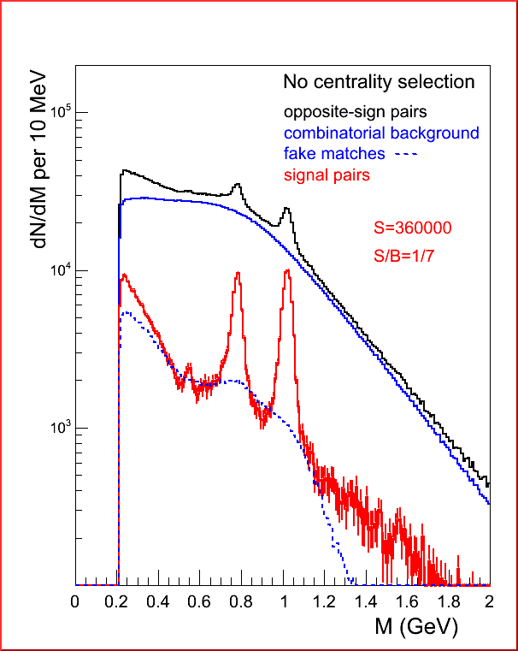
NA60 Low-mass dimuons
Real data !
Mass resolution: 23 MeV at the φ position
ω
φ
η
ω, φ and even η peaks clearly visible in dimuon channel
Net data sample: 360 000 events

Slide 21
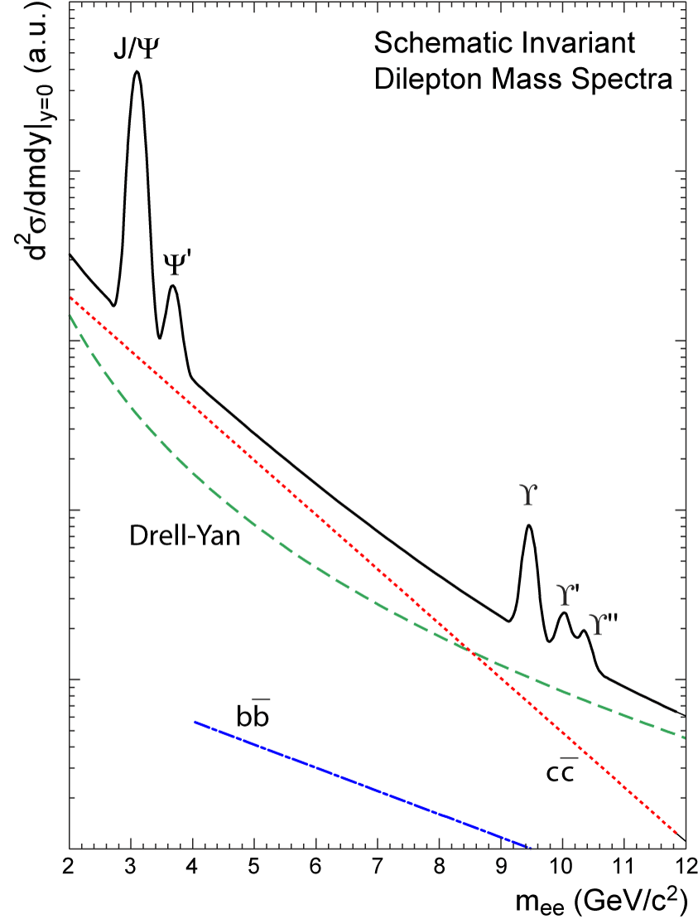
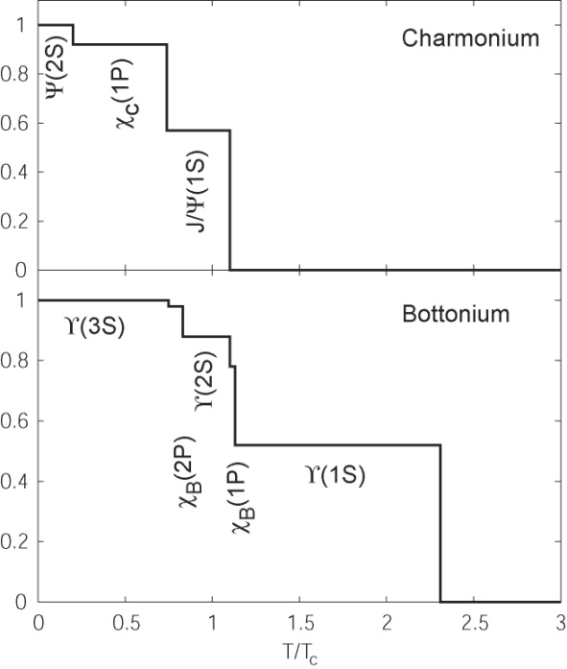
Deconfinement at Initial Temperature
Matsui & Satz (1986): (Phys. Lett. B178 (1986) 416)
Color screening of heavy quarks in QGP leads to heavy resonance dissociation.
Melting at SPS
Thermometer for early stages:
T_{dis}(Ψ(2S)) < T_{dis}(ϒ(3S))< T_{dis}(J/Ψ) ≈ T_{dis}(ϒ(2S)) < T_{dis}(ϒ(1S))
RHIC
√s = 200 GeV
Total bottom / charm production
Decay modes:
χ_{c} → J/Ψ + γ
χ_{b} → ϒ + γ
Lattice QCD:
SPS T_{I} ~ 1.3 Tc
RHIC T_{I} ~ 2 Tc
The suppression of heavy quark states signature of deconfinement at QGP.
J/Ψ (cc-bar) ◊ e⁺ +e⁻, μ⁺ + μ⁻
ϒ (bb-bar) → e⁺ +e⁻, μ⁺ + μ⁻
Notes:
The initial temperature of a heavy ion collision can be determined by the melting of heavy resonance states in the medium by their dissociation temperature in a dense medium.
We know that this heavy particles can only produced that the first interactions of the heavy ion collision.
The left plot shows the schematic invariant mass dilepton spectrum for J/si , si-prime and the Ypsilon, and Ypsilon resonance states.
We know from SPS energies that the J/si is melting.
Here I show an temperature ordering of the melting of the different states and the corresponding temperatures. If the initial temperature is at RHIC higher that 2.5 times
The critical temperature we would expect the mating if the Ypsilon prime.
This measurements require a high resolution lepton measurement with good particle identification

Slide 22
J/ψ suppression
Charmonium production
The J/ψ is a c-cbar bound state (analogous to positronium)
Produced only during the initial stages of the collision
Thermal production is negligible due to the large c quark mass
Charmonium suppression (Debye screening)
Semi-classically (E = T + V)
Differentiate with respect to r to find minimum (bound state)
Find there is no bound state if
For α_{s} = 0.52 and T = 200 MeV, r_{D}(pQCD) = 0.36 fm
Compare with r_{Bohr} = 0.41 fm (setting r_{D}→ ∞ above)
Conclusion: the J/ψ is not bound in the plasma under these conditions

Slide 23
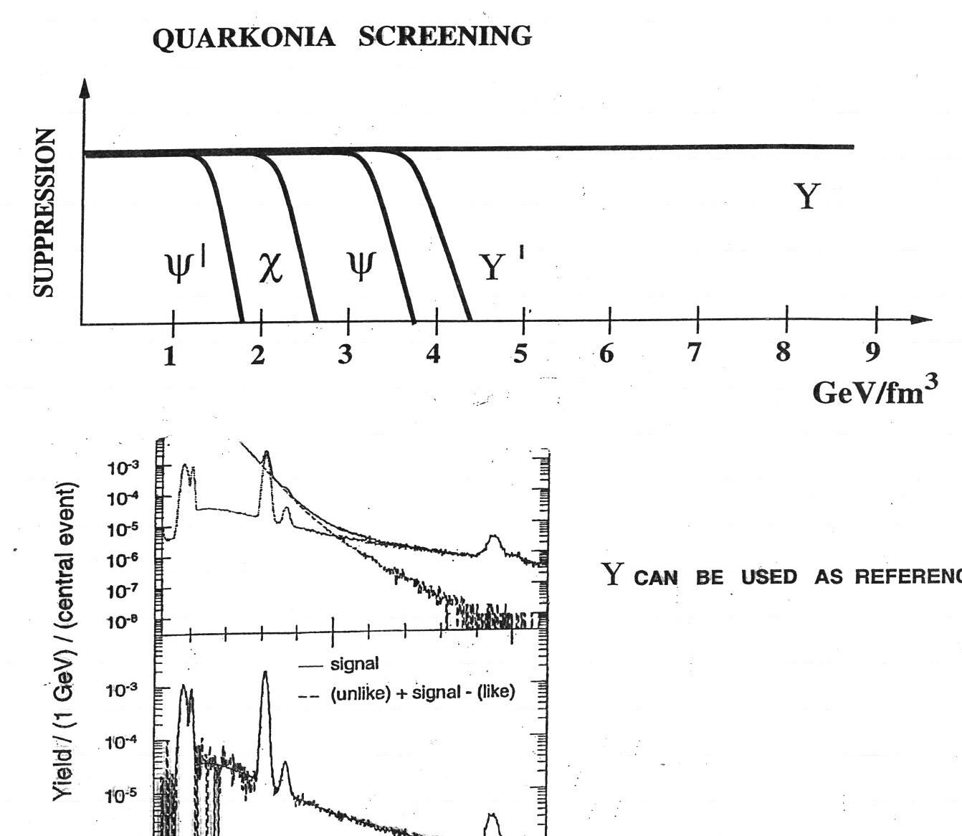
Onium physics – the complete program
Melting of quarkonium states (Deconfinement T_{C})
T_{diss}(Ψ’) < T_{diss}(ϒ(3S)) < T_{diss}(J/Ψ) ≈ T_{diss}(ϒ(2S)) < T_{diss}(ϒ(1S))

Slide 24
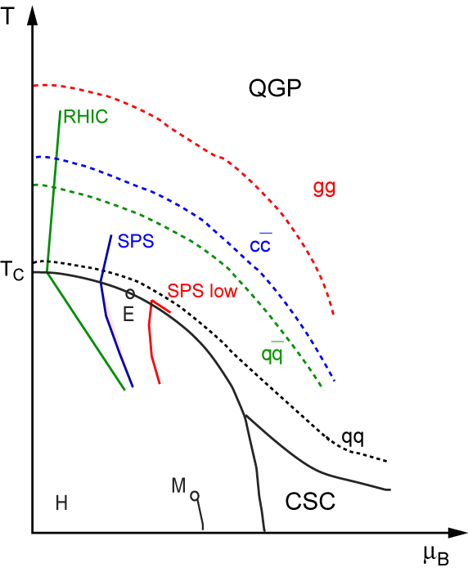
Future Measurements: Resonance Response to Medium
Temperature
Resonances below and above Tc:
Gluonic bound states
(e.g. Glueballs) Shuryak hep-ph/0405066
Deconfinement: Determine range of T initial.
J/ψ and ϒ state dissociation
Chiral symmetry restoration
Mass and width of resonances
( e.g. φ leptonic vs hadronic decay,
chiral partners ρ and a₁)
Hadronic time evolution
Hadronisation (chemical freeze-out)
till kinetic freeze-out.
Shuryak QM04
partons
Quark Gluon Plasma
hadrons
Hadron Gas
Baryochemical potential (Density)
Notes:
Here are some ideas how resonances, bound states and quasiparticle can help to determine the QGP equation of state
One of the more surprising results of our studies was the strong coupling. Here is one possible explanation for the coupling
By Shuryak. He postulates that just above the critical temperature the system does not consist of free mass less partons
but rather of partonic bound states, which dissolve, or melt, at higher temperatures. The longest lived bound states are the
Gluonic bound states. Their interactions could explain the unexpected strong coupling. Some of the states might be color neutral and therefore
measurable as heavy mass resonant states.
The melting of the Charm and Bottom resonances can also be used to measure the initial temperature
And chiral symmetry restoration can be tested through resonance measurements of chiral partners, i.e. resonances of
different mass but with the same quark content at Tc. Let me explain these three resonance measurements in a little
more detail.

Slide 25
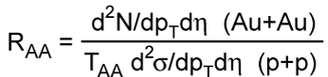
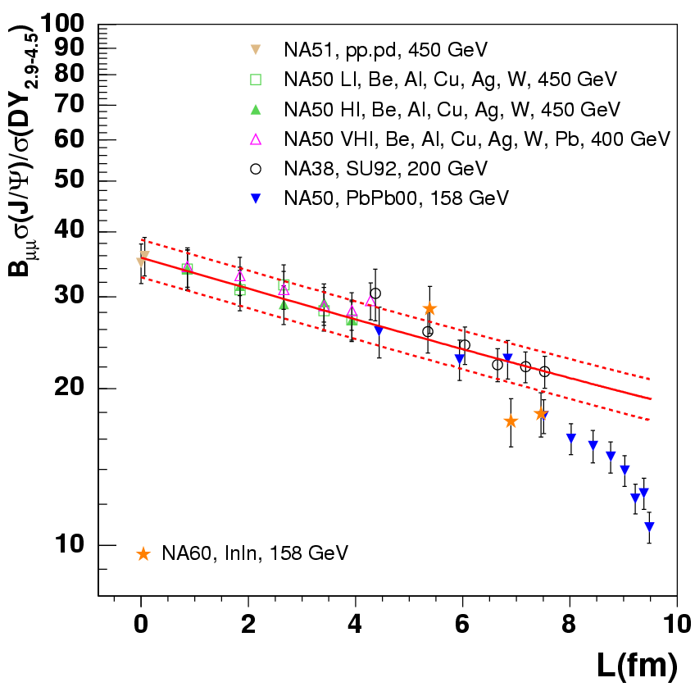
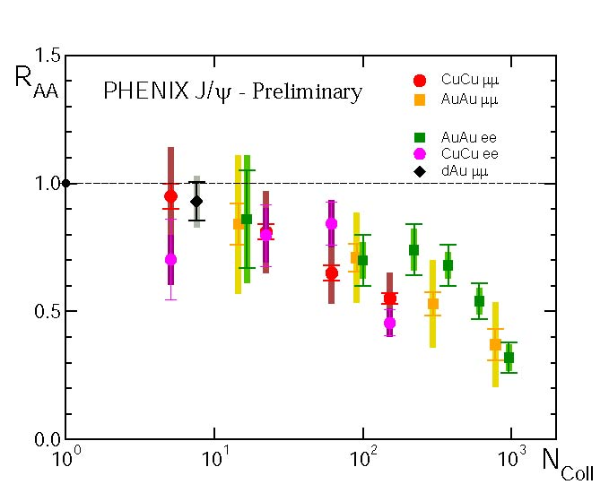
Deconfinement: Melting of J/Ψ
SPS
RHIC
J/Ψ normal nuclear
absorption curve
Interaction length
Projectile
cent | ⟨N_{part}⟩ | ⟨N_{coll}⟩
0−10% | 339 | 1049
10−20% | 222 | 590
40-50% | 64 | 108
60−70% | 20 | 22
80−100% | 2.8 | 2.2
J/ψ suppression at SPS and RHIC are the same
Strong signal for deconfinement in QGP phase
RHIC has higher initial temperature
→ Expect stronger J/ψ suppression
→ Partonic recombination of J/ψ
J/ψ
L
Target

Slide 26
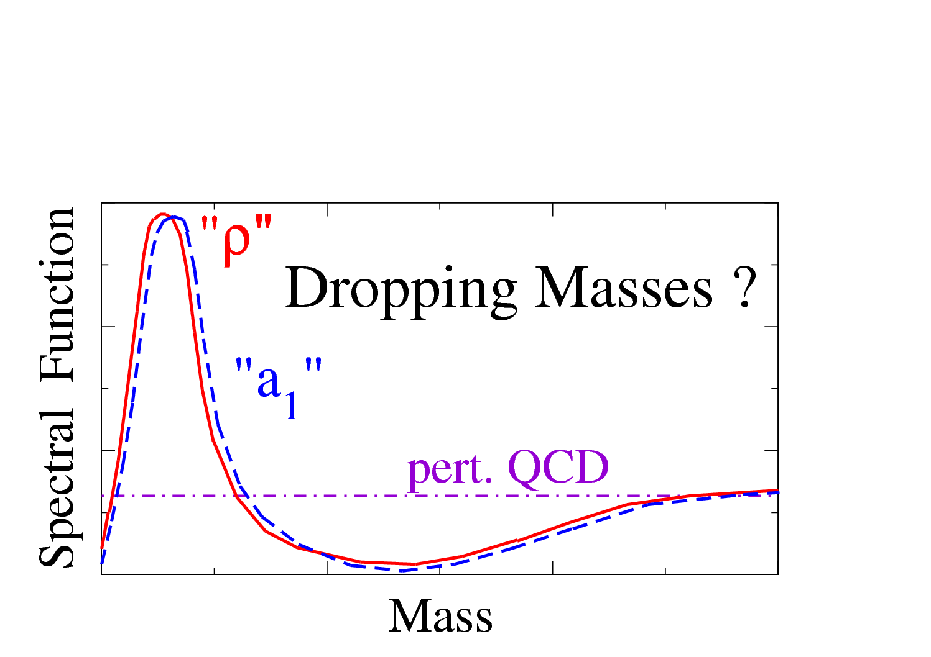
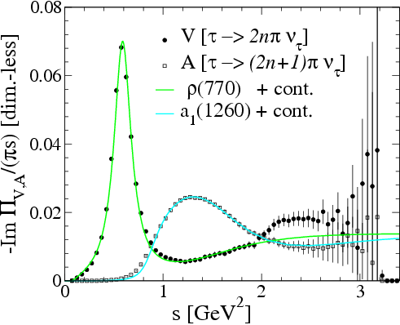
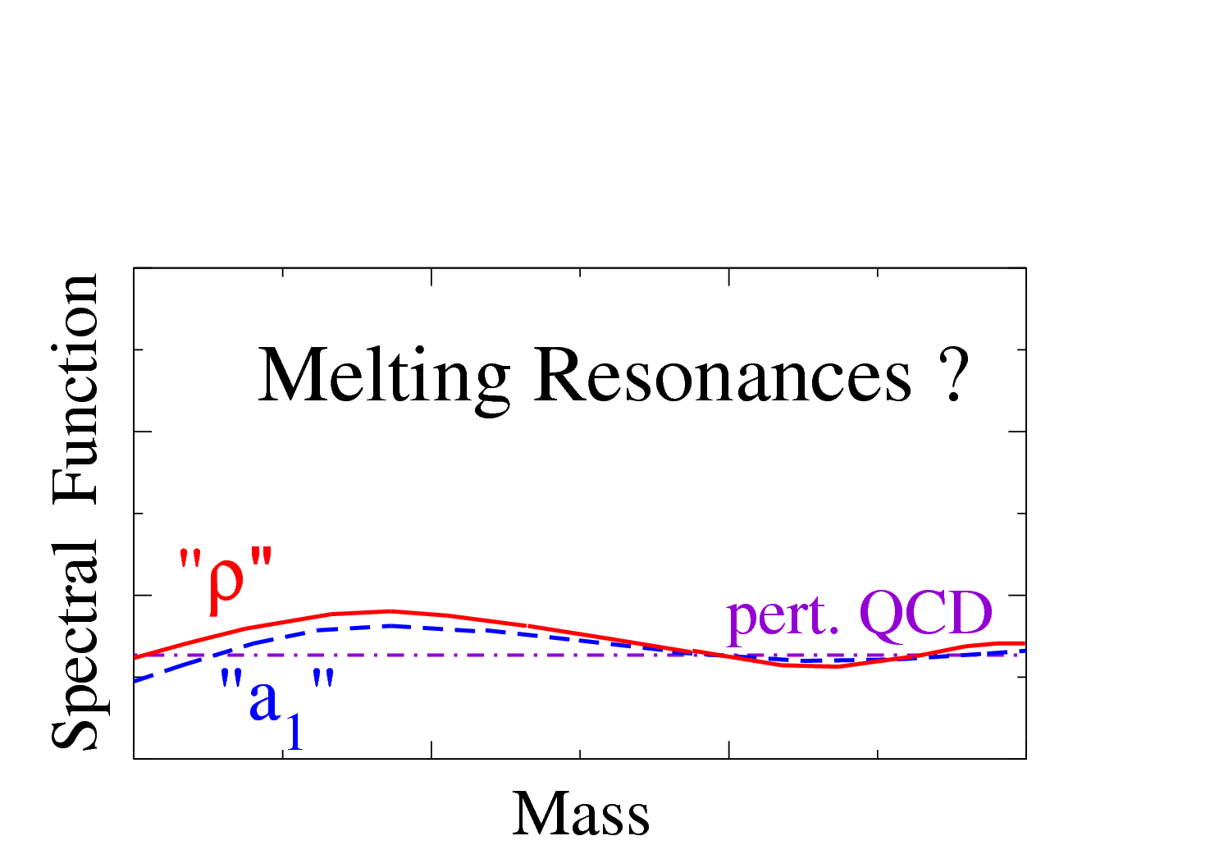
Chiral Symmetry Restoration
Vacuum
At T_{c}: Chiral Restoration
Data: ALEPH Collaboration
R. Barate et al. Eur. Phys. J. C4 409 (1998)
Measure chiral partners
Near critical temperature Tc
(e.g. ρ and a₁)
a₁ → ρ + π
Ralf Rapp (Texas A&M)
J.Phys. G31 (2005) S217-S230
Notes:
If the chiral symmetry is restored at Tc we would expect for the chiral partners which have the same quark content but different masses in vacuum, the same mass and width in medium.
Here are the two scenarios of a spectral function of the rho and a1 in medium.

Slide 27
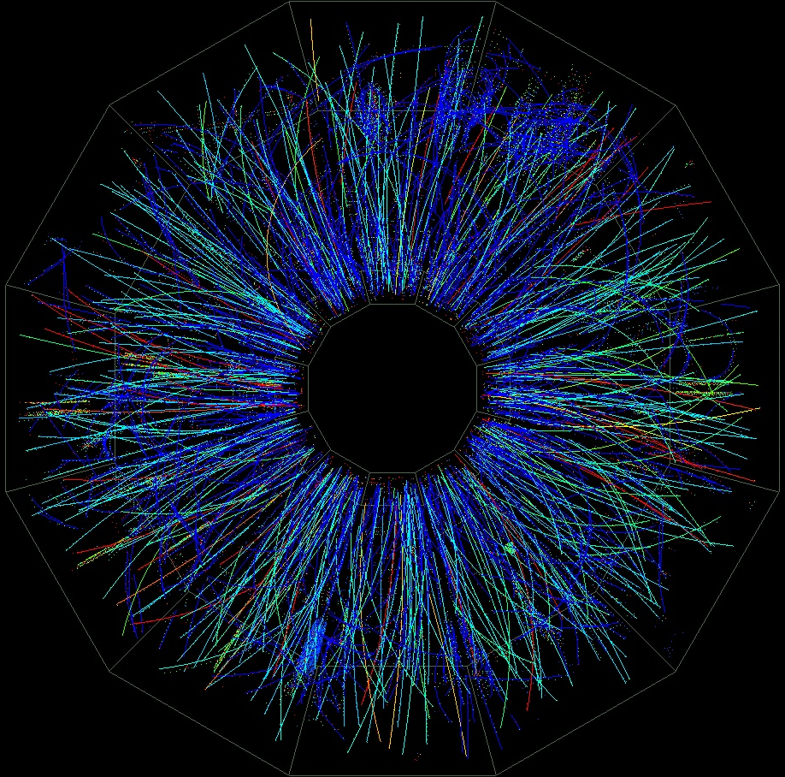
Resonance Reconstruction in STAR
End view STAR TPC
Energy loss in TPC dE/dx
K-
p
p
dE/dx
K
Λ(1520)
π
Σ(1385)
Λ
e
π-
p
momentum [GeV/c]
π-
Identify decay candidates
(p, dedx, E)
Calculate invariant mass
K(892) → π + K
φ (1020) → K + K
Λ(1520) → p + K
Σ(1385) → Λ + π
Ξ(1530) → Ξ + π

Slide 28
Invariant Mass Reconstruction in p+p
Invariant mass:
Λ(1520)
STAR Preliminary
— original invariant mass histogram
from K⁻ and p combinations
in same event.
— normalized mixed event histogram
from K⁻ and p combinations
from different events.
(rotating and like-sign background)
Extracting signal:
After Subtraction of mixed event background from original event and fitting signal (Breit-Wigner).
Λ(1520)

Slide 29
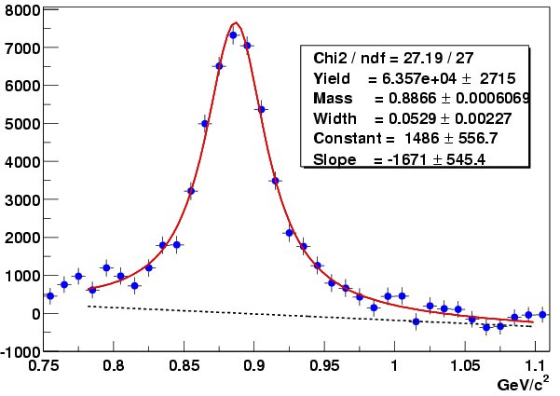
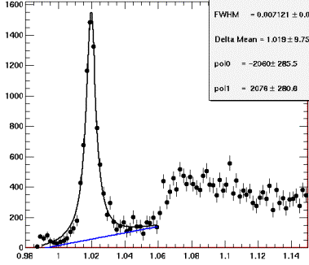
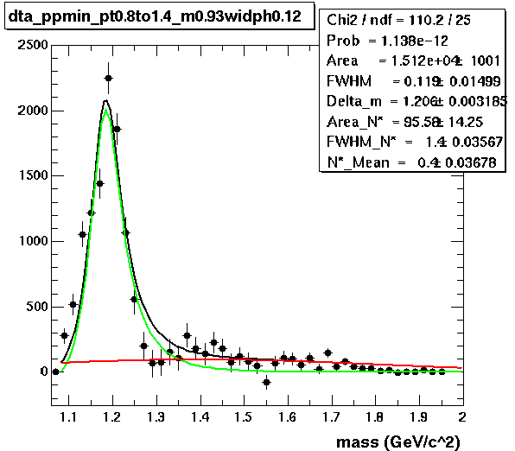
Resonance Signal in p+p collisions
STAR Preliminary
STAR Preliminary
p+p
K(892)
Φ→K⁺K⁻
Statistical error only
STAR Preliminary
Ξ
STAR Preliminary
Σ(1385)
Δ⁺⁺
p+p
Invariant Mass (GeV/c²)

Slide 30
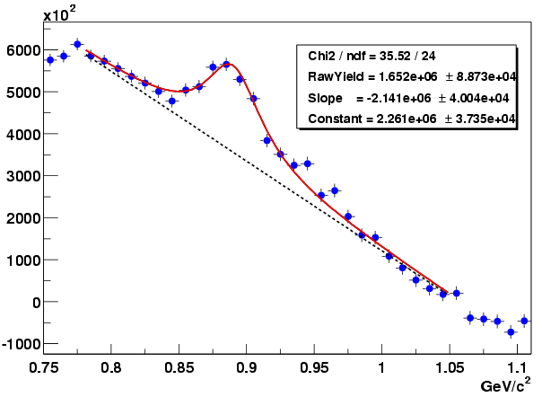
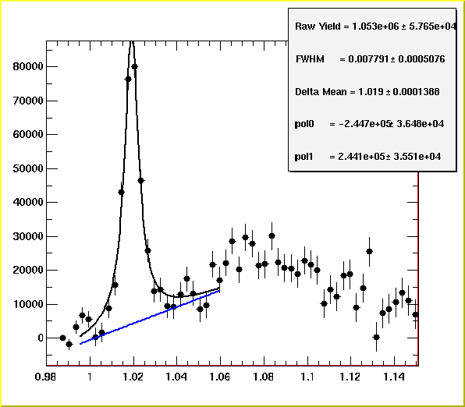
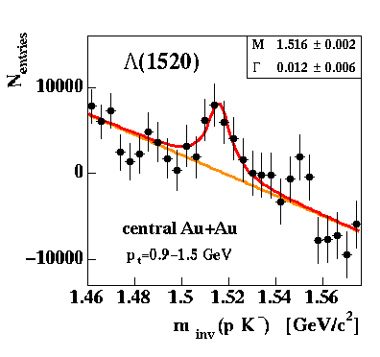
Resonance Signal in Au+Au collisions
STAR Preliminary
Ξ+‾Ξ
K(892)
K^{*0} + K^{*0}
Σ*± +‾Σ*±
Au+Au minimum bias
p_{T} ≥ 0.2 GeV/c
|y| ≤ 0.5
Λ(1520)
STAR Preliminary
STAR Preliminary
φ(1020)

Slide 31
Estimating the critical parameters, T_{c} and ε_{c}
Mapping out the Nuclear Matter Phase Diagram
Perturbation theory highly successful in applications of QED.
In QCD, perturbation theory is only applicable for very hard processes.
Two solutions:
1. Phenomenological models
2. Lattice QCD calculations

