Slide 1
Lecture 9

Slide 2
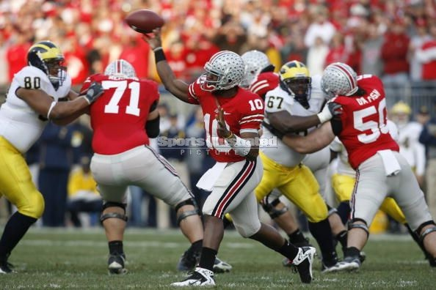
Projectile motion - 2D motion only considering gravity (for now)
Once it’s in the air, the acceleration vector points straight
down → only vertical component of velocity can change
v_{0x} = 100 ft/s
a_{x} = 0
a_{y} = -9.8 m/s²
a_{x} = 0
a_{y} = -9.8 m/s²
a_{x} = 0
a_{y} = -9.8 m/s²
The most difficult concept to absorb is the one that makes the analysis of this motion so simple:
The horizontal component of motion is independent of the vertical component
these are not new equations!
They are just the ones discussed in Chapter 2 using a_{x}=0 and a_{y} = -g
Draw the velocity vector of the football shown above, one second (1 s) after it’s thrown:

Slide 3
Compare: dropping straight down versus leaping horizontally at 4 m/s
0
5
10
0
-5
-10
dropped
Leaping horizontally
-15
t | x | y
0 | 0 | 0
.5
1
1.5
2
t | x | y
0 | 0 | 0
.5
1
1.5
2
-20
Notes:
do it. calculate numbers and tabulate them. and then plot them.
first do the falling one. note how the spacing grows between time intervals (this is a reminder)
Also, emphasize that in both cases, vy0 = 0
Note there is a video on this page.
At bottom, video AND live demo.
In fact, can do a demo of this “live”

Slide 4
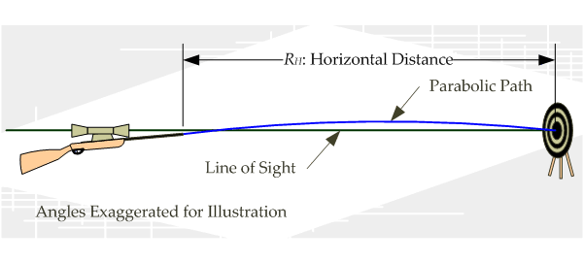
Example 4.1 of text

Slide 5
easy shot?
Players get an intuitive feel for how hard to toss a ball upward for little floaters.
How does this relate to a vertical toss when standing still?
A player lobs a ball straight up (relative to herself) at 10 mph, from an
initial height of 7 feet. She is running towards the hoop at 5 mph.
If she releases the ball 8.2 feet from the hoop,
will she make the shot?
(see also “Analysis of a vertical jump” in Ch 2)
Notes:
VIDEO on this slide. Moving car shoots a ball straight up.
Can also do a demo of this.
Make the point: v0y determines height. v0x is irrelevant
Also, draw picture of parabolic motion with arrows for velocity at various points. Vy changes. Vx doesn’t
Also: at top, vy=0.
vy changes

Slide 6
Range
From the shotput to golf to football punts, one is often interested in the range of a projectile– i.e. the distance it will travel before it hits ground
For the moment, we’ll discuss the case where the initial and final heights of the ball are the same.
If we know the initial velocity components, we can find its range...
Start with the vertical (y) component Remember the “useful formula” from Ch 2
If v_{0,y} = 80 ft/sec and v_{0,x} = 0, (i.e. straight up) how long is the ball in the air?
Now, what if v_{0,x} = 10 ft/sec?
Any ball launched with v_{0y}=80 ft/s will be in the air for 5 sec!
Now the horizontal (x) component.
This is even easier, since v_{x} is constant
Δx = v_{x} Δt , or in this case...
Notes:
This example really shows how x- and y-components are independent.
Ask them: what angle do they THINK it is kicked at? - this is actually a VERY easy analysis that they can actually do. (Could they have done this before? No. Try to impress this on them.)

Slide 7
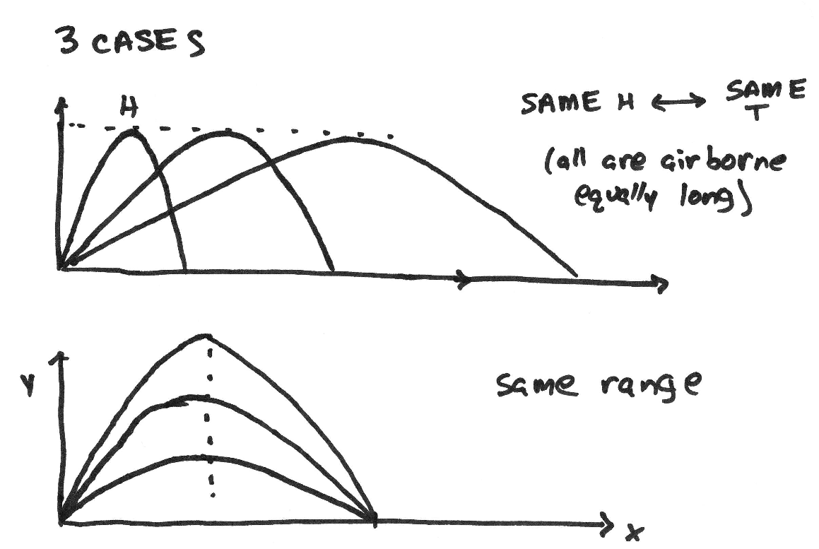
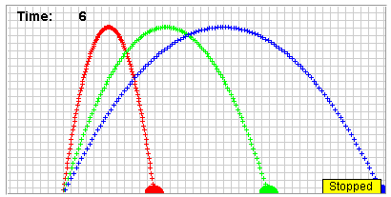
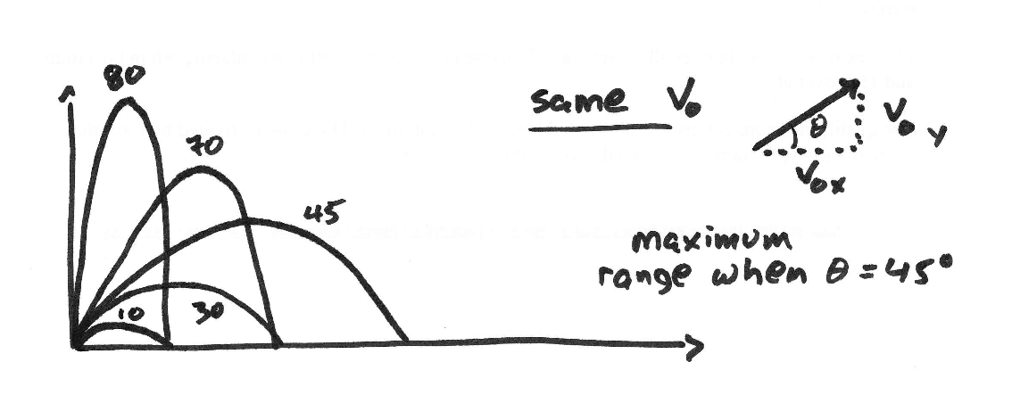
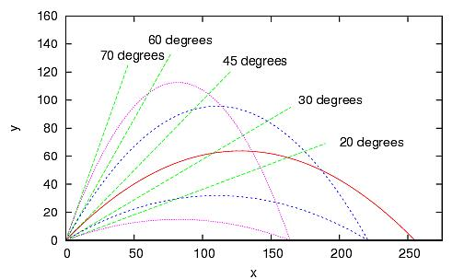
Range of a projectile
Notes:
VIDEO on this page

Slide 8
A Good Punt
What makes a “good punt?”
huge hangtime?
maximum range?
anything else?
A good kicker can launch the ball at about 81 ft/sec. Considering the trajectories from the previous page, what is a good launch angle?
angle too large: lots of hang time, but little range– receiver calls fair catch, with good yardage max hangtime:
angle small (but not too small): good range, but receiving team has good opportunity to set up a return max range:
one reasonable strategy: have the punting team’s players reach the receiver just at the moment that the ball does.
A fit player averages about 9 yards/sec at full run down the field.
What is the launch angle, if the ball moves down the field at the same speed?
What is the hang-time?
How far down the field will the ball come down?
see textbook fig 4.3
Notes:
Show figure 4.3 of textbook.

Slide 9
Marquette King
[Show King Video]
Launch:
25 Yard Line
time stamp: 0:58.32
Apex:
Height: 32 yards
time stamp: 1:00.80
Landing:
-8 Yard Line
time stamp: 1:03.30
Range = 25 + 58 = 83 yards
Hang = 63.30 – 58.32 = 4.98 sec
Notes:
Marquette King --- Punter for Oakland Raiders. Only african-american punter in NFL.
In 2013 season: 84 punts, average 48.9 yards per punt.

Slide 10
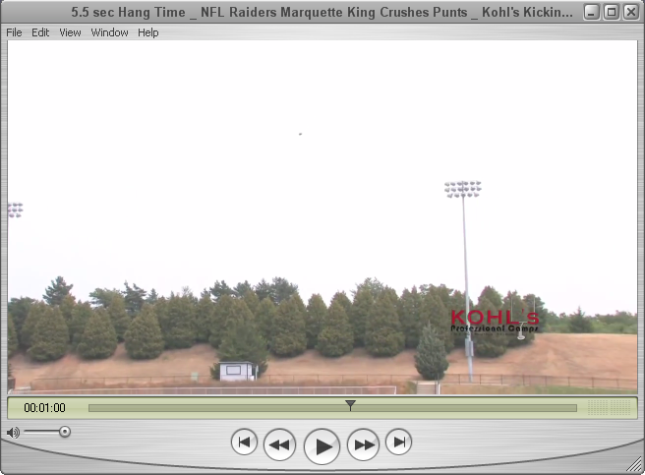
Height = 30 + 2 yards = 32 yards
6 yards above
Light Post
4 yards above
30 yards
20 yards

Slide 11
Punt, continued
draw the velocity, find the launch speed and launch angle
Marquette King practicing punts for the Raiders
How high does the punt go?
Notes:
practice with drawing, and finding what direction this thing goes. going thru the visualization is useful, I think. also, convert the launch speed to mph

Slide 12
Lecture 10

Slide 13
Example - fastball
[Show Fastball Video]
How far does a pitch drop on its way to the batter, if thrown horizontally at 105 mph?
(Note: assume pitcher “stretches” and releases ball 1.5 m forward of the rubber.)
compare:
eye-blink ~ 200 ms (0.2 s)
bat-swing ~ 150 ms
Notes:
95 mph = 41.85 m/s
delta-t = delta-x/v = (18.4 m)/(41.85 m/s) = 0.44 s
-----
delta-y = 0.5*g*delta-t^2 = 0.95 m = 3.1 feet (!!!)
I also have this slide (scanned pdf file and also at the end of this powerpoint) of the figure from Bob Adair on “looking, thinking, acting” – how the time of flight is spent by the batter (e.g. he might as well close his eyes for the second half of the flight)

Slide 14
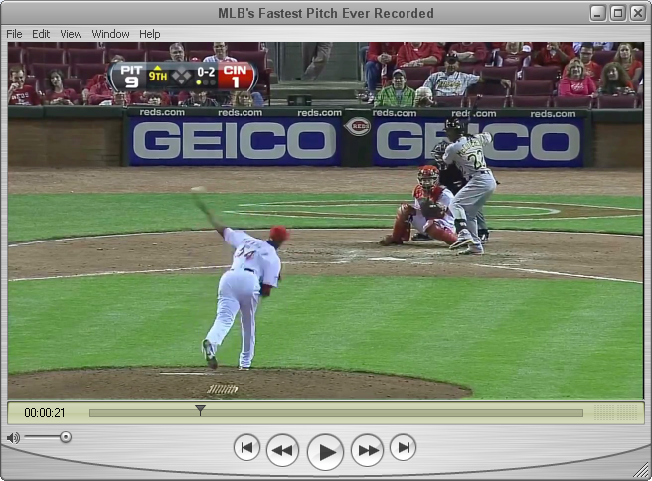
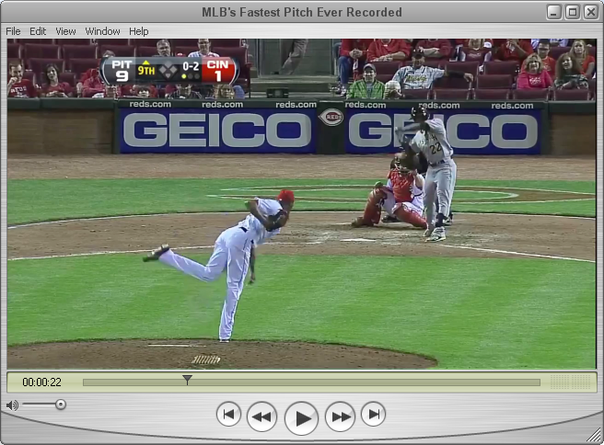
Time stamp: 0:21.77
Time stamp: 0:22.13

Slide 15
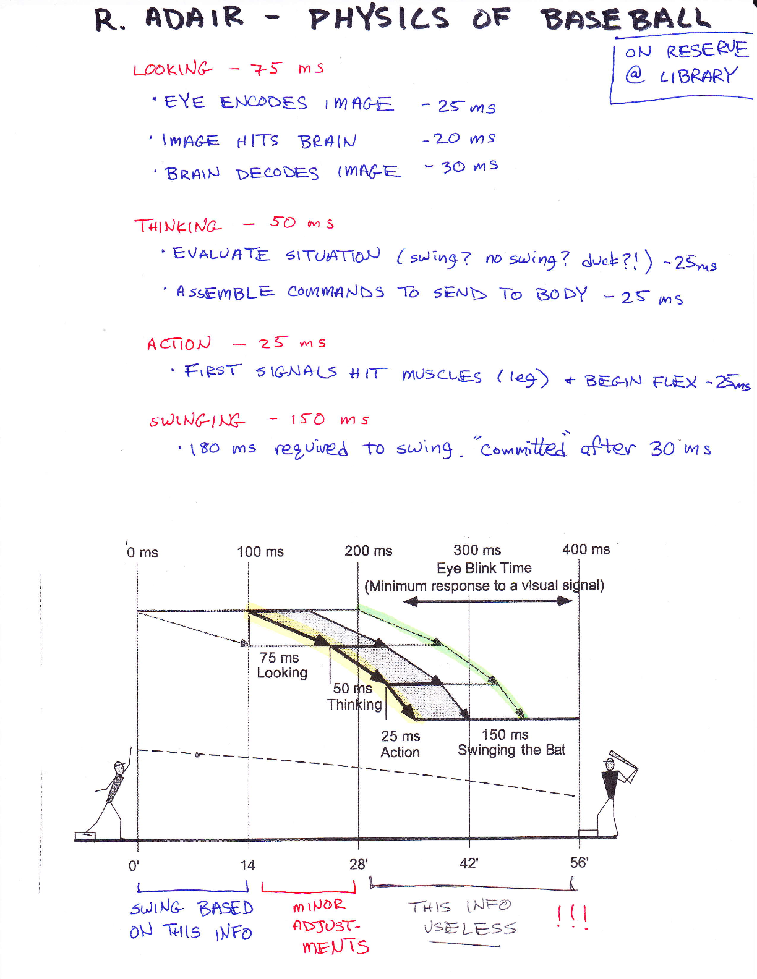

Slide 16
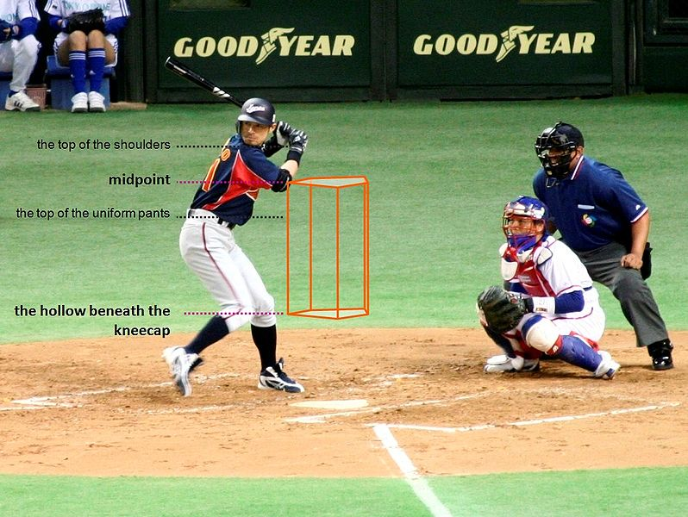
Example – fastball, cont’d
So, the ball will drop 2.5’ by the time it hits the plate.
How far has it dropped when half-way there?
76” = 6’ 4”
(= 1.93 m)
5’6” (for me)
6’ 4” = 6.33 ft. A drop of 2.5 ft (previous page) means crosses 3.8 feet above plate
→ in strike zone.
10”
90 mph versus 93 mph
~ 50 cm (~20”) in horizontal
~ 8 cm (~3”) in vertical
[compare max bat diameter 2.75”]
3% change in speed important!
Note: all pitches drop by an equal amount. Why?
similar to figure 4.4
in Adair’s “Physics of Baseball”
Snapshot of three pitches
at t=400 ms
Prof. Cebra’s strike zone
21”-50” (0.53-1.27 m)
Notes:
so, the 10” matters!
Also, 3% change in velocity means signif differences in where the ball comes across the plate! And the batter has to time it perfectly.
The cross-section of the bat is 2.75” which means one could swing and miss BOTH the 90 mph AND the 93 mph balls, being too high for the former and too low for the latter.

Slide 17
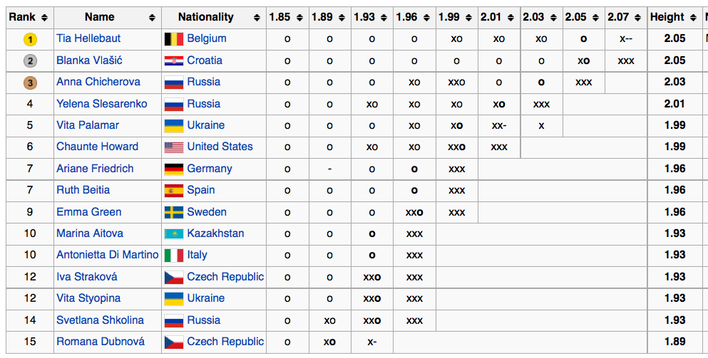
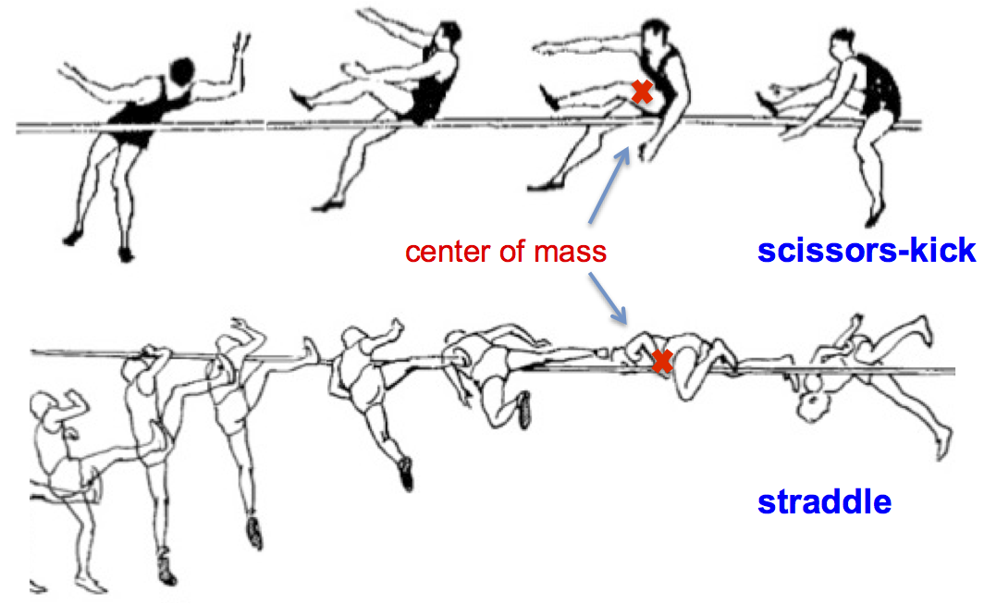
Flopping – extreme positions to “cheat” gravity
hurdle
scissor-kick
straddle
Fosbury flop
Notes:
answer to top question: YES! Foam pad!! Without that, you don’t want to flop! (or else... you want to do real well on your FIRST jump, because you won’t get another one)
look at fosbury picture. he is HIGH! (so many pics only show close-up)
But... look at his FORM. he’s doing the flop, but today’s athletes do it much more extreme!
then, of course, my videos. showing c.m. passes UNDER bar.
also show book figure 4.7

Slide 18
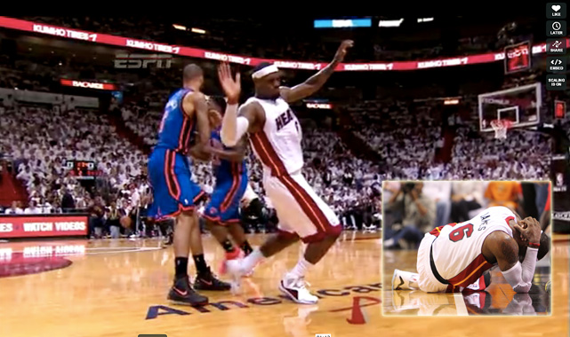
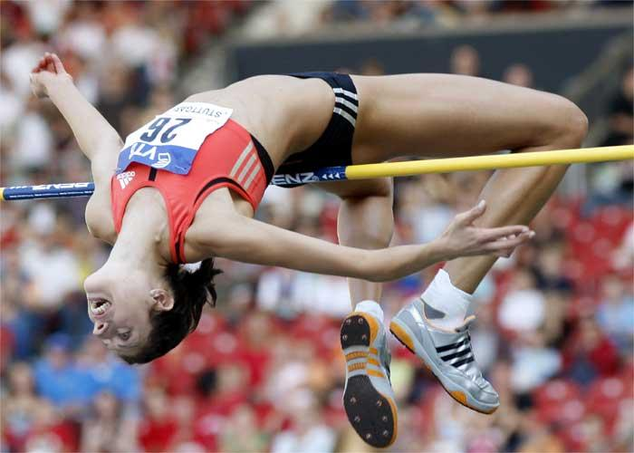
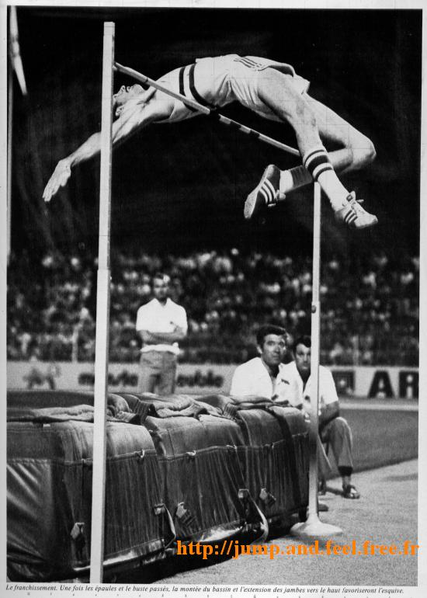
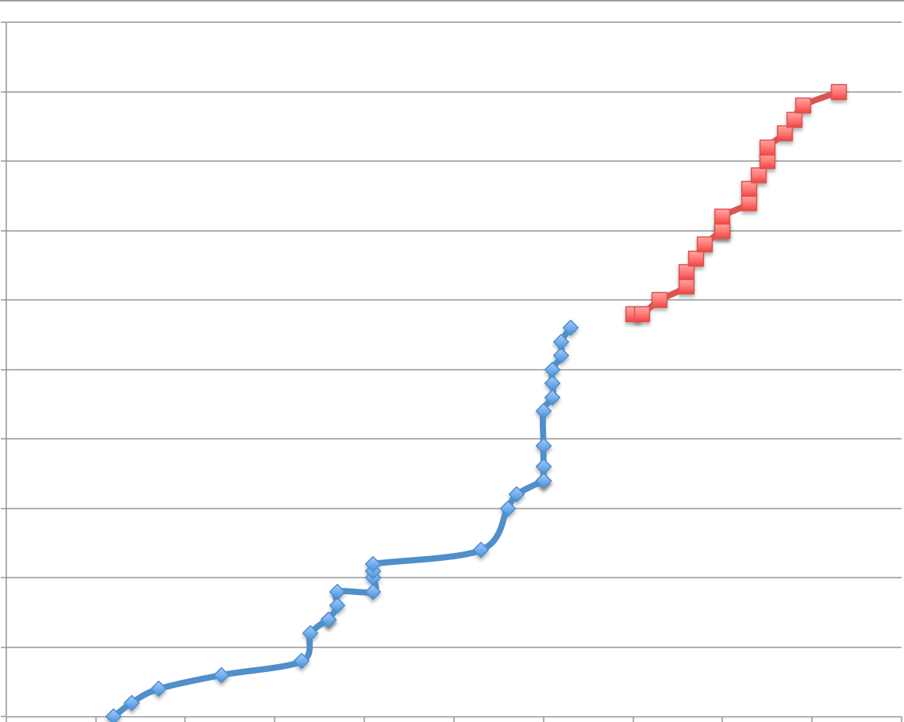
Flopping – extreme positions to “cheat” gravity
Bad flop
Good flop
S.I. Great Moments in NBA Flopping
Blanka Vlasic 2008
2.5
2.4
record height (m)
2.3
2.2
2.1
2.0
1900
1920
1940
1960
1980
2000
Dick Fosbury - 1968
Notes:
answer to top question: YES! Foam pad!! Without that, you don’t want to flop! (or else... you want to do real well on your FIRST jump, because you won’t get another one)
look at fosbury picture. he is HIGH! (so many pics only show close-up)
But... look at his FORM. he’s doing the flop, but today’s athletes do it much more extreme!
then, of course, my videos. showing c.m. passes UNDER bar.
also show book figure 4.7

Slide 19
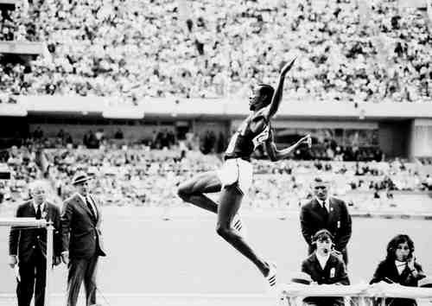
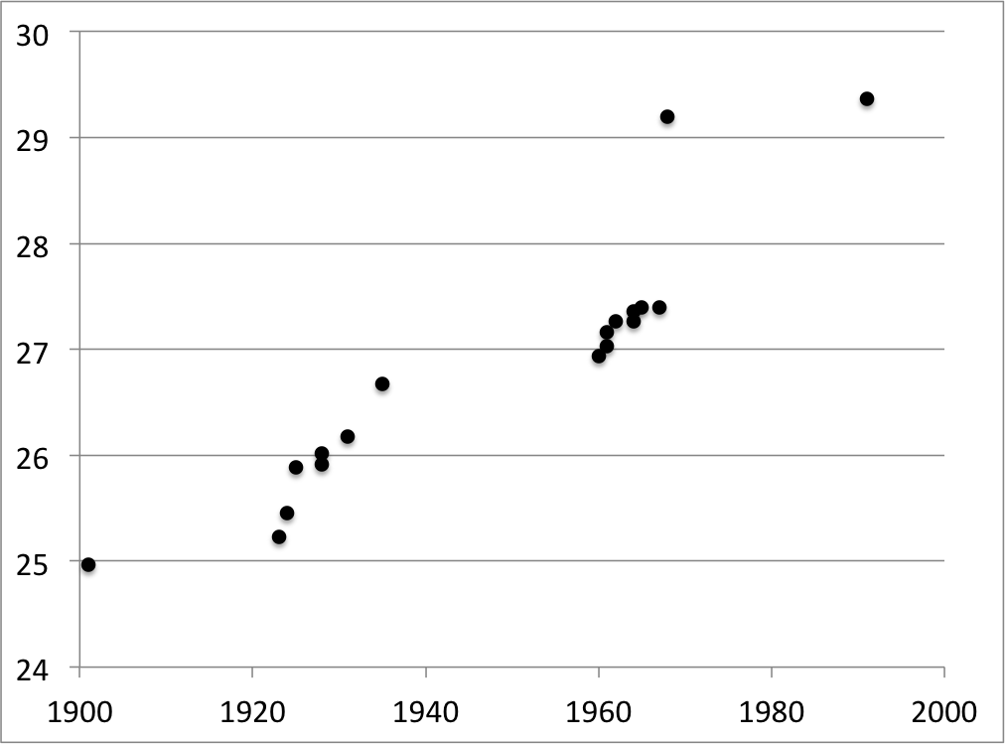
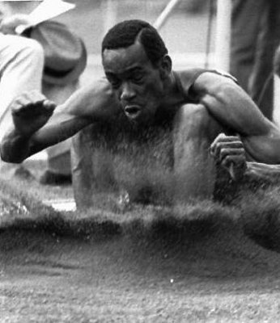
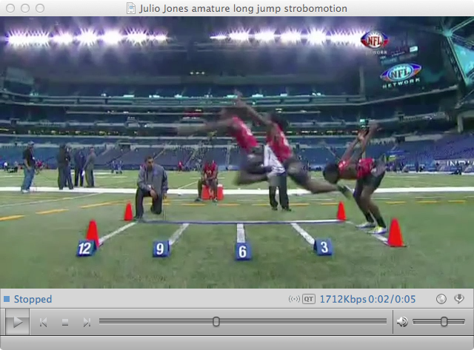
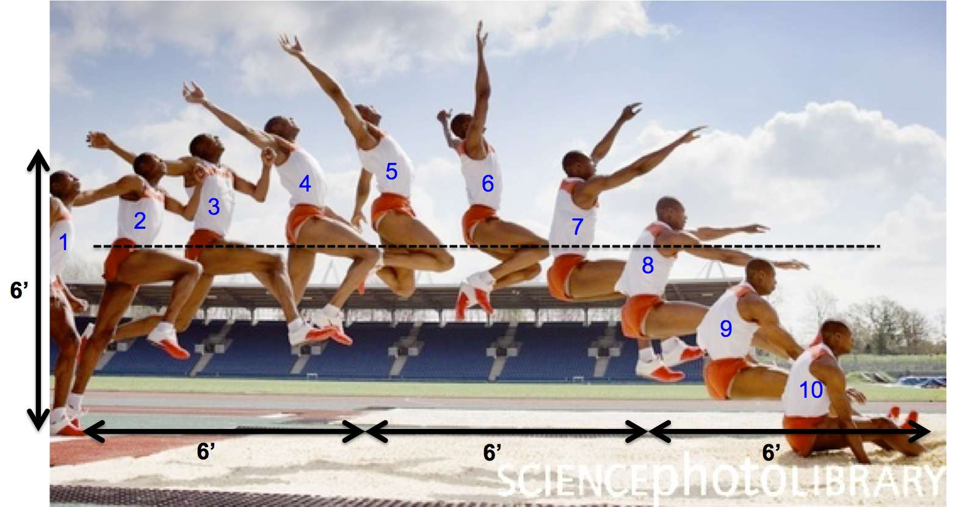
More body contortions: Long jump
In the 1968 Olympics in Mexico, Bob Beamon became the first man in history to break the 29’ mark. As a matter of fact, he was the first to break the 28’ mark! In addition to his amazing speed and strength, technique has a lot to do with it.
Bob Beamon
1968: 29’2.4”
Mike Powell
1991: 29’4.3”
record (ft)
video: Bob Beamon
1967: 27’4.8”
1935: 26’7.6”
in previous 32 years: gain of 9.2”
an amazing landing

Slide 20
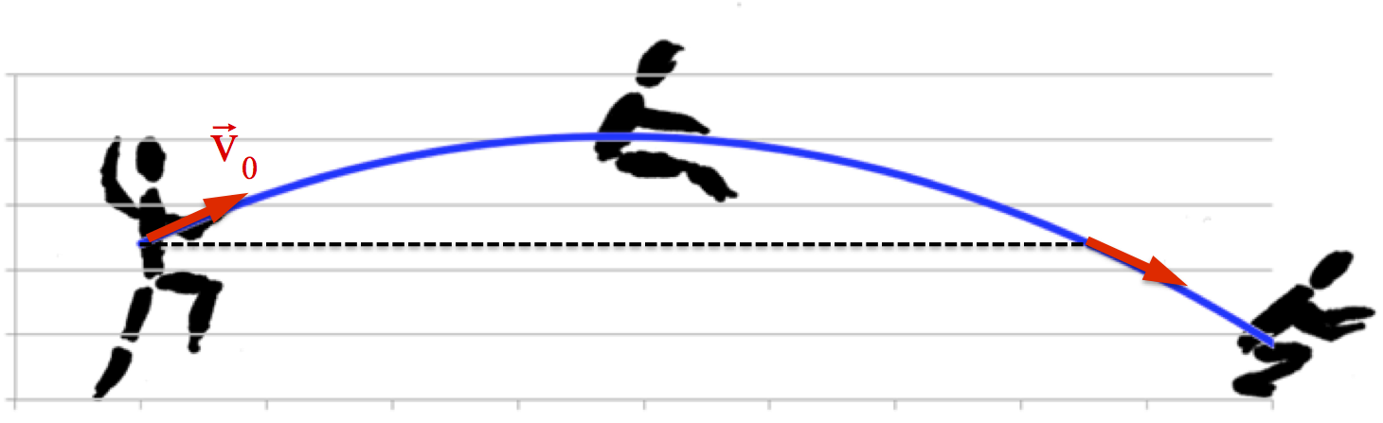
Bob Beamon’s jump, in numbers
What is Beamon’s launch velocity?

Slide 21
Bob Beamon’s jump, in numbers
What does the Range Equation say?
How much “extra time” is Beamon in the air?
How much “extra distance” does that give him?

