Slide 1
Lecture 16

Slide 2
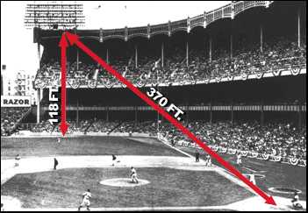
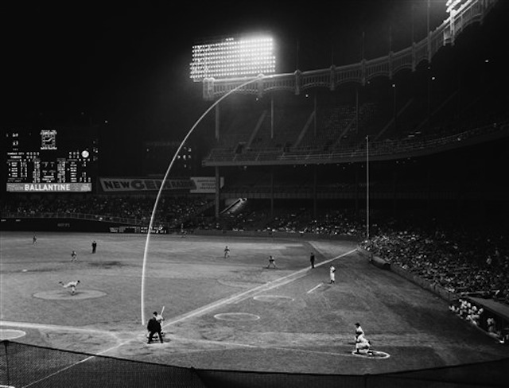
Mickey said "the hardest ball I ever hit" came in the 11th inning on May 22, 1963 at Yankee Stadium. Leading off in the bottom of the 11th, with the score tied 7-7, A's pitcher Bill Fischer tried to blow a fastball past Mickey.
734 feet ?

Slide 3
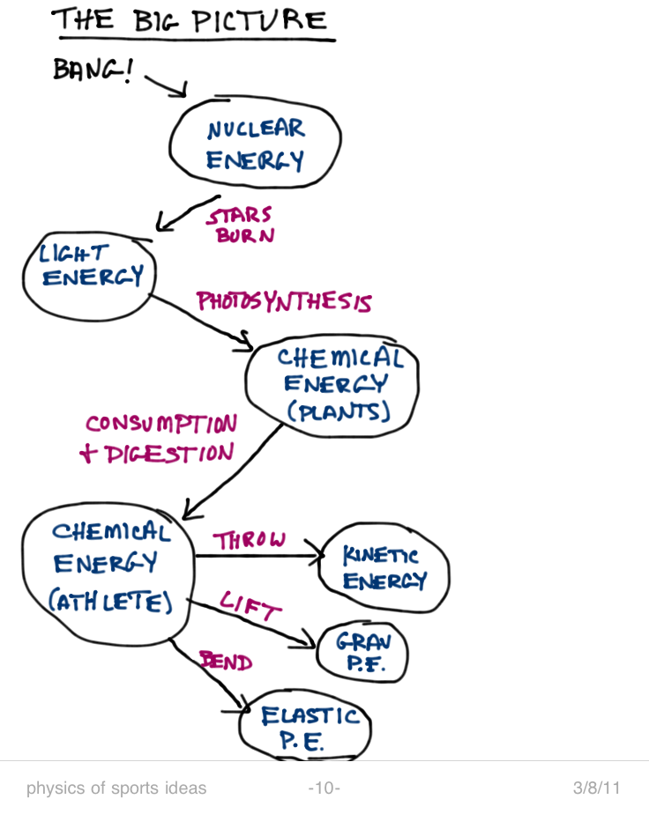
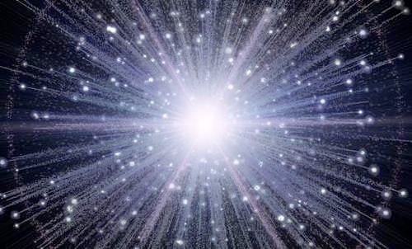

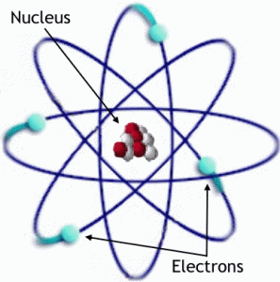
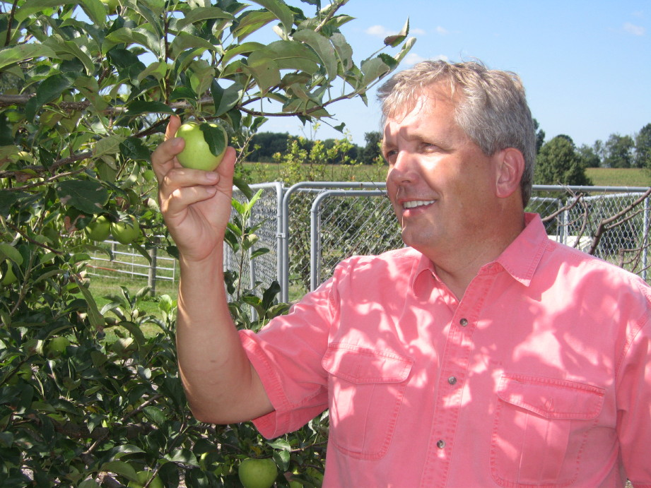
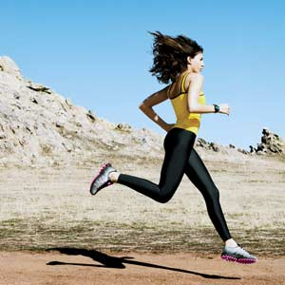
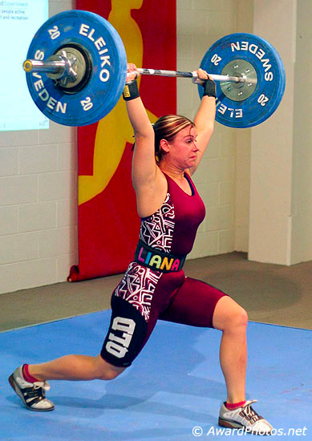
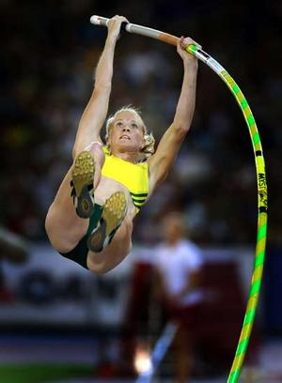
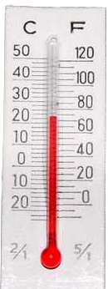
Forms of Energy:
Nuclear Energy (PE)
Chemical Bond Energy (PE)
Intermolecular Bonds (PE)
Gravitational (PE)
Spring (PE)
Translational Kinetic Energy
E&M Radiation
Rotational KE
Vibrational KE
Thermal KE

Slide 4
Relevant forms of energy
kinetic
thermal
permanent deformation
elastic potential
gravitational potential
chemical Energy
There are many more types, but we’ll
mostly deal with these six.
Kinetic Energy
KE = ½mv²
What are the units of PE_{grav}?
Estimate the barbell’s gravitational energy.
Compare with KE of a 100-mph pitch.
If she drops the barbell, what is its kinetic energy just before hitting the floor?

Slide 5
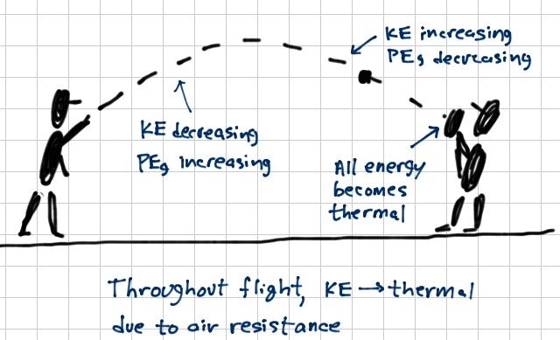
“Potential” Energy
Potential energy = “stored energy”
Kinetic energy is easily converted to/from different forms of P.E.
energy converted to thermal or “dent” forms cannot be converted back (*)
K.E.
one way
thermal energy
“dent” energy
grav. P.E.
elastic P.E.
Efficiency:
useful output
η = -------------------
input work
one way
one way
thermal energy
“dent” energy
thermal energy
“dent” energy
* this is a true statement in our discussion of sports physics. In a wider context, of course, thermal energy can be converted to kinetic energy, as in steam or combustion engines.

Slide 6
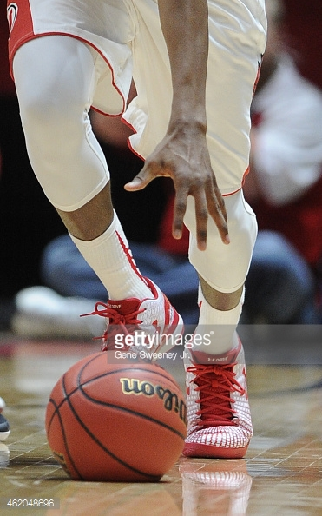
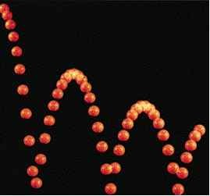
Follow the energy
Joules
Joules
Joules
Joules
And at the end, all we have is heat...
Joules
Determine the efficiency of the bounce of a basketball

Slide 7
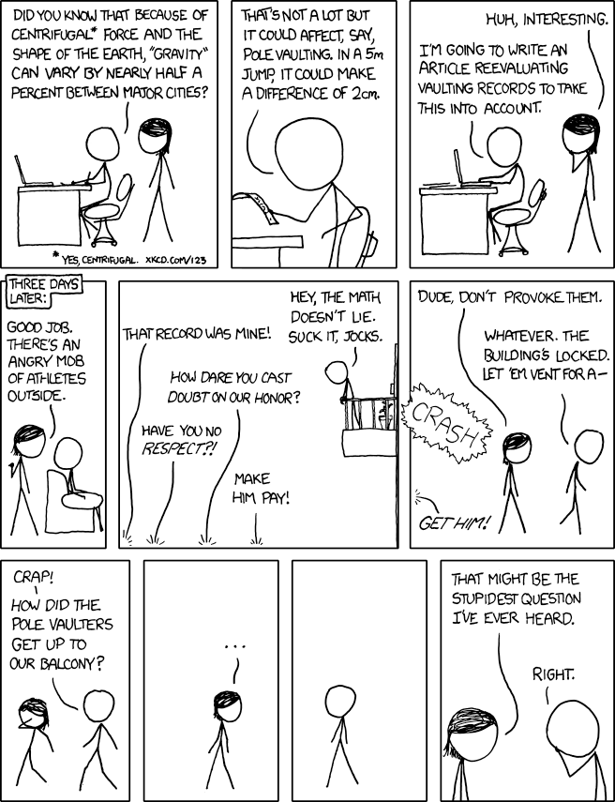
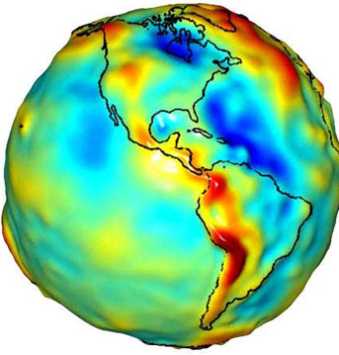
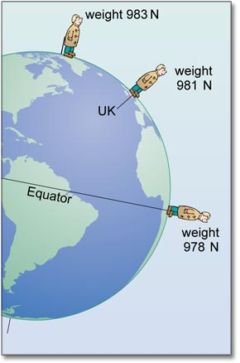
http://xkcd.com/852/
2 effects:
1
2

Slide 8
Work – where it all starts
Scientist’s terminology: The total energy is conserved in an isolated system.
Total energy = K.E. + P.E._{grav} + P.E._{elast} + E_{dent} + E_{thermal}
The “isolated systems” of the previous pages included the air, floor, glove...
But where does the energy come from, in the first place?
Usually... you! You are considered “external to the system” so you can change the system’s energy.
When you exert some force on some part of a system (ball, bat, puck, opposing player) you are doing work on the system.
Work
The only way to change an object’s kinetic energy is to change its speed – i.e. to accelerate it.
And the only way to do that is to apply a force. Two categories:
collision: strong and varying forces act suddenly over very short times
we’ve been discussing this, C.O.R., etc
smoother “push” over longer times (e.g. slowing by friction, pushing a football sled)
here, we say that the force is doing work
Units: N*m = Joule (just like energy)

Slide 9
In this video the ballet dancer is converting the chemical energy in their body into kinetic energy and using it to move their body around the dance floor. In order to dance and jump so gracefully the dancer is exerting work, which involves exerting force. In addition the dancer is demonstrating how powerful his muscles are as he leaps into the air, with power being work done divided by change in time.

Slide 10
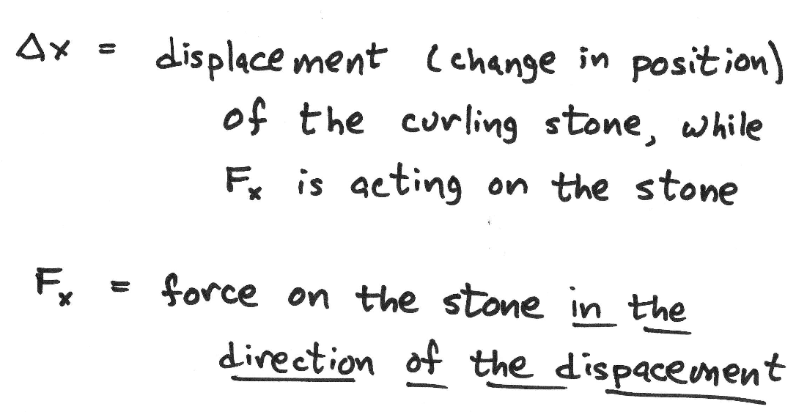
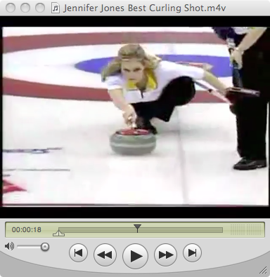
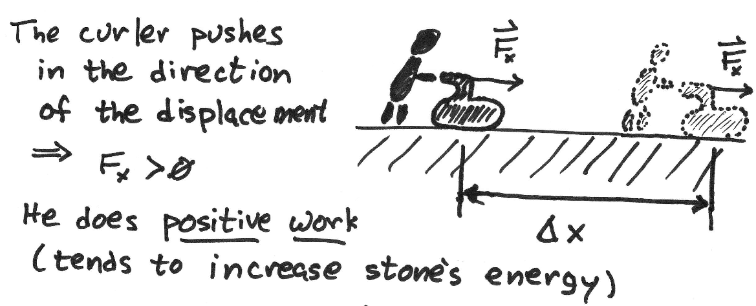
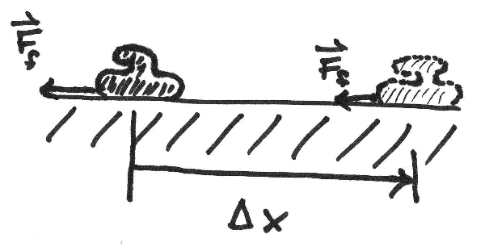
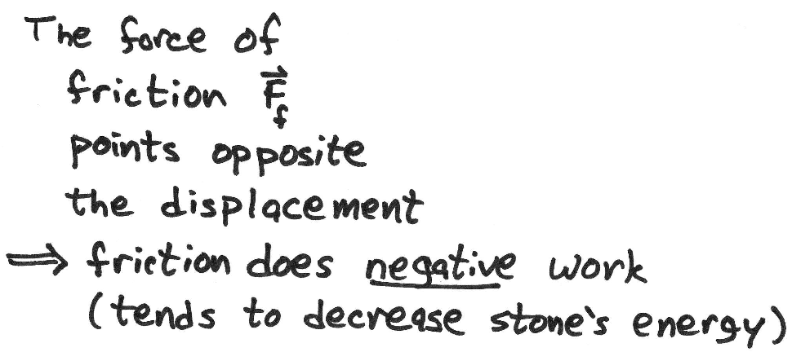
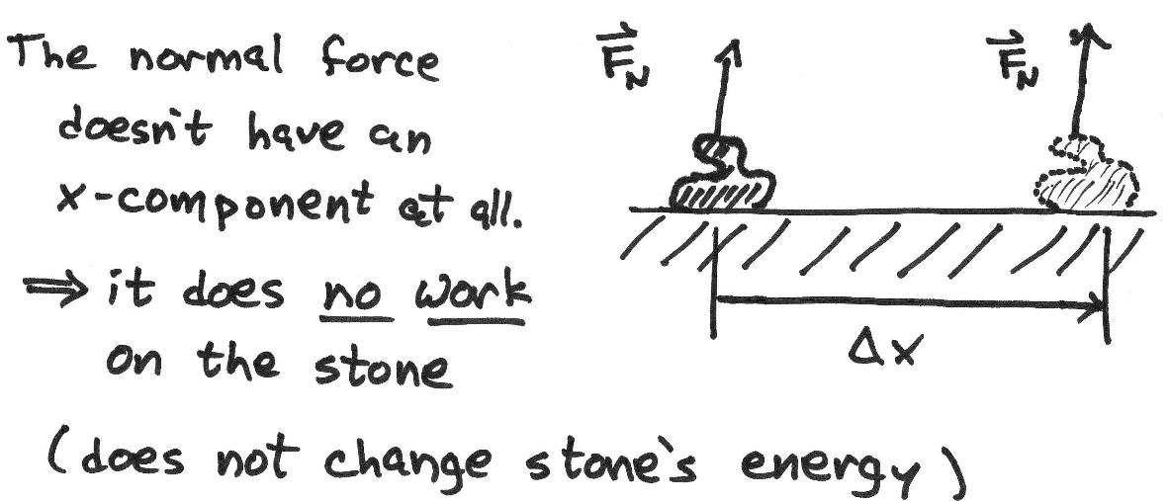
Example: Curling
Sometimes, various forces are considered to be outside the system...
important: not all forces do work, even if the object is displaced

Slide 11
work examples
How much work did she do, to increase the energy of the system?
Example 2: A 1000-kg car originally moving at 35 m/s skids 30 m on a dry road (μ_{k}=0.9). How much work was done by friction?
Example 3: A cyclist originally going 18 m/s is slowed to a stop by air drag over 300 m. How much work was done by air drag? (Ignore rolling friction.)
Notes:
First example:
Ff = mu*N = mu*mg = 0.9*(1000 kg)*(9.8 m/s^2) = 8820 N
this force is opposite to displacement, so answer will be NEGATIVE WORK
W = -(8820 N)*(30 m) = 264,600 J
Second example:
Whew – who knows!??!??
We can certainly say that the work will be negative since force is against displacement.
[in fact, work done by drag or kinetic friction is (almost) always negative.]
but it is not a constant force, so how can we calculate it????
…
well... we can use the “work-energy theorem” which comes next!

Slide 12
Net work & the change in energy
If there are several “external” forces, the net work is just the sum of the works done by the external forces
Key point: the change in the system’s energy equals the net work done on the system
Pay attention to which forces are “external”
if friction is an external force, it causes system’s total energy to change
if friction is an internal force, the system’s total energy does not change (but redistributes itself from one form to another)
revisit example 3: how fast is the car going, after the skid?
revisit example 4: Is it easier, now?

Slide 13
Lecture 17

Slide 14
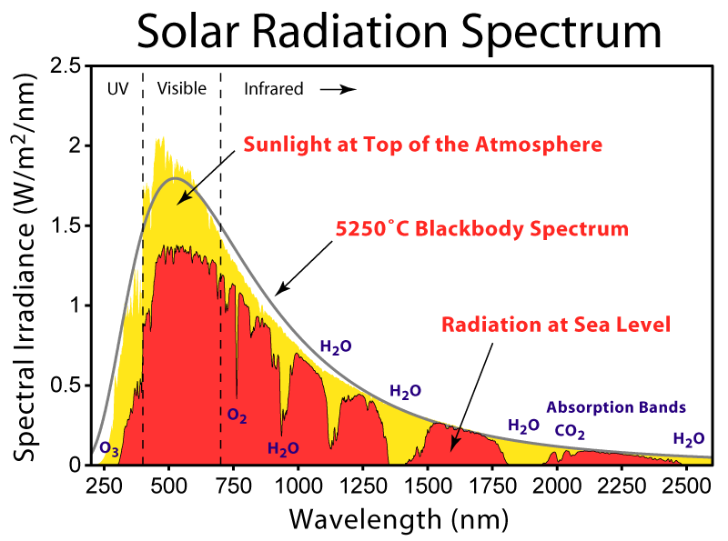
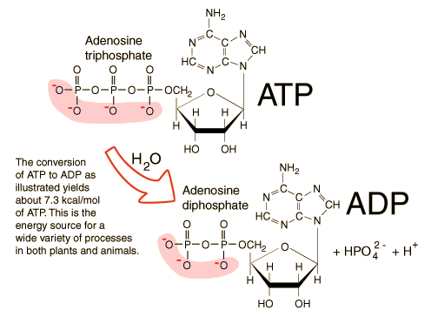
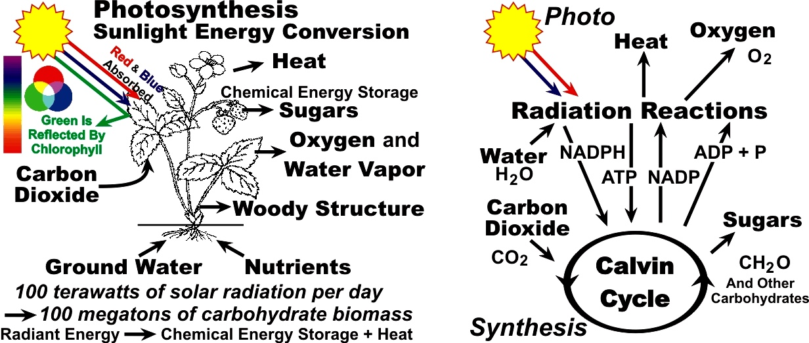
Chemical Energy
Solar radiation 1120 W/m²
R_{earth} = 6378.1 km
Total Solar power:
1.4 x 10¹⁷ W = 140 PW
Note: Shasta Dam – 676 MW

Slide 15
Sugars, Carbohydrates, and Fats
Sugars (Saccharides): 4 kcal/gram
Glucose --- the simplest sugar (yields about 38 ATP per molecule)
Sucrose --- table sugar
Carbohydrates (starches): 4 kcal/gram
polymers of saccharides
as easy to break down as saccharides
Fats (Lipids): 9 kcal/gram
harder to break down then carbohydrates
Proteins (Amino Acids): 4 kcal/gram
Alcohols (ethanol): 7 kcal/gram

Slide 16
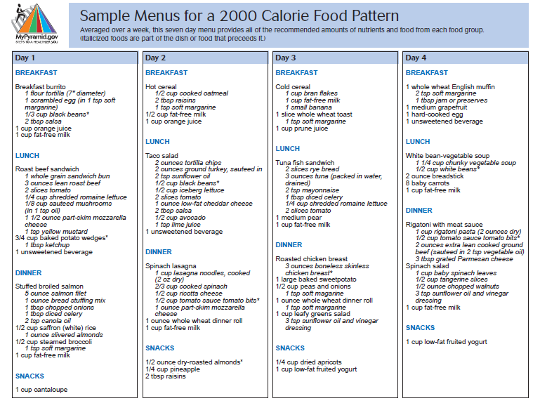
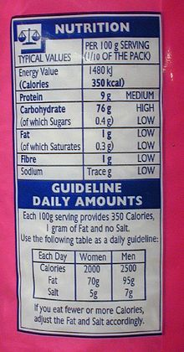
FDA 2000 Calorie Diet
In general, the efficiency of muscles is rather low: only 18 to 26% of the energy available from respiration is converted into mechanical energy.

Slide 17

Metabolic Equivalent Task (MET)
The Metabolic Equivalent of Task (MET), or simply metabolic equivalent, is a physiological measure expressing the energy cost of physical activities
Physical activity | MET
Light intensity activities | < 3
sleeping | 0.9
watching television | 1.0
writing, desk work, typing | 1.8
walking, 1.7 mph (2.7 km/h), level ground, strolling, very slow | 2.3
walking, 2.5 mph (4 km/h) | 2.9
Moderate intensity activities | 3 to 6
bicycling, stationary, 50 watts, very light effort | 3.0
walking 3.0 mph (4.8 km/h) | 3.3
calisthenics, home exercise, light or moderate effort, general | 3.5
walking 3.4 mph (5.5 km/h) | 3.6
bicycling, <10 mph (16 km/h), leisure, to work or for pleasure | 4.0
bicycling, stationary, 100 watts, light effort | 5.5
Vigorous intensity activities | > 6
jogging, general | 7.0
calisthenics (e.g. pushups, situps, pullups,jumping jacks), heavy, vigorous effort | 8.0
running jogging, in place | 8.0
rope jumping | 10.0
RMR: resting metabolic rate
Example Problem: Will you gain weight if you consume the FDA standard 2000 Calorie diet, and adopt a sedentary lifestyle?
Backpacking – Sierras: 3000-4000 Calories per day
Outdoor activity Antarctica: 5000-6000 Calories per day
Tour de France: 6000-9000 Calories per day

Slide 18
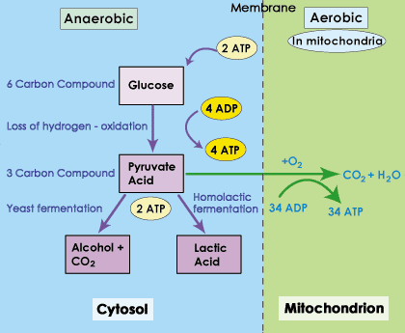
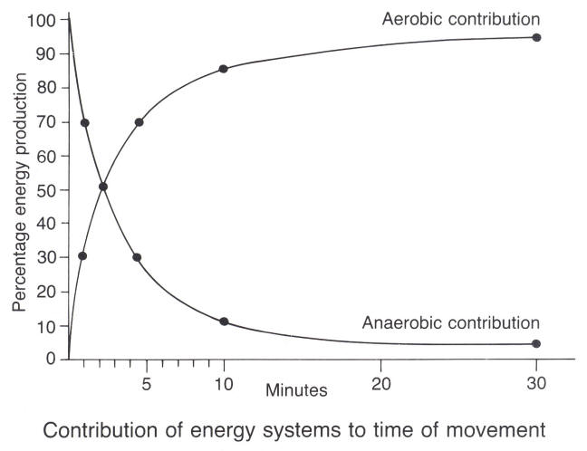
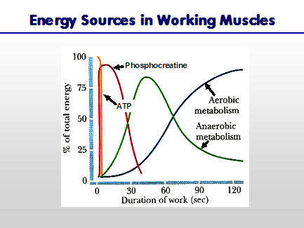
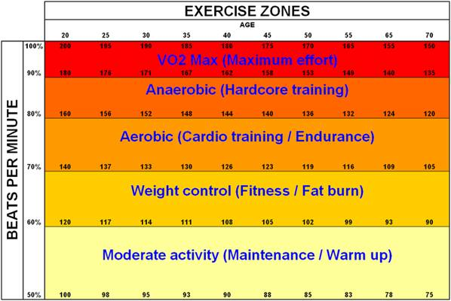
Aerobic versus Anaerobic

Slide 19
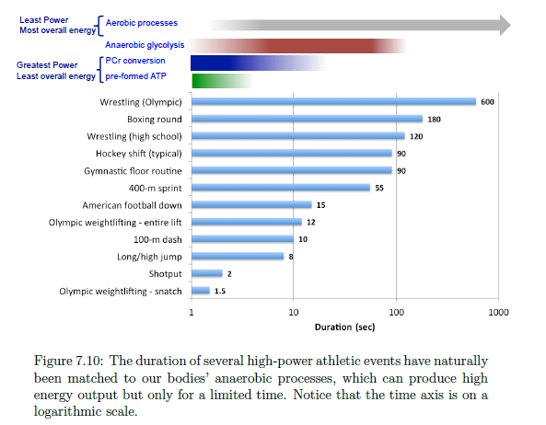
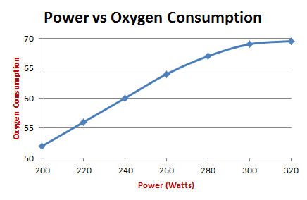
Work and Power
W = F Δx Joules
Power = work/Δt Watts (1 J/s)
Horsepower (1 hp = 746 W)

Slide 20
Lecture 18

Slide 21
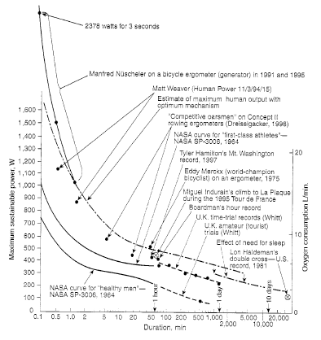

Slide 22
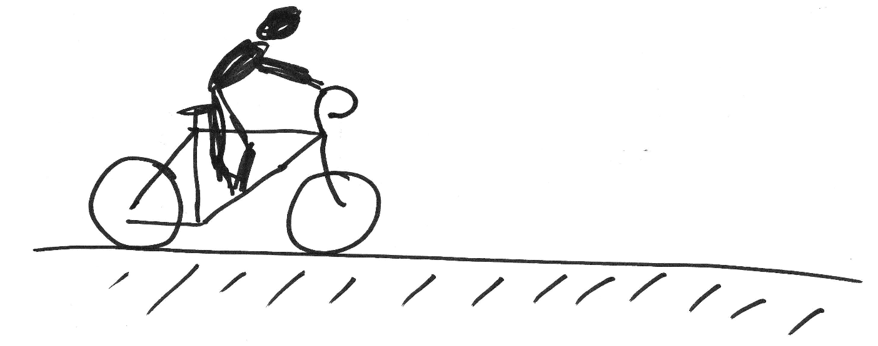
Work and cycling on flats & on hills
(How many Calories is this?)
v=0
v=20 mph
Q) Is it possible for him to perform this much work, without increasing the kinetic energy of himself and the bike?
A) Yes – work done, increases total energy.
Q) If the poor guy is grinding up a hill at a measly– and constant– 3 mph, how high could he climb, if he does 3523.5 J of work?
v=3 mph
v=3 mph
Δx = h
Analyze:
The rider is doing positive work.
K.E. does not change, but P.E._{grav} increases
what if the hill was like this?
Δx = h
what about air drag?
Notes:
1 Calorie = 4129 J
so, increasing speed to 20 mph takes 3523/4129 = 0.85 Calories (ONLY!!)

Slide 23
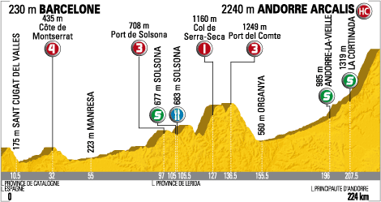
Power
In sports, it is often not the work done, but the rate at which work is done, that matters.
Clearly, in a bike race, the biker that gets to the top of the hill in 10 seconds will do better than one who gets there in 40 seconds, even though they both do 3523.5 J of work.
An athlete must be powerful.
Units:
1 Joule/sec = 1 Watt = 1 W = 0.0013 hp
1 hp = 1 horsepower = 746 W
How much power can an amateur cyclist generate? _________
Accounting for ~65% efficiency of class-demo bike: __________
Example: Assuming constant power out: how long does it take me to climb a 1-mile-long 6% hill at constant speed? Assume my bike is 90% efficient.
7% grade
1 mile = 1609 m
Stage 7 of Tour 2009
rise/run = 0.06
Notes:
do the in-class demo of the power-bike (with headlights)
for significant timescales, Armstrong might generate 300 W.
me: 200 W

Slide 24
Power, cont’d
Example
With same power output, how fast could I be going after 15 minutes, on flat terrain?

Slide 25
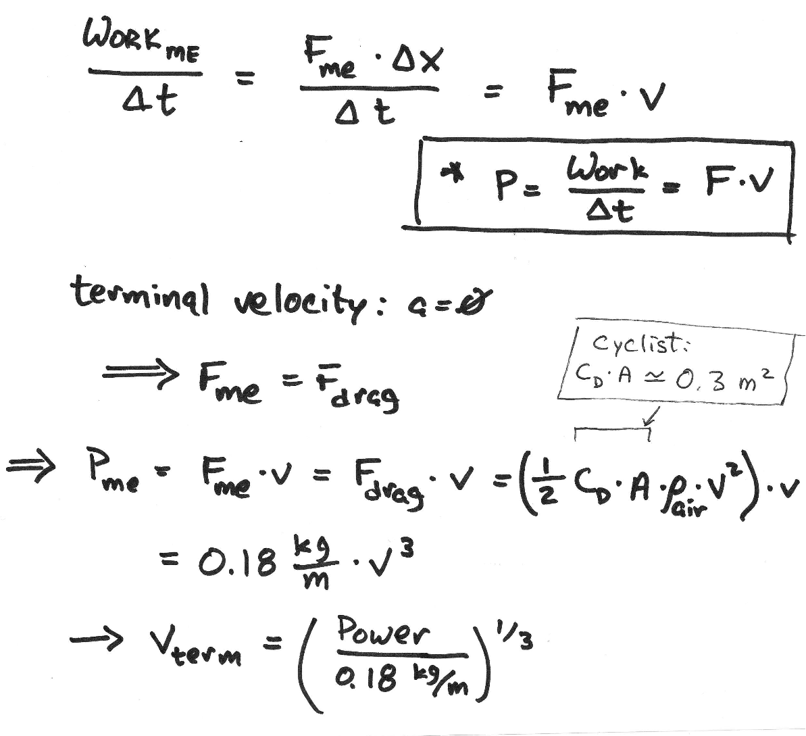
Power “lost” to drag
As the previous example shows, while neglecting air drag was reasonable for my (slow) climb up the 6% grade, it is apparently not appropriate on the flats.
every second that I do work…
K.E. (& v) grows
drag force grows
more negative work done by drag in that second
terminal velocity: when rate of negative work by drag is the same as positive work done by me. (just like freefall)
What’s possible for the amateur cyclist?
What if he could increase power by 50%??

Slide 26
Power– some perspective
Electrical devices have ratings in Watts, telling the rate at which they consume energy. But you are charged for the energy you use, which is why your electric bill is in kW*h (kilowatt-hours)
Just considering electricity, how many kW*h of does your house/apartment consume in a day? In an hour?
1 horsepower = 746 W (≅ 1 kW)
rate at which a healthy horse can do work
equivalent of raising 1 ton of weight 3.3 inches each second
1 hp*s = ______________ Joules = _________ Calories

Slide 27
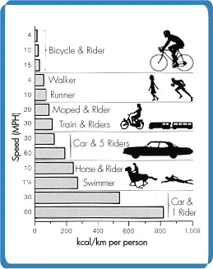
Drag dominates
A human on a bike is the most efficient moving combination in the world. No powered vehicle or animal requires less energy to move mass over the same distance.
Most efficient animal– salmon– requires 2.5x.
Car full of people: ~5x (This ignores energy required to drill, refine, & transport the fuel.)
At relatively high speeds, drag dominates due to v².
@10 mph: ~1/3 of energy: pushing air out of the way
racing at 30 mph: 90%
(hence increased popularity of recumbents)
graphic: http://www.exploratorium.edu/cycling/humanpower1.html
Consider a commute of 10 miles (roundtrip) in 40m. Assume ~100 W power transmitted to bike. (A bit low number because it includes times one transmits no energy to bike while waiting at lights, crossroads, etc) How much energy is expended on the trip?
Body is 20% efficient at cycling – i.e. 5 Calories burned for each 1 Calorie input to bike → how much must the rider eat to fuel the ride?

Slide 28
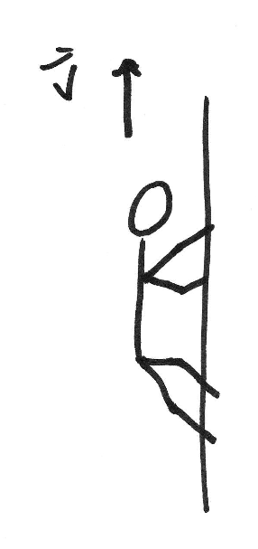
Explosive exertion
Example:
Earlier, we calculated Usain Bolt’s kinetic energy to be 6761 J at the end of the race, if he was running 12 m/s (26 mph)
As the fastest man alive, and certainly massive (207 lb), this is about as much kinetic energy as a runner will have.
How much power did Bolt generate?
This is just the average power. At points in the race, it will approach 900 W!
Furthermore, this ignores the work done to overcome air drag. How important is this?
Work against drag is not dominant but not negligible
Example: Rope Climbing (at one time an official event in Olympics and NCAA)
World record: 20’ in 2.8 sec by Don Perry of UCLA (170 lb)
What was his power output?

Slide 29
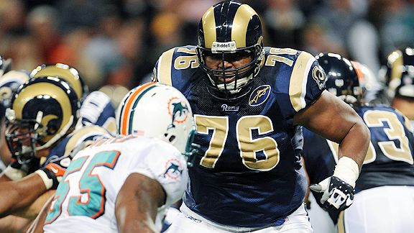
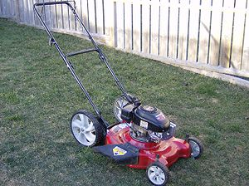
Two broad categories of athletic exertion
RMR (resting metabolic rate) energy required to stay alive, drive a car, watch TV, do homework | 100 W = 1/7 hp = ______ Cal/s (obviously, includes body efficiency factor) | calories consumed by body/day: _________
sustained exertion (~hours) (cyclist, marathoner) in addition to RMR | ~100-300 W ~ ¼ hp = 0.05 Cal/s (if body efficiency ~ 5, ~1.25 hp ~¼ Cal/s) | up to 6000 Cal for TdF stage
explosive exertion (1-2 sec) (football player, sumo, sprinter) in addition to RMR | ~800-2000 W ~ 1.5 hp approx body efficiency varies wildly. | claims of up to 9000 Cal on gameday for pro linemen
Orlando Pace (OSU ‘94-97): original record-holder on OSU’s power-bike: transmitting ~400 W to bike for 2 min.
Also a powerhouse in explosive exertion (nice discussion in Physics of Football by Tim Gay)
what is power output by small gas push mower?

Slide 30
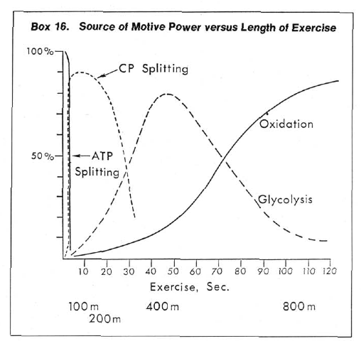
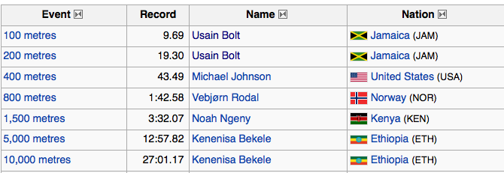
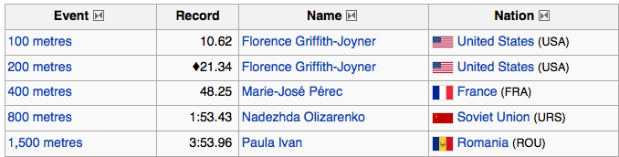
Chemical processes and exertion categories
6+ hp
1.5 hp
The body of a given athlete tends to “specialize,” chemically performing well above average in one of the three broad categories of energy generation.
Records for 100 m & 200 m dash often held by same person.
Very rare for one runner to hold any two of 200 m, 400 m, 800 m races
From H. Bent, J. Chem. Ed 55 12 796 (1978)
splitting of creatine phosphate
glycolysis
oxidation
of glucose
of fat

Slide 31
Lecture 19

Slide 32
Reminder from early in the course
World records – average speed versus race length
1500 m
100 m
marathon
average speed (mph)
100 km
(62.5 mile)
half marathon
brisk walk
distance (m)
sprints
runs
something else
plateau of speeds (power output) in “endurance curve” reflects dominance of oxidation process ~ 1.5 hp
these are average speeds → CP-splitting-dominated races strongly affected by “boost phase” of run.

Slide 33
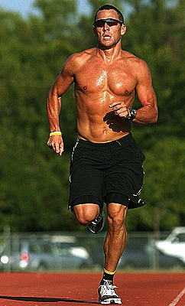
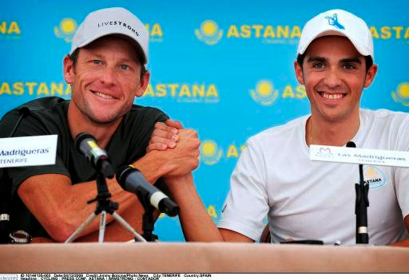
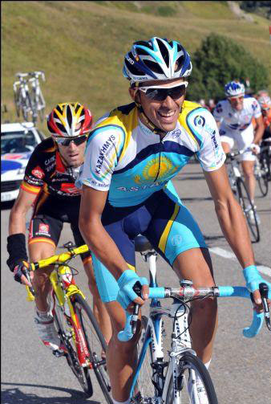
Lean and mean? Sure. - But… should one be leaner, or meaner?
Lance and Alberto, 2009
Armstrong:
5’ 9½“
75 kg (165 lb)
Contador:
5’ 9½“
61 kg (130 lb)
Pro distance cyclists clearly specialize in oxidation, but what of body type?
Clearly, one doesn’t want to be unnecessarily heavy; almost no fat on Tour riders!
But what of muscle? More muscle means more power, but also more mass to accelerate and carry up hills. Does a rider want more muscle mass, or less?
The forces at work:
rolling friction – like static or kinetic (sliding) friction, proportional to normal force
penalty for being heavy (though small penalty, for a good bike)
air drag
does not depend on mass
in principle, some penalty for being “large,” but very little difference b/t riders in reality
gravity
does no work on level ground
uphill: penalty for being heavy
downhill: benefit from being heavy
rider’s force on pedals
benefit from being massive (so long as it’s muscle)

Slide 34
Power to Weight Ratio (PWR)
One often sees reference to a rider’s PWR. Since it is measured in W/kg, it is really the power to mass ratio.
Firm numbers on any given rider are elusive. Furthermore, a rider’s PWR can vary 15% within a season and can depend on the type of ride. Nevertheless, it is a useful parameter to characterize a given rider.
Contator’s numbers range all the way up to 6.25 W/kg
v (m/s)
hill grade
downhill
uphill
downhill – high speed – mass helps
simply more power to overcome drag

Slide 35
time trials, climbs
focus on nearly level ground (time trials)
mass (muscle power) a benefit
v (m/s)
hill grade
focus on climbs
PWR is the name of the game
v (m/s)
hill grade

Slide 36
Hills up and down: How does it work out “on average?”
Rider 1: m=80 kg, PWR=5 W/kg
Rider 2: m=60 kg, PWR=6 W/kg
v (m/s)
Clearly, Rider 1 wins on time trials
But, what about a hilly stage?
After all, Rider 2 is better going up, but Rider 1 is better coming down!
hill grade
Simple case:
1 mile up a 10% grade
v₁=4.2 m/s , v₂=4.8 m/s
then
1 mile down a 10% grade
v₁=26.2 m/s , v₂=23.6 m/s
1 mile
1 mile
who wins?
Notes:
uphill:
delta-t1 = (1609 m)/(4.2 m/s) = 383 s
delta-t2 = (1609 m)/(4.8 m/s) = 335 s
downhill:
delta-t1 = (1609 m)/(26.2 m/s) = 61.4 s
delta-t2 = (1609 m)/(23.6 m/s) = 68.2 s
So, large PWR guy KILLS on the uphill (gaining 50 seconds) and only loses a little bit on downhill. Reason being that downhills are so brief, there’s hardly any time there too lose!
Bottom line: PWR more important than power. You’ll lose a little bit on the level stages, and gain a lot on the hills.

Slide 37
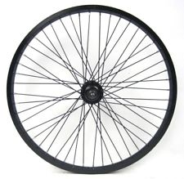
Consider a Wheel --- Rolling at Constant Velocity
Radius = r
mg
N

Slide 38
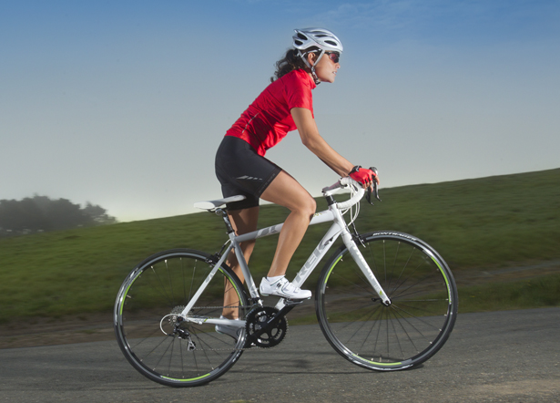
Assume Constant Speed --- What Forces are Active?

Slide 39
Just Focus on the Back Wheel
Forces must balance out

Slide 40
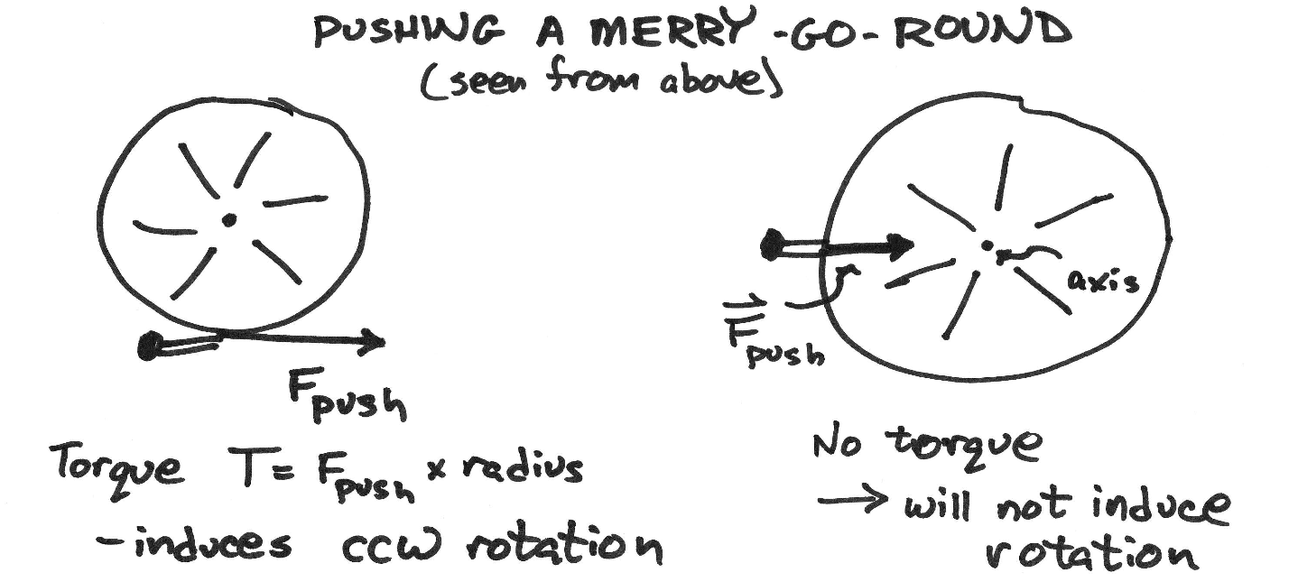
Torque – just the facts
Torque is the rotational equivalent of force
Force → induces acceleration of c.m.
does not matter where the force is applied
Torque → induces “angular acceleration” – increase or decrease of rotation
matters very much where the force is applied
What is the torque induced by a force?
find the axis of rotation
find the “line of action” of the force vector
The “lever arm” (L) is the shortest possible distance (“perpendicular”) between line of action and the rotation axis
torque = force × lever arm: T=F×L
Notes:
we’re not really going to say very much about torque at all, in this course.

Slide 41
Just Focus on the Back Wheel
And Torques must balance out.
Torque ➔ impels things to rotate T = F·r
Radius of Wheel ➔ 0.31 m (0.2995 to 0.3310)

Slide 42



Slide 43
Braking

Slide 44

19th Century Racing Bike
Why were these considered daring to ride?

Slide 45


Slide 46

“Leverage” and wrench – units: foot-pounds
T = F × L
nut = axis of rotation
Notes:
show more examples of “line of action,” besides just this one.

Slide 47

Example – balancing teeter-totter
What is the force provided by the support?
How far from the support should the father sit, to maintain balance?
Notes:
free-body diagrams
line of action
F=0 AND T=0

Slide 48

“Where does gravity act?”
Recall from Part I: c.m. always hangs
directly below a hinge (in equilib)
Gravitational force (weight) is exerted at c.m
hinge (pivot point)
c.m. of irregular object
c.m.
L
line of action passes through
axis of rotation
no torque: equilibrium
counter-clockwise torque T=W*L
Notes:
Also: show how you can balance c.m. on one finger

