Slide 1
Lecture 11

Slide 2
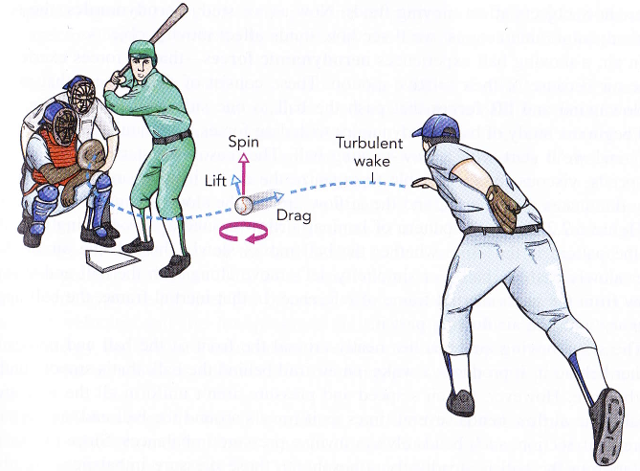
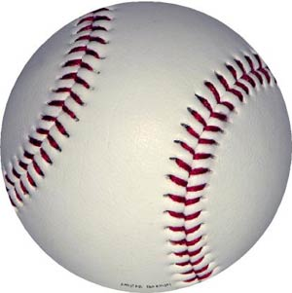
The effects of air or water
Most sports are played in the presence of air, but so far, the trajectories we have calculated are correct only in the vacuum [that’s all that is done in Physics 7, or Physics 9 series courses for science-based majors]
Three additional forces for object moving through air
buoyancy – “bubble” effect – upward force
drag – backward “resistance” as object forces its way through air
Magnus – sideways force on a spinning object moving through air
spin
7ABC, 9ABCD only consider this
if ball is in air
if ball is in air and moving
if ball is in air and moving & spinning

Slide 3
Easiest first – buoyancy
Any object submerged in a fluid (air, water) experiences an upward force equal to the weight of the fluid displaced.
Standard water polo ball characteristics[edit] Ball weight is 400-450 grams (14-16 ounces) and inflated to 90-97 kPa (kilopascals) gauge pressure (13-14 psi) for men and 83-90 kPa (12-13 psi) for women. Water polo balls come in two main sizes: a size 5 (68-71 cm in circumference), intended for use by men, and a size 4 (65-67 cm in circumference), intended for women.
This ball weighs as much as this much the water that it displaces:
Can we determine how deep a water polo ball sinks into the water?

Slide 4
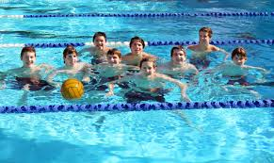
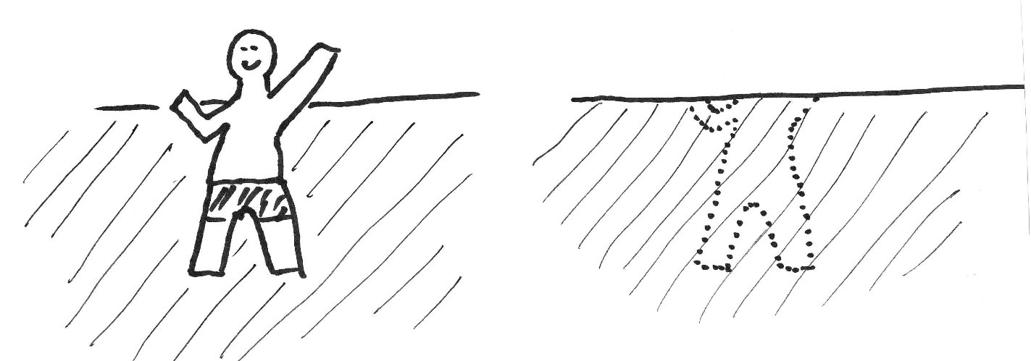
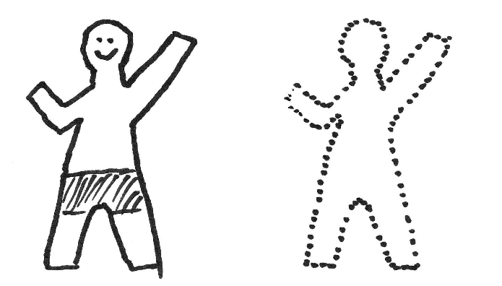
Easiest first – buoyancy
Any object submerged in a fluid (air, water) experiences an upward force equal to the weight of the fluid displaced.
(water)
Magnitude of buoyant force on swimmer equals weight of water inside dotted outline:
F_{buoy} = V_{displaced}*ρ_{H20}*g
for us, everything fully submerged in air
The buoyant force exerted by the
air on the player = weight of air in this volume
Like gravity, the buoyant force is always acting:
constant in magnitude and direction, independent of velocity
Notes:
note that, as I’ve drawn it, the man in air is accelerating downward. (To keep him in equilibrium, I need normal force of the floor)
for myself: estimating volume of human (say, me).
weight = 180 lb
mass = 180 lb * 0.454 kg/lb = 82 kg
I float so I know I’m a little less dense than water, which has density 1000 kg/m^3. So, say I have density 950 kg/m^3
Then my volume is 82 kg/(950 kg/m^3) = 0.086 m^3 (=22.7 gallons)
That means that the weight of the air I displace is 9.8 m/s2 * 1.2 kg/m^3 * 0.086 m^3 = 1 N = 0.22 lb (0.2 pounds ! That’s a lot, actually!)

Slide 5
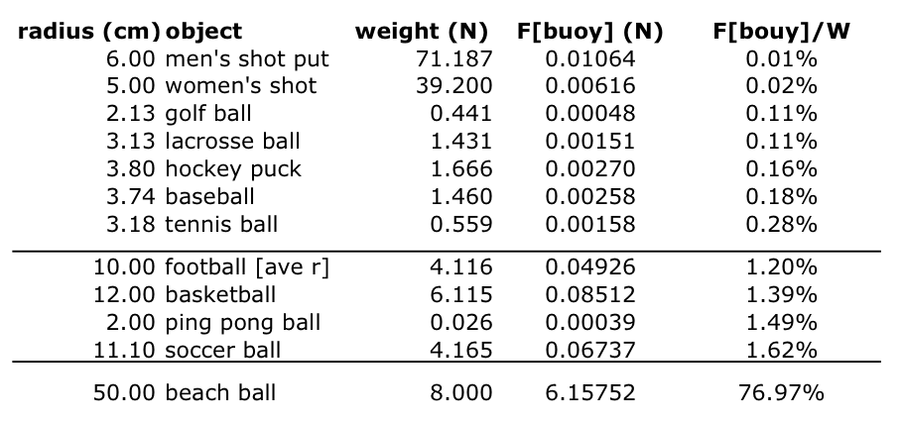
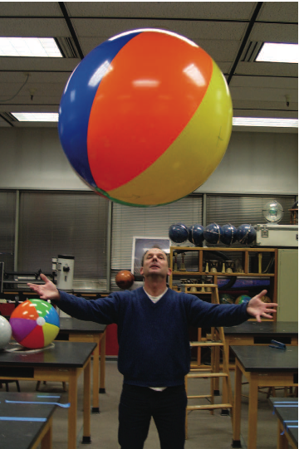
How important is buoyancy?
Example: hypothetical 52 year-old professor: W=160 lb, volume~0.075 m³
Prof fully submerged in water: compare the buoyant force to his weight
Now do the same for prof fully submerged in air
How about for balls?
Notes:
note: in the first case, I would accelerate to the surface, so that I would NOT be fully submerged, since buoyant > weight
Air: W[air] = rho[air]*Volume = (1.2 kg/m^3)*(0.086 m^3)=0.1 kg * (2.2 lb/kg) = 0.2 lb --- negligible (~0.1%)
in water, of course, it is 1000x bigger, so 200 lb. (>100%)

Slide 6
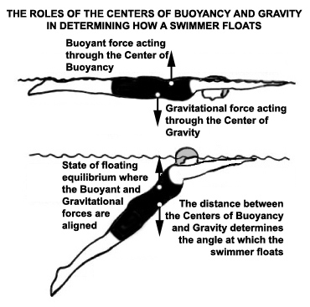
1) Soon after the 2008 olympics, full length racing suits were banned from olympic, collegiate, high school, and basically all other levels of swimming due to the unfair advantage that they created. Some of that unfair advantage had to do with the suits giving the swimmers extra buoyancy, which allowed them to stay higher in the water allowing them to float better, which in turn significantly reduces drag in the water
I think backstroke is the best stroke that illustrates buoyancy because it is a stroke that obviously requires you to use buoyancy to float on your back. Right after the start if you look closely you can see the swimmers kicking under water & blowing bubbles out of their nose which helps them to regulate their buoyancy & eventually bring them to the surface

Slide 7
So, who cares about 1.39%?
A basketball does NOT fall at 9.8 m/s², due to buoyancy – what is its acceleration?
a=_______
Combining the gravitational and buoyant forces still leads to a net force that is constant in magnitude and always pointing down
trajectory shape is still a parabola.
Range formula for parabolic trajectory:
Decreasing g by 1.39% → increase R by 1.39%
Example: using the range formula, estimate the increase in range due to buoyancy for an NBA 3-point shot (23’ 9”)
A 4.72” basketball entering a 9” rim at 45 degrees has ~1.6” clearance front & back
It matters. And good shooters already “know” about this.
Notes:
for the calculation: 0.014*(9+23*12) = 4 inches
So, hey, this is
My little estimate at the bottom: projection of rim is R*sin(theta), and the ball has to fit in there. That calculation ignores the small arc due to gravity, but otherwise is good. One can then calculate the “critical angle” to get in as theta = arcsin(Rball/Rrim) = 31.6 degrees, which is almost identical to Fontana and Brancazio.

Slide 8
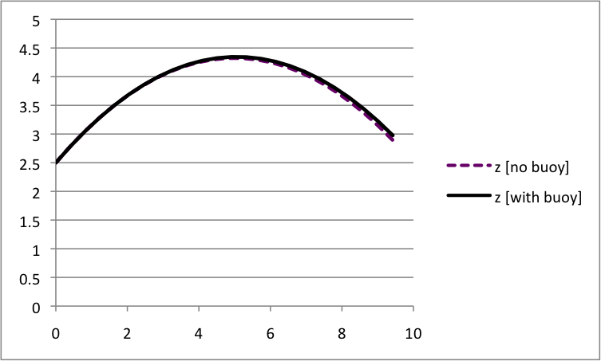
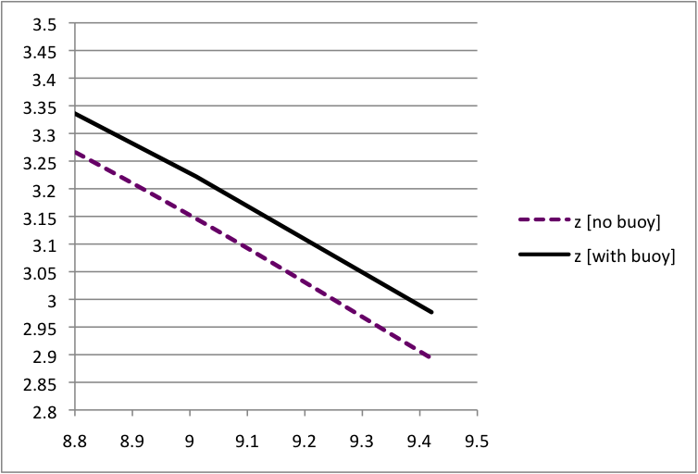
The effects of buoyancy
launched a height of 2.5 m with v₀= 10 m/s at 35-degree angle
rim at 3.05 m (10’)
doesn’t look like much, but blow it up…
rim and balls to scale
through practice, your body has learned to account for buoyant force, though probably it never crossed your mind

Slide 9
Lecture 12

Slide 10
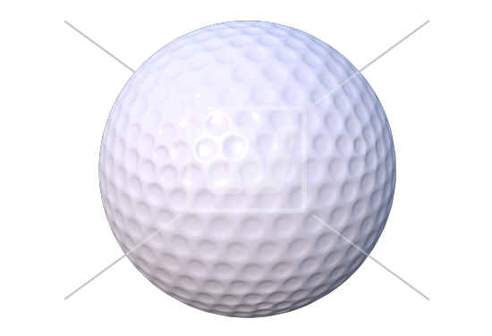
Moving through the air
Gravity and buoyancy are both vertical, constant forces → parabolic paths.
Two additional forces for object moving through air
drag – “resistance” as object forces its way through air
Magnus – sideways force on a spinning object
both are quite complicated; we treat them empirically
Drag – the “resistive” force on an object as it moves through a fluid (e.g. air)
direction: opposite the direction of motion
magnitude: depends on shape, size, properties of air, surface of object... and speed!

Slide 11
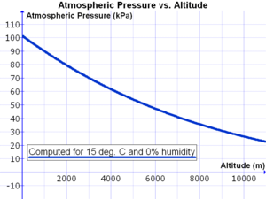
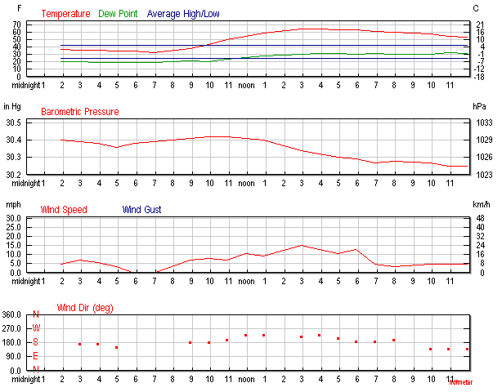
Moving through the air
A = cross-sectional area
presented to the wind
C_{d} – drag coefficient: depends on shape & roughness of object
v = velocity thru air
ρ = fluid density
Balls hit farther
at Mile High Stadium
1000x greater drag in water,
since water 1000x denser
@ sea level with T≈70˚ F and clear skies
A change in temp of 5 degrees [Fahrenheit] → 1% change in ρ_{air}
[cold air has higher density]
A change in altitude of 275 feet → 1% change in ρ_{air}
[less dense air higher]
An impending storm may produce a 5% drop in ρ_{air}
for 11 March 2012, Columbus, OH
rapid rise in T
rapid fall in P
→ big change in density!
http://www.wunderground.com/history/airport/KOSU/2012/3/11/DailyHistory.html

Slide 12
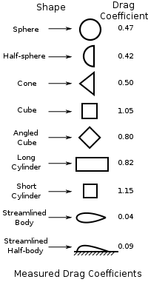
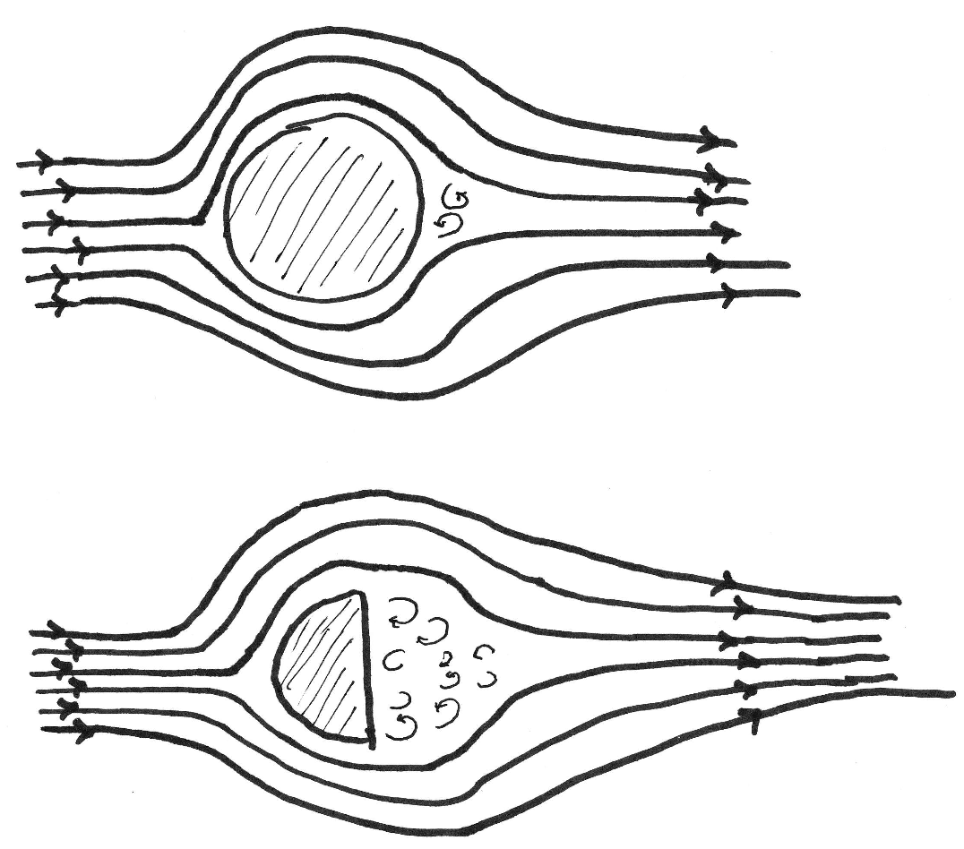
Drag Coefficient versus shape (mostly we’re interested in spherical balls)
Notice that the air “sees” the same front surface for these two
details of “back side” low-pressure (& possibly turbulent) region reflected in C_{d}
Drag is complicated
Figure from Wikipedia

Slide 13
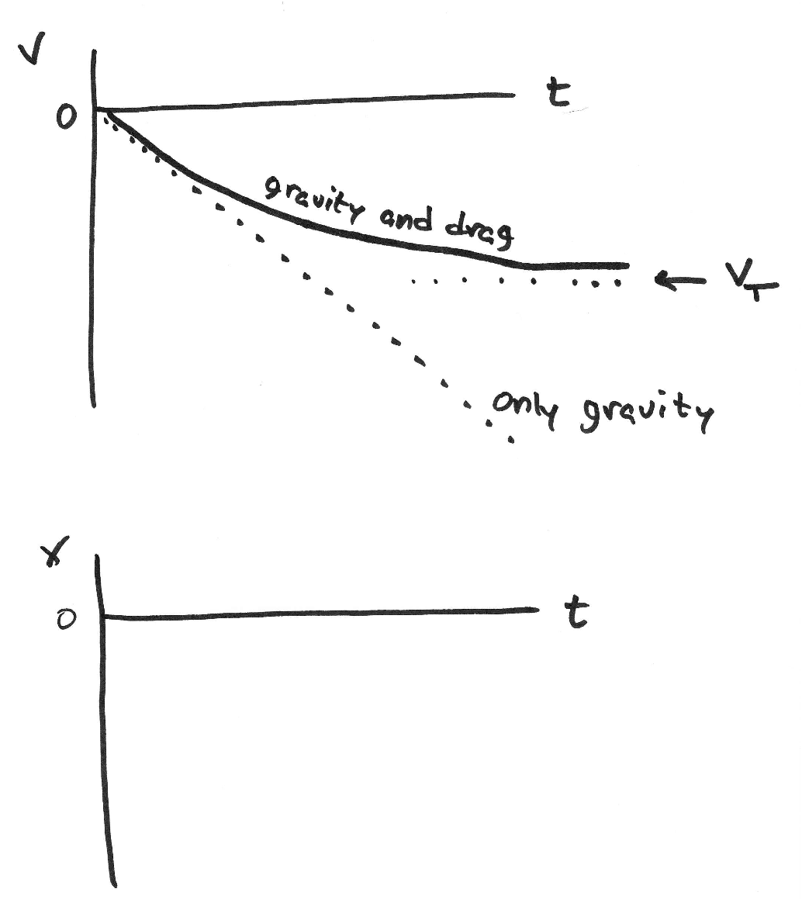
terminally insane?
If you google “catch a baseball dropped from airplane,” you will find all sorts of claims from various years about various people (including an often-repeated one about a grapefruit). One says:
On his fifth attempt he got a ball in his glove, but the impact drove hand, glove, and ball into his face, fracturing the upper jaw in 12 places, braking (sic) five teeth and knocking him unconscious.
How fast would a ball hit the ground, dropped from a plane 10,000’?
However, drag slows the ball. In fact, as the ball moves faster, the drag force increases until it is as large as the ball’s weight, at which point there is no net force, so no acceleration. The ball has reached its “terminal velocity.”
drop: v₀=0.
a_{y} = g

Slide 14
Find the terminal velocity
Sphere C_{D} ~ 0.47 →
In fact, as we’ll soon see, we should use C_{d}=0.3, making v_{T}=43 m/s ~ 95 mph
This speed is typical of ball speeds in a professional game, so a professional catcher should be able to handle it.
Example: Do large hailstones have larger terminal velocity than small ones?
Notes:
for ping-pong ball, I get 8.3 m/s = 18 mph

Slide 15
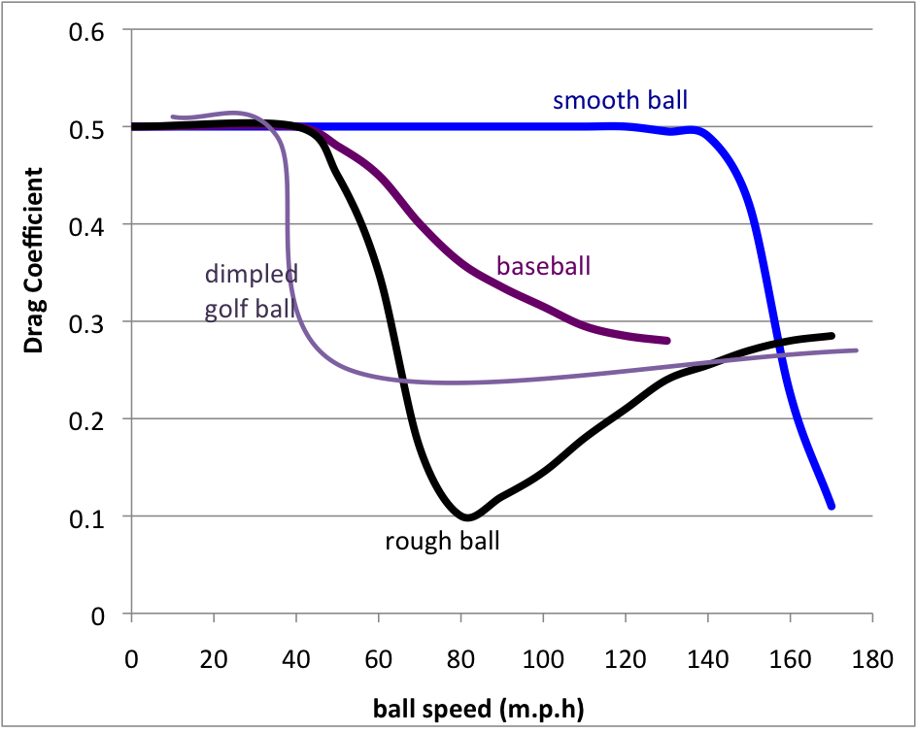
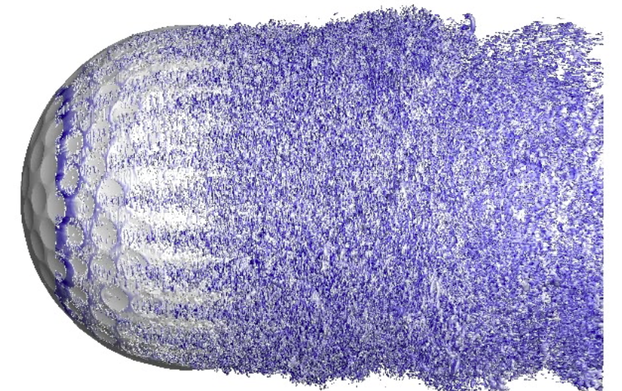
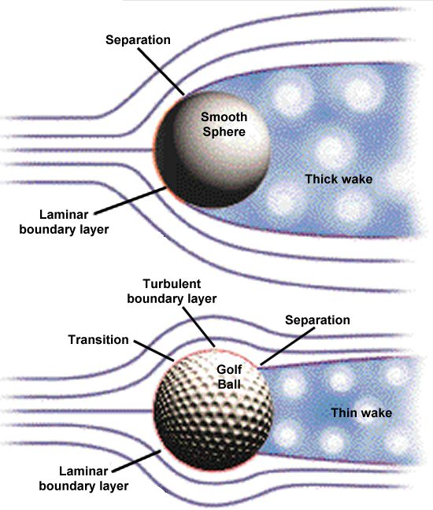
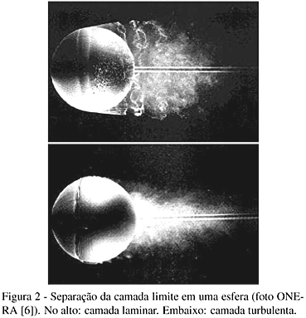
Drag versus velocity and roughness
While the formula contains most of the velocity dependence of the drag force, C_{d} itself depends on v
https://www.youtube.com/watch?v=XkaLsVOrBk0
based on The Physics of Baseball,
R. Adair, itBooks.
It’s not “high school physics”
Details are complicated. Turbulent flow at surface (generated either by high speeds and/or rough surface) is less “sticky” than laminar flow
At high speed, airflow at surface transitions from laminar (smooth) to turbulent, producing less drag
Rough surface → turbulence even at low speeds → less drag for rough balls!
(hence the dimples on a golf ball)
Notes:
super-awesome video on this page

Slide 16
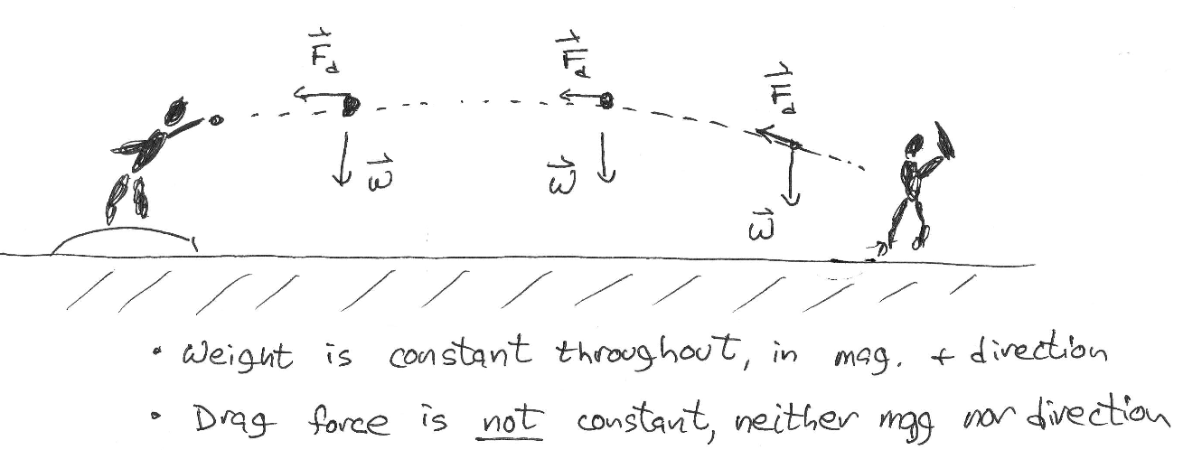
Estimating the importance of the effect
Even if C_{D} were constant, we now have a force which is not constant, either in its strength or its direction. Detailed calculations require a computer.
In complicated situations, making estimates helps guide intuition
Example: a horizontally-pitched fastball (93 mph)
Ignoring drag, how long does it take to reach home (60’ 6”), accounting for 1.5-m stretch?
How much different is it, with drag?
How to handle drag??? That’s hard.
Force varies throughout flight → this is not a constant-acceleration problem.
Notes:
this is how scientists approach complicated situations. A computer, yes, but also estimates. Otherwise, we don’t have a feel of whether the computer’s result makes sense.
This, AND experimental testing, are crucial. These are nontrivial problems. And much the same thing goes on with e.g. climate change calculations. They are subtle but scientists are not just “blindly trusting some huge complicated program”
This example on page 78 of Terry’s notes. Here, the point is that the ball is thrown at ~100 m

Slide 17
effect of drag on pitch
Approximation: assume F_{x}=constant (→ v_{x}=constant), so a_{x}=constant
?!?!? But isn’t the whole point that if a_{x} ≠ 0, then v_{x} is NOT constant?
A) yes. But let’s start with this, and see where we get.
Find F
Find a (“deceleration”)
Find v_{x} when ball crosses plate
Find time of the journey. How much “extra time” does the batter have?

Slide 18
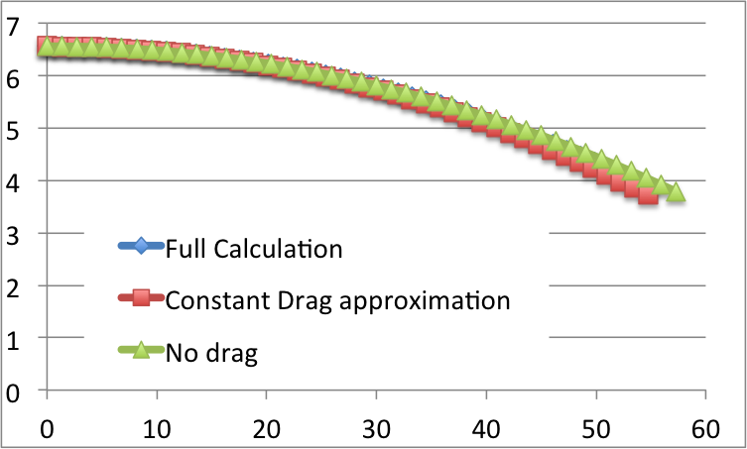
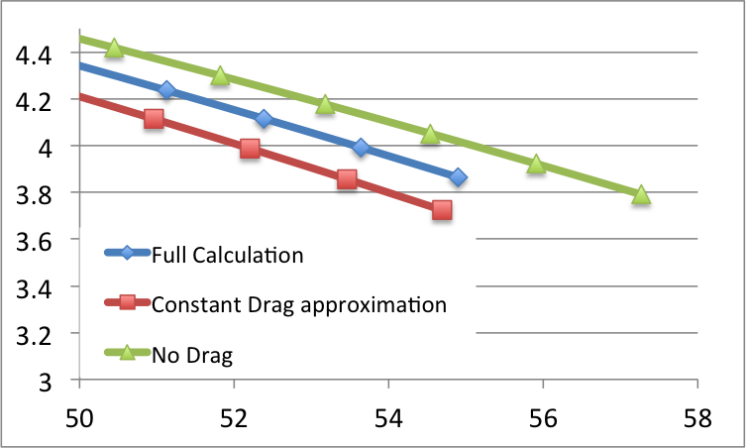
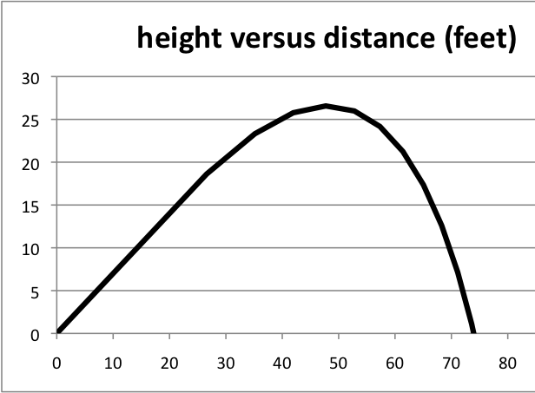
Constant-acceleration calculation versus full calculation
h (ft)
Approximations like this are extremely useful in any study of complex systems.
A good feeling for each effect can be built on what we already know, then we do more exact calculations and experiments.
x (ft)
h (ft)
markers drawn
every 0.01 sec
How could we do a better approximation?
Why does the constant-drag case fall more?
last marker:
t=0.42 sec
home
x (ft)
Drag force
reduces range – significantly for v₀~v_{T}
reduces flight time
reduces maximum height
generates asymmetric flight paths
reduces angle producing max range
(to about 35º for v ~ v_{T})
v0 = 110 mph @ 35 degrees C[drag] = 4.0

Slide 19
the effect for longer trajectories
With drag, max range at 35 degrees (not 45)*
(recall without drag, range for 35 = that for 55)
* this optimum angle will be different for different balls
height (ft)
calculations here: baseball on 70-degree day at sea level
launch: v0 = 110 mph (49.5 m/s) at 35 degrees
no backspin
distance (ft)
roughness: the difference between home run or not
height (ft)
distance (ft)
center field fence
Notes:
with longer trajectories, the effect accumulates
and a hit at 110 mph at 35 degrees is pretty much the perfect shot. pretty much impossible to get a homer if ball were smooth.
(though, again, no backspin)

Slide 20
Lecture 13

Slide 21
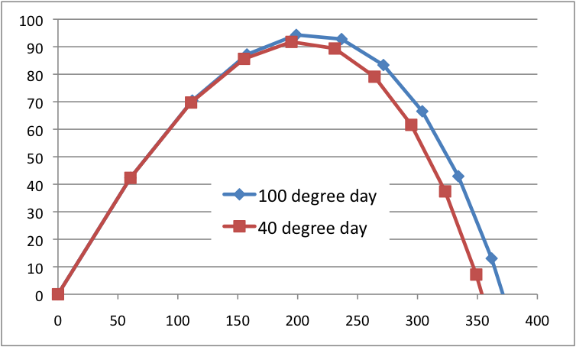
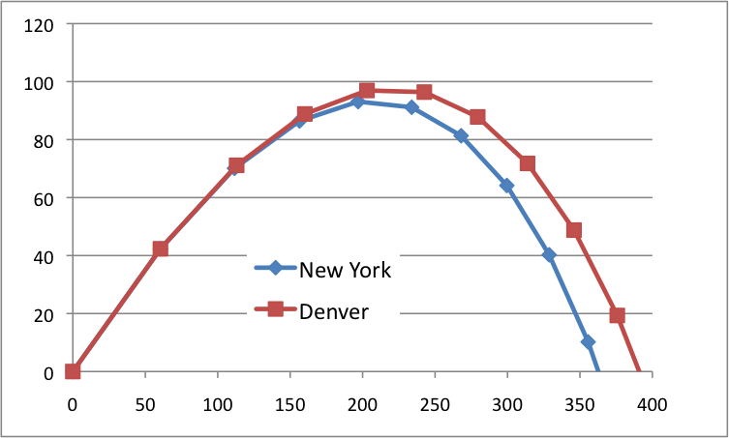
Effects of temperature, altitude on density (and drag)
In Davis (sea level) v₀ = 100 mph, 35 degree launch
h (ft)
x (ft)
70-degree (F) day v₀ = 100 mph, 35 degree launch
h (ft)
(markers every 0.5 sec)
x (ft)
Tough to be a fielder on a hot day in Denver!
& an incoming storm front can reduce density by ~5% in minutes → noticeable to players
Notes:
and, a storm

Slide 22
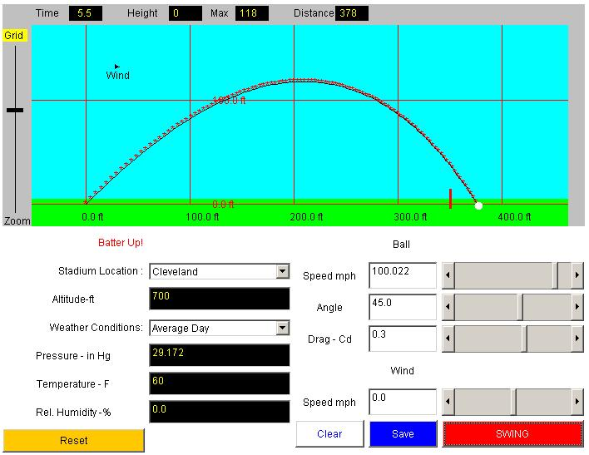
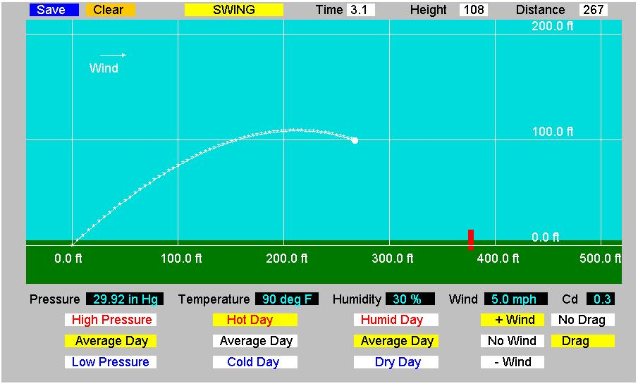
weather and drag effects on a hit ball
http://www.grc.nasa.gov/WWW/k-12/InteractProgs/sportsdown.html
from our friends at NASA.
c/o Jeff Masters at Weather Underground http://www.wunderground.com
Last big storm in Davis --- February 7th, 2014

Slide 23
Importance of drag – other sports
we saw that the buoyant force is negligible for many sports (shot, baseball), but can be significant for some (basketball, table tennis). The important quantity was F_{b}/W.
With drag, the situation is much more complicated. Now, the object’s mass, drag coefficient, and velocity are important.
Here are some balls and high speeds associated with them.
Example: How does the drag force on a well-shot soccer ball compare with its weight? A good table tennis shot?
many/most games are played near their terminal velocity (F_{drag} = W).
basketball is an exception (so is bowling…)
in the other direction… so is table tennis (where v~60 mph are possible!)
how about football? (coming up)
Notes:
answer:
Soccer: Fdrag = 3.93 N which is 94.5% of its weight!
it’s because the ball is so big and light
Lacrosse: Fdrag = 1.707 N which is 119.3% of its weight!
it’s because the speeds involved are so fast (like baseball) and because it’s smooth (so large Cd)
Need rho[air] = 1.2 kg/m^3
Drag is HUGELY important in high-speed games with spherical light balls.
And, when they are NOT light balls, the game tends to be played at higher speeds until…
many/most games are played near their terminal velocity (that’s where Fdrag = W).
basketball is an exception
(so is bowling…)
Table tennis: if I double the speed (to 60 mph), by how much does the drag force increase? By 4! so that Fdrag ~1200% weight (i.e. x12 !!)
how about football?
Next time: maybe talk about the helium-filled football punts Tim Gay talks about in Physics of Football page 155

Slide 24
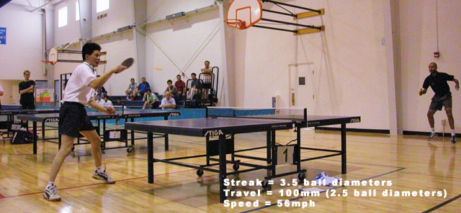
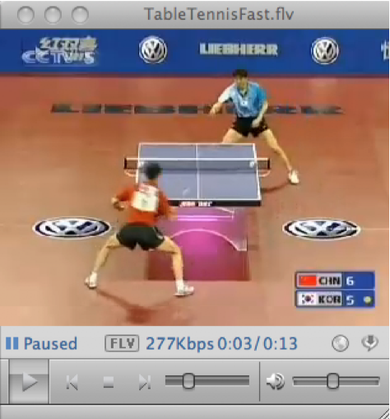
The sport of table tennis
see http://www.jayandwanda.com/tt/speed.html for a very cool & simple technique of measuring table tennis ball speeds
exposure time: 1/250 sec = 0.004 sec
distance traveled while shutter open: 100 mm = 0.1 m
60 mph shots not uncommon
spins in excess of 25 rev/sec
How much time does the opponent have, to react to a hard shot? Compare to a major-league pitch.
The sport of table tennis
Wang Lin vs Ryu Seung Min
2005 World Championship
Notes:
this technique is really cool because
radar guns pick up the paddle often
huge drag (twice that of gravity!) slows ball almost immediately. Want a measure of instantaneous speed.

Slide 25
Effect on the three-point shot
Notes:
This is to do the calculations here instead of cramming them onto the margins on the next page, or doing them on the board as I did in 2011.
or it can be used for notes. there hasn’t been a page for that recently.
can I get some stats on Denver Nuggets home versus away? And their opponents home versus away?

Slide 26
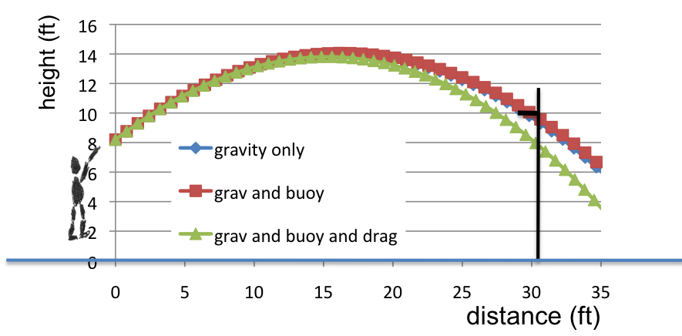
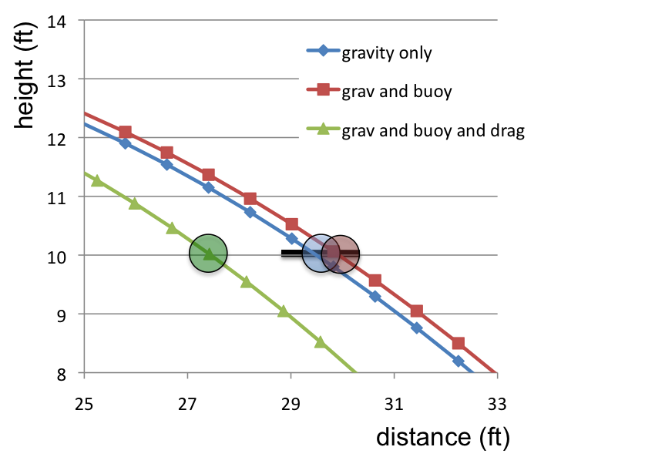
update on the 3-point basketball shot
hoop and balls to scale
launched a height of 2.5 m with v₀= 10 m/s at 35-degree angle
effect of drag opposite that of buoyancy. Both are important, but drag more so. (~2.5 feet!)
Notes:
pictures shown here are png files. excel charts and related stuff at end of this ppt file.

Slide 27
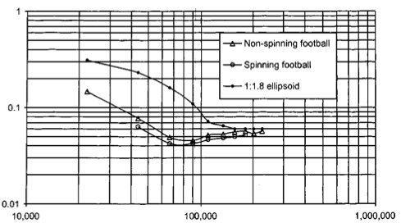
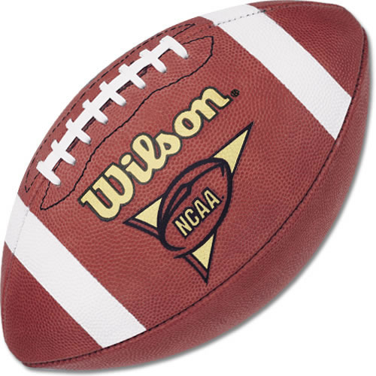
Drag force on a well-thrown football
C_{d} for football “nose-forward”
Watts & Moore,
Am. J. Phys. 71 791 (2003)
Typical pass ~ 22 m/s ~ 49 mph.
NCAA & NFL ball:
Short Circumference: 20 ¾"- 21 ¼"
Long Circumference 27 ¾"- 28 ½ “
Weight: approximately 14-15 oz.
5 m/s
(11 mph)
25 m/s
(55 mph)
~10% effect for well-thrown ball
so it falls more in the category of basketball (F_{d}/W~9%) than soccer, lacrosse, etc, just due to aerodynamics
C_{d} can be up to 10x more for tumbling
Notes:
so, like basketball, football is the exception to the “play at terminal velocity” rule. Like basketball, its more like 10%
But this is really because of the surprisingly small drag coefficient for nose-forward ball. we will study later how a ball keeps that orientation.
Also, numbers I’ve seen (but only in passing and not cited) suggest C[drag] could increase by 10x for tumbling ball)

Slide 28
punts with drag
height (yards)
Example based on The Physics of Football
by Tim Gay, chap 4
distance (yards)
Football punted with
v₀=100 ft/s
= 30.5 m/s = 67.8 mph
at 45 degrees
Temperature 70°F

Slide 29
punts with drag, discussion
(100 ft/s, 45 degrees) | Range | Hangtime | Risetime | Falltime
vacuum | 105 yd | 4.50 s
Denver Spiral | 85 yd | 4.25 s
Columbus Spiral | 80 yd | 4.10 s
Denver Tumbler | 46 yd | 3.45 s
Columbus Tumbler | 42 yd | 3.30 s
Notes:
on the risetime and falltime thing,
Answers to the un-filled-in table: (rise, fall)
vacuum: (2.25, 2.25)
Denver spiral: (2.05, 2.20)
Columbus spiral: (2.00, 2.10)
Denver Tumbler: (1.50, 1.95)
Columbus Tumbler: (1.40, 1.90)

Slide 30
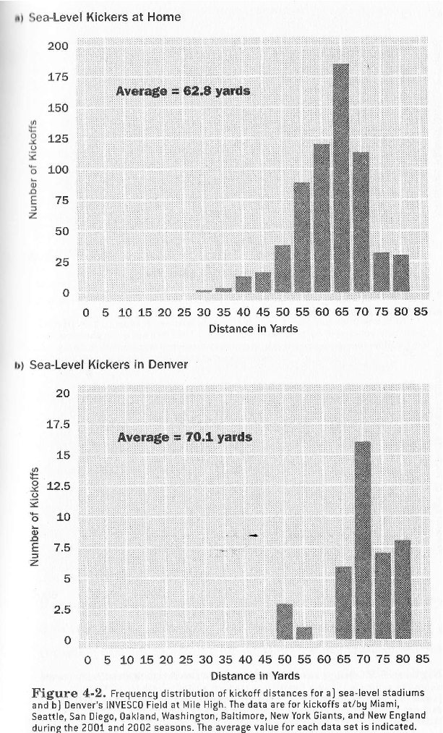
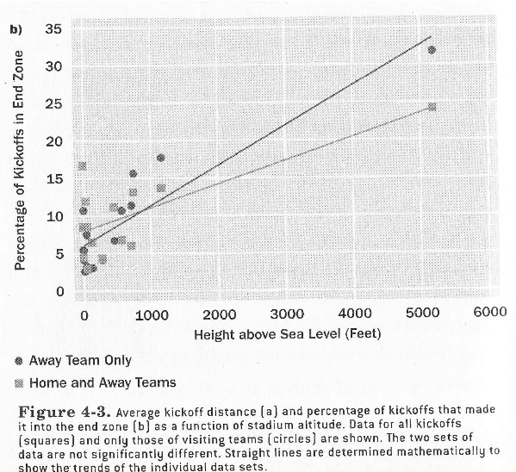
Denver is for kickers
...and golfers, and batters....
not so much for shot-putters
how about passers?
how about outfielders?
Figures from The Physics of Football
by Tim Gay, chap 4 On reserve at the library

Slide 31
Lecture 14

Slide 32
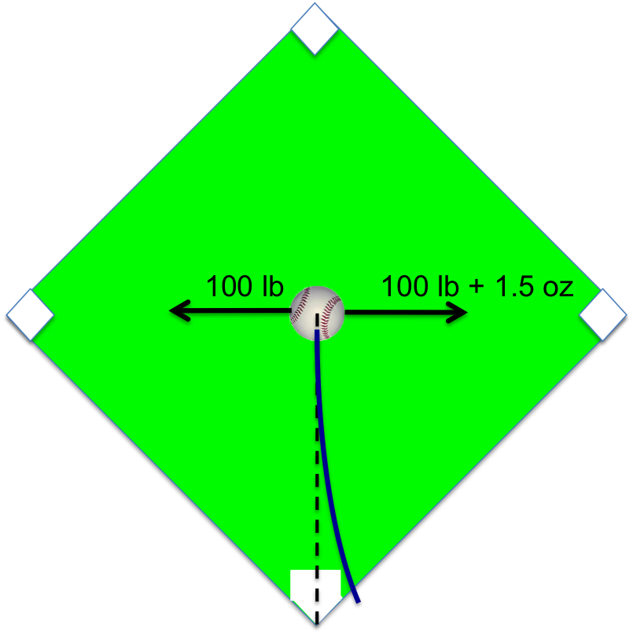
Air’s lateral forces on a baseball
100 lbs push towards 1st base due to air pressure
same air pressure generates 100 lbs towards 3rd
If this balance can be upset by just 1.5 ounces, how much is a 75 mph pitch deflected?
As we’ve just seen, forces on baseball due to moving air (e.g. drag) can be ~5 oz.
How can this force be directed sideward, not just backward?
Notes:
atmospheric pressure: 14.6 psi. Cross-sectional area of baseball = pi*(3.74 cm)^2 = pi*(1.47 in)^2 = 6.8 in^2 -→ lateral force: (14.6 lb/in^2)*(6.8 in^2)=99.44 lb
yep, just about 100 lb.
The nice thing about 100 lb and 1.5 ounces etc, comes directly from Bob Adair’s book p 13.

Slide 33
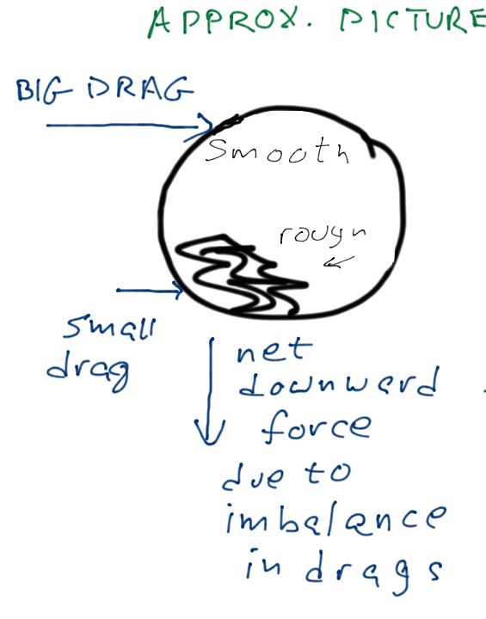
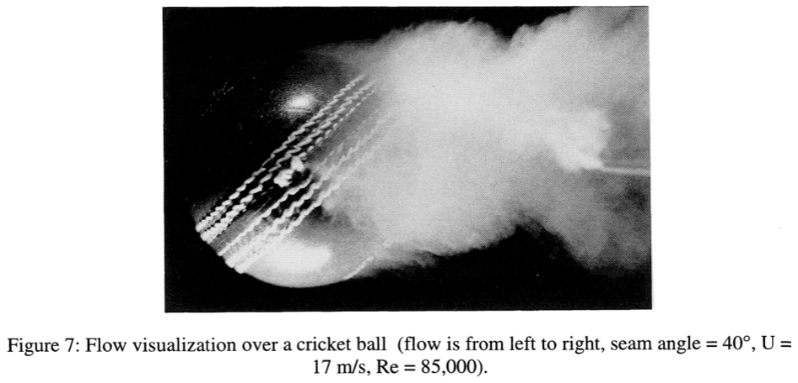
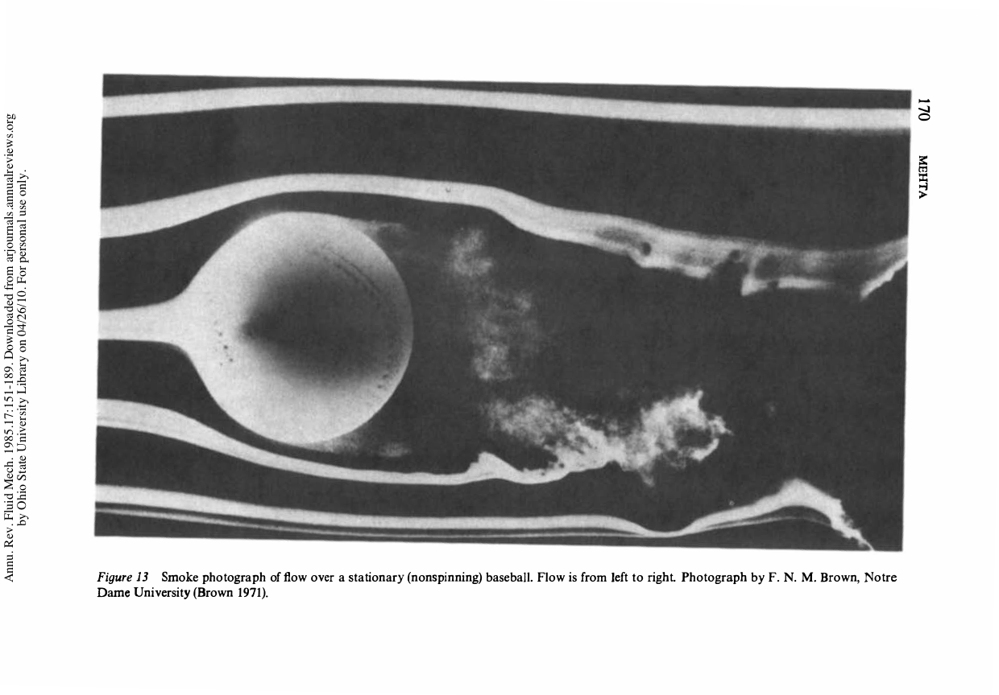
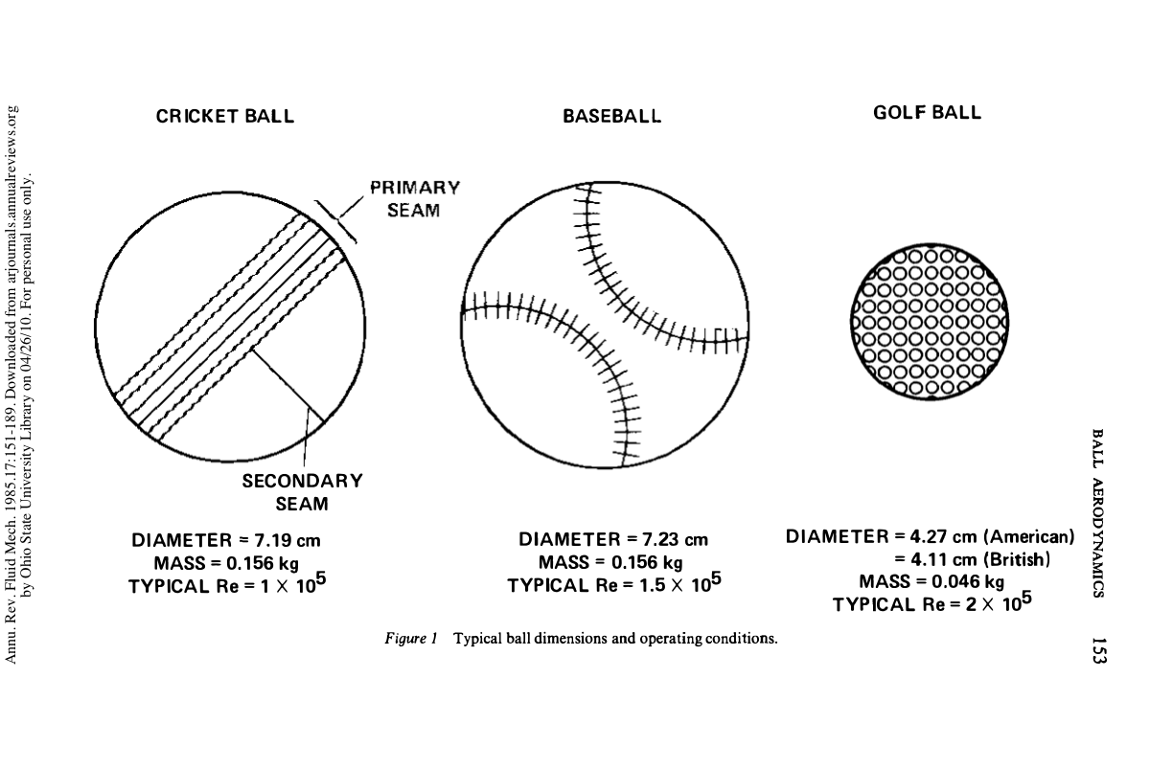
Tools of the bowler / pitcher (no spin)
asymmetry in surface / roughness
→ asymmetry of force
Air deflected upward
ball deflected downward
(Newton’s 3rd Law)
non-spinning cricket ball
(bowlers often try to maintain a
tilted orientation in flight)
symmetric case –
force only “backward”
non-spinning baseball
slight effect due to seams
principle behind knuckleball

Slide 34
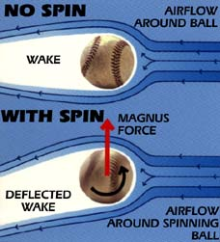
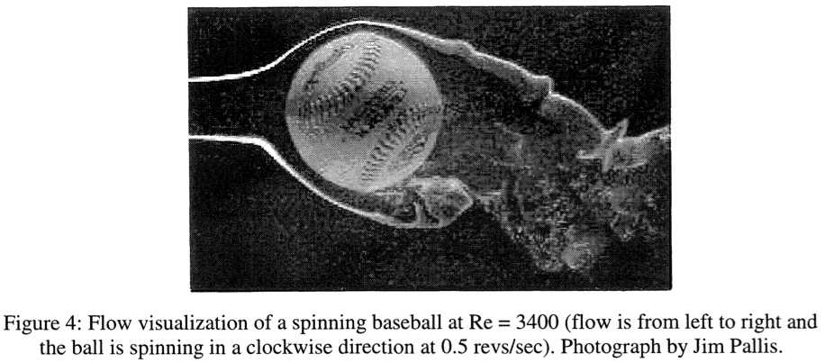
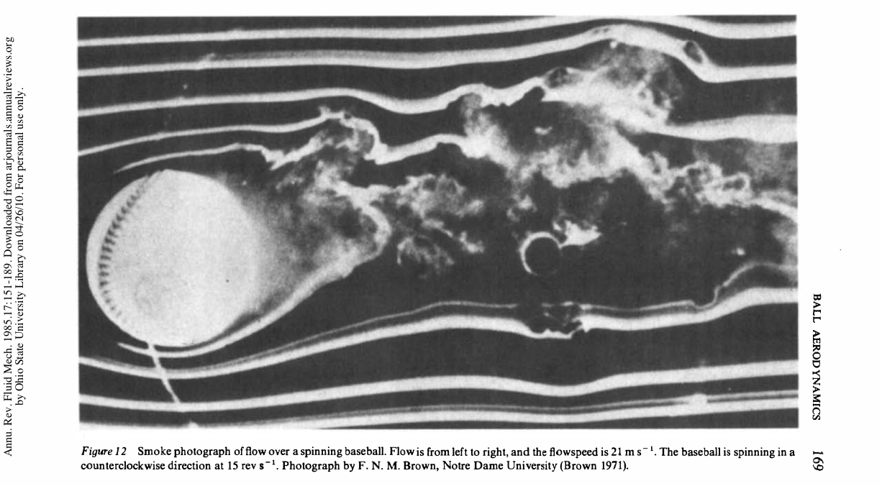
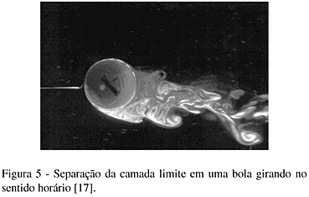
Magnus force - wake deflection due to rotation
Here the asymmetry is not due to smooth/rough giving more/less drag, but
“top” of ball moving faster relative to the wind than bottom → more drag on top
Rule: Sideward Magnus force
is in the direction that the “front”
of the ball is moving
(front means “into the wind”)
Which way are these balls moving?
Which way are they accelerating?
Magnus coefficient
C_{magnus} ~ 1 typically
f= # rotations per second
Notes:
next time – also show the video “Curve Balls” which I have in the videos directory (under physics demo library / effects of air)

Slide 35
Lecture 15

Slide 36
Forces, forces… an example
Forces on a table tennis ball…
near Earth
in air
initially falling (5 m/s) straight down while in air
spinning (10 rps, or 600 rpm) while it falls in air
m = 2.7 g
r = 2 cm
What is the magnitude and direction of the ball’s acceleration?
Sketch the subsequent trajectory of the ball.
Notes:
The full analysis of this has been scanned on 3 May, and is on two slides at the end of this file.

Slide 37
Forces, forces… an example (cont’d)
m = 2.7 g
r = 2 cm
Notes:
Do demo with Styrofoam cups spinning. Also, the demo with the foam tubing!

Slide 38
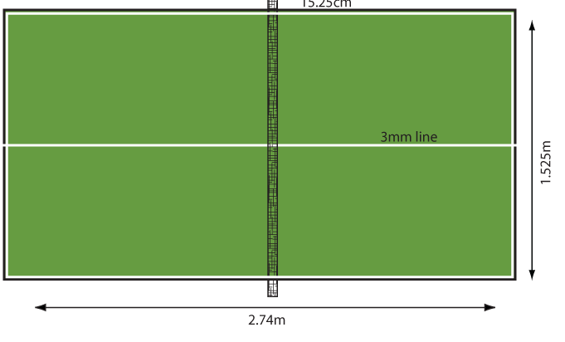
Example – slice of table tennis ball
for a good player, assume
v=28 mph and spin 60 rps (*)
(12.6 m/s)
hit horizontally 22 cm above table
(note net 15.2 cm high)
28 mph
Considering only gravity and Magnus force, where will the ball land?
[besides ignoring air drag, we will assume constant Magnus force; this is how one approaches a complex problem– adding complexity as needed]
(*) high but achievable: http://tabletennis.about.com/od/spin/a/spin.htm
Notes:
first step: how long is it in the air? Well, it has to fall 0.22 m starting with zero vertical velocity. t=sqrt(2*delta-y/g) = sqrt(2*(0.22 m)/(9.8 m/s2)) = 0.21 sec
[note that this is half as long as a major league fastball to reach home.]
fine. Now, how far forward does it go?
ESTIMATE that vx is constant (even though magnus accelerates it to the side) – so delta-x = vx*delta-t
delta x = 12.6 m/s * 0.21 s = 2.65 m, which is towards the back end of the table (good shot)
okay, now for lateral part (call it “y”)
vy0 = 0
ay = Fy/m where Fy is magnus
note that omega = 2pi*60 rps = 377 rad/s
Fmag = 0.5*C*rho*r*A*omega*v = 0.5*(1)*(1.2 kg/m3)*(pi*0.02^2)*(0.02 m)*(377 rad/s)*(12.6 m/s) = 0.072 N
[this is almost triple its weight of 0.026 N !!!]
ay = Fy/m = 0.072 N / 0.0027 kg = 26.5 m/s^2 (3 g’s !)
okay then delta-y = v0y*t + 0.5*ay*t^2 = 0+0.5*(26.5 m/s^2)*(0.21 sec)^2 = 0.58 m
so it hits at the back corner. not bad!
Now, again this is an ESTIMATE, since the magnus force points perpendicular to velocity, which (obviously) was changing, not always pointing to the right.

Slide 39
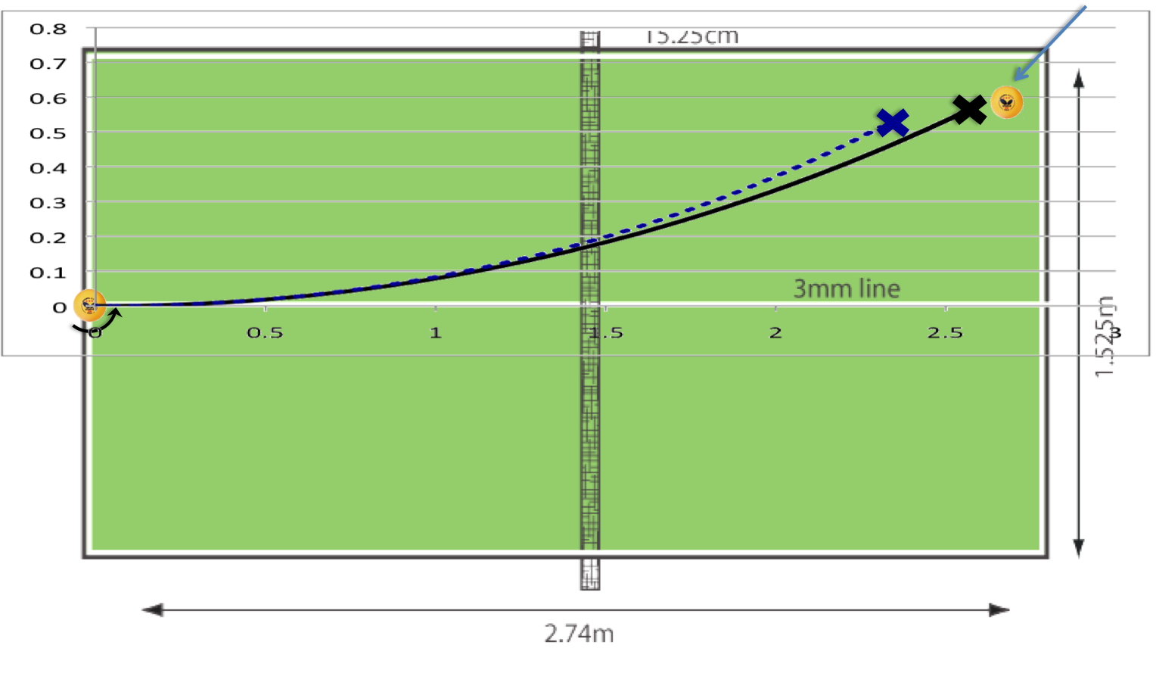
Table tennis slice, continued
our simple estimate
full magnus calculation
with drag
full magnus calculation
(no drag)
Closer and closer to the “truth” as effects are added.
Typical approach in science of complicated systems (like sports)

Slide 40
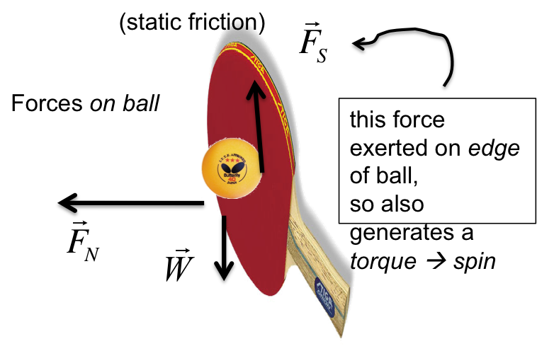
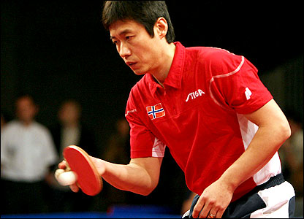
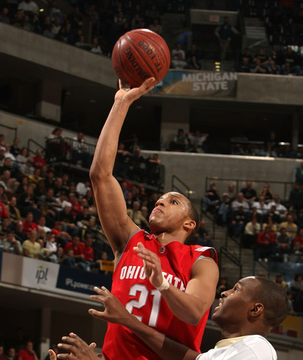
Generating a spin
upward slice generates topspin upon launch, resulting Magnus force leads to a diving shot
h (ft)
Table tennis ball
10 m/s at 5 degrees, 30 rps
x (ft)
Natural basketball wrist snap generates 2 rev/sec backspin
Knowing that a shot reaches about 1 meter above the hoop, about how many rotations does the ball make in a shot?
can someone find me a nice video?
Evan Turner
not Evan Turner

Slide 41
Final update on the 3-point shot
as before: shot from 2.5 m
at 10 m/s, at 35 degrees
with 2 rot/sec backspin
on a warm day in Columbus
rim and balls ~ to scale
backspin – makes huge difference
also: “steepens” descent due to asymmetric trajectory

Slide 42
v0 = 10 m/s (22 mph)
at 88 degrees
backspin 40 rps
Can we understand a “looping pop-up” in terms of the Magnus force?
At the highest speeds and highest spins, in “fast” games, the Magnus force can be on a par with gravity (sim drag)
radius (cm) | ball | mass (kg) | high speed (m/s) | f[rot] (rps) | purpose(s) | knuckle? | F[mag] (N) (max) | F[mag]/W (max)
2.00 | ping pong | 0.0027 | 14 | 25 | top/back/side float/dive/curve |  | 0.03 | 1.25
2.13 | golf | 0.045 | 55 | 60 | backspin - lift, increase range |  | 0.38 | 0.86
3.74 | baseball | 0.149 | 40 | 30 | top/back/side - sink/rise/curve | knuckler | 0.74 | 0.51
12.00 | basketball | 0.624 | 7 | 2 | backspin - lift, increase arc | claimed | 0.29 | 0.05
11.1 | soccer | 0.425 | 30 | 10 | sidespin bend (curve) | toe kick | 4.86 | 1.17
8.51 | nose-first football | 0.42 | 20 | 10 | spiral spin: on punt, ball curves left/right on descent
10.5 | volleyball | 0.27 | 15 | 10 | topspin on serve | "floater" | 2.06 | 0.78
3.25 | tennis | 0.058 | 30 | 30 | top/back/side float/dive/curve |  | 0.37 | 0.64

Slide 43
fastball vs sinker
We had calculated that a 93 mph (42 m/s) pitch crosses home plate in 0.46 sec
in this time, a horizontally-pitched ball falls…
A good pitcher might impart up to 1500 rpm (25 rps) of topspin.
How many times does the ball rotate, on its way to the plate?
Including Magnus, what is ball’s downward acceleration?
How far does it fall by the time it crosses the plate?
video: Tim Lincecum
The “magic” of Δy ~ t²: The ball does not “break,” but ¾ of its swing comes in the 2nd half of its flight, when batter is committed

Slide 44
Rising fastball?
There are claims of fastballs that “hop” enough to be rising as they cross the plate.
What would be the spin on such a ball?
But a wiffleball is another story
height (ft)
Ball “hops” relative to expectation
distance from release (ft)

Slide 45
Interactive simulations @ NASA website & copy linked to CARMEN
http://www.grc.nasa.gov/WWW/k-12/InteractProgs/sportsdown.html
Pitches – wind tunnel and overhead
Pitches - 3D
Bend of soccer ball

Slide 46
Path due to the Magnus force
We already know that any pitch will hit the ground in about 1/2 sec
Ignoring gravity, what path will a 78 mph slider take?
centripetal
acceleration
Notes:
draw the path of baseball on the right, velocity vector and force vector. then continue it (dotted line) and draw velocity vector and force vector
in a homework or something, have them calculate the circular path of a soccer bending kick and a table tennis side-curver

Slide 47
circular boomerang
While it only deviates about 10” by the time it crosses home plate, given enough space, a pitcher could throw a slider, then turn around and catch it.
How long would he have, between throw and catch?
400’
Notes:
given enough space (and ignoring gravity), a pitcher could throw a slider and then turn around and catch it.

Slide 48
Cosmic rays, particle physics and baseball
why are they not circles?

Slide 49
fútbol and football
a favorite pastime for young people:
bending &posting
In Football Physics (on reserve at library), Univ. Nebraska Prof. Tim Gay discusses several rotational effects– some rather complicated– in detail.
One I found interesting: On our table of Magnus force in different sports, football was unique in having its spin often as a spiral– the “front” of the ball is not moving in such a way as to produce a Magnus force
if spiral is always along “long” axis, and nose is always “forward,” no Magnus force

Slide 50
“nose up” & “turnover” punts
What does the receiver see, on the ball’s way up?
on the way down?
Does it matter whether the kicker is left- or right-footed?

Slide 51
“Knuckling”
The lateral Magnus force does not rely on features of the ball’s surface (though the Magnus coefficient can depend on the surface).
In a sense, the rapid rotation “averages out” the surface features, as they encounter the onrushing wind.
“blurred” by spin
Tim Wakefield knuckleball video.
However, as we’ve discussed (e.g. relating to cricket) a strong lateral force can be generated by such features.
Knuckling: throwing a ball with no or very low spin such that asymmetric drag forces are generated at random. Trajectories can “flutter” with bends in both directions. Figure from Adair, based on wind tunnel measurements).
Figure from Adair, based on wind tunnel measurements
A true knuckleball is unpredictable to the batter, catcher and pitcher.
While the name originates from an early way of holding the ball while throwing such a pitch in baseball, the technique is also used in volleyball (on some serves) and soccer (intentionally or not, with toe-kicks).
In The Physics of Basketball, (on reserve at the library), John Fontanella speculates that players who fail to put backspin on long shots unwittingly generate knuckling forces.
In The Physics of Baseball (on reserve at the library), by Bob Adair:
One catcher, known for his success with knuckleball pitchers, was asked how he managed to handle the pitches. He replied that it was easy, explaining that he just waited until the ball stopped rolling and picked it up.

Slide 52
“No” spin wanted
Tim Wakefield
Wade Boggs
wakefield video
kids and cameras

