Slide 1

The Physics of Sports
PHY 010 “Topics in Physics”
TR 10:30-11:50
Roessler 55
Instructor: Daniel Cebra
CRN 36469,36469,36470
Goals:
To develop an understanding of the principles, theories and methods of fundamental physics and the relationship and implications to address problems in the real world in the context of athletics.

Slide 2

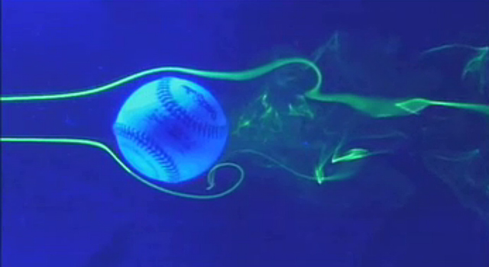
Welcome to Physics 10 – The Physics of Sports
Q) Will I become a better athlete/player by taking Phys 10?
A) Probably not. For that, you should listen to your coach or trainer, not a physics professor. However, you will learn the science behind some things your coach tells you (e.g. focus on consistency rather than increasing head speed, on a golf swing).
Goals
to understand the physics (forces, energy, etc) behind what your body already knows.
to appreciate a scientific approach to a complex system
The physics of sports is not the clean well-defined physics of fundamental matters [e.g. Large Hadron Collider]. Hence, conclusions must depend upon approximations and estimates. But estimates are part of the physicist’s repertoire.
E.g. path of a ball. Successive approximations:
consider only gravity
only gravity and air resistance
only gravity, air resistance, and Magnus
gravity, air resistance, Magnus, and buoyancy
The physics of sports isn’t rocket science. It’s much harder.
-- Bob Adair in The Physics of Baseball
Notes:
ALL world citizens should have such an appreciation for the science of complex systems, as they grapple with climate change, etc.

Slide 3
Scientific notation
Any number can be written D.DD ×10^{n}
Number of days in January: 31 =
Number of Students on the UC Davis Campus (fall 2012): 32,653 =
0.005 =
600,000 =

Slide 4

Units and Conversions – length, time, speed
British (Imperial)
1 mile = 5280 ft
1 ft = 12 in
1 yd = 3 ft
1 lb = 16 oz
1 gallon = 8 pints
Metric (SI)
1 km = 1000 m
1 m = 100 cm
1 kg = 1000 g
1 liter = 1000 ml
Only Burma, Liberia and the U.S.
have not adopted SI as the primary system of measurement
- source Wikipedia
which is more
“natural”?
Between systems: 1 mile = 1.609 km 1 in = 2.54 cm
1 mile =
1 mile =
1 mile =
1 m =
1 hr =
100 mph =
SI prefixes – indicate factors of 10 of a given unit (meter, liters, etc)
Of the 20 SI prefixes, we will only be using 3:
kilo | k | 1000 = 10³
centi | c | 0.01 = 10⁻²
milli | m | 0.001 = 10⁻³
1 mg = 10⁻³ g = ________ kg
Notes:
100 mph = 44.7 m/s - one to remember
1 m = 100 cm = 100/2.54 in = 39.37 in = 3.28 feet = 1.09 yards
Football field --- hash marks are on the yard lines
Basketball --- hoop is ten feet high
Soccer – goal box is 8 feet high, 8 yards wide
Baseball --- home plate to first base, 90 feet

Slide 5
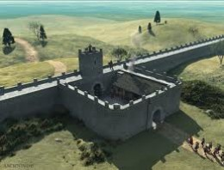
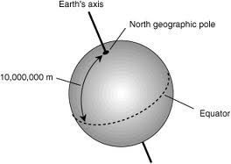
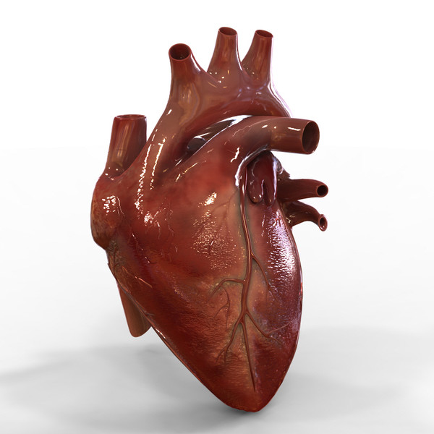
Where Did the Unit Systems Come From?
Mile is derived from the roman mille passum, meaning one thousand paces
The kilometer is not that much more noble, 10,000 km is the distance from the pole to the equator.
One second is the time of one heartbeat
Notes:
Foot --- size of a man’s foot
Inch --- size of one finger knuckle
Yard --- half a pace
Pound --- weight of one pint of water

Slide 6
You can always multiply by one
Multiplying any quantity by one (1) doesn’t change it.
Just as true, and more useful, when units are included…
which “one” to use?
2 laps around track =
length of my finger: f = 2.4 inches.
What if we multiply this by 1 = (1 in)/(2.54 cm) ?
Participant in “walk-a-thon”: v = 3 mph.
Express in units of “laps around the track per 12-hour night”

Slide 7
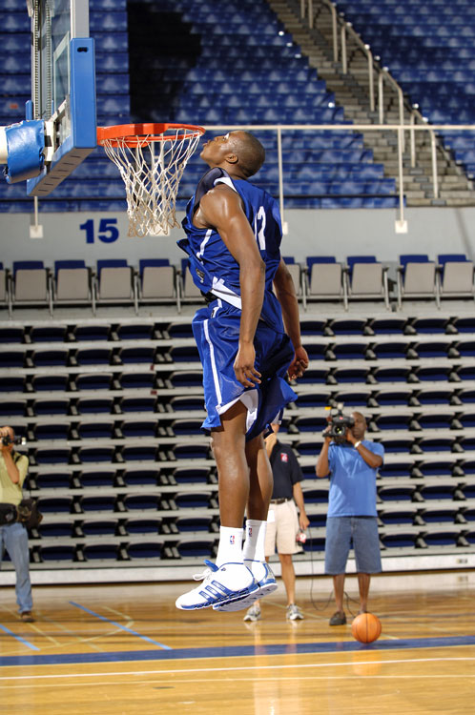

Putting sports into numbers - 1
A scientific treatment of sports requires quantification.
Very often, this means approximate quantification, based on photos or video.
On photos, use known objects for scale.
Notes:
Dwight Howard --- 6’ 11”

Slide 8
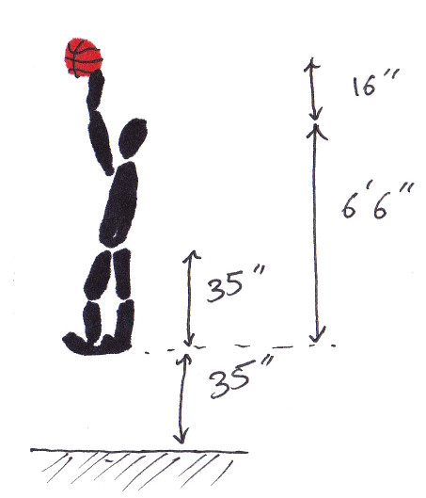
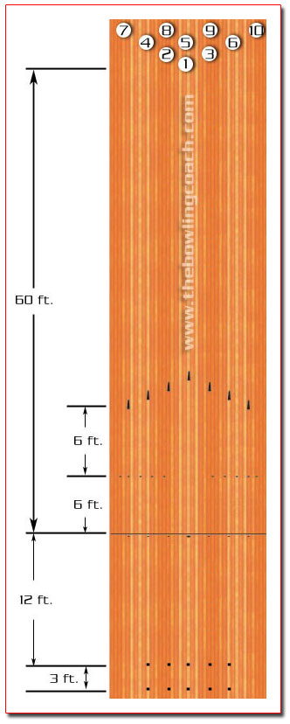
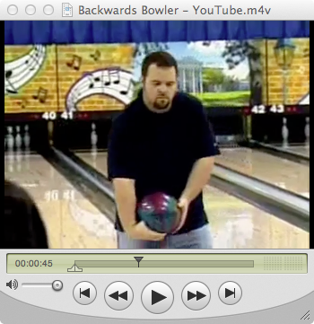
Putting sports into numbers - 2
A scientific treatment of sports requires quantification.
Very often, this means approximate quantification, based on photos or video.
When there is no photographic footage of the situation, or if we are discussing a hypothetical event, we need “typical” scales
Typical height (male):
Speed of a sprinter
marathon runner
Man’s weight (and mass)
Major league fastball
Professional bowler roll
Notes:
Height of male: 5’ 9”
Speed of sprinter: 10 m/s (100 meters in 10 seconds)
Speed of marathoner: 5 minute miles => 12 mph
Man’s weight: 200 lbs, 85 Kg
Major League fast ball: 90 mph
Professional Bowler: 35 mph
Video: backward bowler https://www.youtube.com/watch?v=64vbnwtL7I8
I had no idea how fast a bowler rolls, so I looked up the length of a bowling alley (60’ from foul line to head pin) and found a YouTube video of the “Backward Bowler.” Kind of funny! Regardless of bowling backward, he has a “typical” speed ball. Frame-by-frame analysis: delta-t = 2.2 sec.
v= 60’/2.2sec = 27.3 ft/s = 8.3 m/s = 18.6 mph
[very similar to basketball foul shot, interestingly. AND to a fast runner. it’s speeds like this that make video, with its 30 fps frame rate, perfect for sports. Things like golf balls or fast balls or tennis serves require high-speed footage.]

Slide 9
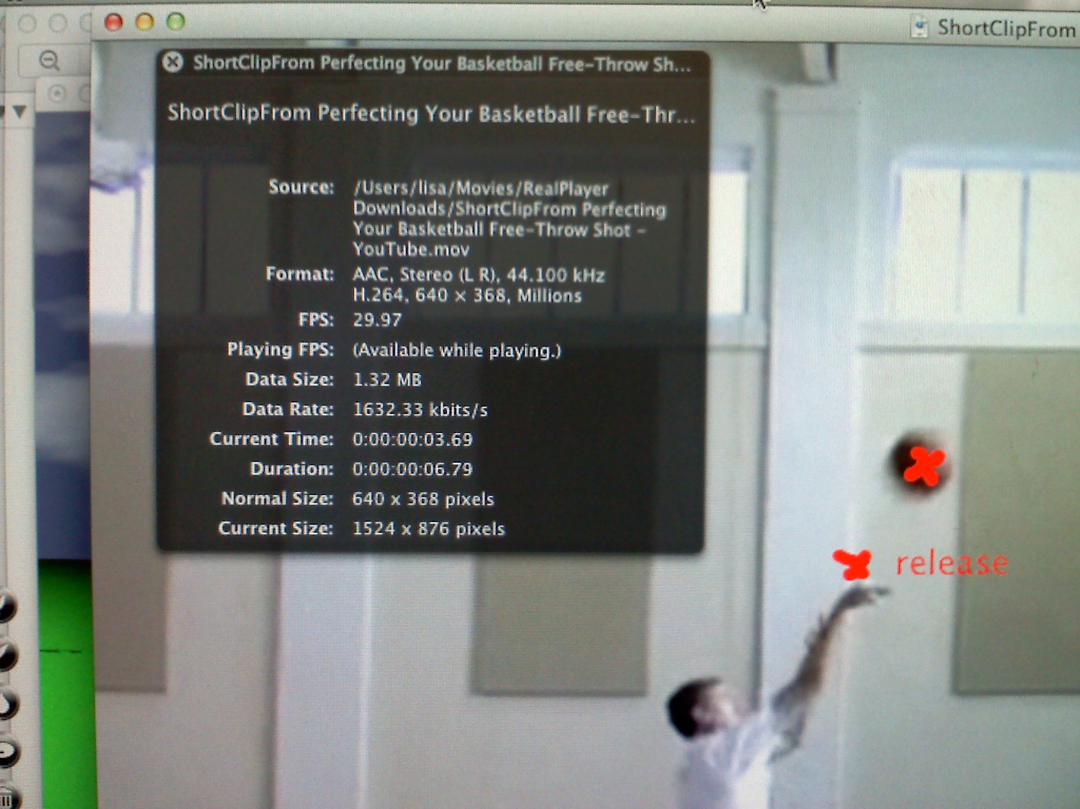

Putting sports into numbers - 3
A scientific treatment of sports requires quantification.
Very often, this means approximate quantification, based on photos or video.
For video (e.g. downloaded from YouTube), use QuickTime 7 (not QuickTime 10)
which will show you the “Movie Inspector” window
30 frames per second (fps) is typical
this tells the time of the frame, down to 3/100 of a second. good enough for many of our purposes (QT 10 has less precision)
Also see Figure 1.1 in your book,
and discussion
Notes:
Three videos.
the foulshot one (since it has such nice contrast and a non-moving camera) in the picture
Roger Federer
DeShaun Thomas (since he’s in the class; last year I used Jared Sullinger) – see if you can find one where the camera doesn’t pan!!!
a video I downloaded from Youtube, a “Monkey See” instructional video on foul shots. I took a 5-second clip from the 4-minute video. Mark it up with the ScreenMarker app for mac.
To get the image on this page, I actually had to take a picture of my screen with my cellphone (!!!!!) because QuickTime takes away the “Movie Inspector” window unless QuickTime is the application running.
The distance the ball travels between two frames is about one length of his hand, estimated to be 9” (a bit larger than mine, since he’s taller and anyway I have small hands) or 0.75 ft. The time between frames is 0.03s → v = 0.75’/0.03s = 25 ft/s = 7.6 m/s = 17 mph. Which is just about right, compared to Fontanella’s book.
Also show the Roger Federer serve video. The one I used to make the Fig 1.1 in the book.
Notes of Quicktime --- reads AVI, DV stream, MP2, MP4, QuicktTime Movie formats
Use FSS video downloader to capture videos and convert their formats.

Slide 10


Notes
Notes:
this is essentially for notes on the Federer and Sullinger (or should it be DeShaun Thomas??) video.

Slide 11
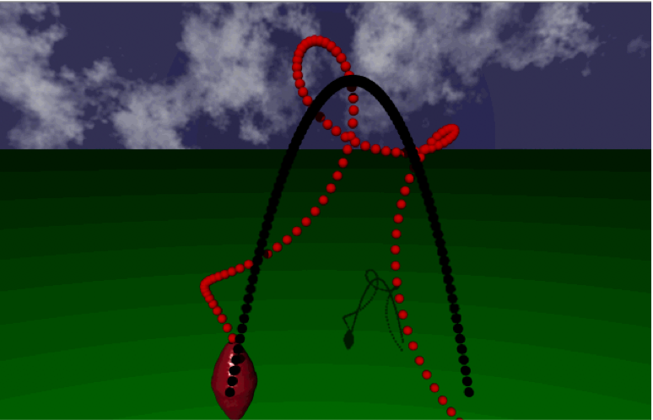
Where “it’s” at –the center of mass
We will often reference “the position” of something (a ball, a person...) The position will appear in mathematical formulas
But when we discuss “the” position of a football, do we mean
the position of its tip?
the position at its center?
the position of one of its laces?
We could find equations for any of these positions, but usually we will mean the center of mass (or “center of gravity”)
The center of mass (a.k.a. center of gravity) is the point at the “average position of the matter” of an object.
The c.m. usually follows a much simpler path than any other part of an object.
c.m. always hangs directly below a free pivot point
an object can be balanced at, and only at its c.m.
a person is stable only if her c.m. lies above a position between her points of support
c.m. follows a parabola in free flight
any spinning takes place about an axis through the c.m.
Notes:
Video: my little animation thing
in class: get a volunteer who says they can touch their toes.
Have them show that they can.
Then, place them with their back directly against a wall and their heels against a wall. They will not be able to touch their toes, as they will fall over.
Bring Physics Phil (the wooden model doll) and have him touch *his* toes – show it only works if he pushes his butt backwards, so his c.m. is over his position of support.
Show The Matrix clip

Slide 12
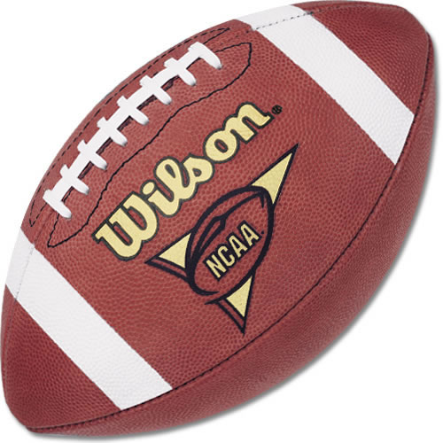
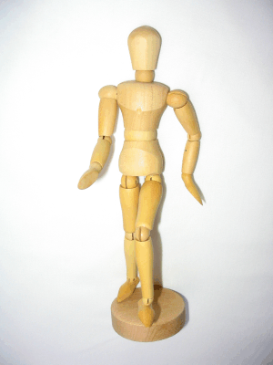
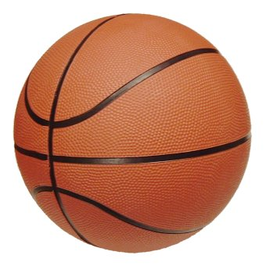
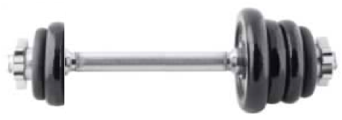
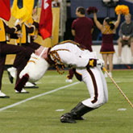
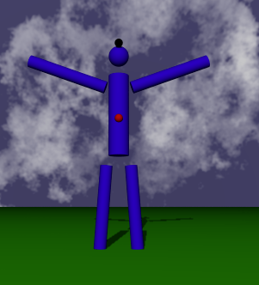
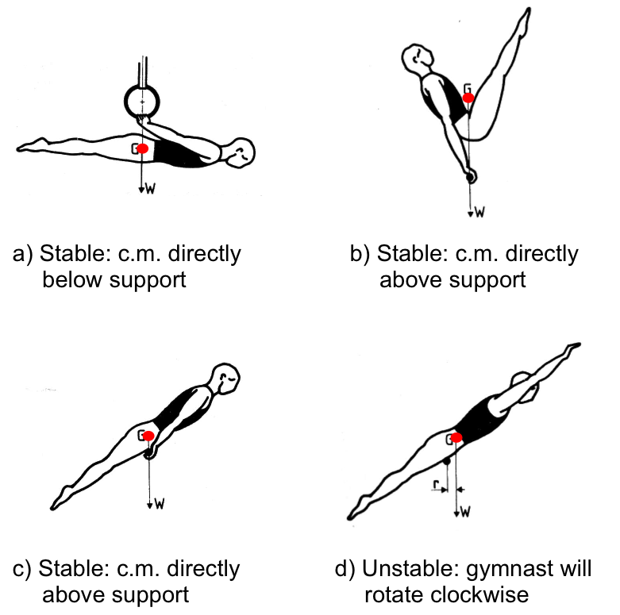
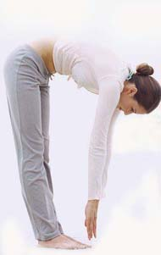
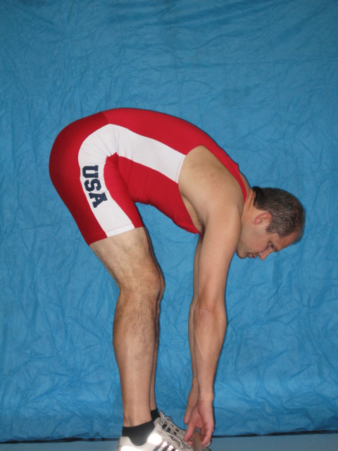
Where “it’s” at –the center of mass
center of symmetric objects
towards the mass
just below navel on
person standing at ease
Crucial to sports:
c.m. changes as a person changes their body position
c.m. and stability
Notes:
Video: my little animation thing
Volunteer thing.
And Phil the mannequin thing
in class: get a volunteer who says they can touch their toes.
Have them show that they can.
Then, place them with their back directly against a wall and their heels against a wall. They will not be able to touch their toes, as they will fall over.
That video of mine is important and versions of it will appear again– get them used to it. The head (black dot) is not moving, but the c.m. is. The c.m. is what shows up in our equations.
Bring Physics Phil (the wooden model doll) and have him touch *his* toes – show it only works if he pushes his butt backwards, so his c.m. is over his position of support.
Have Phil do the backbend, too. Show how if he even just barely lifts his arm, he goes over.

Slide 13
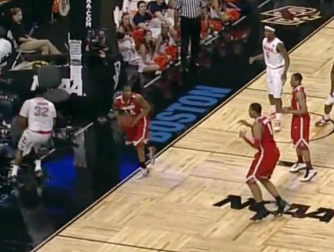
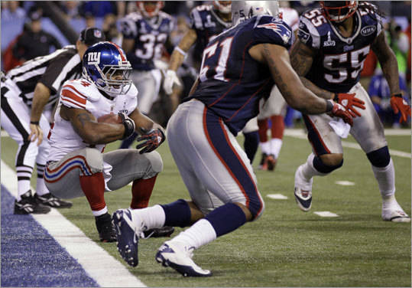
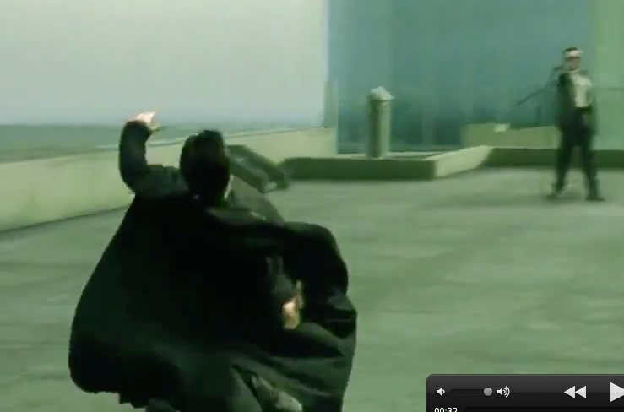
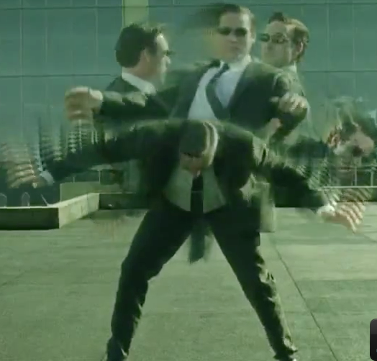
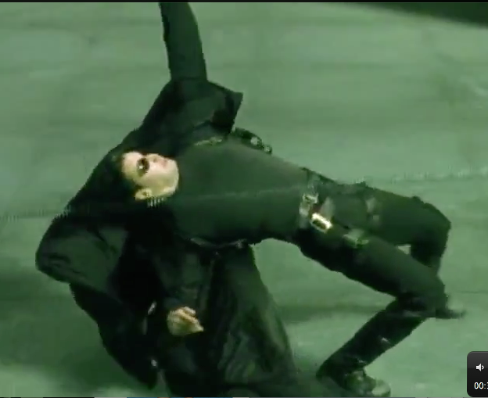
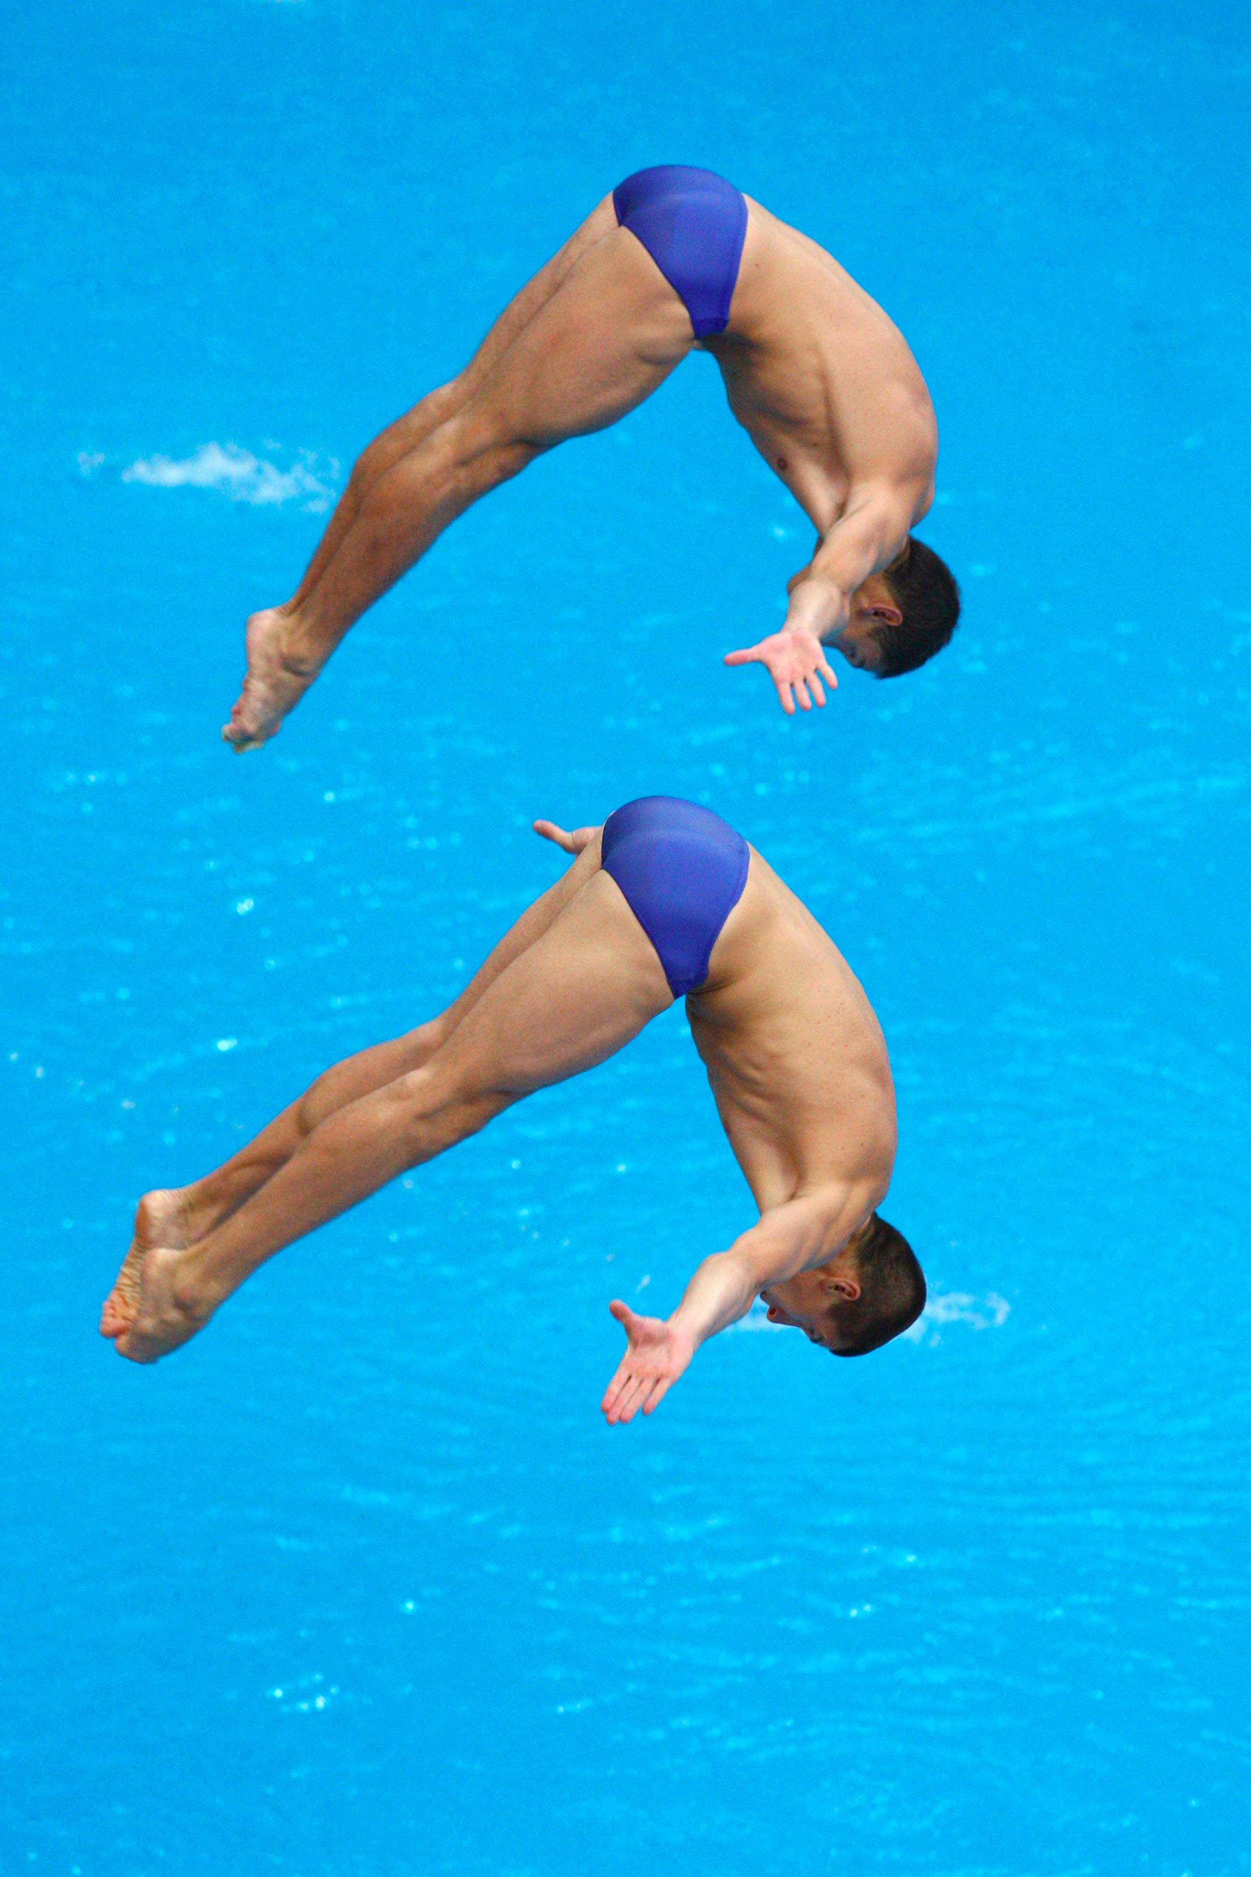
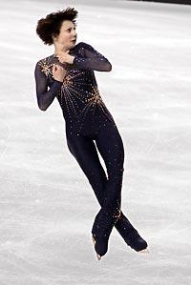
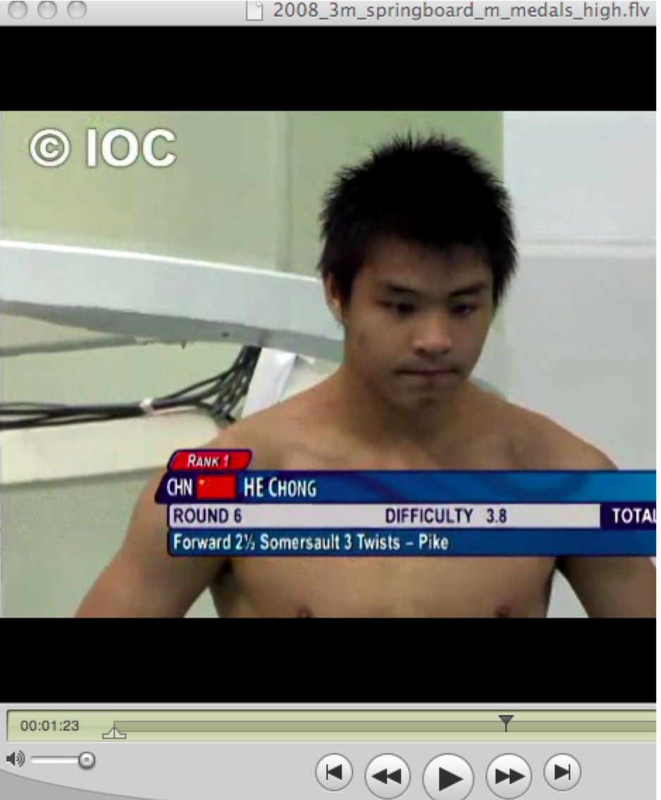
Where “it’s” at –the center of mass
Buford in Elite Eight, 2012
Ahmad Bradshaw Superbowl XLVI
Neo versus an Agent in The Matrix
“just” crazy fast
Beyond crazy fast
any spinning takes place about an axis through the c.m.
Ukraine Divers Illya Kvasha and Oleksiy Prygorov
Bronze medal in 3m synchronized diving, Beijing 2008
He Chong 2008 Olympics
Irina Slutskaya
Notes:
Two videos
Diver (He Chong) and The Matrix
(don’t do Irena Slutskaya for now).
Show The Matrix clip
Show Irena Slutskaya and a diver (need to find a video.
(Don’t show “flapping and jumping” video right now.)

Slide 14
Lecture 2

Slide 15
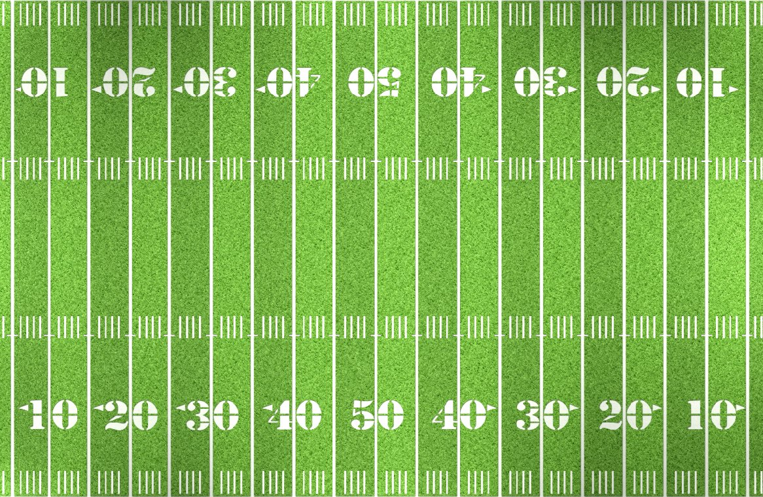
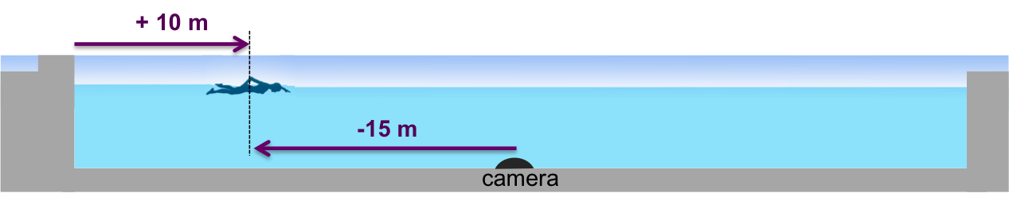
Kinematics – quantifying motion
kinematics: deals essentially with time and position (x,y,z)
  for now, just time and x
motion is when things change.
  ∆x = change in position (aka “displacement”)
  ∆t = change in time
average speed: distance traveled (in some time) / ∆t
average velocity change in position (in some time) / ∆t
  Terrelle Pryor: 40-yard dash in 4.33 sec [Show Terrelle Pryor Video]
  calculate v_{ave} in yd/sec, then m/s, then mph
  [Show Punt for the National Championship Game Video]
  [Show Michael Phelps Video]
Notes:
calculate Vave in yd/sec, then m/s, then mph
Emphasize the point: This is how AVERAGE velocity is defined.
Obviously, at t=0, instantaneous velocity is 0. And at t=4.33, v>vave.
vectors versus scalars
We are coming to that on the next pages.
Draw football field and show position x – and importance of origin

Slide 16
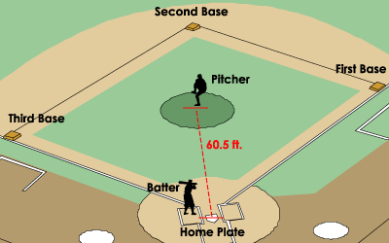
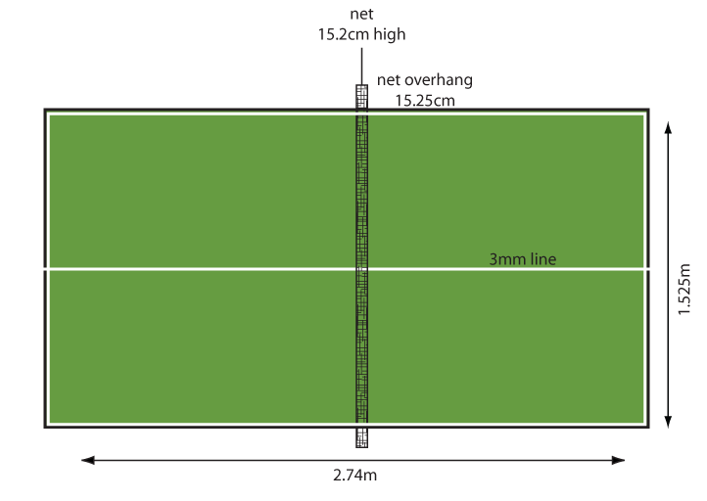
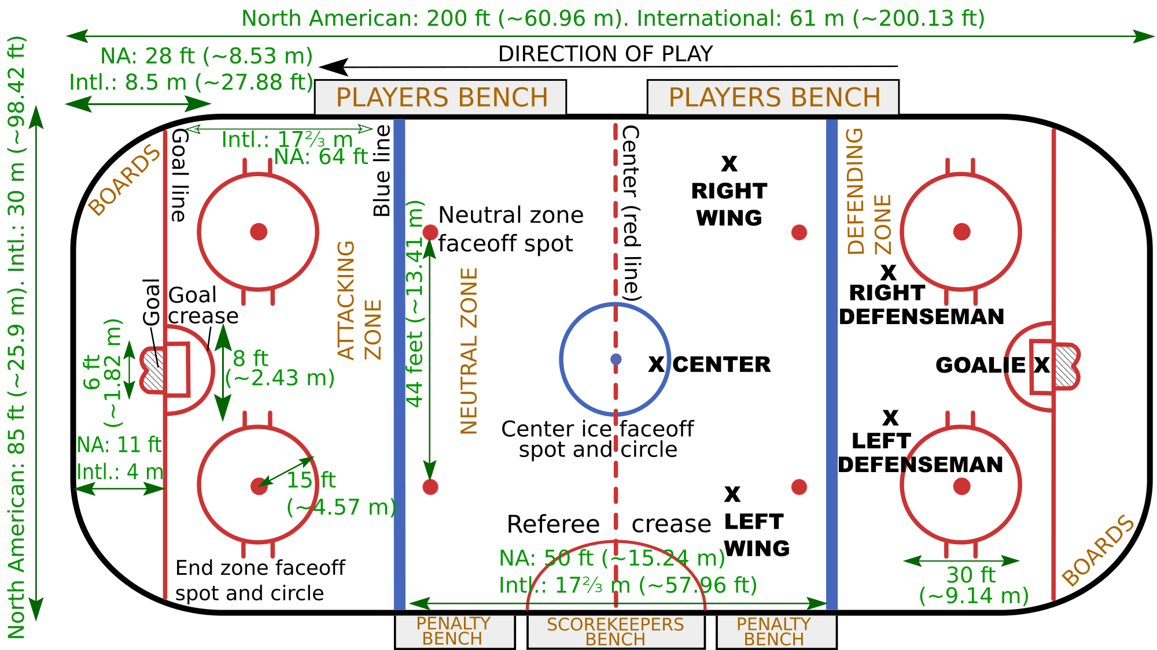
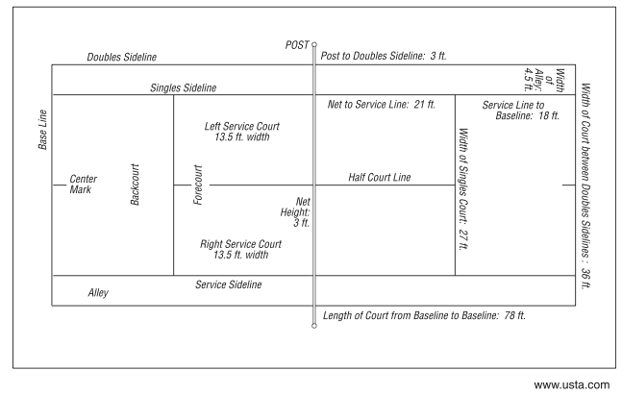
reaction time in “fast” games
[Show Home Run Video]
0.450 sec
http://science.kqed.org/quest/video/anatomy-of-a-home-run-web-only/
[Show Ping Pong Video]
[Show Slap Shot Video]
[Show Tennis Video]
Notes:
video: table tennis game
baseball ~ hockey ~ 100 mph (which is terminal velocity) delta-t ~ 0.35 s = “fast”
table tennis: ~25 mph (average) which is ALSO terminal velocity; delta-t ~ 0.35 s = ALSO fast
tennis: slower and bigger distance. Why? Because unlike batter, goalie, table-tennis player, a tennis player has to run to the ball!!
Games are designed to play off space and time.

Slide 17
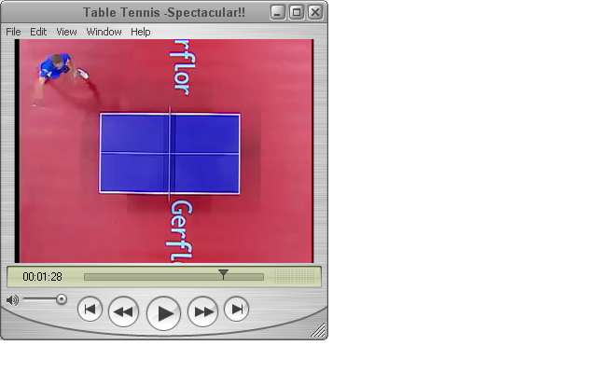
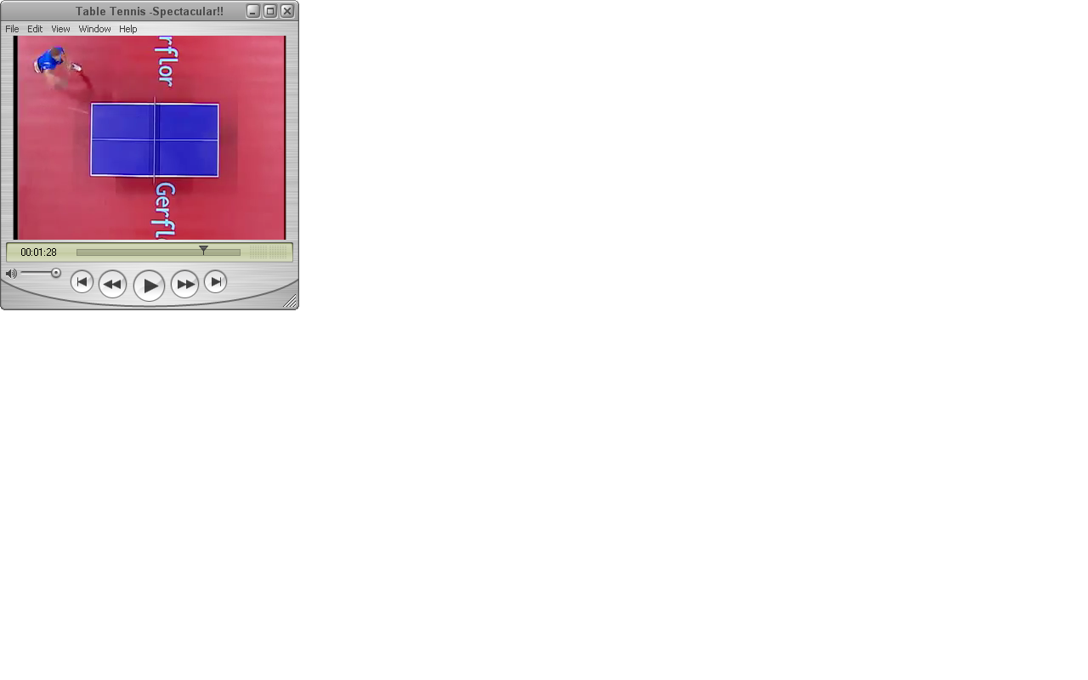

Current Time 01:28.59
2.74 m
Current Time 01:28.62
0.76 m
Distance = √(x²+y²)
= 2.82 m
Current Time 01:28.79
Δt = 1:28.79 – 1:28.62 = 0.17 sec
v = Δx/Δt
= 2.82 m/ 0.17 sec
= 16.6 m/s

Slide 18
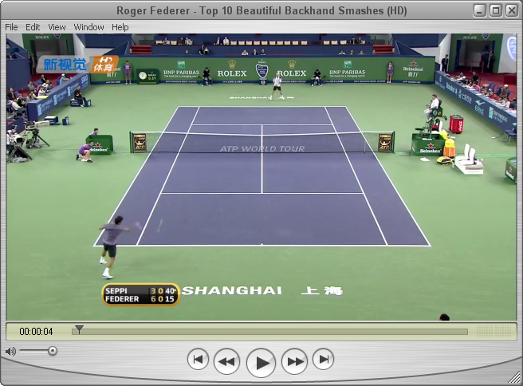
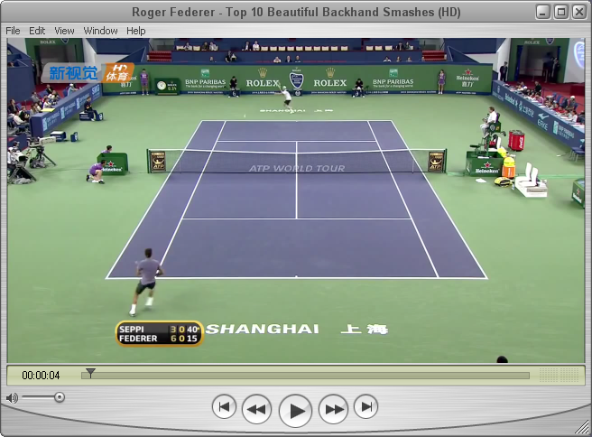
4.08 sec
4.84 sec
70 mph
Notes:
Delta t = 0.76 seconds… longer then baseball, hockey, or ping-pong.
Speed =

Slide 19
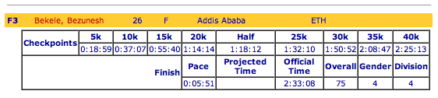
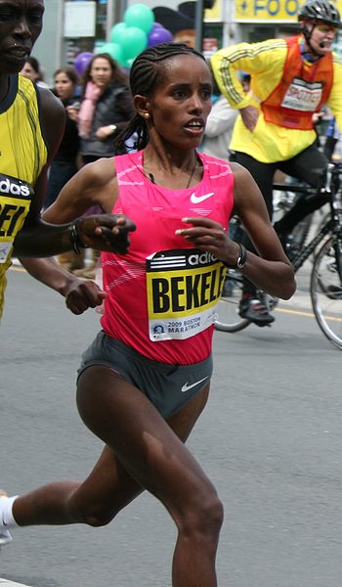
Example with graphs – Boston Marathon 2009
from http://www.baa.org/2009/
Bekele’s time: 2:33:08
  in hours: ________ hours
  in seconds: _________ s
Distance run: 26.2 mi = 42.2 km
Bekele’s average speed
  = _______ mph
  = ________ m/s
Average speed for first 5 km only:
= ________ m/s
Notes:
Bekele – 4th place for women

Slide 20

Graphs – a picture is worth 1000 words (or numbers)
Bekele
 | t (s) | x(km)
0:00:00 | 0 | 0
0:18:59 | 1139 | 5
0:37:07 | 2227 | 10
0:55:40 | 3340 | 15
1:14:14 | 4454 | 20
1:32:10 | 5530 | 25
1:50:52 | 6652 | 30
2:08:47 | 7727 | 35
2:25:13 | 8713 | 40
2:33:08 | 9188 | 42.2
my friend from Worthington
 | t (s) | x (km)
0:00:00 | 0 | 0
0:25:27 | 1527 | 5
0:48:58 | 2938 | 10
1:10:21 | 4221 | 15
1:35:53 | 5753 | 20
2:16:37 | 8197 | 25
2:59:36 | 10776 | 30
3:40:29 | 13229 | 35
4:04:04 | 14644 | 40
4:13:11 | 15191 | 42.2
45
40
35
30
distance (km)
25
20
15
10
5
0
0
2
4
6
8
10
12
14
16
thousands of seconds
Notes:
slowly go through the points of graphing.
What are the axes?
have them fill it in, at least the shaded parts (yes, it’s slow, but just do it to get what a plot means)
Especially with the "friend from Worthington," you can see the "fade," quite different from the almost-constant speed of Bekele.
COMPANION SLIDE AT END – SHOWS THE PLOT FILLED IN
show:
his AVERAGE velocity is lower then her AVERAGE velocity (he is slower, overall)
Segues back to discussion of instantaneous velocity, changing velocity, and so... acceleration.

Slide 21
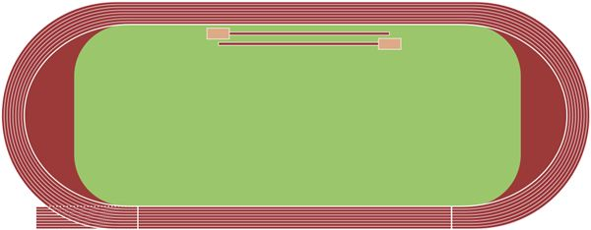
speed, velocity
Notes:
can draw a 100-m dash speed = (magnitude of) velocity
200-m dash: speed much larger than velocity
400-m velocity = 0 (!)

Slide 22
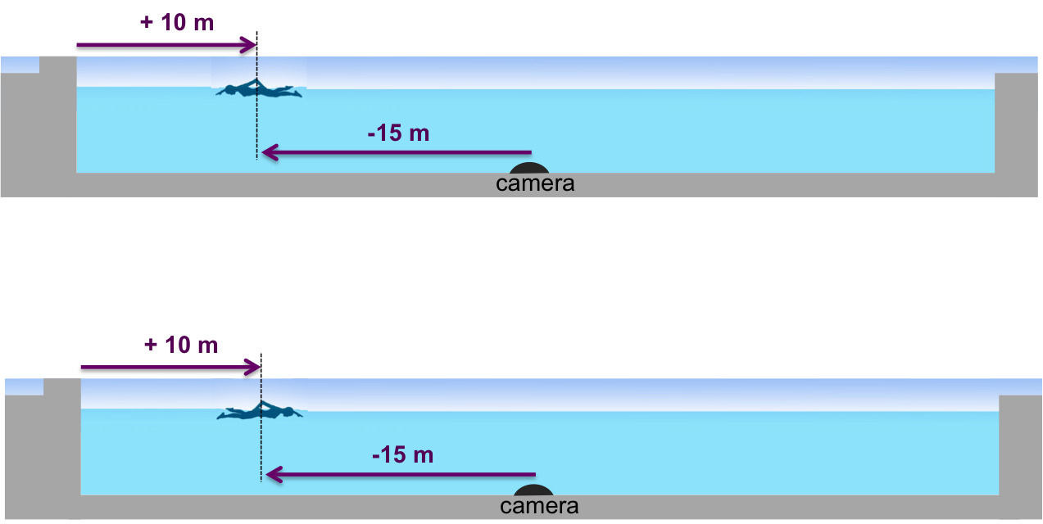

Slide 23
Lecture 3

Slide 24
What do these graphs mean?
Which one would correspond to Terrelle Pryor’s 10-yard sprint that we discussed earlier?
[Show Pryor video again]
x
x
time
time
x
x
time
time
x
x
time
time
Notes:
Which one would correspond to Terrelle Prior’s 10-yard sprint that we discussed earlier?
On Terrelle’s plot, draw straight line from end to end. The slope of that line shows the average velocity. Clearly the instantaneous velocity is different, and is always changing.
Also on Terrelle’s plot, mark x=0 and x=10 yards and t=0 and t=4.33 s

Slide 25
Average and instantaneous velocity
40
x (yd)
30
20
10
reaction time
~ 0.2 s
1
2
3
4
time (s)
The slope of the tangent line is the instantaneous velocity
What is v at t=3.25 s? v(3.25 s) = __________________
at any given time, your instantaneous velocity differs from the average velocity of the trip
A car’s speedometer measures instantaneous velocity
Notes:
can also point out that NFL 40-yard times are usually HAND-STARTED which means that the reaction time is taken out! (so in the NFL, this would be a 4.3 sec, whereas in track, it would be about 4.6 sec

Slide 26
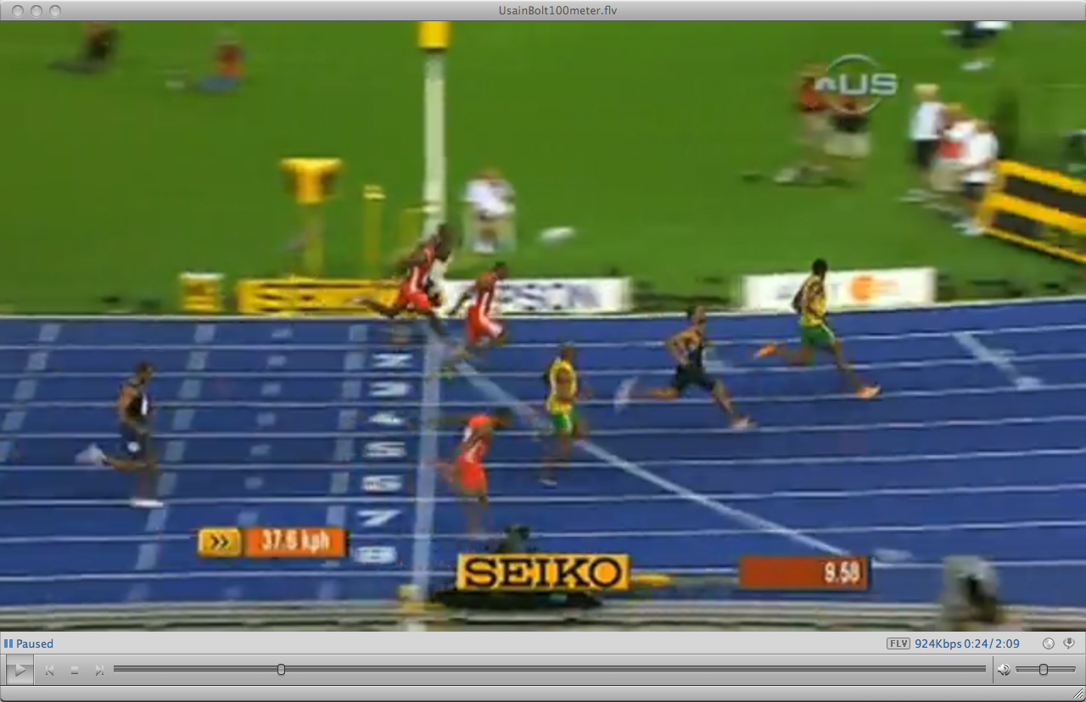
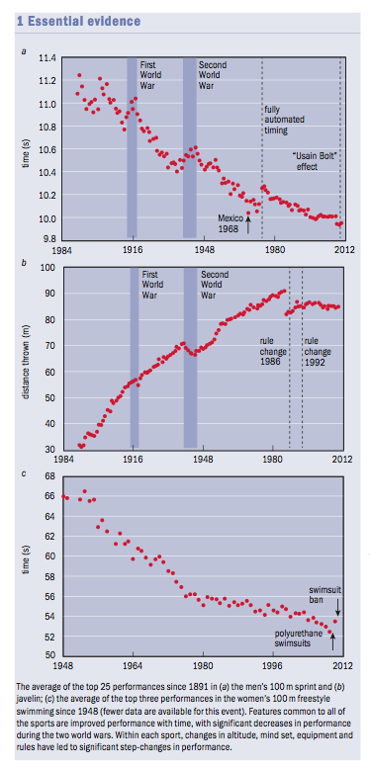
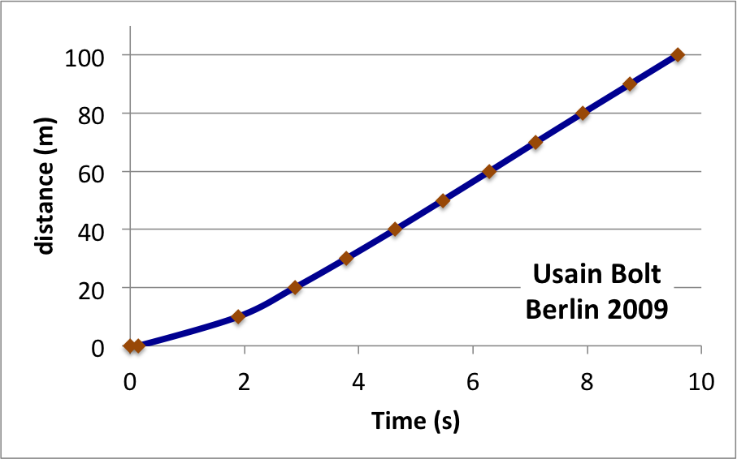
Usain (“Lightning”) Bolt
Video estimation of Bolt’s speed at various points in the race
[Show Usain Bolt Video]
slope = 12.2 m/s
slope = 5.7 m/s
Minimum allowed reaction time, to avoid false start: 100 ms = 0.1 s
Notes:
This slide takes significant time.
Discuss the figure, with the drop during WW2 and with hand-timers
show also VIDEO of 100 m run – Bolt CRUSHES the competition
estimate from video: by how much TIME did bolt beat Tyson Gay?
to get this, need speed (100 m / 9.58 s = 10.44 m/s)
then, estimate that he is 1.5 m behind Bolt (I just do this by roughly guessing how many persons, laying down, could fit between them in the picture)
so, delta-T = delta-x / v = 1.5 m / 10.44 m/s = 0.14 s
Reaction time (measured electronically from the pads) of Bolt – 0.146 (the commentators on the video say this)
this is measured by pads in the starting blocks (you can see them clearly just as the commentators are saying the thing about the reaction time

Slide 27
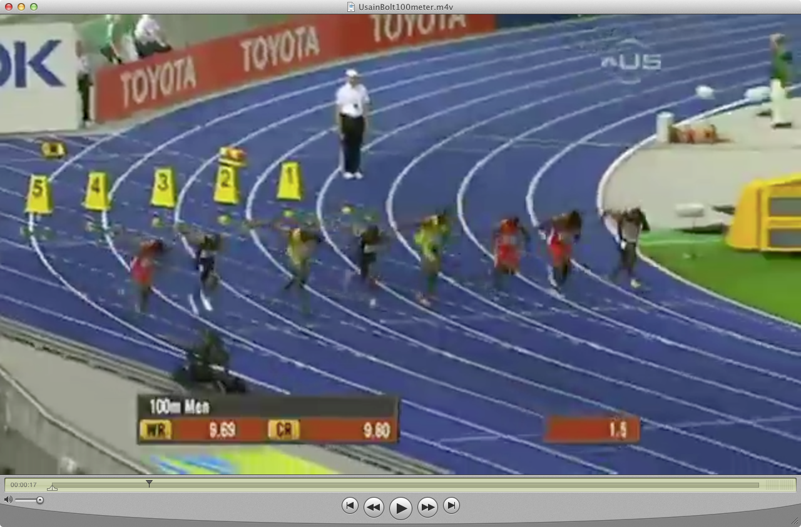
Extracting splits from video
Notes:
this is just to show the class how it can be done. We won’t do it in class... (new)

Slide 28
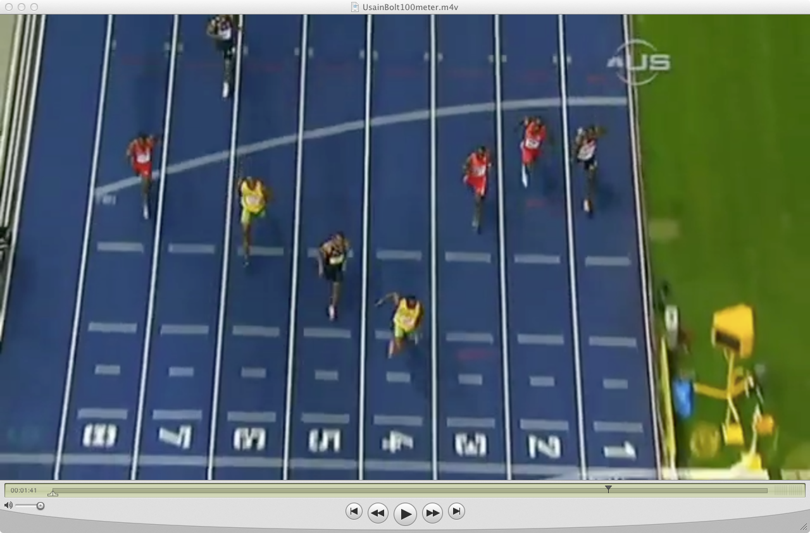
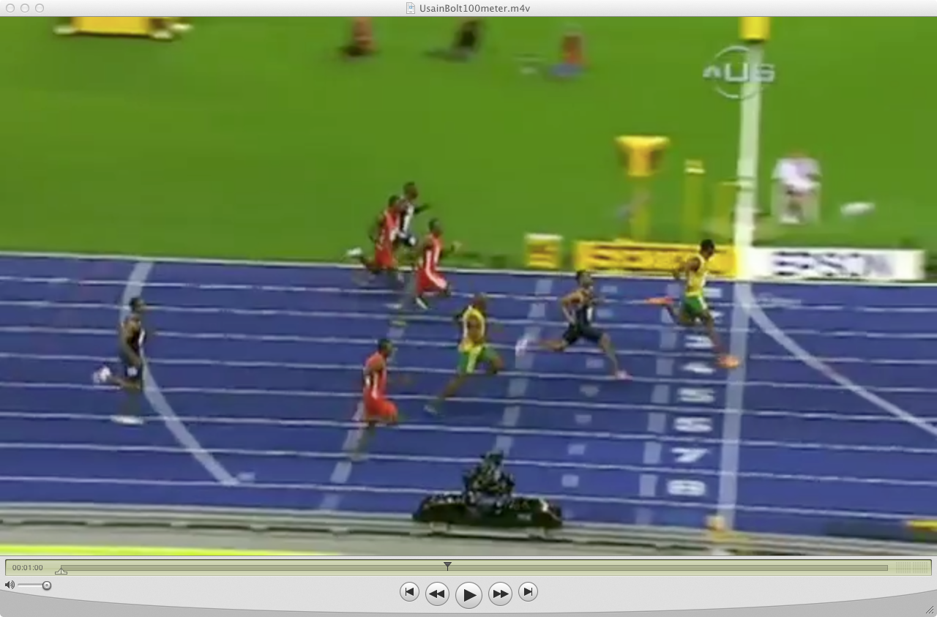
Extracting splits from video (2)
Notes:
this is just to show the class how it can be done. We won’t do it in class...

Slide 29
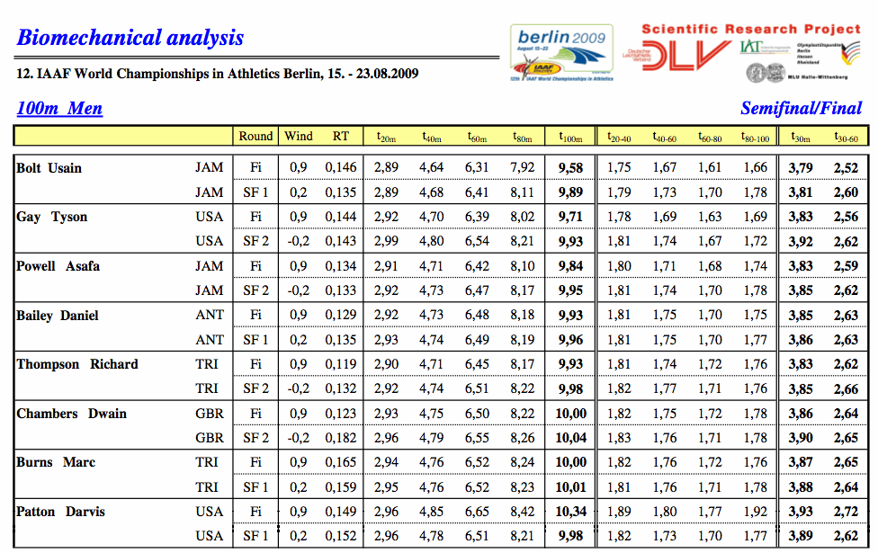
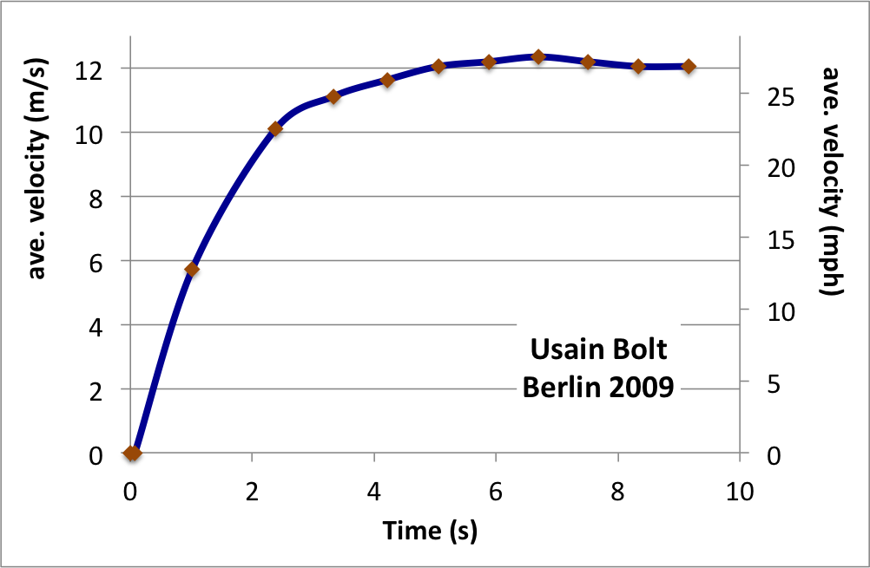
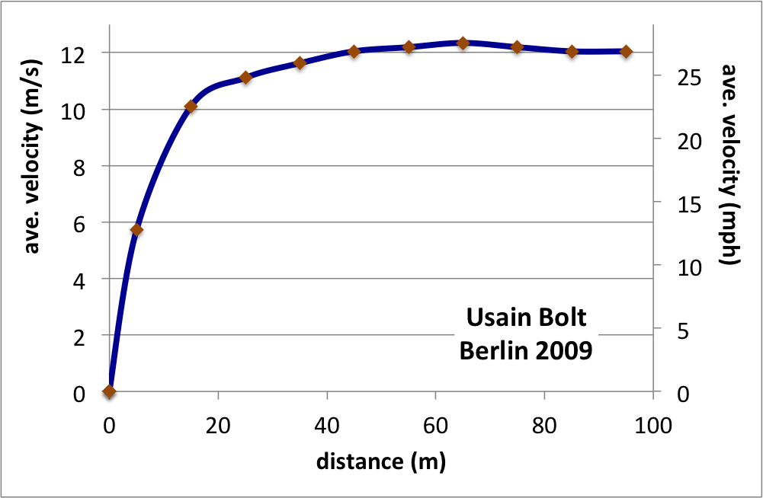
sprints – it’s all about getting to max speed
Notes:
to the last question: yes, it does, since now we know that v at end of race is MORE than v at beginning, so delta-t is actually LESS than the previous estimate.
very interesting that they ALL slow down in the final 20 m
also, Bolt gets up to speed quicker than Gay, since he has a worse reaction time (2 ms) but ends up 3 ms ahead of gay by the 20-m mark.
Would LOVE to have Gay’s splits in 10-m intervals

Slide 30

How Remarkable was that race?

Slide 31
What about the 200 meter?
[Show second part of Usain Bolt Video]
100 m time 9.58
200 m time 19.19

Slide 32
marathons – it’s all about maintaining speed
position (m)
time (s)
velocity (m/s)
time (s)

Slide 33

Sprints and runs
compilation from Brancazio
Surprisingly universal Human speed curve:
marathon
sprints
runs
100-m dash
one mile
Notes:
I’m actually saying “something else” because there seems to be a new limit the body is hitting, beyond the marathon.

Slide 34
Revisit the graphs – (instantaneous) velocity versus time
x
v
meaning
__________
A)
time
time
x
v
B)
meaning
__________
time
time
x
v
meaning
__________
C)
time
time
x
v
meaning
__________
D)
time
time

Slide 35
Acceleration versus top speed
In a race, whoever has the highest average velocity wins.
But average velocity is a function of both acceleration and top speed
[Show Horse vs Car video]
[Show Car vs Jet video]

Slide 36


Newton’s first law (N1L)
Until a force acts on something (e.g. hockey puck), it will always move in a straight line without changing its speed.
two pucks in equilibrium
v
But especially in sports, the interesting stuff is precisely when velocities change.

Slide 37
Lecture 4

Slide 38
Acceleration
Just as velocity is the rate that position changes with time, acceleration is the rate that velocity changes with time
x
v_{x}
time
time
** Note: Δx, v, a… all have directions. Here, we are using “+” to indicate “to the right.” So, in the plot above, the runner’s left-ward motion “cancels” his motion to the right, and he ends up where he started.
Technically, these are vectors and we will use them extensively. We come to this soon.
a_{ave} is the slope of this line
v_{x}
just like with velocity, the
instantaneous acceleration
at any time, is just the slope
of the velocity curve at that time
time

Slide 39
Acceleration
what’s happening at the ?
x
time
Discussion:
Are you safe if a car constantly accelerates towards you?
[Show Horse versus Car videos]
Are you safe if a car constantly accelerates away from you?
Notes:
draw v versus t
discussion. The runner is turning around. At “X” he is momentarily stationary (that’s why v=0) BUT he IS accelerating
stationary (momentarily) but accelerating!!
As we are going to get to soon, acceleration implies FORCE. The runner is exerting a lot of FORCE to turn himself around from running fast to the right to running fast to the left.
Draw pictures of the runner at different times, including early on, the “reaction time,” along with forces as arrows.
Question 1: if a car is constantly accelerating towards you, are you safe? (no, not if it keeps doing it forever)
Question 2: if a car is constantly accelerating away from you, are you safe? (NOT NECCESARILY!) Think of the baseball player sliding into third. He is accelerating AWAY from the thirdbaseman, but his velocity is towards him.

Slide 40


The flip side to N1L
N1L:
Until a force acts on something (e.g. hockey puck), it will always move in a straight line without changing its speed.
Flip side to N1L:
If an object is accelerating then there is a nonzero net (total) force acting on it.
v_{x}
30 m/s
25 m/s ~ 55 mph
20 m/s
to calculate
acceleration of the shot, need to know ∆t.
we estimate this soon.
10 m/s
0 m/s
t
∆t
contact time between stick and puck
Notes:
note: 36 m/s ~ 80 mph, which is a fast (but not record-setting) shot.

Slide 41


v
v > 0
a > 0
a
v
a
v < 0
a > 0
[Show Drag Racing Video]
Notes:
new

Slide 42
“Deceleration is acceleration”
v_{x}
v_{x}
0
a_{x}
Force of friction on player
t
∆t
acceleration quantifies the change in velocity with time.
A right-pointing acceleration means that every moment a small amount of right-ward velocity is added.
v_{x}
0
v
a
Force of blade on puck
t
∆t
We’ll return to forces properly later.
For now, we discuss their result– acceleration.

Slide 43

Constant acceleration
If the total force on an object is constant, its acceleration will be constant
Although forces are often changing with time, they are often constant over particular intervals of time, and it is useful to consider the case of constant acceleration.
Example: A 1989 Ferrari 612 Scaglietti requires 4.6 s to reach a speed of 60 mph, starting from rest (*). What is its average acceleration?
3 important formulas
Notes:
100 mph = 45 m/s

Slide 44
Constant acceleration
Assume the Scaglietti‘s acceleration is constant. Then, it is easy to find the car’s velocity at any given time
In this case, the initial velocity is v_{x,0} = 0
What is the Ferrari’s speed after 14 seconds (assuming constant acceleration)?
v_{x} (mph)
0
2
4
6
8
10
12
14
Notes:
13.05*14=182.7 mph (!)

Slide 45
Lecture 5

Slide 46

Useful formulas for constant acceleration
3 important formulas
How does the position of the car vary with time?
x (m)
Notes:
on blackboard, write down x at t=0,1,2,4.6,10,16, then draw the plot

Slide 47


Example – ball rolling down an incline
video – ball on incline
3 important formulas
Use these equations to find the acceleration on the puck
(next page)
v_{x}
30 m/s
20 m/s
10 m/s
0 m/s
t
∆t
contact time between stick and puck
Notes:
Note VIDEO in this page (1-10 “rolling ball incline”)

Slide 48
What is the puck’s acceleration?
Now find the stick-on-puck contact time:
Example question: A ball is known to be not accelerating (a=0 m/s²)
What can you say for certain about its motion?
Notes:
this is not really a slapshot, which is in contact with the puck over a significantly shorter distance. A real nice site on this is
http://capitals.nhl.tv/team/console.jsp?catid=16&id=36736
There, he makes the point that the slapshot typically hits the ice 1 foot behind the puck, in order to flex the stick back.
t=v/a=(36 m/s)/(781 m/s^2) = 0.046 s
answer to question: it is moving at constant speed (i.e. make sure they know that it need not be at rest)

Slide 49

Rope climb: text figure 2.9
vertical motion: use y
[ Video: Rope Climb]
Notes:
Many points to make/consolidate on this figure
it is c.m. that matters
smith is going up, but accelerating down
is the displacement of his hands the same as of his c.m.? (no, because he is seated on floor and stretched out at top, so the distance between his hands and c.m. is different in the two positions.)

Slide 50

Motion under the influence of (only) gravity
often consider motion when only one force is present– gravity
Besides being obviously important in all sports, gravity is a good place to start, since it is simple:
  F_{g} always points down → acceleration is always down
  the acceleration is the same for all bodies
[video: motion in vacuum]
[ Video: Matthew Micham Beijing 2008]
Notes:
Note VIDEO on this page (01-14 Guinea and Feather)
Also: for “dense” objects not moving too fast, the “only gravity” approximation is good.
again emphasize it is his c.m. that is given by those equations.
Also show micham video. note how high his c.m. rises by estimating based on the railings and stopping the action.
Also, calculate how fast he hits the water.

Slide 51

Analysis of 40” vertical jump
[video: vertical jump]
launch speed
flight time - Use equation 1.
Just consider the “upward journey”
Useful formula
flight time (hang time), landing at same vertical position as take-off
Notes:
Don’t refer to the dwight howard figure at this point. We come to it later
A video of someone taking a jump shot – with a digital clock and a meter stick on the camera – would be so sweet here !!!

Slide 52

Vertical jump: height and velocity as function of time
y(t)
40”≈ 1 m
20”≈ 0.5 m
0
0.25
0.5
0.75
1.0
t (s)
5
what does this look like?
2.5
v_{y}(t) (m/s)
0
0
0.25
0.5
0.75
1.0
t (s)
-2.5
-5
Notes:
in class, fill in what v versus t looks like. v(t=0)=4.46 m/s
point out that by symmetry v(t=T) is NEGATIVE what it was initially (i.e. v(0.91s)=-4.46. Use “Equation 1”
the graph is easy then: a straight line between (0.0,4.46) and (0.91,-4.46)

Slide 53

A (much) harder jump
What if Dallas could double v_{0y} (i.e. take off at 20 m.p.h.)
how much higher would Dallas jump?
how much longer would he spend in the air?
~13‘
y(t) (m)
t (s)
Notes:
use scaling. Twice as long in the air. FOUR TIMES as high!! (Nobody can jump 4 meters (13 feet)!!!)
Bring in a visual aid – mark on wall 40” and then 80” (which would be twice as high) and then 13’ which is what you get for twice as long/fast
And keep in mind: once in the air, there are no forces on him (remember we’re ignoring air friction which certainly isn’t going to make you go HIGHER), except gravity. So this is the trajectory he MUST follow.
And in ALL of this stuff, keep reminding them, these are NOT PARABOLIC TRAJECTORIES. THIS IS HEIGHT VERSUS **TIME**
No matter WHAT you do, that “useful formula” linking hang time with height is unavoidable (in absence of air).

Slide 54

Figure 2.11
Notes

Slide 55

Forces and Dynamics
Until now, we have discussed kinematics – the quantitative description of motion in terms of time, position, velocity and acceleration
Newton (N1L) tells us that there can only be acceleration if there is a “net” force on an object
  no force → no acceleration → straight-line motion with constant speed (which might be zero)
Force = “push or pull”
  has a magnitude (strength) and a direction, so is a vector, like velocity and acceleration
  magnitude of velocity measured in m/s (or ft/s or mph)
  magnitude of force measured in pounds (lbs) or ounces (oz)
  or Newtons (N)
    1N = 0.225 lb = 3.6 oz
    1 lb = 4.45 N
    16 oz = 1 lb
Forces important in sports:
Weight
Normal
Tension
Friction
Aerodynamic/hydrodynamic
  buoyancy
  drag
  lift (Magnus)
vectors
Notes:
Here, emphasize. Pounds are not only used for weight. Also, ask a non-American what they weigh themselves in. They likely answer “kilograms,” which is wrong.
Short note on what each of these forces are, and when we will discuss them. (actually likely never get to tension, except maybe in muscle or something, or if we discuss the force on the rope in rope climb)
Weight is the only “non-touching” force. It is ALWAYS present. Consider it in EVERY situation.

Slide 56

Equilibrium and N1L; Weight and GRF
N1L: The net force on an object in equilibrium is zero.
What makes Bart go?
states of equilibrium:
7 mph to right
9 mph to right
stationary
2 mph up
5 mph left
Free Body Diagram.
Ground Reaction Force.
Notes:
The little grey boxes are cool. They are “states of equilibrium” To go from one state to another (from one velocity to another) requires a force
from left to right, you need: push foot back, air drag, jump, push foot forward
Absent a force, you stay in your box.
Bart: what is “making him go?”
Certainly not air drag– that’s stopping him!!
No, NOTHING is making him go. There is no force on him (we’re ignoring the *slowing* effects of friction), so he is in equilibrium.
Draw the forces on him (FBD) – Weight and GRF
GRF is an example of a Normal Force
The way I like to say it: “Nothing moves him. He is moving.”
This makes it clear: no outside influence is acting to make him move. An outside influence can only– and is the only thing!– that can CHANGE that state.
Use the rest of the page to draw a person, and make Free Body Diagram.
Use the force plate on a person.

Slide 57

The “net” force in volleyball: FBDs on 2011 NCAA champs
(8: John Klanac)
07 MAY 2011: Grayson Overman (05) of the Ohio State University serves to the University of California Santa Barbara during the Division I Men's Volleyball Championship held at Rec Hall on the Penn State University campus in University Park, PA. Ohio State defeated UCSB 3-2 to win the national title game.
Joshua Duplechian/NCAA Photos
Weight
Normal
Tension
Friction
Air...
What is Grayson’s acceleration? Do we know for sure?
What about Klanac’s?
Notes:
FBD on #8 = John Klanac (Senior in 2011) : G on left foot and G on right foot, up. Weight down. In equilibrium. a=0
so Gl+Gr=W
(And we saw from the force plate on the previous page, Gl+Gr = constant, so we’ll just call it G)
and on #5 Grayson Overman (Junior now in 2012): Weight down. NOT in equilibrium.
a = ???? - can we tell?
YES!
a=-g down. (First hint of F=ma.)
it does not matter whether he is MOVING up or down
it does not even matter whether he is MOVING forward or backward!
we are ignoring air for now, so the ONLY forces are gravity and due to anything he is TOUCHING, which, at the moment, is nothing.
(see list at bottom right)
Grayson accelerates (down) because there is an IMBALANCE of forces on him.

Slide 58


Acceleration if (and only if) there is a force imbalance
We’ve estimated acceleration of a hockey shot at 495 m/s² (50 gee’s)
If the player had exerted the force on a curling stone, the acceleration would be much less, due to the stone’s mass
Although they are very much related, don’t confuse mass and weight
mass = “the amount of matter” in an object. Crudely: “The number of atoms.”
weight = the force that the Earth exerts on an object due to gravity.
Physics professor (in 2015):
1.66x10²⁷ Oxygen atoms + 8.2x10²⁶ Carbon atoms + 4.3x10²⁷ Hydrogen atoms
= 73 kg = 5.0 slug
Shaquille O'Neal (in 2011)
3.40x10²⁷ Oxygen atoms + 1.6x10²⁷ Carbon atoms + 8.8x10²⁷ Hydrogen atoms
= 147.4 kg = 10.17 slug
“Shaq is 10 slugs”
1 kg = 0.0685 slug 1 slug = 14.6 kg
1 kg = the amount of matter in 5x10²⁵ C atoms
(50,000,000,000,000,000,000,000,000 C atoms)

Slide 59


Force and mass
an object/person ONLY accelerates if there is a force imbalance
an object/person MUST accelerate if there is a force imbalance
mass ~ how resistant something is to a force
Newton’s 2nd Law
(N2L)
Units: 1 lb = (1 slug)(1 ft/s²) 1 N = (1 kg)*(1 m/s²)
variation in g
mass and weight: related but not the same
Force of gravity
for objects on Earth:
Weight of 1 slug:
Weight of 1 kg:
Weight of Shaq
in Greenland
in Denver
plus “centrifugal” effect
New York: g = 32.154 ft/s²
Denver: g = 32.131 ft/s²
Greenland: g = 32.226 ft/s²
1 kg = the amount of matter in 5x10²⁵ C atoms
(50,000,000,000,000,000,000,000,000 C atoms)
Notes:
At the top, write “So, FORCE IMBALANCE IS THE NAME OF THE GAME!”
the whole point of sports is to create and control force imbalances
under the “Units equations” write “F” and “m” and “a”
(i.e. if F=ma, then “the units for F” = “the units for m” times “the units for a”)

Slide 60
Lecture 6

Slide 61
Force of the shot
What is the force of the stick on the puck?
If the same force were used to shoot a curling stone instead of a puck, how fast would the stone be moving after the shot?
Notes:
on my list of masses, curling stone is 40 lb, 18.2 kg, 178 N

Slide 62

Dwight Howard’s vertical
Specs:
m = 123.3 kg (8.28 slug)
h = 211 cm (6’11”)
2004 Orlando
2012 LA Lakers
2013 Houston
How fast did he leave the floor?
What force accelerated him to that velocity?
Notes:
delta-y = 37” in this photo.
Since he touches the rim → 39”
calculate v0
well, that means there has to be
an acceleration
a distance over which a applies
(v2=v02+2ax)
Already in panel (b), his c.m. has a velocity. It has been accelerated
panels (a) and (b) → a upward
panels (c) and (d) → a downward (=g)
it is in panel (c) that he has the 9.9 mph upward velocity
in panel (d) his velocity is zero
Maybe show Blake Griffin video?

Slide 63

Jeremy Lin: NBA Basketball Player – Houston Rockets
6’ 3”, Taiwanease American
Played Palo Alto High School, Won Division II State Title
Played at Harvard, no scholarship
2010 joined Golden State Warrior as walk-on
2011 Played for New York Knicks
2012 joined Houston Rockets
2014 joined the LA Lakers
October 13, 2013, Taipei, Taiwan
01:00.07
[Show Jeremy Lin Video]
Notes:
Has moved center of mass to its lowest point.

Slide 64

mg
GRF
01:00.20
Now, let’s determine the accelerating force:
Notes:
Starting to accelerate upwards

Slide 65

01:00.27
Now, let’s determine the vertical acceleration:
Acceleration of 2 g’s!
Notes:
Just about to leaving the floor

Slide 66

6’ 8”
10’
01:00.67
Center of mass = 0.565 × 6’3” = 3’6” when standing with arms by sides
At take off, probably 6” higher… therefore CoM is at about 4’0”
Notes:
Maximum hieght

Slide 67

01:01.07

Slide 68




Slide 69

Do Gymnasts jump higher than basketball players?
Gabby Douglas 4’11”, 90 lbs
[Show Gabby Douglas Video]
17 m
Height of C.M. before jump: (0.545) × 59” = 32”
Height of C.M. after jump: ~72”
Vertical jump ~ 40”
Notes:
Gabby Douglas

Slide 70

GRF in more detail
Notes:
play with force plate. Have a kid do crouching, waving arms, jumping, landing, etc.
show that peak force is not average force
see if you can get the time of flight and relate it to the average force and the crouch (!!)
Make, in real time, figures 3.6 and 3.7
video – my little cartoon guy. When he accelerates his arms up, the ground is pushing him up.

Slide 71

Let’s Talk Landing
If Jeremy Lin lands with knees locked, making his shoes “absorb the impact,” what force is he susceptible to?
How does that depend on sole thickness?
Adidas adiPower Howard
– Howard’s war boot for 2011-12
[Show Langdings Video]

Slide 72


Howard in flight - Making the most of it.
Also: is this ad “fair?”
From the text: In the figure, Dwight Howard’s lips will just barely touch the rim at the peak of his jump. If he left the ground at the same speed, but lifted his arms while in the air, would his lips not reach the rim, or would they crash into the rim?
Notes:
also ask the question at the bottom of page 69 in the text.

Slide 73
Which Image is More Impressive?

Slide 74

What accelerated Jeremy Lin? - Not “himself”
Something accelerates because the forces on it are unbalanced
(Howard pushing down on the floor tends to accelerate the floor down)
push of the stick accelerates the puck
push of the bat accelerates the baseball
push of the hand accelerates the basketball
push of the floor accelerates the player upward
push of the floor accelerates the player forward
makes
sense
?
Frictional force of floor on William Buford
Newton’s Laws
1st Law: If there is no net force on an object, its acceleration is zero. In fact, if the acceleration is zero, we know there is no net force
2nd Law:
3rd Law: The force exerted by body 1 on body 2 is always accompanied by a force of equal magnitude but opposite direction by body 2 on body 1
(sometimes these are called “action-reaction” force pairs)
Notes:
write on the slide: Sum F is sum of forces ON HOWARD.
Howard pushing down on the floor accelerates the floor down

Slide 75
for notes
Horizontal acceleration, the easy way
To accelerate our body vertically, we manipulate gravity and GRF.
We achieve horizontal acceleration through
recoil after slapshot or shotput
having a linebacker slam into us
...friction
Leftward push of the floor accelerates Buford to left
Can we estimate the horizontal force component if he reaches 8 mph 1 sec after starting from rest?
Frictional force of floor on William Buford
[Show Curling Video]
Notes:
from first week of class, estimate a quick acceleration at 3.5 m/s2. Use Buford’s weight of 220 lb to get a force of something like 70 lbs.
buford is enrolled in my class
I got the 3.5 m/s2 from our little sketches for short-distance sprints in the first week of the class.

Slide 76
Friction - concepts
Forces Buford exerts on floor
Forces the floor exerts on Buford
The vertical forces are “normal” forces, perpendicular to the surfaces
The horizontal forces are frictional forces.
friction force: generated when two surfaces slide (or try to slide) by each other
the direction of the force: always opposes the slide
the magnitude of the force depends on several things:
  the nature of the surfaces – quantified by a “coefficient of friction”
    big μ → “sticky”
  the normal force between the surfaces (in our example, 190 lb)
  whether the surfaces are sliding or only “trying to slide”
    kinetic friction: the surfaces are slipping past each other
    static friction: the surfaces are “trying to slide” but are not. (i.e. they would slide past each other, except friction prevents it)
In our example: even though Buford is moving,
his shoe is not slipping on the floor → this is static friction

Slide 77
Lecture 7

Slide 78




Slide 79


Sometimes Static Friction Just is Not Enough
[Show Slipping Videos]

Slide 80


Vectors
So far, we’ve dealt with forces, velocities and accelerations that are either horizontal or vertical. Time for more sophistication.
Vectors have magnitude and direction.
100 ft/s
θ=35°
100 ft/s
Notes:
+ and – signs on components are fine.
magnitude is always positive.

Slide 81


Shot put – the net force
[Show Shot Put Video]
detail: We’ll see that if the projectile launches and lands at the same height, maximum range is achieved for 45° launch angle.
If the launch and landing heights differ, the optimum angle changes. We won’t go into details, but optimum launch angle for shot put is about 42°. Coaches know this “intuitively.”
So, we want…
42°
Question: At what angle should an athlete push? (not 42 degrees!)
Reese Hoffa
1) Free body diagram and label forces
Important: Don’t include F_{net} in this step
Notes:
This push is an example of a “normal force”
This is Terry’s nice shot-put example from his notes II.6
But he makes the point earlier that 45 degrees is NOT the optimum launch angle – Here, I just sort of mention it. Maybe I should cover it next time, like he does on pages II.3,II.3a,II.4…

Slide 82
Shot put – cont’d
2) Add all forces to find net force
Component-wise addition
These are the useful equations
Graphical addition
3) If desired, can redraw, replacing all forces with the single force F_{net}
θ

Slide 83
Shot put – example
If I can generate 80 lbs of force with one hand and push at 50°
What is the angle and magnitude of the net force on a
16-lb (7.26 kg) shot?
What is the resulting acceleration?
Use “useful equations” to find components of net force:
As I train and grow stronger, how should my push angle change, to optimize distance?
Notes:
For answer to final question, seems clear. And look at Hoffa, a few pages back– he’s pushing at about 42 degrees. I’d probably have to push at 55 degrees!

Slide 84

Static friction
Static friction works to avoid slipping.
Buford pushes with 68 lb → floor pushes with 68 lb
Buford pushes with 85 lb → floor pushes with 85 lb
Buford pushes with 120 lb → floor pushes with 120 lb
Buford tries to push with 250 lb → SLIP!
Static friction has a maximum strength
The amount of stickiness quantified by coefficient of static friction μ_{s}
Friction depends on how
tightly the surfaces are pressed together
(the normal force of one on the other)
the “absolute value” signs tell us that this equation gives us the magnitude of the force.
The direction of the force is… whatever direction opposes the sliding!
μ_{s} isn’t something one calculates– it is measured, and there are tables for every material you could imagine (google “table coefficient of friction” for a taste)

Slide 85
Static friction
Equipment | Surface | mu[static]
basketball shoes | wooden floor | 1.0-1.2
basketball shoes | wooden floor dusty | 0.3-0.6
cleated shoes | astroturf | 1.2-1.7
cleated shoes | grass | 0.9
Biomechanics and biology of movement Nigg, MacIntosh, Mester
How quickly can Buford get to v=10 m/s,
starting at rest?
What happens if he tries to accelerate more quickly?
Notes:
the table is from Biomechanics and biology of movement
By Benno Maurus Nigg, Brian R. MacIntosh, Joachim Mester
Note: when we do the car example, we will point out later on that Buford’s mass drops out.

Slide 86
Lecture 8

Slide 87

Kinetic friction
When two surfaces rub across each other, the “bumpiness” at the atomic level opposes the motion (“dragging mountain ranges across each other” *)
The amount of stickiness quantified by coefficient of kinetic friction μ_{k}
Friction depends on how
tightly the surfaces are pressed together
(the normal force of one on the other)
the “absolute value” signs tell us that this equation gives us the magnitude of the force.
The direction of the force is… whatever direction opposes the sliding!
typical values
Car tire on… | mu[kinetic] | mu[static]
dry asphalt | 0.72 | 0.8
wet asphalt | 0.4 | 0.5
grass | 0.35 | 0.4
Equipment | Surface | mu[kinetic]
skates | ice | 0.003-0.007
bobsled runner | ice | 0.01-0.05
skis | snow | 0.05-0.2
* the situation is actually a lot more complicated, but this is a good way to think about it

Slide 88

braking a car
Example: A driver without ABS brakes panics, slams on the brakes, and skids a distance of 50 m before coming to a rest. Then he tells the police officer that he was traveling under the 55-mph limit. He points out that his Toyota Echo weighs only 2020 lbs, which means that the force of friction is less. Does he get a ticket?
[Show ABS Video]
[Show Drifting Video]
Notes:
of course, the mass does NOT matter. While it is true that a less massive car means less normal force which means less friction, it is also true that a less massive care REQUIRES less force to accelerate (decelerate) it. The analysis here shows that these two effects cancel each other, and the mass simply doesn’t matter.
Note that the same was true in the example with William Buford a couple of pages ago.

Slide 89

In the pit or on the sleds - Static and kinetic friction
Linemen in training push a sled across the grass. We’ll assume the coefficients of friction between sled and grass to be the same as between a tire and grass.
high-schoolers hit the sleds
A coach is training one very strong 280-lb lineman. With a short burst before colliding with the sled, the lineman can get it moving. The question is: can he keep it moving?
The coach steadily increases the weight on the sled. What is the maximum weight of the sled, if the lineman is to keep it moving at a constant speed by pushing straight ahead? [The lineman is very strong, so the limit is imposed by friction.]
Let’s break this problem into parts.
1) Identify all forces on the lineman and on the sled. Make separate diagrams

Slide 90
Sled example, continued
2) Identify relationships between forces.
2b) By Newton’s 2nd Law:
“moving at constant speed” → zero acceleration
→ zero net force on player and on sled
Anything the player can do, to allow him to push an even heavier sled?
Notes:
? [answer: yes: push slightly UP on the sled. That does two things
it increases the normal force on their shoes– more friction for them
it decreases the normal force on the sled– less friction of sled

Slide 91



Greater sideways force through greater normal forces
Vance Walker vs Nick Mangold

Slide 92
[Show Driver Video]

Slide 93
[Show Hammer Throw Video]

Slide 94





