Slide 1
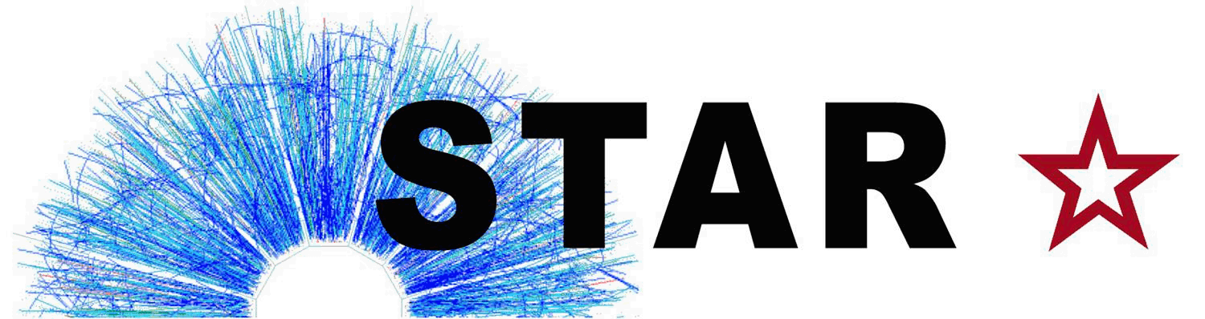
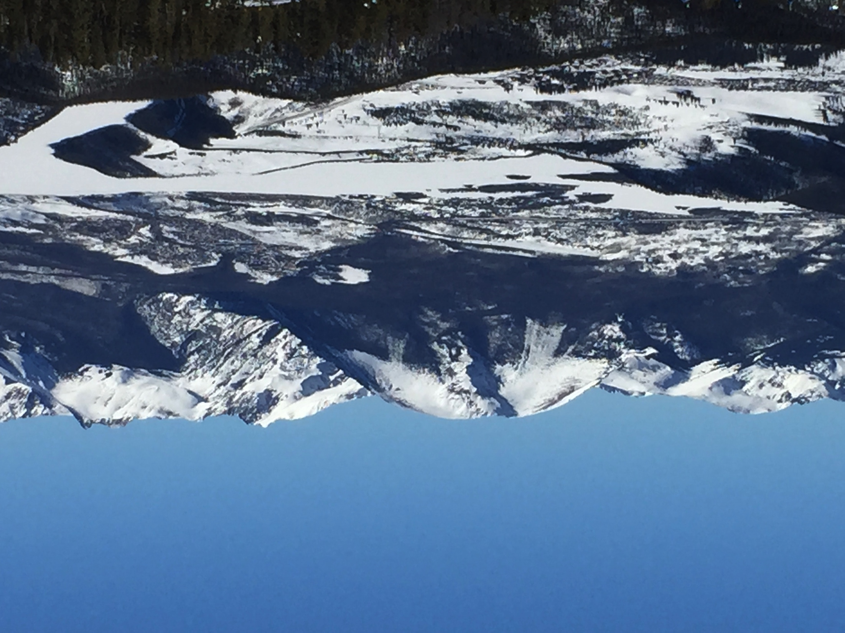



Upsilon results from
A panorama of results from
p+p, d+Au, Au+Au, and U+U.
Manuel Calderón de la Barca Sánchez
for the STAR Collaboration
31st Winter Workshop on Nuclear Dynamics
Keystone, CO
27/Jan/2015

Slide 2
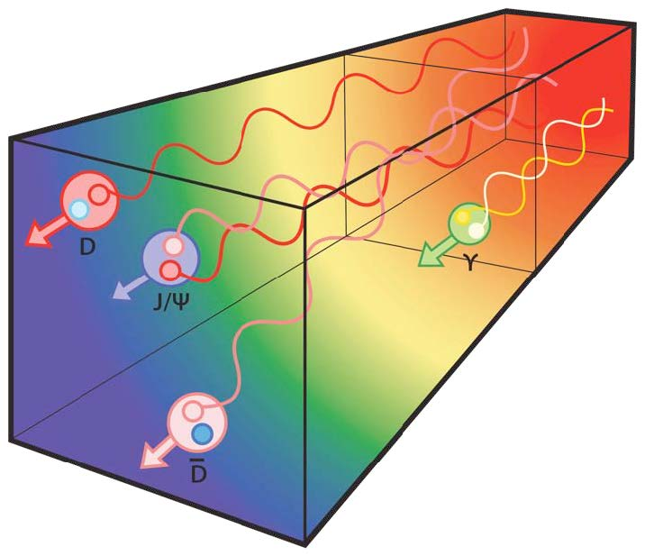
Outline
Heavy Quarkonium in Heavy Ion Collisions
  ϒ production
    pp, dAu, AuAu collisions
      Nuclear Modification
      Comparison to models
      Questions from trends in data
From A. Mocsy

Slide 3
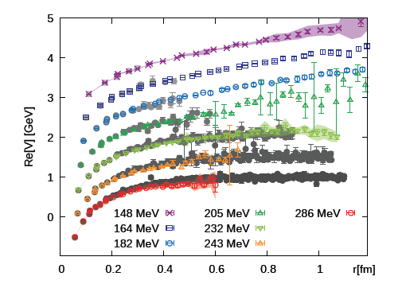
Heavy Quarkonium: why?
Heavy quarkonia are massive, produced early
  pQCD can estimate production
Sensitive to temperature and deconfined color fields: input from Lattice QCD
  Debye screening, Landau damping
    Re and Im V(r, T)
  Different states have different sizes/binding energies
    Expect Sequential suppression
Cold-nuclear matter effects
  Initial state effects: e.g. nPDF
  Final state: energy loss, absorption
Regeneration
  Uncorrelated heavy quarks can pair up
Bottomonium: a cleaner probe than charmonium...
  3 states are accessible experimentally
  expect small CNM effects
  expect small regeneration effects
Burnier, Kaczmarek, Rothkopf
arXiv:1410.2546

Slide 4
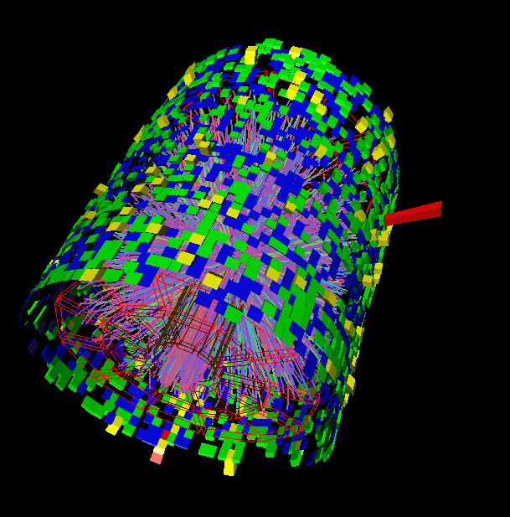
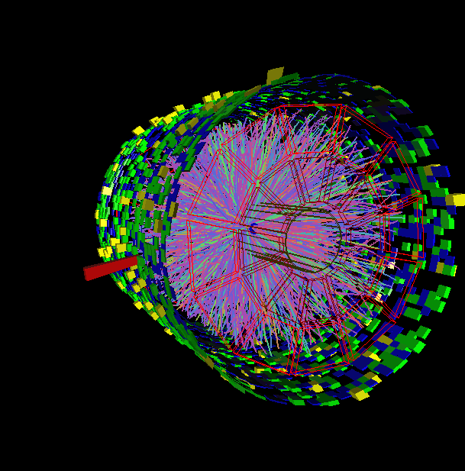
Measuring ϒ in STAR
STAR: electron channel
Analysis steps:
  Triggering: L0, L2 (pp, dAu)
  TPC tracking, e-ID via dE/dx
  TPC-EMC match, e-ID via E/p
Datasets
  pp, 200 GeV (2009 Run)
  d+Au 200 GeV (2008 Run)
  Au+Au 200 GeV (2010 Run)
  U+U 193 GeV (2012 Run, prel.)
pp, d+Au, Au+Au Results:
      STAR: PLB 735 (2014) 127

Slide 5
ϒ in pp collisions in STAR
Results on cross sections
      STAR: PLB 735 (2014) 127
      PHENIX: PRC 87, 044909 (2013)
  STAR data:
    20 pb⁻¹, all from pp run 2009.
    Improvement over 2006 run:
      Less inner material
Unlike-sign and like-sign data are fit simultaneously, likelihood fit
  Shape of Drell-Yan from NLO pQCD (R. Vogt)
  Shape of from PYTHIA.
Calculations:
    CEM: R. Vogt
    CSM: Lansberg & Brodsky
Data ~ in between CEM and CSM predictions.

Slide 6
ϒ in d-Au in STAR
STAR dAu cross section and comparison to pp.
  Note: dAu scaled down by 10³.
  Int. Luminosity: 28.2 nb⁻¹
Midrapidity point is lower than expectations from CEM.
  Calculation includes shadowing
  Does not include estimate of nuclear absorption
pp data also lower than prediction,
  compare R_{dAu}, where many theoretical and experimental uncertainties cancel.
PLB 735 (2014) 127
Notes:
Absorption | final-state effect, after cc that forms and the J/ψ has been produced, pair breaks up in matter due to interactions with nucleons

Slide 7
ϒ R_{dAu} in STAR, near y=0
Invariant mass distribution in dAu at |y|<0.5
  Scaled pp reference fit shown for comparison
R_{dAu} vs. y
  Model comparison:
    Shadowing, EPS09
      R. Vogt
    Energy loss
    Energy loss + shadowing
      Arleo & Peigné
  y~0 is right in the middle of the antishadowing region
  Expect R_{dAu} > 1 (small effect)
  Observe R_{dAu} < 1
  Absorption seems to be important
PLB 735 (2014) 127

Slide 8
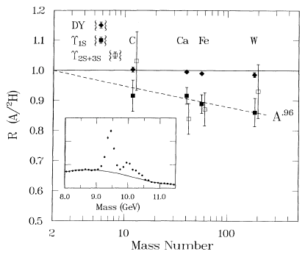
p+A Upsilon results: E772 @ √s~40 GeV
Ratio of nuclear targets normalized to deuterium
Suppression seen with increasing A.
A dependence:
STAR result is in the same range:
  for σ_{dAu} = (2 A)^{α}σ_{pp} :
    α =ln(σ_{dAu} /σ_{pp} )/ln (2A)
    α ~ 0.9
PRL 66 (1991) 2285
Suppression is the same for 1S and 2S+3S (within errors).
  Drell-Yan is not suppressed, follows A scaling.
Notes:
Add reference to E772 paper.

Slide 9
Comparison: STAR & E772
For a similar comparison, separate ϒ(1S) state
  Increases the statistical uncertainty compared to sum ϒ(1S+2S+3S)
  Use|y|< 1, check A dependence.
  Also compare y or x_{F} dependence.
STAR result: consistent with A trend from E772.
Large suppression seen near x_{F}~0 by E772, α~0.9.
  Same as STAR |y|<0.5 points.
Shadowing, or shadowing+E. Loss cannot explain suppression at y=0.
Effect goes away in the forward y bins.
A higher-statistics d+Au run would help.
  Note: dAu 2008 run was first attempt at measuring bottomonium in cold nuclear matter, can revisit with higher statistics
  2015 plan for a p+A run at RHIC
PLB 735 (2014) 127

Slide 10
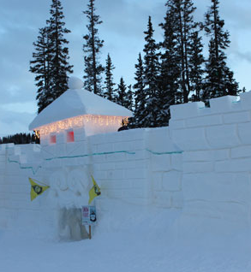
Cold matter findings
Cold Nuclear Matter effects are important!
STAR dAu results show suppression at y=0
  Not expected from shadowing
  Absorption (or other effect) seems to be needed
  Similar effect seen in at √s~40 by E772
Cold nuclear matter

Slide 11
Bottomonium in Hot Matter
Integrated Luminosity: 1.08 nb⁻¹.
Au+Au 0-10% Most central
No L2 trigger on tower pairs, only L0 single high-tower trigger
  Yield extracted by subtracting background estimate from data.
  Scaled pp reference fit shown for comparison
PLB 735 (2014) 127

Slide 12
ϒ in STAR, AuAu
PLB 735 (2014) 127
Invariant mass distributions in 3 centrality bins
Possible to separate the ground state statistically.
Comparison to N_{coll}-scaled pp reference:
  Clear suppression of excited states.
  Suppression of the ground state in the most central bin.

Slide 13
STAR ϒ R_{AA} vs. N_{part}
PLB 735 (2014) 127
Left panel: all data in STAR acceptance |y|<1
  dAu, and two most peripheral Au+Au bins: consistent with no suppression
  Suppression in the most central Au+Au bin: Consistent with expectations for hot & cold nuclear matter, however...
Right panel: bin closest to midrapidity, |y|<0.5
  dAu suppression is of the same magnitude as central AuAu: Important to understand dAu system
Calculations:
  Strickland & Bazow: Includes estimate of heavy quarkonium potential, Re and Im. Evolution through anisotropic hydro. (Nucl. Phys. A 879 (2012) 25 ), T: 428 – 442 MeV (Depending on η/s, to match dN/dη)
  Emerick, Zhao & Rapp: attempt to include both Hot & Cold nuclear effects. T₀ = 330 MeV.

Slide 14
ϒ Ground state R_{AA} in STAR
PLB 735 (2014) 127
Consistent with no suppression in dAu and peripheral AuAu
Suppression in most central collisions
  R _{AA}(1S) = 0.66 ± 0.13(Au + Au stat.) ± 0.10(p + p stat.)^{+0.02} _{−0.05}(Au + Au syst.) ± 0.08(p + p syst.).
  Models from Strickland et al., and Liu et al. consistent with central suppression
    However, neither model includes any CNM effects.

Slide 15
Hypothesis testing, |y|<1
Measurements: vertical line
  R_{dAu}
  R_{AA}, 0-10% most central
    pink band: syst. unc.
Hypothesis test:
  Run pseudoexperiments for various scenarios
  Stat. unc.: width of distributions
    No suppression: R_{AA}=1
    A^{α} scaling for dAu (CNM effect)
      A^{2α} for AuAu
    QGP effects only
      Based on Strickland et al.
    QGP effects + A^{α} scaling
A^{α} scaling: consistent with dAu data
QGP+A^{α} scaling: consistent with AuAu data
Other scenarios are disfavored.
PLB 735 (2014) 127

Slide 16
Hypothesis testing, |y|<0.5
Hypothesis tests:
    No suppression: RAA=1
    A^{α} scaling for dAu (CNM effect)
      A^{2α} for AuAu
    QGP effects only
      Based on Strickland et al.
    QGP effects + A^{α} scaling
Clear that |y|<0.5 shows large suppression in dAu.
  Comparable to central AuAu
  No particular scenario is favored.
    Additional statistics in dAu would be beneficial.
PLB 735 (2014) 127

Slide 17
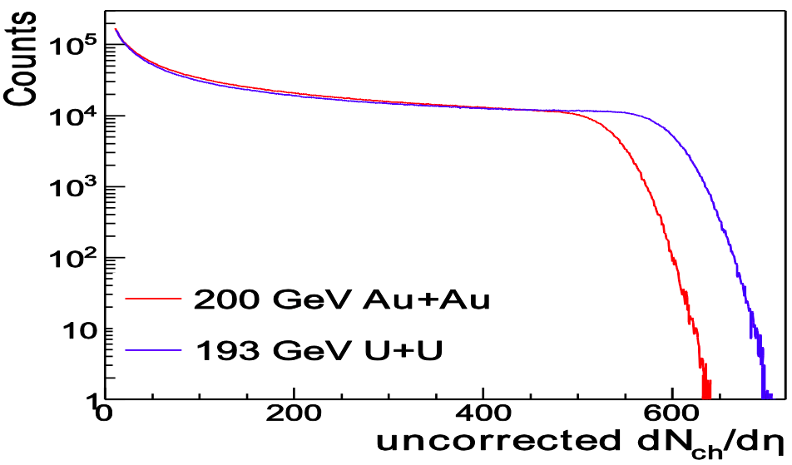
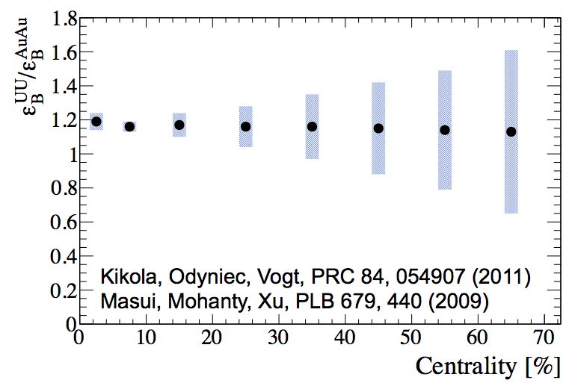
Higher energy density: U+U
RHIC √s_{NN}=193 GeV U+U data (2012)
Reach higher N_{part,} N_{coll}, N_{ch}, than in Au+Au
Provide higher energy density
  Expect ~20% increase for U+U compared to Au+Au

Slide 18
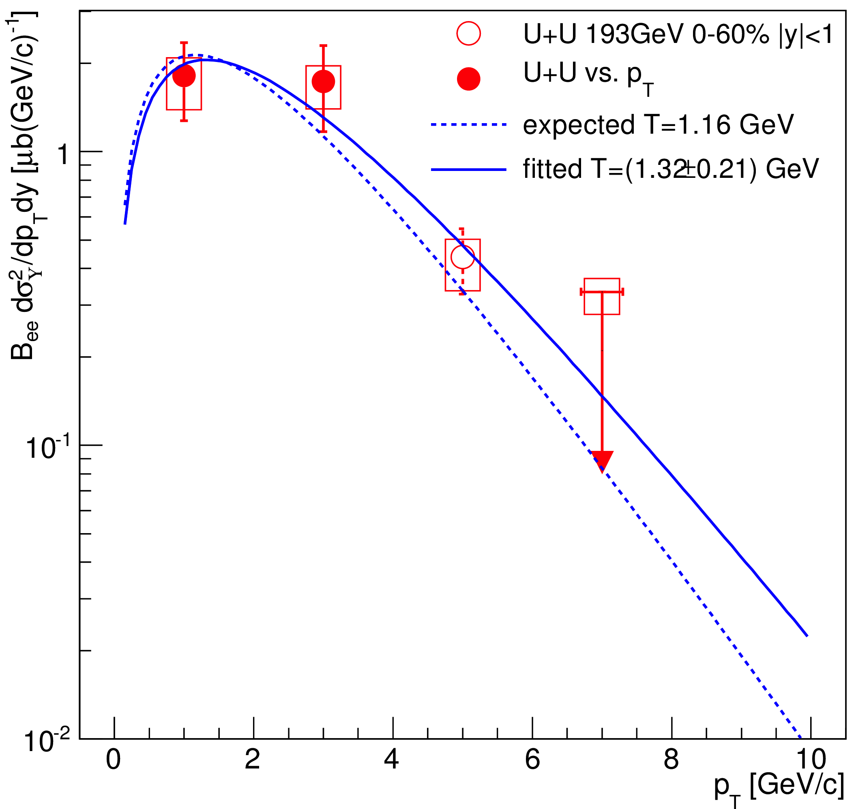
U+U ϒ peak, spectrum, and σ
comb. bg subtracted
e⁺e⁻ pair invariant mass
U+U
√s_{NN}=193 GeV
0-60%
STAR preliminary
STAR preliminary
ϒ cross section (STAR preliminary)
U+U 193 GeV, 0-60% centrality stat. syst
Similar method of yield extraction:
  Likelihood fit.
  Shape of D-Y from pQCD, from PYTHIA.

Slide 19
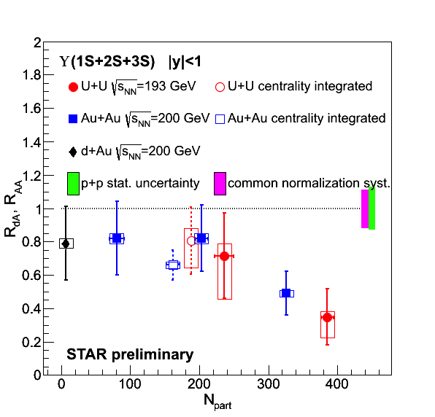
ϒ R_{AA} at higher energy density
Trend in U+U follows and extends that from Au+Au

Slide 20
Suppression vs. binding energy
Overall pattern of sequential suppression in hot nuclear matter is observed.
  Cold-nuclear matter effects: suppression in mid-rapidity d+Au larger than predicted by shadowing/energy loss models.
  p+Au data from 2015 will be useful to shed more light on this.

Slide 21
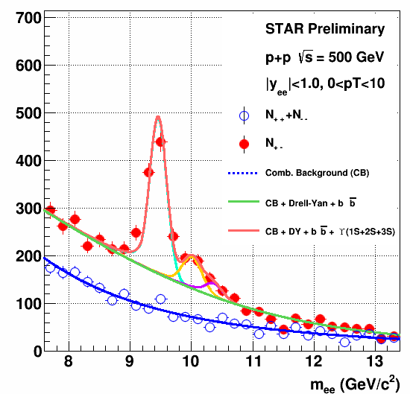
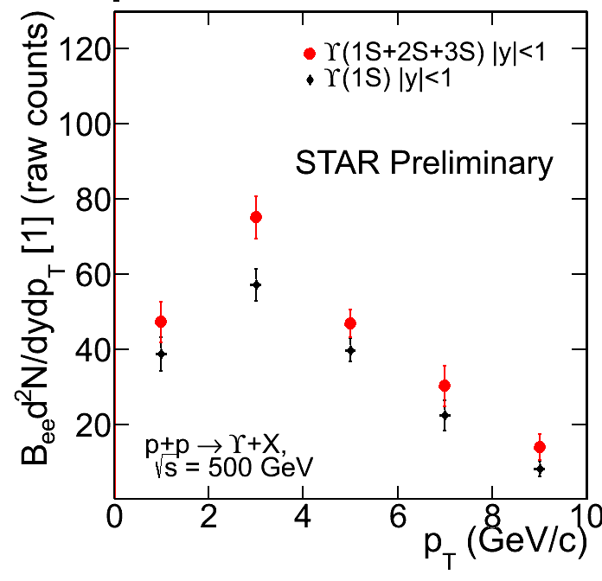
Outlook: analyses underway
p+p √s=500 GeV, 2011. L ~ 22 pb⁻¹
x-section larger than at 200 GeV
L0-only
excited-to-ground state ratio
p_{T} spectrum, out to ~10 GeV/c
  Stat. error ~10%, up to ~25% at highest p_{T}
  Efficiency/Acceptance corrections under study.

Slide 22
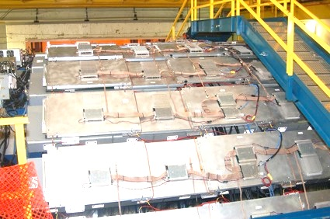
Outlook: Muon Telescope Detector
Outermost, gas detector
Physics goal: Precision measurement of heavy quarkonia through the muon channel
Acceptance:
45% in azimuth, |y|<0.5
Complete in 2014, sampled ~13.8 nb⁻¹ in Au+Au data
R_{AA}
ϒ projection
<N_{part}>

Slide 23
Conclusions
ϒ: Measurements in STAR spanning pp, dAu, A+A
dAu data are now showing intriguing features
  Possible large suppression at y=0
AuAu data: Results from STAR look very consistent with sequential suppression picture.
  Hint that suppression at y=0 in dAu is of similar magnitude as central Au+Au:
    Outlook: Higher statistics p+Au run will be very helpful.

Slide 24
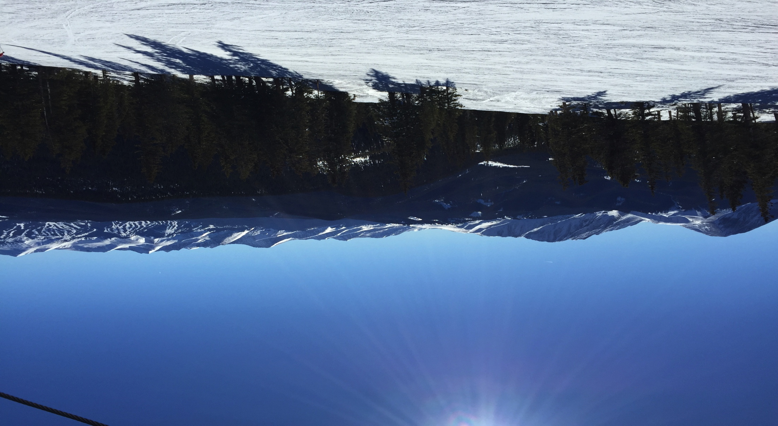
Thank you!

Slide 25
Backup

Slide 26
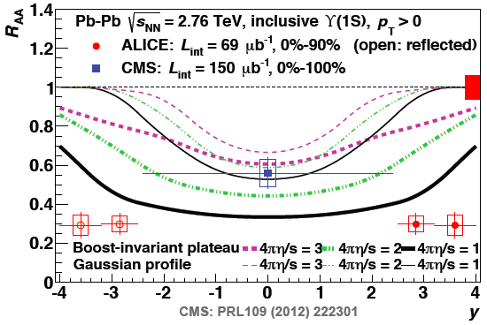
ALICE and CMS compared to Model
Model from Strickland et al.
  Expect largest suppression “dip” at y=0.
  Changing model parameters does not change this feature.
    Change in T profile
      Gaussian profile
      Boost invariant profile
      Widens/narrows dip, but dip remains
    Change in shear viscosity (and therefore initial T)
      Increases/Decreases R_{AA} scale, but dip remains
  Most (all?) models on the market have this behavior.
    Note: this model does not have regeneration...

Slide 27
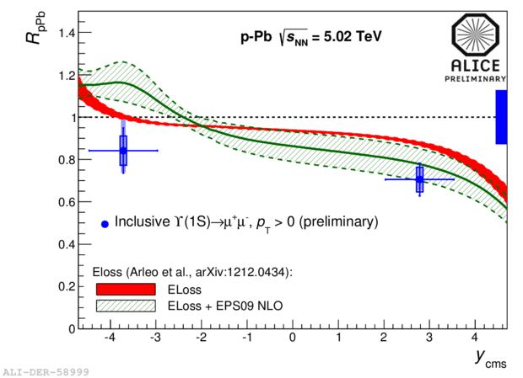
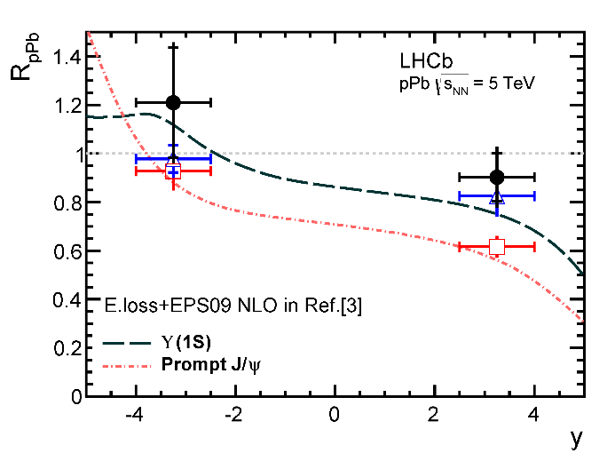
LHC ϒ results for R_{pPb}
Antishadowing region is y~0 at RHIC, but y~-3 at LHC.
LHCb: Slight enhancement at backward rapidity, indication of antishadowing
ALICE: enhancement at backward rapidity, slight suppression.
E. Loss+Shadowing (EPS09) consistent with LHCb backward y data, some tension with ALICE
    EPS09 NLO: IJMP E22 (2013) 1330007
    E. loss : JHEP 03 (2013) 122

Slide 28
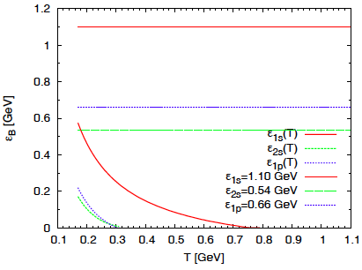
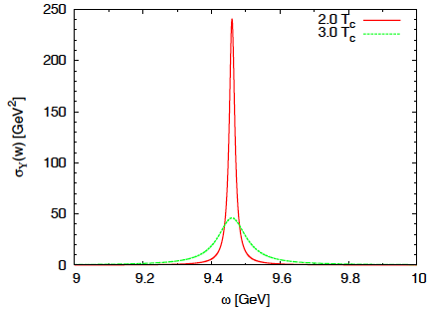
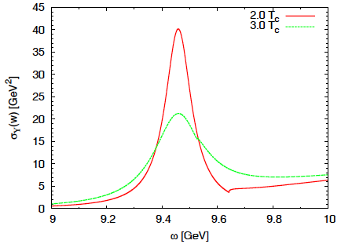
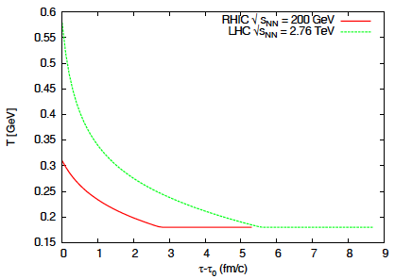
ϒ in Emerick, Zhao, Rapp model
Strong
Binding
Weak
Binding
Weak vs. Strong Binding
  Binding energy changes (or not) with T.
  Narrower spectral functions for “Strong” case
  Ratios of correlators compared to Lattice: favor “Strong” binding case
Kinetic Theory Model
  Rate Equation: dissociation + regeneration
  Fireball model: T evolution.
    T ~ 300 MeV @ RHIC
    T ~ 600 MeV @ LHC
Emerick, Zhao & Rapp.
EPJ A (2012) 48:72

Slide 29
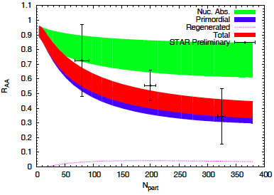
ϒ in Emerick, Zhao, Rapp model
Comparison to data:
  Mostly consistent with data
  Little regeneration: Final result ~ Primordial suppression
  Large uncertainty in nuclear absorption. Need dAu, pPb.
    Based on our preliminary result R_{dAu}=0.78
    σ_{abs} ~ 1 – 3.1 mb
Hot
Emerick, Zhao & Rapp.
EPJ A (2012) 48:72
Suppression due to cold nuclear matter:
can bring R_{AA} down to ~0.6
(most central, lower edge of green band).
Additional suppression needed to bring
R_{AA} down to ~0.4 : hot nuclear effects

Slide 30
E772 Setup
Study A dependence of ϒ family in pA.
Fixed nuclear targets: liquid deuterium, C, Ca, Fe, W.
proton beam @ 800 GeV.
  Equivalent √s=√((800+1)²-(800)²)=√1601 ~ 40 GeV
Measured Drell-Yan, ϒ(1S) and ϒ(2S+3S)
  x_{F}, x₂ and p_{T} dependence.
Reminder about x_{F} and rapidity:
  Definition: x_{F} = p_{Z}/p_{Z}(max) (in CM Frame), y=1/2 ln((E+p_{Z})/(E-p_{Z}))
    For two protons at √s=40 GeV, p_{Z}(max)=19.98 ~20 GeV
  x_{F} = 0 is equivalent to y = 0. (p_{Z}=0 gives 0 for both)
  For other values, need E, which means we need p_{T}. Assuming p_{T}~1 GeV:
    x_{F} = 0.1, p_{Z}=2 GeV, E=10.247, y=0.198 ~ 0.2
    x_{F} = 0.2, p_{Z}=4 GeV, E=10.817, y=0.388 ~ 0.4
    x_{F} = 0.3, p_{Z}=6 GeV, E=11.704, y=0.566 ~ 0.6

Slide 31
Au+Au 2011 Upsilons
Au+Au √s_{NN}=200 GeV, 2011
L ~ 2.8 nb⁻¹
same setup as in 2010
factor of ~3 in statistics.

