Slide 1




A panorama of bottomonium results
with focus on STAR and CMS.
Sunrise in Grand Teton National Park
Manuel Calderón de la Barca Sánchez
INT Workshop on Heavy Flavor and Electromagnetic Probes in Heavy-Ion Collisions
University of Washington
19/Sep/2014

Slide 2
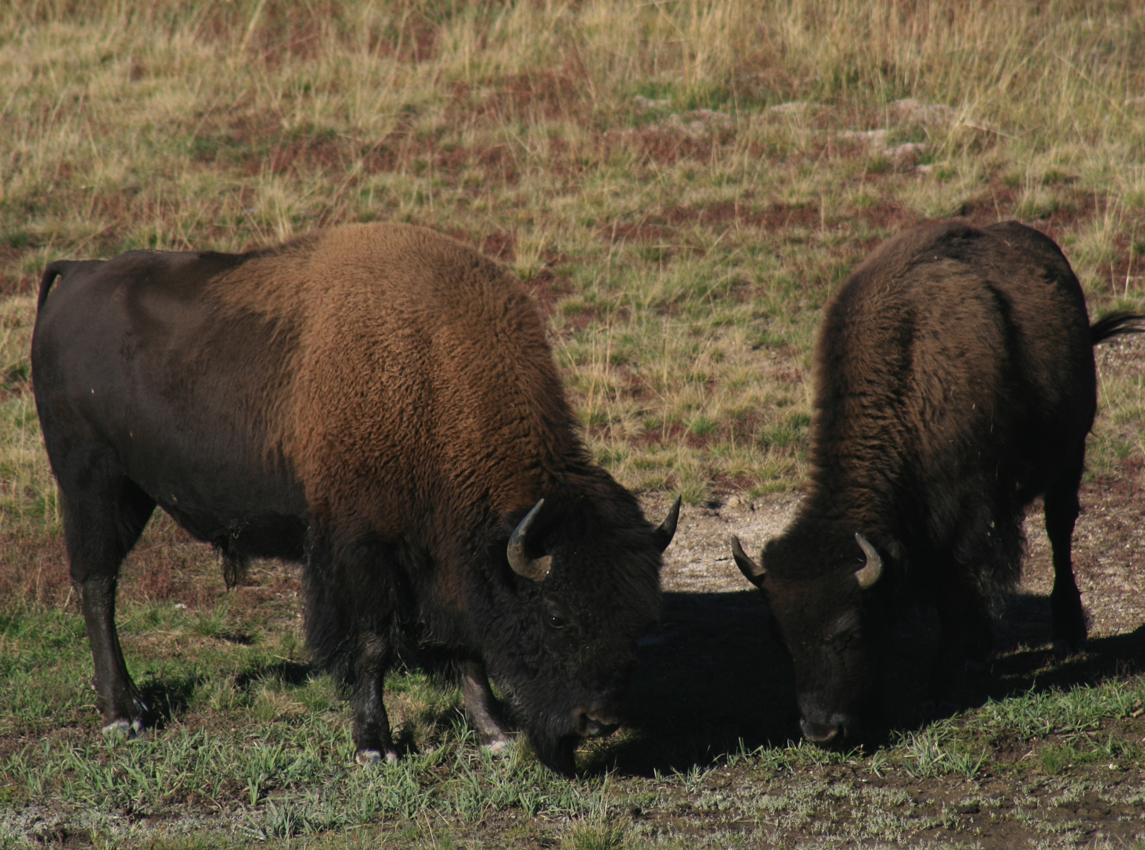
Outline
Heavy Quarkonium
  ϒ production
    pp, p(d)A collisions
      RHIC & LHC
      Comparison to models
      Questions from trends in data
    AA collisions
      Ditto...
Two beautiful and massive objects
that roam freely a colorful field.

Slide 3
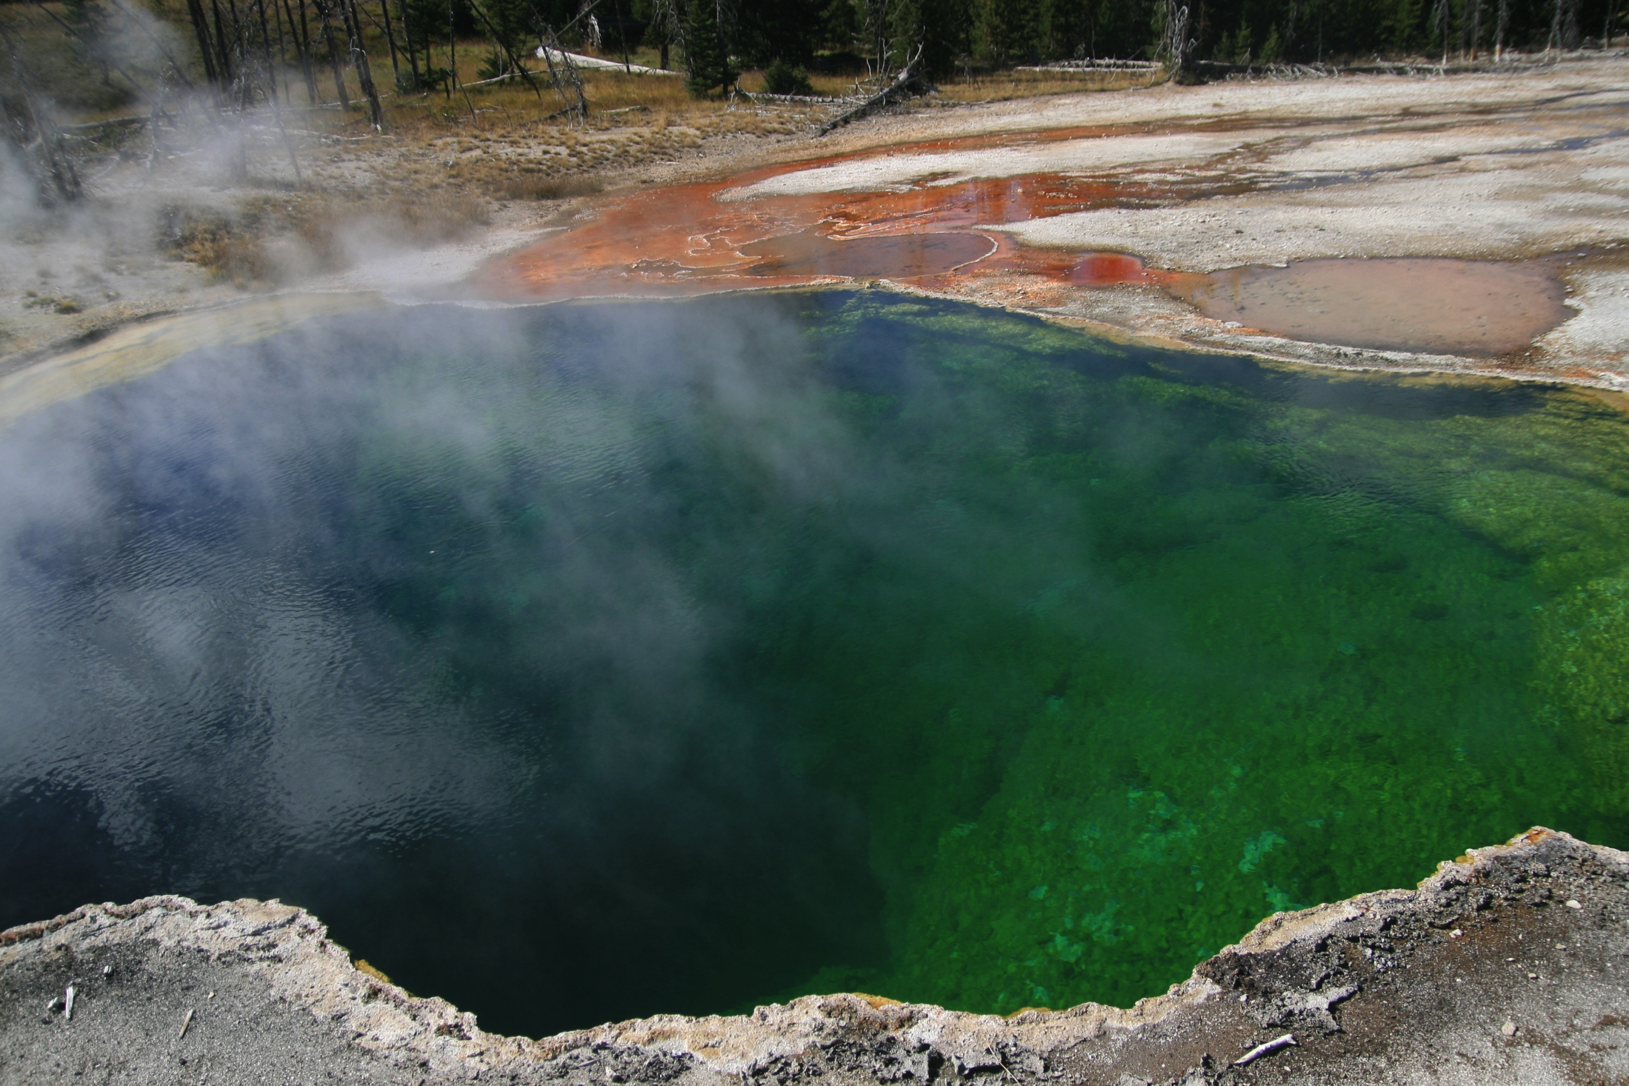
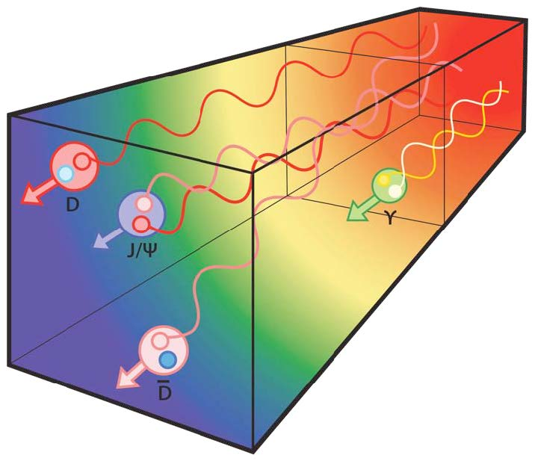
Heavy Quarkonium: why?
States are massive, produced early
  pQCD can estimate production
Sensitive to temperature and deconfined color fields: input from Lattice QCD
  Debye screening, Landau damping
    Re and Im V(r, T)
  Different states have different sizes/binding energy
    Sequential suppression
Cold-nuclear matter
  Initial state effects: e.g. nPDF
  Final state: energy loss, absorption
Regeneration
  Uncorrelated heavy-quarks can pair up
Bottomonium: a cleaner probe than charmonium...
  3 states are accessible experimentally
  expect small CNM effects
  expect small regeneration effects
From A. Mocsy

Slide 4
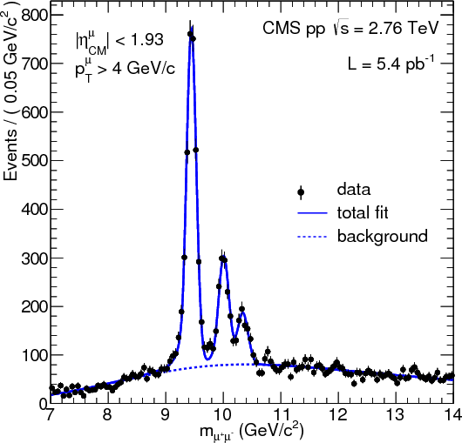
Measuring ϒ
STAR: electron channel
CMS, PHENIX, ALICE: dimuon channel
Experimental Results:
      STAR: PLB 735 (2014) 127
      PHENIX: PRC 87, 044909 (2013)
      CMS:
        PRL 109 222301 (2012)
        JHEP 04 103 (2014)
      ALICE:
        arXiv:1405.4493

Slide 5
ϒ in pp collisions at RHIC
Results on cross sections
      STAR: PLB 735 (2014) 127
      PHENIX: PRC 87, 044909 (2013)
  STAR data:
    20 pb⁻¹, all from pp run 2009.
    Improvement over 2006:
      Less inner material
Calculations:
    CEM: R. Vogt
    CSM: Lansberg & Brodsky
Data ~ in between CEM and CSM predictions.

Slide 6
ϒ in d-Au at RHIC
STAR dAu cross section
  Note: Scaled by 10³.
Midrapidity point is lower than expectations from CEM.
  Calculation includes shadowing
  Does not include estimate of nuclear absorption
pp data is also lower than prediction,
  compare R_{dAu}, where many theoretical and experimental uncertainties cancel.
Notes:
Absorption | final-state effect, after cc that forms and the J/ψ has been produced, pair breaks up in matter due to interactions with nucleons

Slide 7
ϒ R_{dAu} at RHIC, near y=0
Invariant mass distribution in dAu at |y|<0.5
  Scaled pp reference fit shown for comparison
RdAu vs. y
  Model comparison:
    Shadowing, EPS09
      R. Vogt
    Energy loss
    Energy loss + shadowing
      Arleo & Peigné
  y~0 is right in the middle of the antishadowing region
  Expect R_{dAu} > 1 (small effect)
  Observe R_{dAu} < 1
  Absorption seems to be important

Slide 8
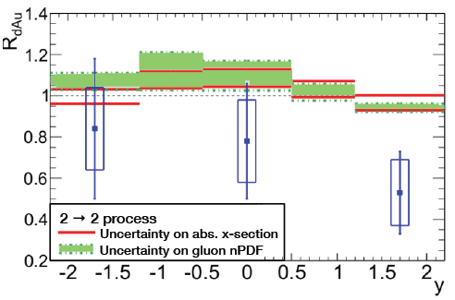
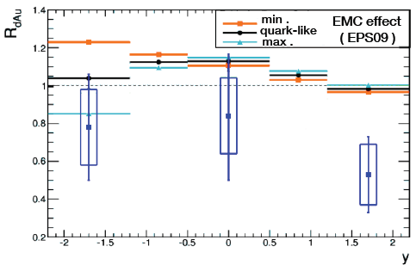
Model from A. Rakotozafindrabe, et al.
Shadowing/Antishadowing of gluon nPDF: green band
  Note: STAR data on plot were preliminary.
EMC effect (right panel)
  Also expects slight enhancement at mid-rapidity.
Must include additional absorption (red lines)
  Why does absorption still give R_{dAu}>1? : Heard that absorption in this calculation needed updating/revisiting.
A. Rakotozafindrabe,
E. Ferreiro,
F. Fleuret,
J.P. Lansberg,
N. Matagne,
arXiv:1207.3193

Slide 9
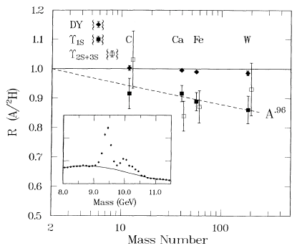
Yields vs. Mass Number in E772
Ratio of nuclear targets normalized to deuterium
Suppression seen with increasing A.
A dependence:
STAR result is in the same range:
  for σ_{dAu} = (2 A)^{α}σ_{pp} :
    α =ln(σ_{dAu} /σ_{pp} )/ln (2A)
    α ~ 0.9
Suppression is the same for 1S and 2S+3S (within errors).
  Drell-Yan is not suppressed, follows A scaling.
  Suppression is not as large as for J/ψ (α=0.92±0.008)

Slide 10
Comparison: STAR & E772
For a similar comparison, separate ϒ(1S) stat
  Increases the statistical uncertainty compared to sum ϒ(1S+2S+3S)
  Use|y|< 1, check A dependence.
  Also compare y or x_{F} dependence.
STAR result: consistent with A trend from E772.
Large suppression seen near xF~0 by E772, α~0.9.
  Same as STAR |y|<0.5 points.
Shadowing, or shadowing+E. Loss cannot explain suppression at y=0.
Effect goes away in the forward y bins.
A higher-statistics d+Au run would help.
  Note: dAu 2008 run was first attempt at measuring bottomonium in cold nuclear matter, can revisit with higher statistics

Slide 11
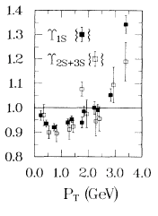
Note: p_{T} dependence in E772
Not trivial either.
  Suppression largest at ~1 GeV
  Gives way to large enhancement above 3 GeV
Might follow up later in STAR: but again, need more statistics.

Slide 12
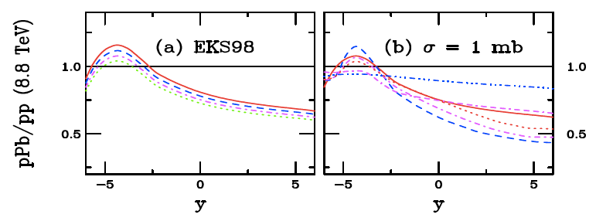
R_{pPb}: what to look for at LHC
Expectations From Ramona’s calculations for LHC
Left: fixed PDF, varying σ_{abs} : absorption has little effect
Right: fixed σ_{abs}, vary the PDF : effect on pPb nPDF is large
At LHC, kinematics of initial gluons different than at RHIC
  Lower-x gluons: stronger shadowing.
    Expect suppression at midrapidity at LHC from shadowing alone.
    Larger uncertainty from gluon PDF than from absorption at LHC

Slide 13
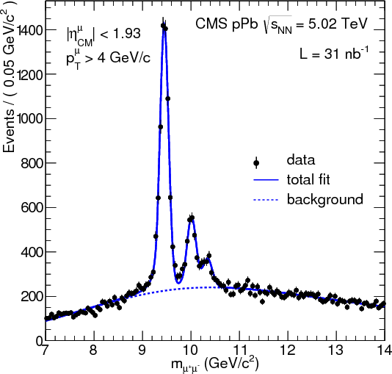
ϒ in pPb at LHC with CMS
CMS Upsilon dataset for pPb
  31 nb⁻¹ @ √s_{NN}=5.02 TeV
    From two datasets:
      Pb+p, ~18 nb⁻¹
      p+Pb, ~12 nb⁻¹
      Energy of p beam: 4 TeV
        Pb beam: 4 x Z/A = 1.58 eV
Observables:
  Double ratio, single ratio
  “Self-normalized” yields
  Study as a function of event activity
    Look at activity close to or far from ϒ meson.
      Close: N_{tracks}
      Far: E_{T}
ϒ
(-1.93, 1.93)
η
E_{T}
(-5.2, -4)
N_{tracks}
(-2.4, 2.4)
E_{T}
(4, 5.2)

Slide 14
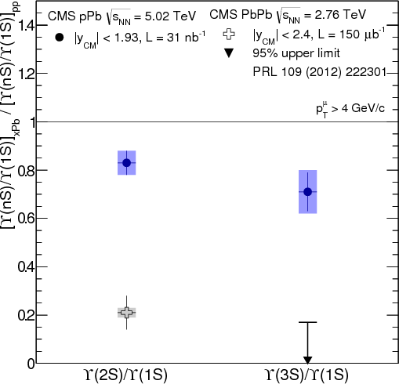
ϒ Double ratio, pPb and pp
pp reference for single ratio:
  No pp data at the same energy
  Solution: use results from 1.9, 2.76, and 7 TeV
    No significant dependence is observed vs. √s
Key feature of double ratio:
  All initial-state effects should cancel
    e.g. shadowing affects excited and ground state in the same way
Observation:
  Double ratio < 1 in pPb
  Double ratio in pPb higher than in PbPb
  Similar for 2S than for 3S
Implication: possible presence of final state effects in pPb which affect excited states more than ground state
  Note: double ratio = 1 does not imply absence of final-state effects
  They could modify excited and ground state equally
Expect small ϒ absorption in hadronic matter
Lin & Ko, PLB 503 (2001) 104
Note: depends on radius.
Hence, larger absorption for 2S and 3S

Slide 15
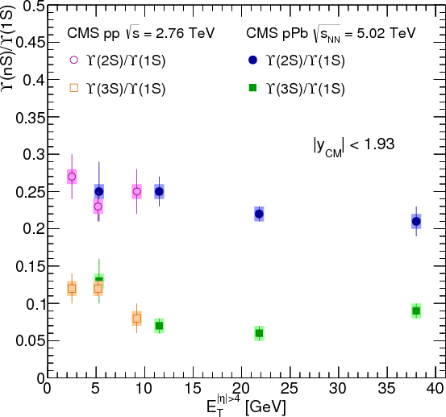
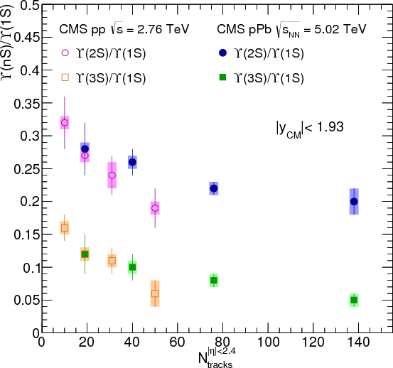
Single ratios vs. event activity
E_{T}^{|η|>4}, Far activity:
  Single ratios vary very little as the activity increases
N_{track}^{|η|<2.4}, Near activity:
  Single ratios decrease significantly with increasing activity
  Interplay between produced and surrounding event, both in pp and pPb
    Additional multiplicity produced with the ground state?
    Final-state interactions breaking up the excited states?

Slide 16
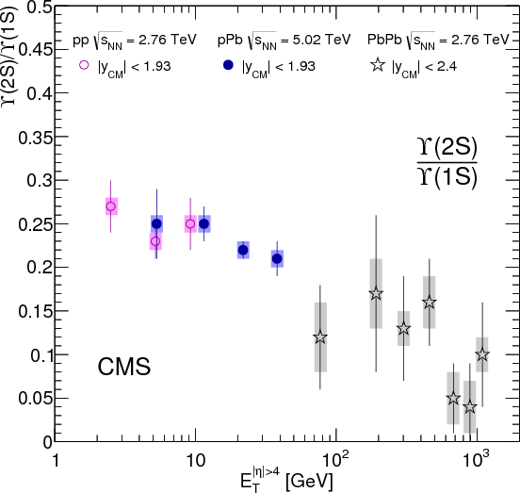
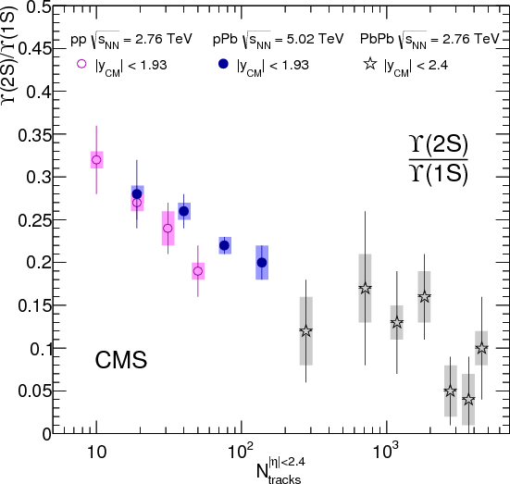
Single ratios vs. activity from pp to PbPb
Span large range in event activity variables, pp, pPb, PbPb
Overlap is limited between pPb and PbPb
  Need additional data to investigate the dependence in the three systems.

Slide 17
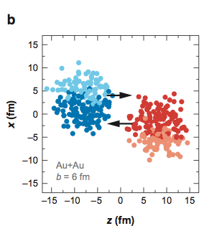
Self-normalized yield, motivation
  Allows us to look at scaling of cross section with activity
  In PbPb, activity connected to N_{coll} via Glauber model
  A simple binary-nucleon-nucleon collision ansatz:
    In a given event, the yield of scales with binary collisions
    In the same event, the activity of the event also scales with binary collisions
    Leads to linear scaling of yields with activity, assuming no other effects
  Similar connection for pPb is also common paradigm: still deal with nucleon-nucleon collisons
  For pp, does this hold?

Slide 18
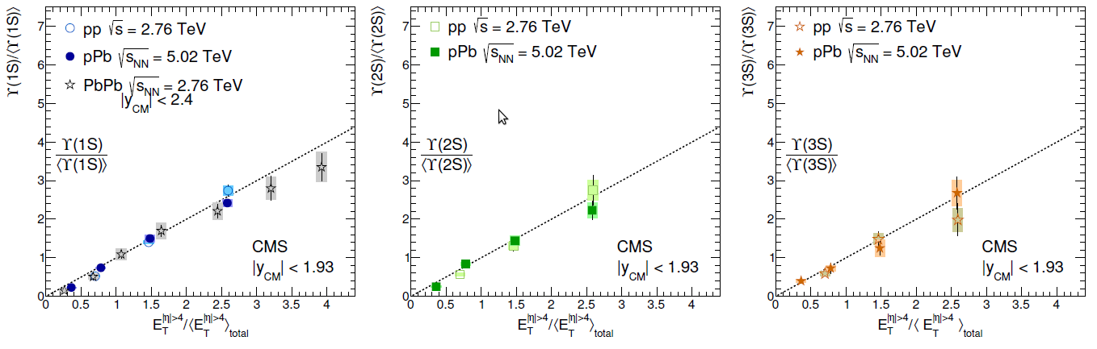
Self-normalized yields: Far
E_{T}, Far activity Note: x-axis is also self-normalized.
Close to linear scaling is observed for all systems, all states.
    Suppression in PbPb for high E_{T}: central events.
pPb, pp follow very closely line with slope 1 (dashed line)
    Fit gives slope consistent with 1 within errors.
    All systems, all ϒ states.
Notes:
Very different <ET> GeV: 3.5 (pp), 14.7 (pPb), 765 (PbPb)

Slide 19
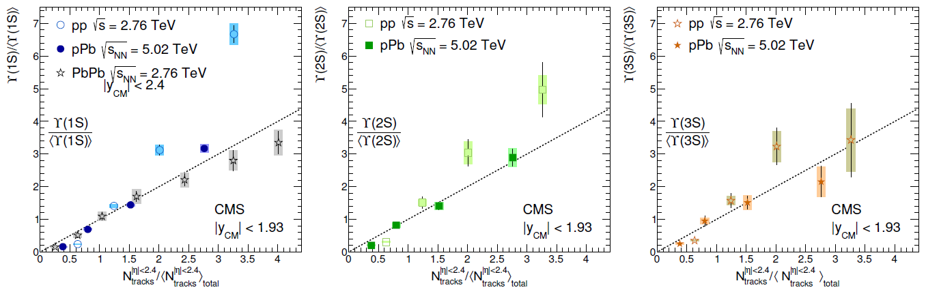
Self-normalized yields: Near
N_{tracks}, Near activity
Significant differences among systems and among states!
  ϒ(1S) production scaling: stronger than linear in pp.
  pp: indications that slope is smaller for 2S and for 3S.
All states, even in pp, regardless of whether activity is far or near, show increase relative yield in higher activity events.
  Number of parton-parton collision scaling? Multi-parton interactions in pp?

Slide 20
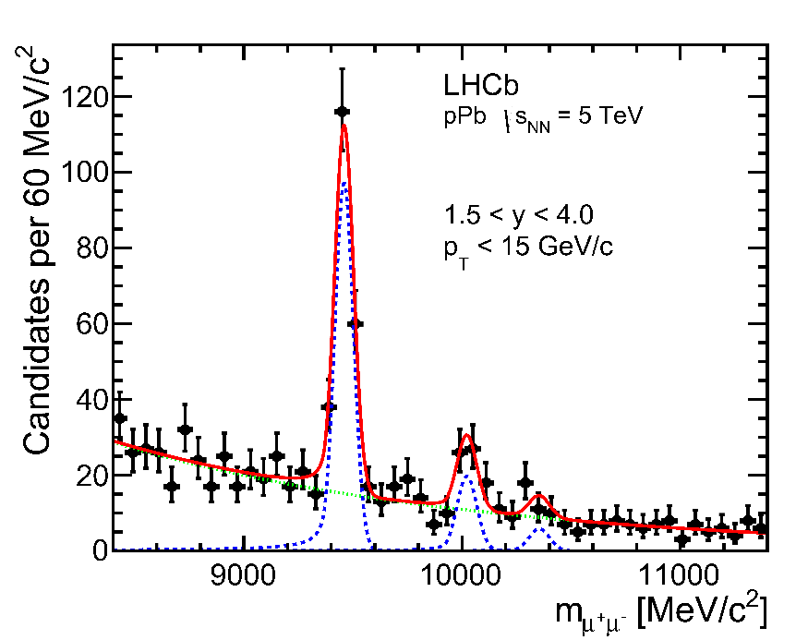
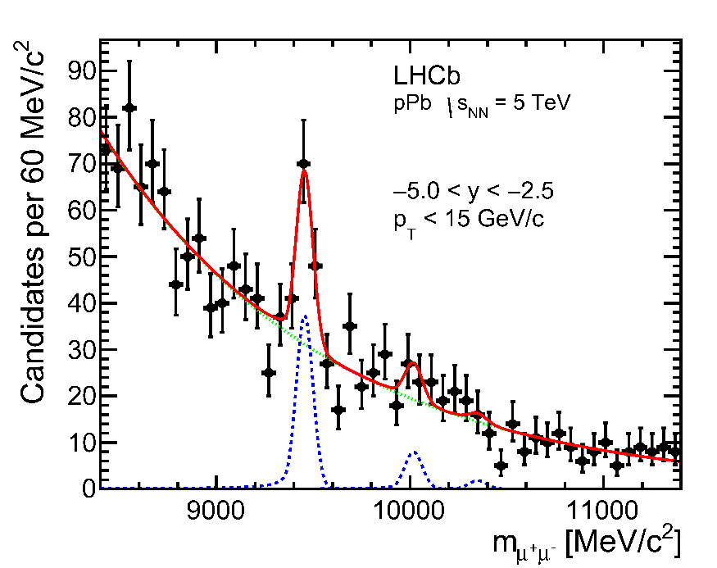
LHCb ϒ results for pPb
arXiv:1405.5152
Signal seen in LHCb
Signal yield | Forward (pPb) | Backward (Pbp)
ϒ(1S) | 189±16 | 72±14
ϒ(2S) | 41±9 | 17±10
ϒ(3S) | 13±7 | 4±8

Slide 21
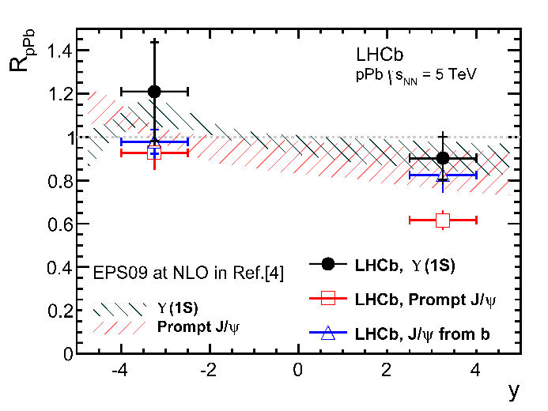
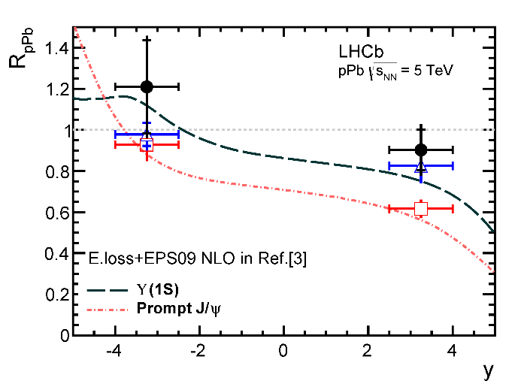
LHCb ϒ results for R_{pPb}
Used interpolated pp reference
Slight enhancement at negative rapidity, indication of antishadowing
Slight suppression at forward rapidity
Different theoretical models are consistent with data, within uncertainties
    EPS09 NLO: IJMP E22 (2013) 1330007
    E. loss : JHEP 03 (2013) 122

Slide 22
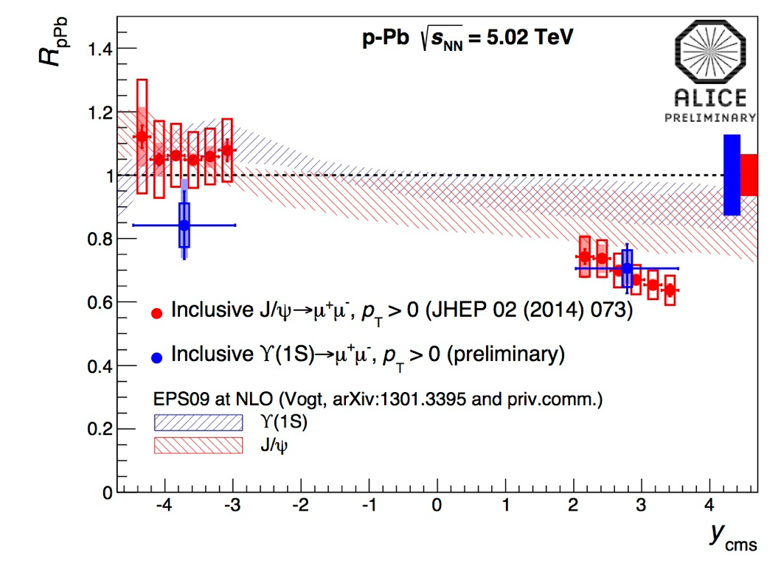
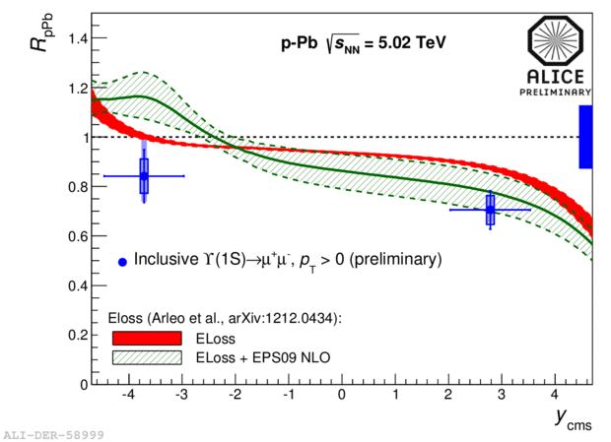
ALICE ϒ results for R_{pPb}
ALICE sees no enhancement at backward rapidity, slight suppression.
  EPS09 NLO expects antishadowing. ELoss + EPS09 also expects enhancement.
Forward rapidity data:
  EPS09 NLO expects only modest suppression
  Including E. Loss lowers R_{pPb}, data near lower end of prediction
Note: ALICE data in both cases lower than LHCb data.

Slide 23
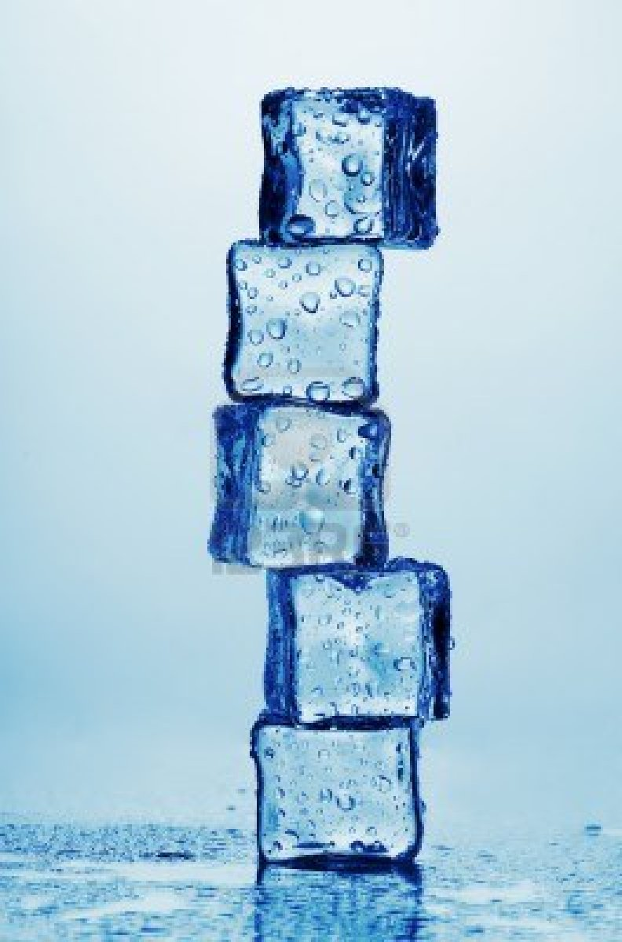
dAu, pPb Summary
Cold Nuclear Matter effects are important
STAR dAu results show suppression at y=0
  Not expected from shadowing
  Absorption seems to be needed
  Similar effect seen in E772
CMS pPb results:
  Evidence for final state effects in pPb: suppress excited states relative to ground state
CMS event activity study:
  single ratios affected by nearby activity
    final-state breakup of excited state?
  self-normalized yields increase vs. activity
    multi-parton interactions in pp?
Cold nuclear matter

Slide 24

Bottomonium in Hot Matter
“Morning glory” pool: a hot spring with a balmy temperature of 70 C.

Slide 25
ϒ in STAR, AuAu
Invariant mass distributions in 3 centrality bins
Possible to separate ground state.
Comparison to N_{coll}-scaled pp reference:
  Clear suppression of excited states.
  Suppression of ground state in most central bin.

Slide 26
STAR ϒ R_{AA} vs. N_{part}
Right panel: all data in STAR acceptance |y|<1
  dAu, and two most peripheral bins: consistent with no suppression
  Suppression most central Au+Au: Consistent with expectations for hot & cold nuclear matter, however...
Left panel: bin closest to midrapidity, |y|<0.5
  dAu suppression is of the same magnitude as central AuAu: Important to understand dAu system
Calculations:
  Strickland & Bazow: Includes estimate of heavy quarkonium potential, Re and Im. Models evolution through anisotropic hydro. (Nucl. Phys. A 879 (2012) 25 )
  Emerick, Zhao & Rapp: attempt to include both Hot & Cold nuclear effects

Slide 27
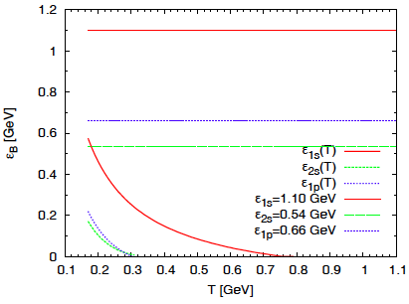
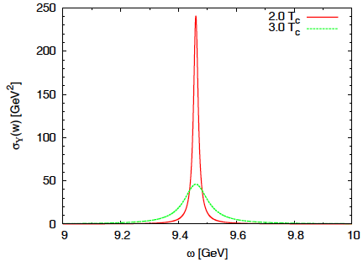
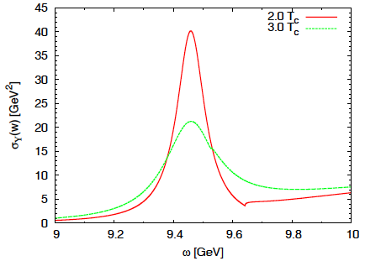
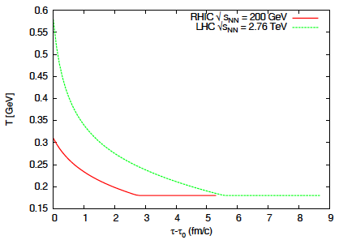
ϒ in Emerick, Zhao, Rapp model
Strong
Binding
Weak
Binding
Weak vs. Strong Binding
  Binding energy changes (or not) with T.
  Narrower spectral functions for “Strong” case
  Ratios of correlators compared to Lattice: favor “Strong” binding case
Kinetic Theory Model
  Rate Equation: dissociation + regeneration
  Fireball model: T evolution.
    T ~ 300 MeV @ RHIC
    T ~ 600 MeV @ LHC
Emerick, Zhao & Rapp.
EPJ A (2012) 48:72

Slide 28
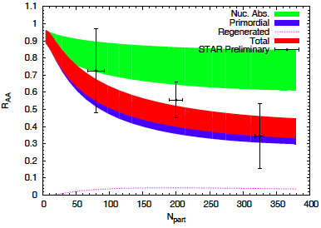
ϒ in Emerick, Zhao, Rapp model
Comparison to data:
  Mostly consistent with data
  Little regeneration: Final result ~ Primordial suppression
  Large uncertainty in nuclear absorption. Need dAu, pPb.
    Based on our preliminary result R_{dAu}=0.78
    σ_{abs} ~ 1 – 3.1 mb
Hot
Emerick, Zhao & Rapp.
EPJ A (2012) 48:72
Suppression due to cold nuclear matter:
can bring R_{AA} down to ~0.6
(most central, lower edge of green band).
Additional suppression needed to bring
R_{AA} down to ~0.4 : hot nuclear effects

Slide 29
ϒ Ground state R_{AA} in STAR
Consistent with no suppression in dAu and peripheral AuAu
Suppression in most central collisions
  R _{AA}(1S) = 0.66 ± 0.13(Au + Au stat.) ± 0.10(p + p stat.)^{+0.02} _{−0.05}(Au + Au syst.) ± 0.08(p + p syst.).
  Models from Strickland et al., and Liu et al. consistent with central suppression
    However, neither model includes any CNM effects.

Slide 30
Hypothesis testing, |y|<1
Measurements: vertical line
  R_{dAu}
  R_{AA}, 0-10% most central
    pink band: syst. unc.
Hypothesis test:
  Run pseudoexperiments for various scenarios
  Stat. unc.: width of distributions
    No suppression: RAA=1
    A^{α} scaling for dAu (CNM effect)
      A^{2α} for AuAu
    QGP effects only
      Based on Strickland et al.
    QGP effects + A^{α} scaling
A^{α} scaling: consistent with dAu data
QGP+A^{α} scaling: consistent with AuAu data
Other scenarios are disfavored.

Slide 31
Hypothesis testing, |y|<0.5
Hypothesis tests:
    No suppression: RAA=1
    A^{α} scaling for dAu (CNM effect)
      A^{2α} for AuAu
    QGP effects only
      Based on Strickland et al.
    QGP effects + A^{α} scaling
Clear that |y|<0.5 shows large suppression in dAu.
  Comparable to central AuAu
  No particular scenario is favored.
    Additional statistics in dAu would be beneficial.

Slide 32
ϒ in CMS PbPb
Clear suppression of all states in PbPb.

Slide 33
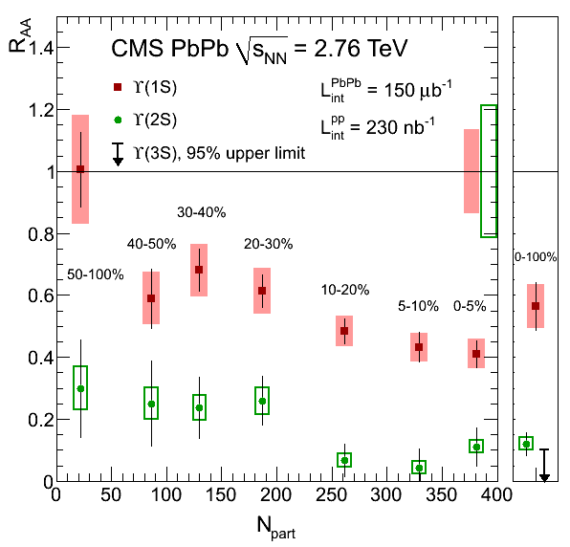
CMS ϒ R_{AA} vs. N_{part}
Centrality integrated:
  ○(1S) : 0.56 ± 0.08 ± 0.07
  ○(2S) : 0.12 ± 0.04 ± 0.02
  ○(3S) : < 0.10 @ 95% CL
Observation of sequential suppression.
Comparison to STAR R_{AA} ○(1S), |y|<1 :
  0.88±0.09±0.13^{+0.03}_{−0.07} ±0.11
  More suppression at LHC compared to RHIC
If directly produced fraction is ~51%: result consistent with suppression of excited states only.
Notes:
AuAu stat, pp stat, AuAu syst, pp syst.

Slide 34
CMS PbPb and models
Models from Strickland et al. and Emerick et al. consistent with data.
  Suppression level is similar in both models
  EZR model: Regeneration component is small for ϒ.

Slide 35

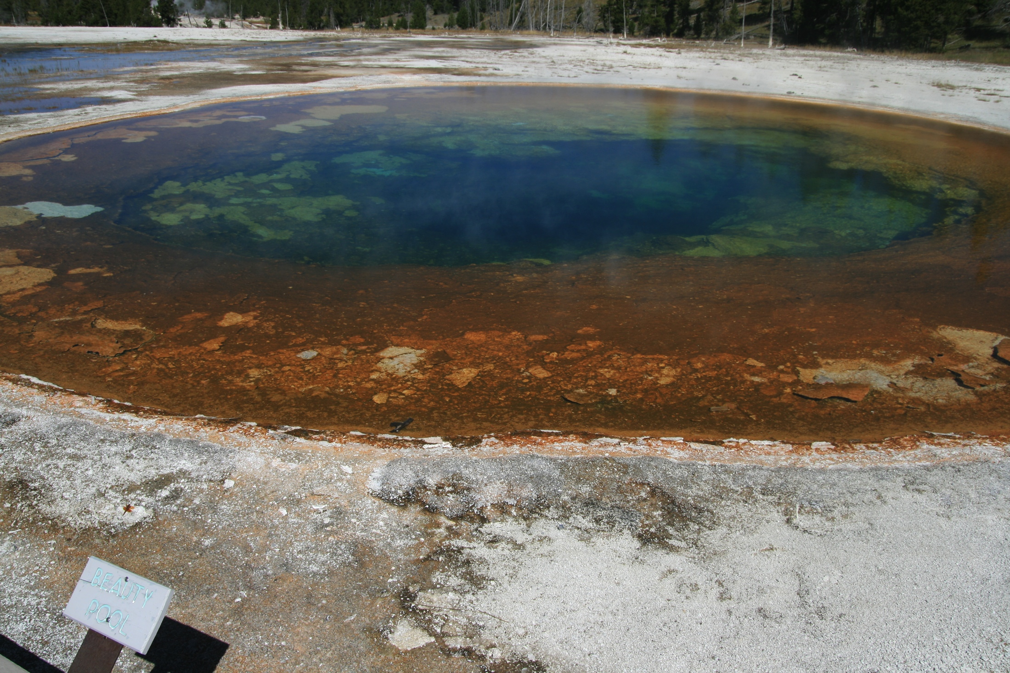
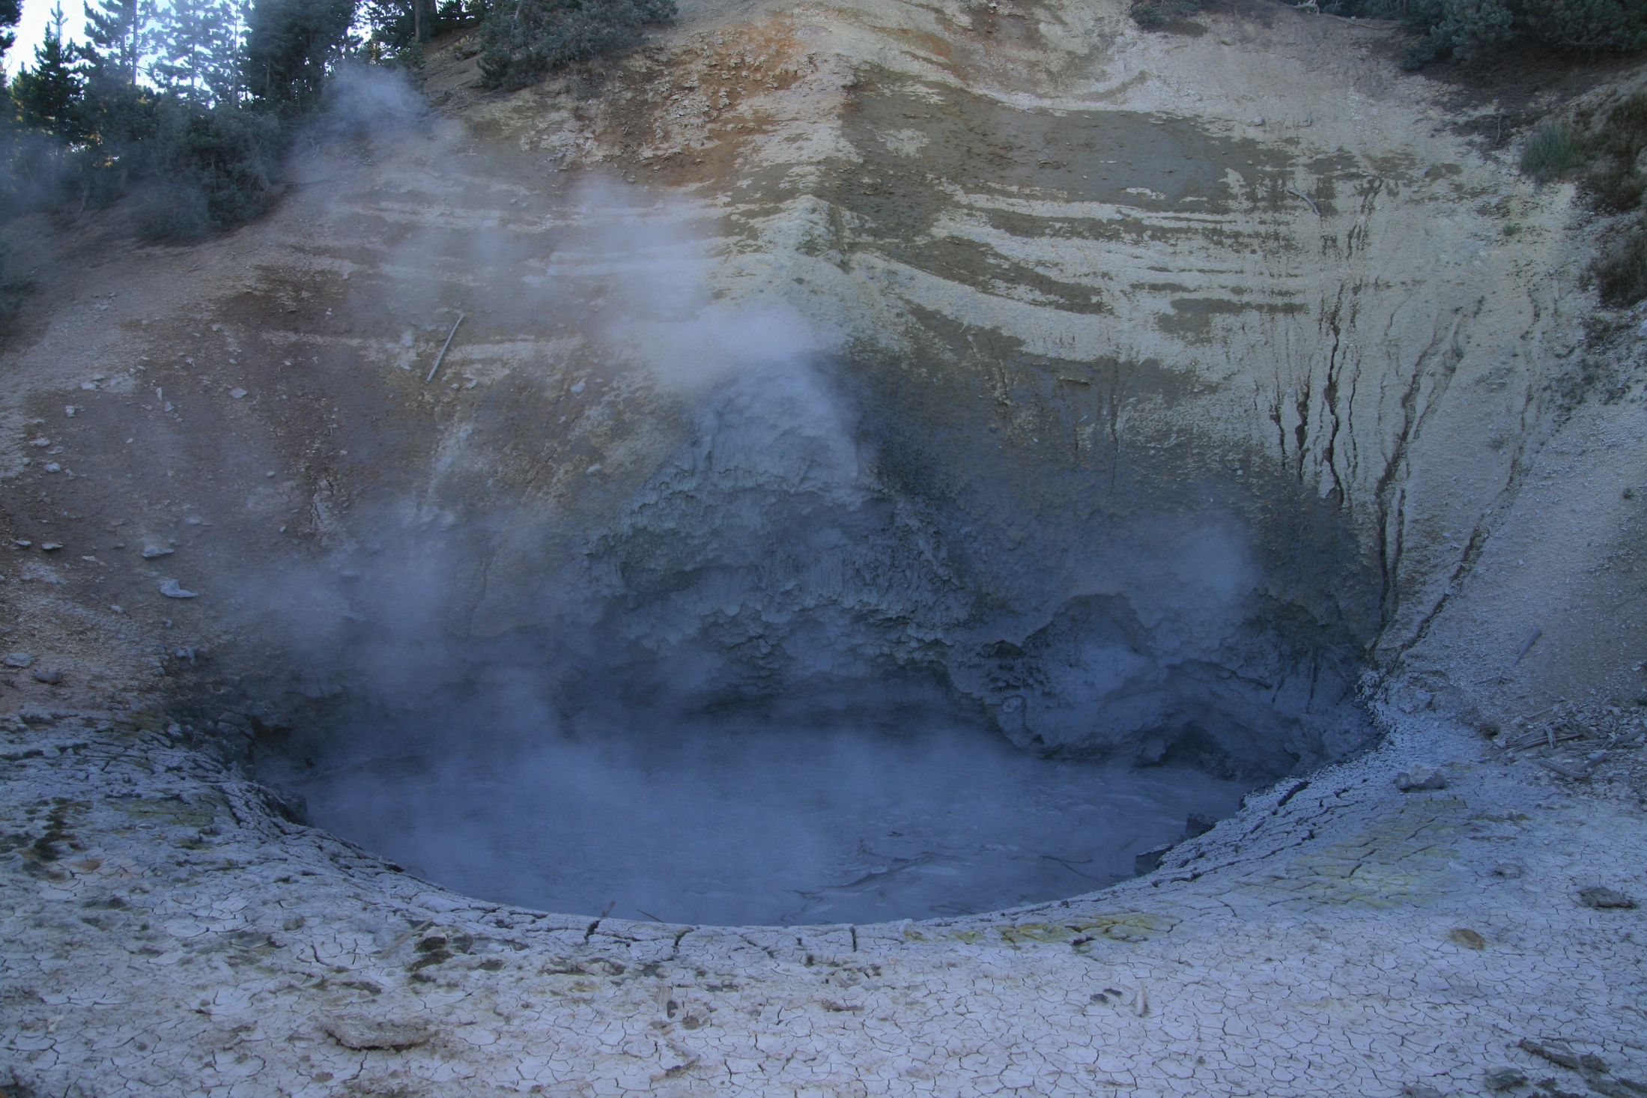
LHC results...
CMS showed sequential suppression
  Models are consistent with this picture
LHCb shows results consistent with shadowing, can also have some E. loss, but both ok within uncertainties
The beauty peaks were painting a compelling picture.
... but then things got murky...
Beauty Pool
Mud Volcano

Slide 36
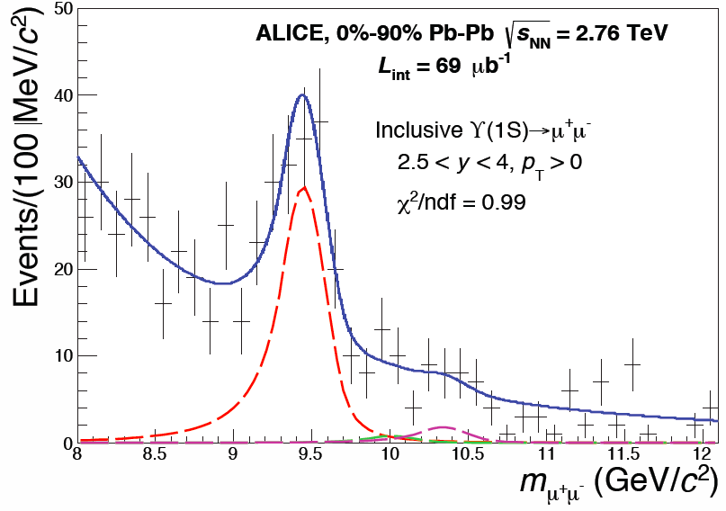
ALICE ϒ Results
arXiv:1405.4493
ALICE Measures ϒ in PbPb
  Forward rapidity region
    2.5 < y < 4
    Note: CMS, |y|<2.4
Fit to 1S to extract yield in PbPb
  Uses LHCb pp for reference

Slide 37
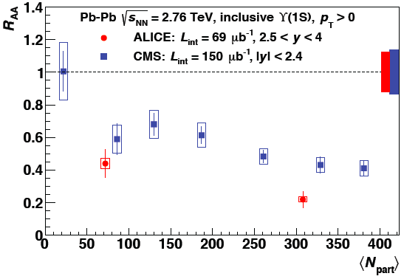
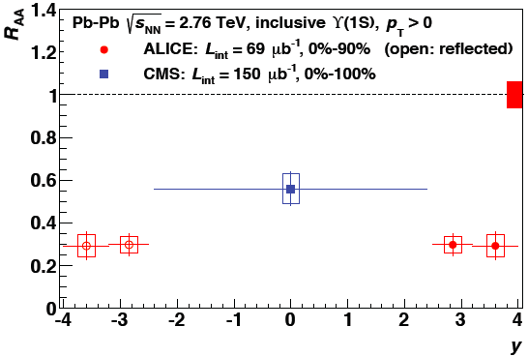
ϒ R_{AA} vs. Npart, forward y
Comparison between CMS and ALICE
  ϒ R_{AA}: more suppression at forward rapidities!
    Energy density, T should be smaller at forward y. What gives?

Slide 38
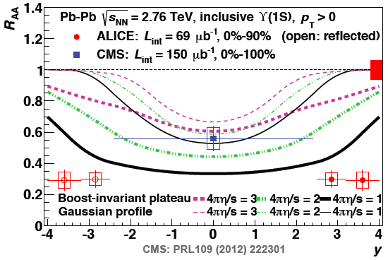
Comparison to dynamical model
Model from Strickland et al.
  Expect largest suppression “dip” at y=0.
  Changing model parameters does not change this feature.
    Change in T profile
      Gaussian profile
      Boost invariant profile
      Widens/narrows dip, but dip remains
    Change in shear viscosity (and therefore initial T)
      Increases/Decreases R_{AA} scale, but dip remains
  Most (all?) models on the market have this behavior.
    Note: this model does not have regeneration...

Slide 39
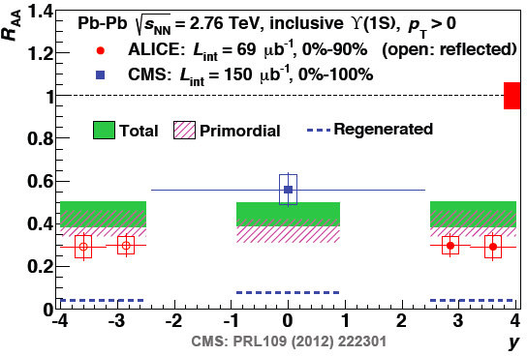
Comparison to transport/regeneration
Model from Emerick et al.
  Includes a regeneration component, albeit small
  Includes absorption component
  Yet, model cannot account for stronger suppression at forward rapidity

Slide 40
In the works, p_{T} and y
ALICE
CMS results on R_{AA} vs. p_{T} and y with first PbPb run, limited statistics
  JHEP 1205 (2012) 063
  No indication of smaller R_{AA} at higher y.
In progress, p_{T} and y dependence with higher statistics and finer bins.
  150 μb⁻¹, compared to 7.3 μb⁻¹

Slide 41
Summary plots vs. binding energy
Overall pattern of sequential suppression is observed.
  But there are important details that do not fit.

Slide 42
Conclusions
ϒ: an observable that is throwing surprises!
dAu, pPb data are now showing intriguing features
  Possible large suppression at y=0 at RHIC
  Final state modifications of excited state compared to ground state
    Double ratio < 1 in pPb
pp data vs. event activity:
  single ratios decrease when activity is near ϒ:
    breakup of excited states? higher multiplicity when ground state is produced?
  Increase of self-normalized yield: multi-parton interactions?
AuAu data: The first results from STAR and CMS looked very consistent with sequential suppression picture.
  But forward rapidity data challenges our closely held beliefs!

Slide 43

Thanks!
Here’s to the continued exploration of beautiful peaks, and that we find a crisp, clear vista of the QCD landscape

Slide 44
Additional

Slide 45
E772 Setup
Study A dependence of ϒ family in pA.
Fixed nuclear targets: liquid deuterium, C, Ca, Fe, W.
proton beam @ 800 GeV.
  Equivalent √s=√((800+1)²-(800)²)=√1601 ~ 40 GeV
Measured Drell-Yan, ϒ(1S) and ϒ(2S+3S)
  x_{F}, x₂ and p_{T} dependence.
Reminder about x_{F} and rapidity:
  Definition: x_{F} = p_{Z}/p_{Z}(max) (in CM Frame), y=1/2 ln((E+p_{Z})/(E-p_{Z}))
    For two protons at √s=40 GeV, p_{Z}(max)=19.98 ~20 GeV
  x_{F} = 0 is equivalent to y = 0. (p_{Z}=0 gives 0 for both)
  For other values, need E, which means we need p_{T}. Assuming p_{T}~1 GeV:
    x_{F} = 0.1, p_{Z}=2 GeV, E=10.247, y=0.198 ~ 0.2
    x_{F} = 0.2, p_{Z}=4 GeV, E=10.817, y=0.388 ~ 0.4
    x_{F} = 0.3, p_{Z}=6 GeV, E=11.704, y=0.566 ~ 0.6

