Slide 1

Quarkonia and open heavy flavor production at STAR
Manuel Calderón de la Barca Sánchez
UC Davis
STAR Collaboration
Hard Probes 2012
Cagliari, Sardinia, Italy.
30/May/2012

Slide 2

Outline
Heavy Quarkonia in medium
  J/ψ
    Transverse momentum spectra
      pp collisions: compare to production
      AuAu: Probe of the medium
        R_{AA}, Elliptic Flow v₂
  ϒ production: A cleaner probe of the medium.
    pp, Au+Au. Baseline, hot nuclear matter effects.
Open Heavy Flavor
  Direct D meson reconstruction
  Non-photonic electrons

Slide 3
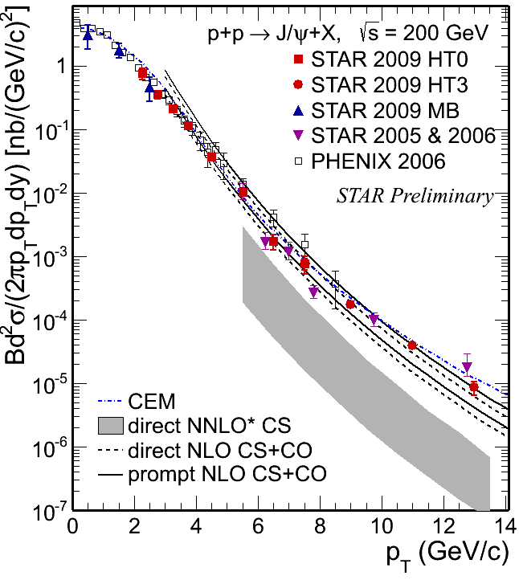
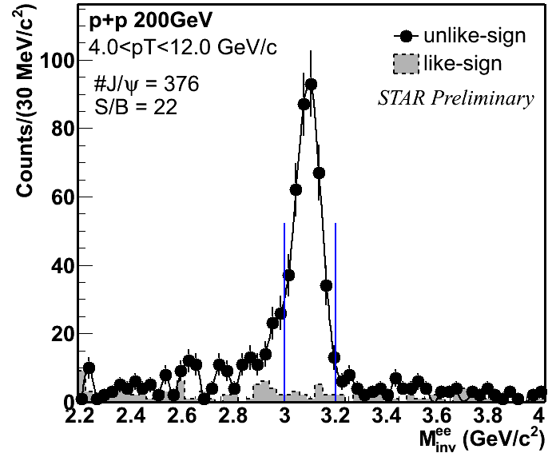
J/ψ in pp collisions, √s=200 GeV
Measured spectra from 0 to ~13 GeV.
  Results consistent with other measurements.
  Great S/B. Needed for polarization studies.
  NNLO* CS misses high p_{T} part.
    P. Artoisenet et al., Phys. Rev. Lett. 101, 152001 (2008), and J.P. Lansberg private communication.
  NLO CS+CO and CEM consistent with our data
    CEM: M. Bedjidian et al., hep-ph/0311048, and R. Vogt private comm.
    NLO CS+CO, Wang et a., PRD 84 114001 (2011)
Phys. Rev. Lett. 98, 232301 (2007)
JPG 37, 085104 (2010)
ArXiv:1101.1912 (2011)
Notes:
Color singlet model: direct NNLO still misses the high-p_{T} part
P. Artoisenet et al., Phys. Rev. Lett. 101, 152001 (2008), and J.P. Lansberg private communication.
NLO CS+CO describes the data
Y.-Q. Ma, K. Wang, and K.-T. Chao, Phys. Rev. D84,
51 114001 (2011), and private communication
CEM can also reasonably explain the spectra down to ~1 GeV/c
M. Bedjidian et al., hep-ph/0311048, and R. Vogt private communication

Slide 4
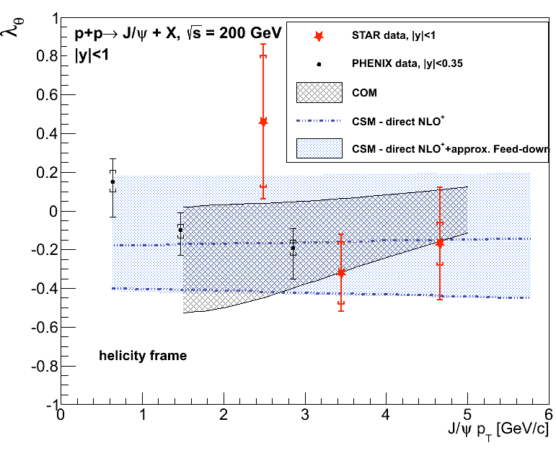
J/ψ polarization
Measurement in 3 bins:
  2-3, 3-4, 4-6 GeV/c
Observed polarization is not large
  Consistent with zero within errors.
  Consistent with both CSM and COM predictions
STAR Preliminary
PHENIX: Phys. Rev. D 82, 012001 (2010)
COM: Phys. Rev. D 81, 014020 (2010)
CSM NLO+: Phys. Lett. B, 695, 149 (2011)

Slide 5
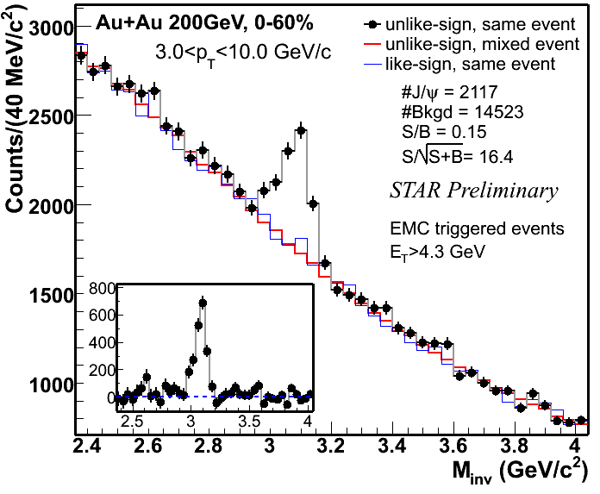
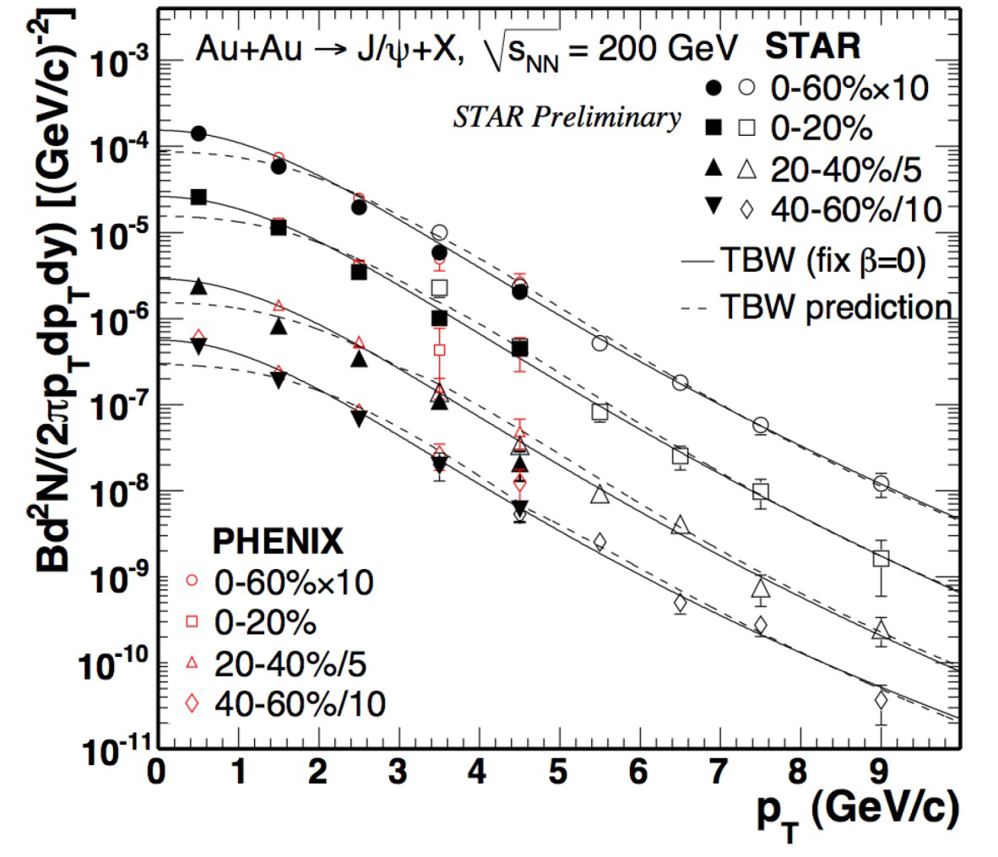
J/ψ in Au+Au collisions
Phys. Rev. Lett. 98, 232301 (2007)
JPG 37, 085104 (2010)
High significance ~16σ signal.
High-tower trigger: Extend p_{T} reach to 10 GeV.
  Consistent with previous measurements in the lower p_{T} region.
  TBW comparison: no radial flow?

Slide 6
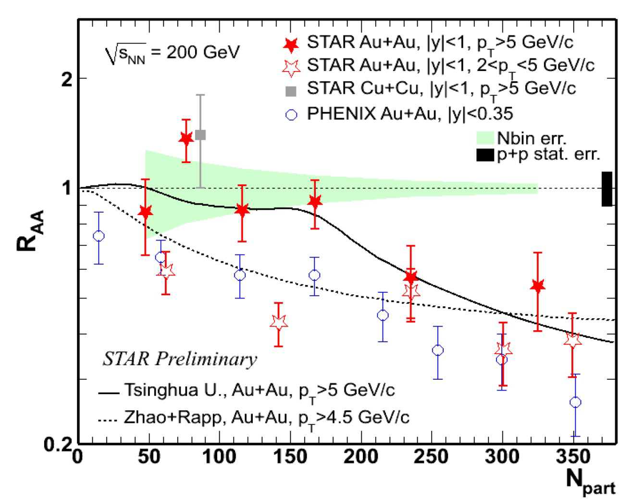
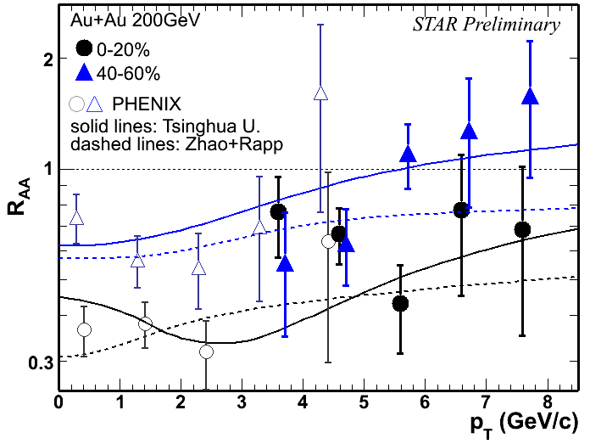
J/ψ R_{AA} , Npart and p_{T}
Y. Liu, et al., PLB 678:72 (2009), Tsingua U.
X. Zhao and R.Rapp, PRC 82, 064905(2010)
STAR CuCu: PRC80, 014922(R), PLB 678:72 (2009), PRC 82, 064905 (2010)
PHENIX: PRL98, 232301
Suppression increases with centrality.
Less suppression at high p_{T}.
In mid-central collisions, consistent with no suppression above p_{T}=5.

Slide 7
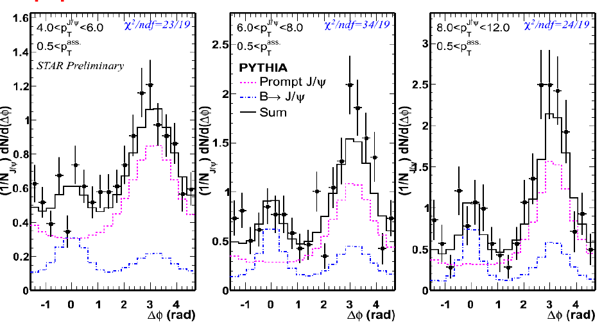
J/ψ-hadron correlation
Near-side contribution: Sensitive to B-feeddown
Notes:
Find our how much of our charm is due to our beauty...

Slide 8
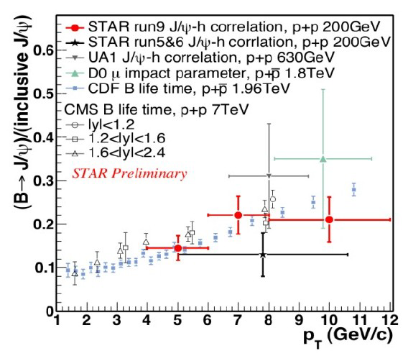

B feeddown contribution
B fraction: similar to previous measurements
  Consistent with no energy dependence.
How much of our charm comes from our beauty?
  B mesons carry 10-25% of charmonium yield.
c
B

Slide 9
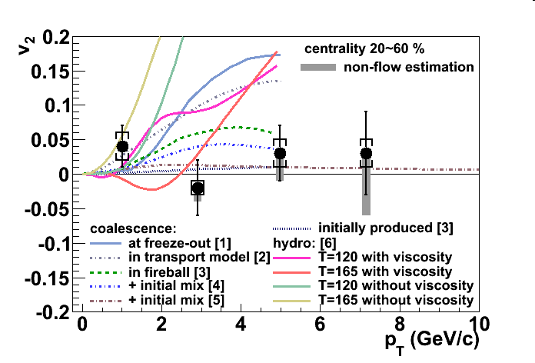

J/ψ Elliptic Flow
Sensitive to transport properties, and production mechanisms
  Primordial/Initial
    pQCD: isotropic in φ.
  Coalescence/Regeneration
    Thermalized, flowing charm: large v2
      Can light quarks move heavy quarks?
J/ψ azimuthal anisotropy
  v₂: consistent with zero for p_{T}>2 GeV/c.
  Disfavors coalescence from thermalized charm quarks.
    Need initially produced quarks for models to agree better with data.
STAR Preliminary
light quark
[1] V. Greco, C.M. Ko, R. Rapp, PLB 595, 202. (minbias)
[2] L. Ravagli, R. Rapp, PLB 655, 126. (minbias)
[3] L. Yan, P. Zhuang, N. Xu, PRL 97, 232301. (b=7.8 fm)
[4] X. Zhao, R. Rapp, 24th WWND, 2008. (20~40 %)
[5] Y. Liu, N. Xu, P. Zhuang, Nucl. Phy. A, 834, 317. (b=7.8 fm)
[6] U. Heinz, C. Shen, priviate communication. (20~60 %)

Slide 10
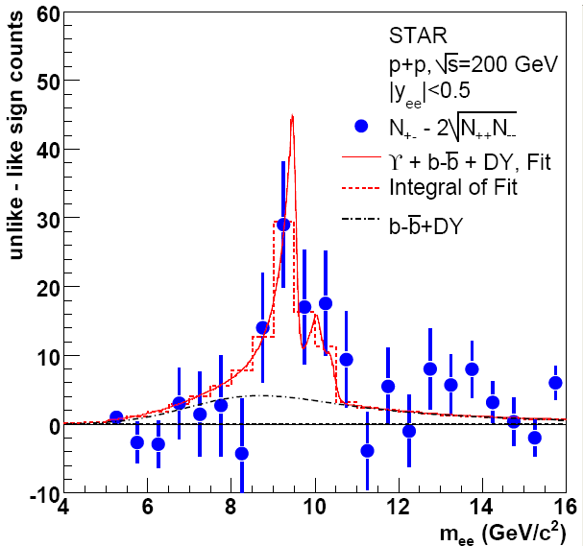
Go heavier! ϒ production
pp Collisions, Reference data
2006: ∫L dt = 7.9 ± 0.6 /pb
  N_{ϒ}(total)= 67±22(stat.)
2009 data: ∫L dt ~ 20 /pb
  N_{ϒ}(total)= 145±26(stat.)
  Improved statistics.
Phys. Rev. D 82
(2010) 12004

Slide 11
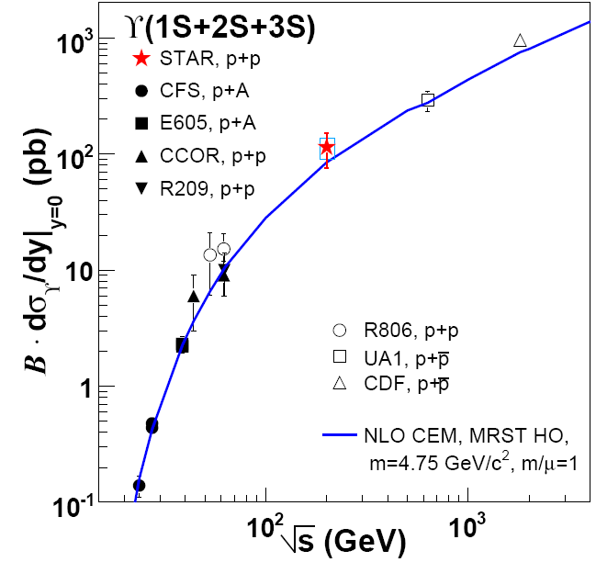
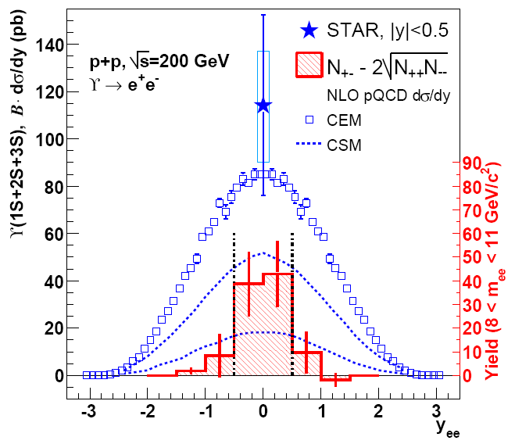
ϒ cross section in pp
Phys. Rev. D 82
(2010) 12004
STAR Preliminary
STAR Preliminary
ϒ(1S+2S+3S) cross section: consistent with NLO pQCD.
Good reference for studying nuclear effects.
Talk by A. Kesich,
Parallel V A.

Slide 12
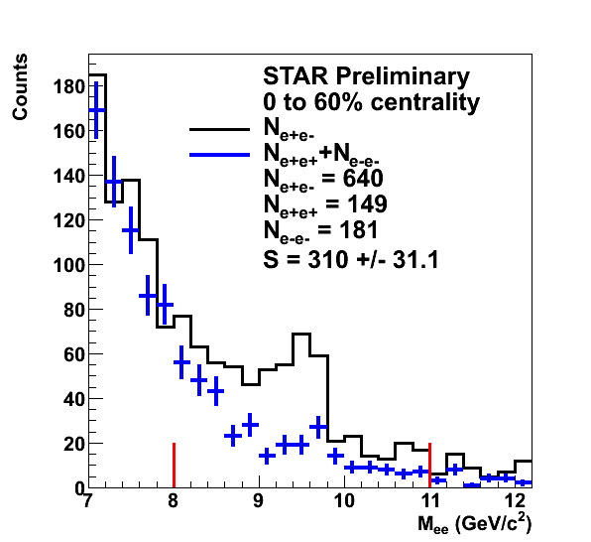
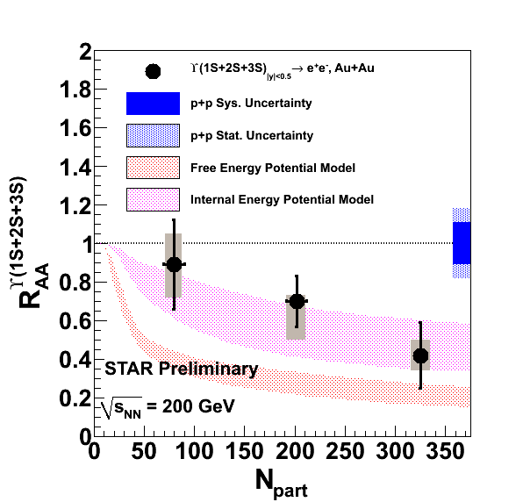
Beauty in a hot, perfect liquid
Models from M. Strickland and D. Bazow, arXiv:1112.2761v4
Raw yield in|y|<0.5 = 197 ± 36
  ∫L dt ≈ 1400 µb⁻¹
R_{AA}: Observation of Upsilon suppression. (Including 2009 pp Preliminary dσ/dy)
  Expect: Recombination: negligible, Hadronic co-mover absorption: negligible.
  Suppression observation: sensitive to deconfinement effects!
Talk by A. Kesich,
Parallel V A.

Slide 13
ϒ model comparison
Incorporating lattice-based potentials, including real and imaginary parts
  A: Free energy (disfavored),
  B: Internal energy (consistent with data vs. N_{part})
Includes sequential melting and feed-down contributions
Dynamical expansion, variations in initial conditions (T, η/S)
  Data indicate: 428 < T₀ < 442 MeV, 1 < 4πη/S < 3
M. Strickland and D. Bazow,
arXiv:1112.2761v4

Slide 14
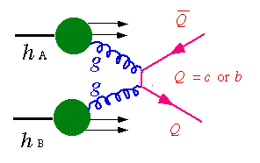
Open Heavy Flavor
K⁺
e⁻/μ⁻
D⁰
ν_{l}
K⁻
π⁺
D⁰
See Talk by D. Tlusty, Parallel II A.

Slide 15
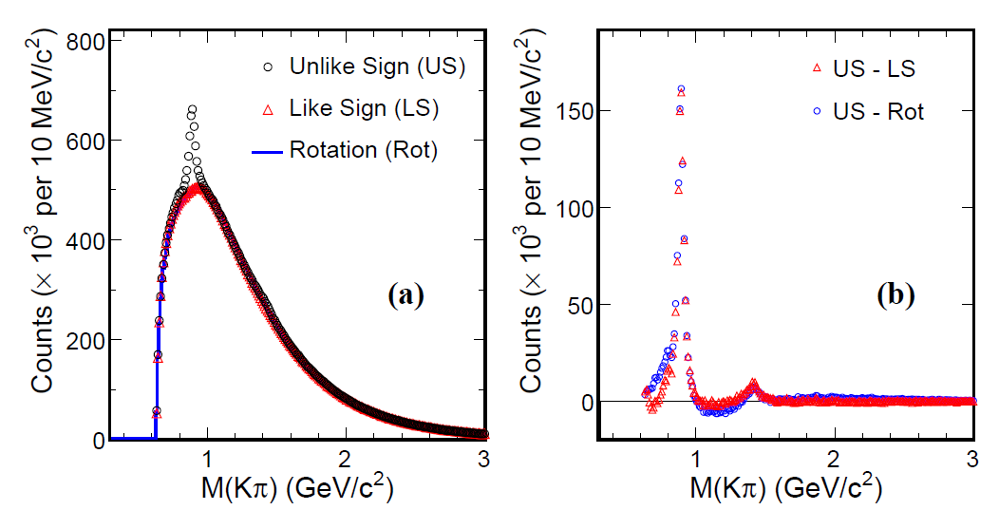
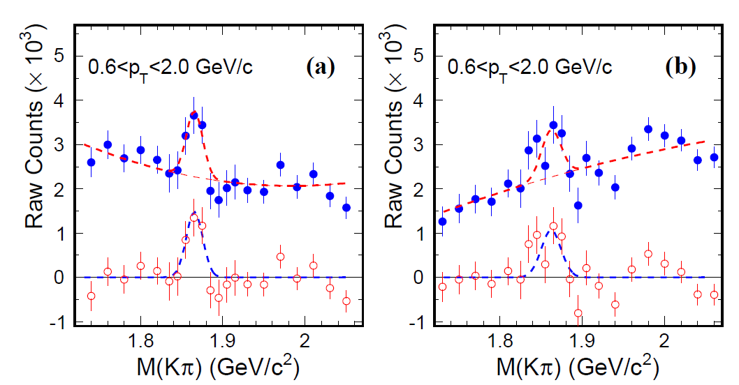
D⁰ signal in pp
D⁰ ➔ Kπ
p+p 200 GeV
  minimum bias 105 M
4-σ signal observed.
Different methods to study combinatorial background.
  Like Sign, Rotation
Consistent results from two background methods
arXiv:1204.4244.

Slide 16
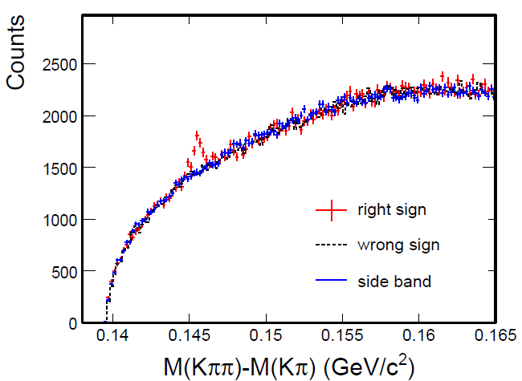
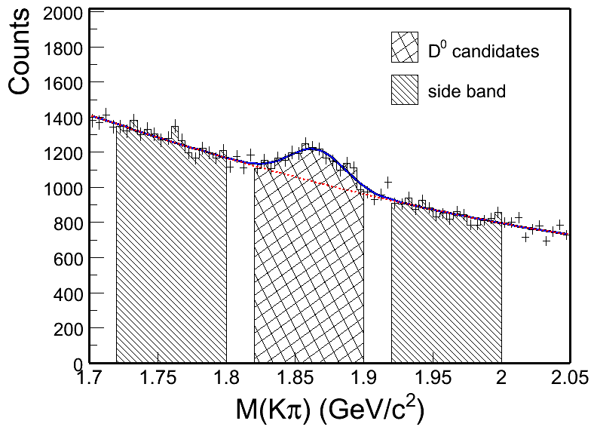
D* meson in pp 200 GeV
arXiv:1204.4244.
B.I.~Abelev, et al., PRD 79 (2009) 112006.
8-σ signal observed.
Background Reconstruction (2 methods)
  Wrong sign:
    D0 and -, D0 and +
  Side band:
    1.72< M(K) < 1.80 or
    1.92 < M(K) < 2.0 GeV/c²

Slide 17
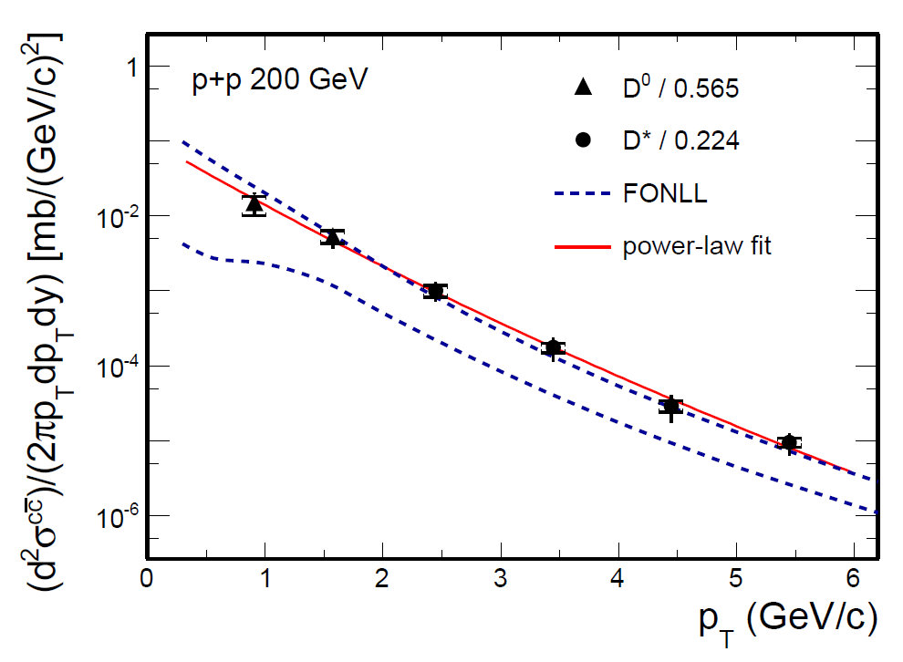
Combine D0 and D*
D⁰ scaled by N_{cc} / N_{D0} = 1 / 0.56
D* scaled by N_{cc} / N_{D*} = 1 / 0.22
Consistent with FONLL upper limit.
dσ/dy = dN/dy|^{cc}_{y=0} × F × σ_{pp}
F = 4.7 ± 0.7 scale to full rapidity.
σ_{pp}(NSD) = 30 mb
arXiv:1204.4244.
STAR Preliminary
Fragmentation fractions: PDG, PLB 667 (2008) 1
FONLL: M. Cacciari et al., PRL 95 (2005) 122001
Charm cross section at midrapidity
Charm total cross section
See Talk by D. Tlusty, Monday Parallel II A.

Slide 18
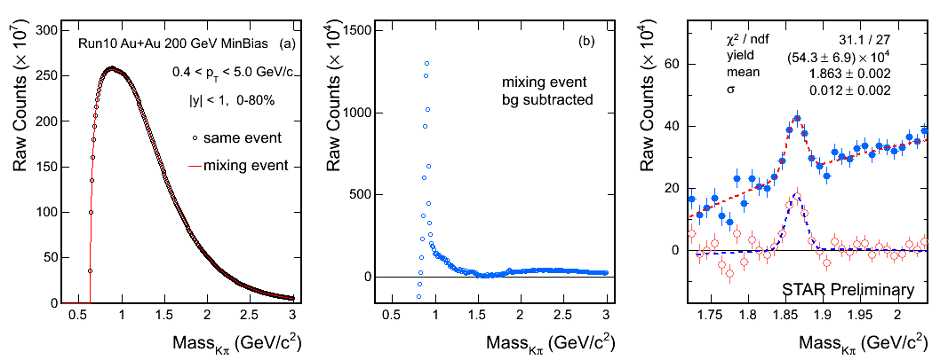
D⁰ signal in Au+Au
YiFei Zhang, JPG 38, 124142 (2011)
Year 2010 minimum bias 0-80% 280M Au+Au 200 GeV events.
8-σ signal observed.
Mass = 1863 ± 2 MeV (PDG value is 1864.5 ± 0.4 MeV)
Width = 12 ± 2 MeV

Slide 19
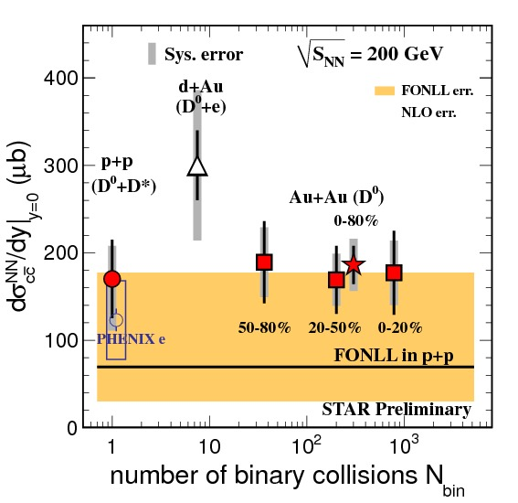
Charm cross section compilation
All of the measurements show similar σ.
Year 2003 d+Au : D⁰ + e
Year 2009 p+p : D⁰ + D*
Year 2010 Au+Au: D⁰
Assuming N_{D0} / N_{cc} = 0.56 does not change.
Charm cross section in Au+Au 200 GeV:
Mid-rapidity:
186 ± 22 (stat.) ± 30 (sys.) ± 18 (norm.) μb
Total cross section:
876 ± 103 (stat.) ± 211 (sys.) μb
Charm cross section follows number of binary collisions scaling =>
Charm quarks are mostly produced via initial hard scatterings from pp to AuAu.

Slide 20
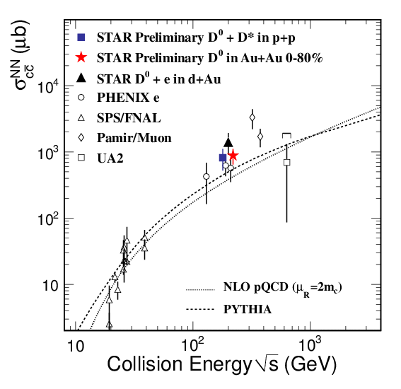
Charm excitation function
500 GeV pp, Minimum bias
See Talk by D. Tlusty, Monday Parallel II A.
Charm data: help constrain pQCD calculations.
500 GeV pp data coming soon.

Slide 21
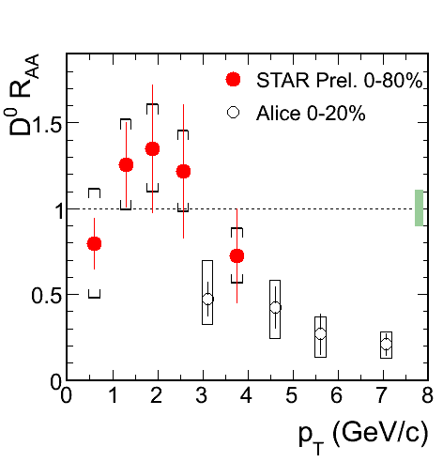
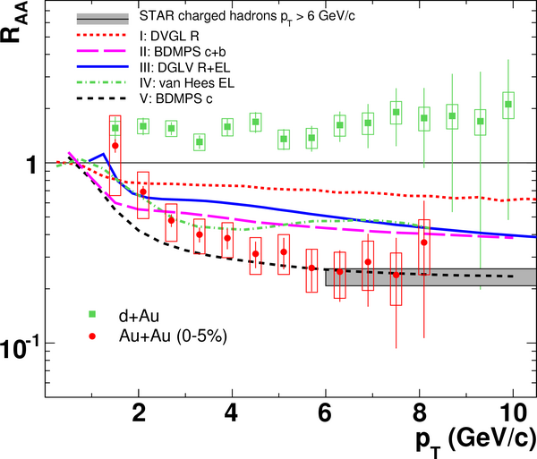
Charm R_{AA} via D⁰s and NPE
STAR, PRL 98 (2007) 192301
At RHIC, NPE is our way to study high p_{T} charm and bottom production & quenching.
  Recall: NPE are suppressed at high p_{T}.
  D0 measurement at low p_{T}.
  STAR upgrades: improved charm measurements
  STAR D mesons at low p_{T} : consistent with binary scaling
  ALICE: D meson suppressed at high p_{T}.
    More central selection than STAR
      arXiv:1203.2160

Slide 22
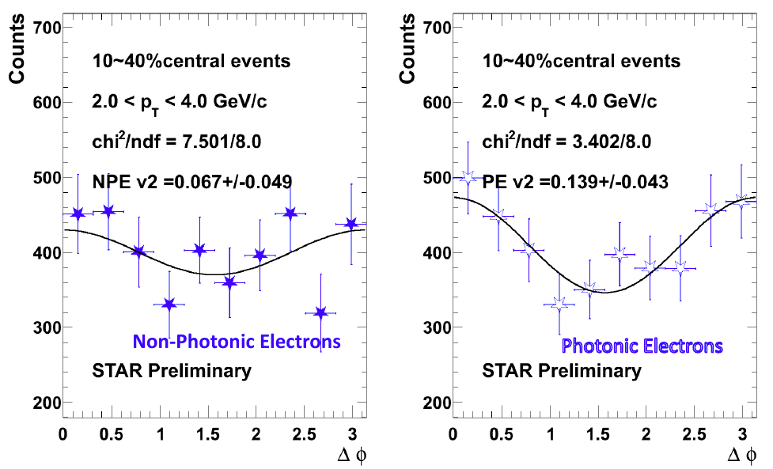
Non-photonic electron v₂
Mid central collisions: Indications that Non-photonic electrons have finite v₂
  See Talk by O. Hájková. Parallel IV A

Slide 23

Conclusions and Summary
Heavy Quarks: great tool to study the Quark Gluon Plasma.
J/ψ suppression decreases at high p_{T}.
  J/ψ v₂: consistent with zero.
    Disfavors a dominant coalescence contribution for p_{T}>2 GeV
  J/ψ-h: B fraction, not a significant √s dependence
ϒ production cross section and hot nuclear effects
  ϒ in Au+Au: suppression
    Probe of deconfinement.
    Access medium properties, e.g.
      428 < T₀ < 442 MeV
Open Charm: D⁰ and D* measurements
  Production consistent with FONLL calculations
    For all systems: p+p, d+Au and Au+Au
  Low p_{T} R_{AA}: consistent with no suppression
    Suppression at higher p_{T}, e.g. High p_{T} NPE.

