Slide 1
Weak Boson Results from CMS
Probing the initial stage in nuclear collisions
using electroweak measurements

Slide 2
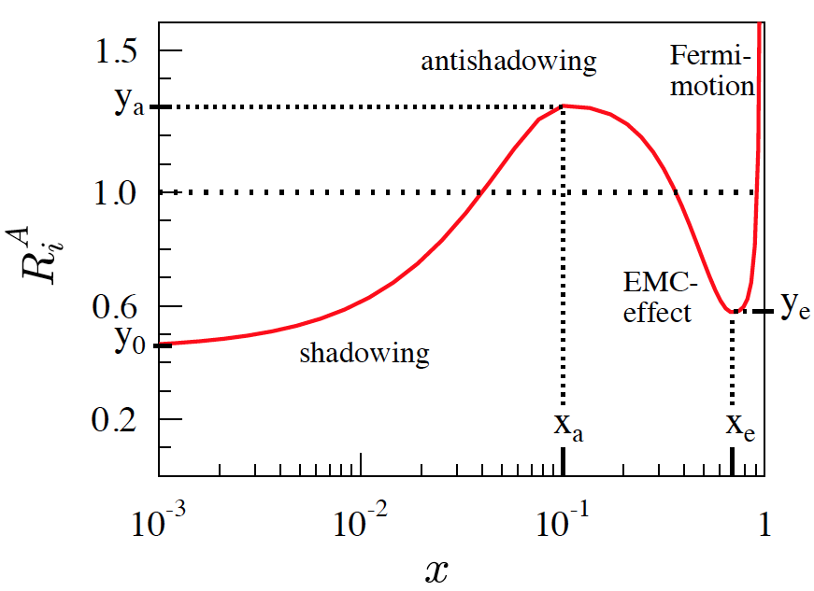
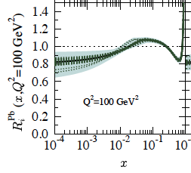
Electroweak probes: unique tools
Z, W bosons: well calibrated probe in pp
LHC energies: access to Z, W in pA and AA
  Electroweak bosons in dilepton channel:
  No final state modification by QCD medium
    Test Binary scaling hypothesis
    `Standard candle’ for initial state
  Sensitive to initial state
    Constrain nuclear PDFs
JHEP 0904 (2009) 065
EPS09 NLO
valence quarks

Slide 3
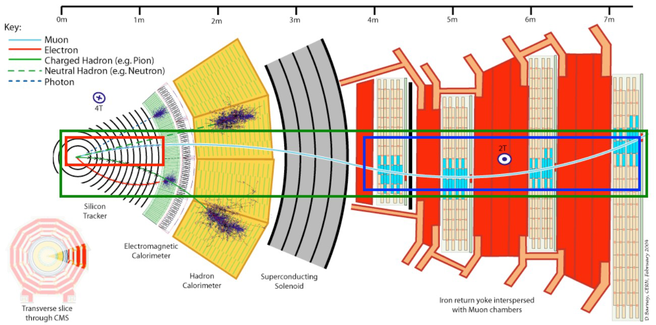
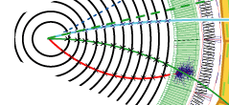
Muon/Electron reconstruction in CMS
Muons: Si tracker + muon detectors
  p_{T} resolution: 1-2% up to p_{T} ~ 100 GeV/c
Electrons: Si tracker + ECAL cluster
  h/e discrimination: shower shape + E_{ECAL}/p_{track}
  p_{T} resolution: 1-2% for p_{T} ~ 45 GeV/c
Notes:
Dedicated outside-in tracking to correct for Bremsstrahlung
Re

Slide 4
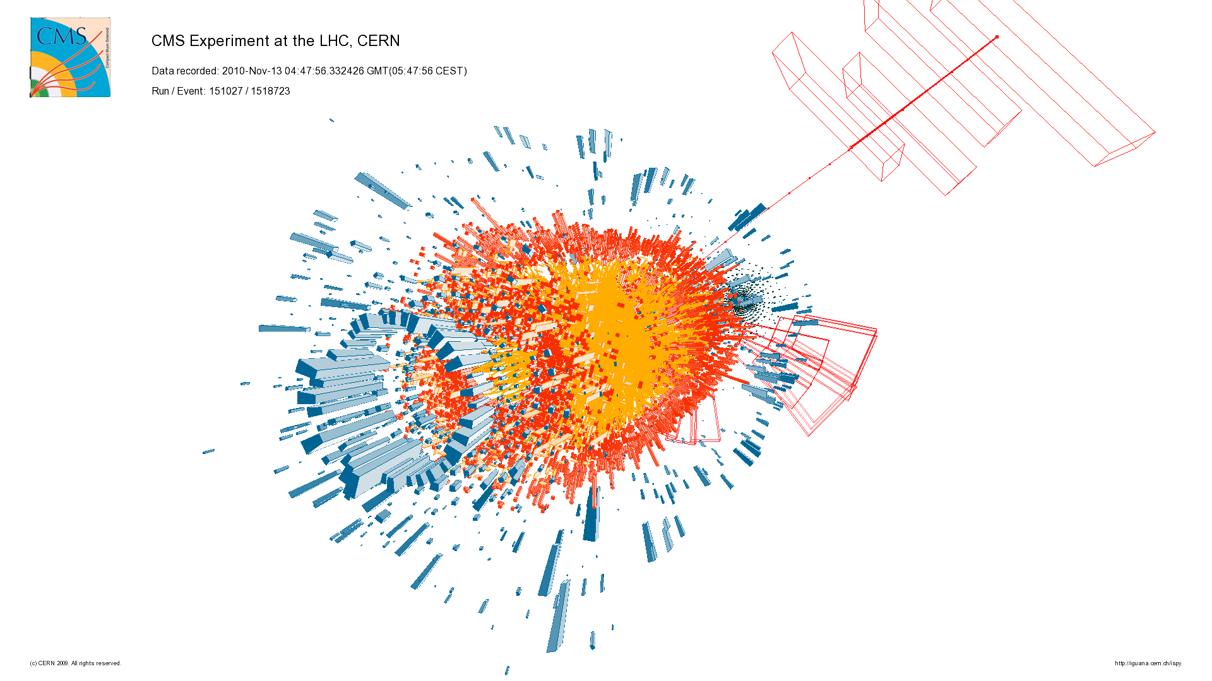
W μν event display

Slide 5
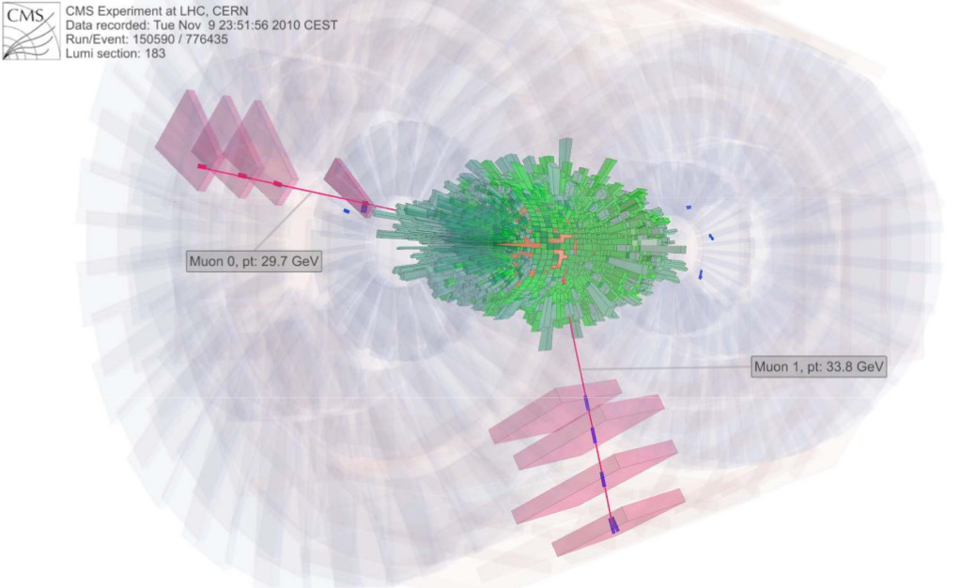
Z μμ event display

Slide 6
Z in PbPb and pp @ 2.76 TeV
PbPb data, 2011 run
pp data, 2013 run
Muon and electron channels.
Lepton selection
  p_{T} > 20 GeV/c
  |η^{μ(e)}|<2.4 (1.44)
Excellent S/B
Signal shape agrees with simulation in both channels and both collision systems!
CMS, arXiv:1410.4825
Submitted to JHEP

Slide 7
W: μ + missing p_{T} in PbPb
PLB 715 (2012) 66
W signal in muon spectrum at high p_{T}
  Require good quality muons + Z veto
Missing p_{T} : obtained from tracking
  All muon triggers: momentum is balanced
    Some centrality dependence: resolution for missing p_{T}
  Signal events with high p_{T} muon: large imbalance
    No centrality dependence, agrees with simulation
Notes:
Muon pT: muons with good quality + veto Z events.

Slide 8
W transverse mass in PbPb
Excellent S/B
Good agreement between data and simulation
Shape is consistent between pp and PbPb
  modulo resolution difference
PLB 715 (2012) 66

Slide 9
Electroweak bosons in PbPb vs. N_{part}
PLB 715 (2012) 66
CMS, arXiv:1410.4825
R_{AA}(Z) = 1.10 ± 0.05 ± 0.09
R_{AA}(W) = 1.04 ± 0.07 ± 0.12
R_{AA} ~ 1, no centrality dependence: Standard candles!
  Best test of binary-collision scaling hypothesis
Can study finer initial-state nuclear effects via kinematics
Notes:
Note: Expect ~2 more times more W+ than W- in pp. More up quarks than down quarks. W+ needs u-dbar, W- needs d-ubar.

Slide 10
Z boson rapidity distribution in PbPb
Comparison to POWHEG
  No nuclear effects: CT10
  With nuclear effects: CT10 + EPS09
Differences between models are small in PbPb

Slide 11
W boson charge asymmetry in PbPb
pp:
  little dependence of asymmetry on η.
PbPb:
  asymmetry is smaller
  larger dependence on η.
Comparison between pdfs:
  Clear preference for nuclear pdf in PbPb

Slide 12
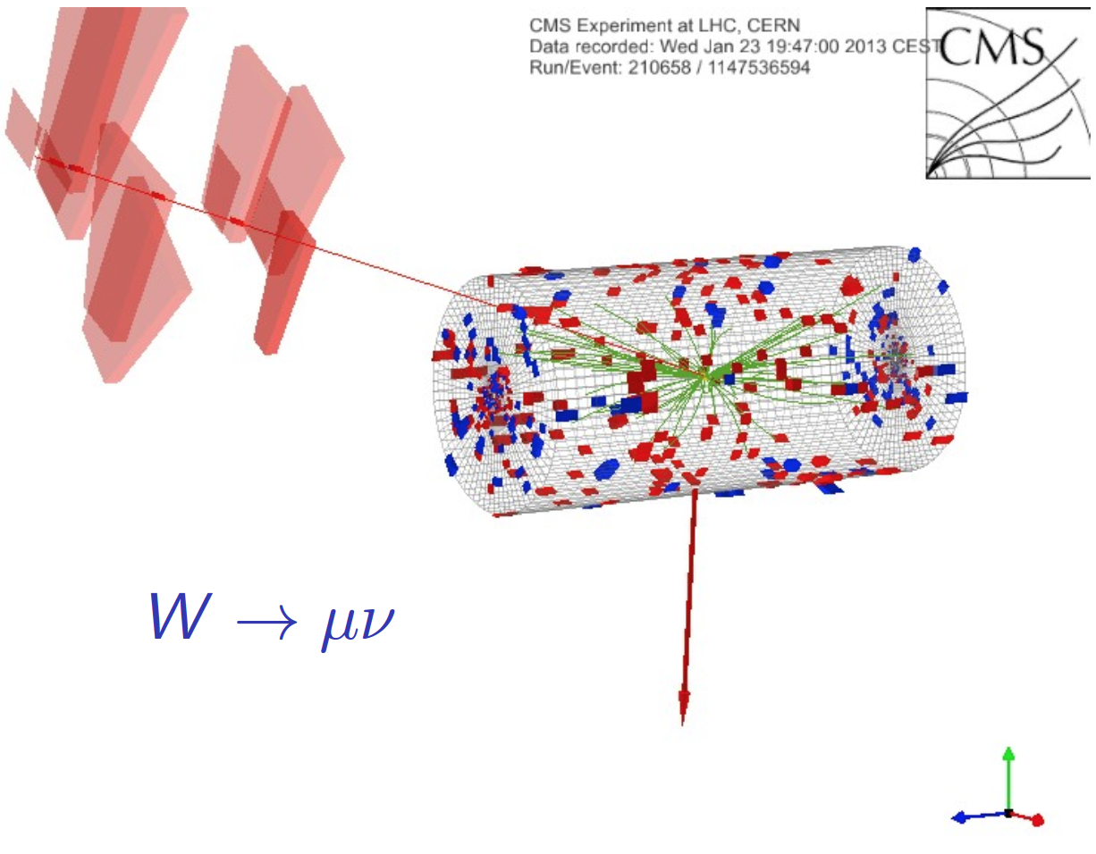
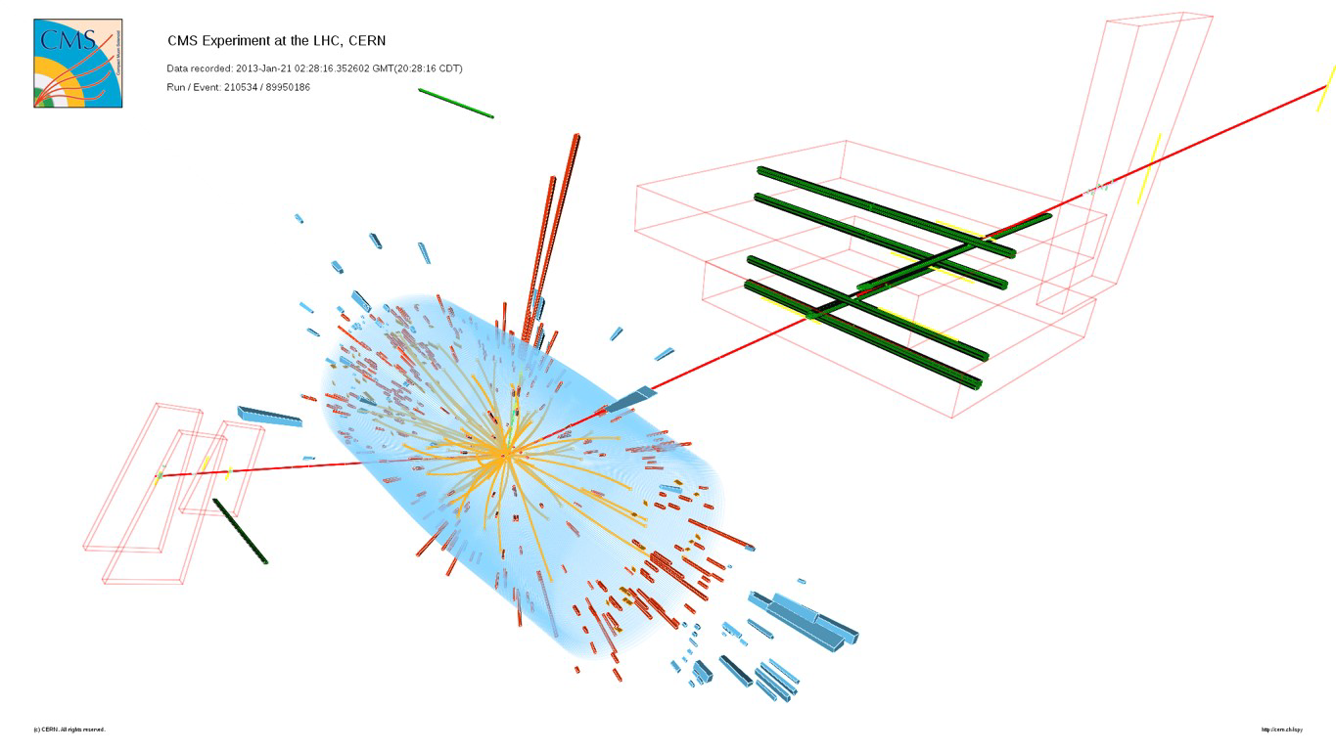
Z and W bosons in pPb
Higher cross sections in pPb: √s=5.02 TeV
Asymmetric collisions: new observables
  forward/backward asymmetries
  better sensitivity to nPDF

Slide 13
W and Z Data in pPb
CMS-HIN-13-007
CMS-HIN-14-003
W selection: p_{T} > 25 GeV/c, |η^{μ}_{lab}|<2.4, |η^{e}_{lab}|<2.5
Z selection: p_{T} > 20 GeV/c, |η^{μ}_{lab}|<2.4
Asymmetric acceptance in rapidity
  CM Frame is boosted

Slide 14
Z Cross section vs. rapidity in pPb
Distribution shifted to c.m. frame
Scaling σ_{pPb} = A σ_{pp} works well: scaled pp predictions consistent with data

Slide 15
W cross sections vs. η in pPb
P(χ²) = 11%^{CT10} (17%^{EPS09})
P(χ²) = 41%^{CT10} (80%^{EPS09})
Distribution displayed in lab frame
pp predictions in good agreement with data
Nuclear effects are too small for discriminating: use asymmetries.

Slide 16
Forward-backward asymmetry: .
P(χ²) = 19%^{CT10} (13%^{EPS09})
P(χ²) = 16%^{CT10} (72%^{EPS09})
Better sensitivity to nuclear modification.
W⁻ data show preference for nuclear effect
W⁺ data: no pdf is preferred

Slide 17
Z Forward-Backward ratio in pPb
For Z boson, F/B ratio should be 1 if no nuclear effects present
Data: hint of nuclear effects.
  Uncertainties are still large
    Data: statistical uncertainty dominates
    nPDF: uncertainty band not shown

Slide 18
Conclusion
We are beginning to explore nuclear modification in heavy-ion collisions using electroweak probes!
To first order: Z and W production scales with binary collisions in pPb and PbPb
  Initial-state nuclear effects on quark PDFs O(10%)
  Hints of nuclear effects in W & Z data
    Asymmetries vs. rapidity show promise for discriminating power
    More luminosity would help distinguish between nPDFs
  Z,W Cross sections and asymmetries can be used as part of global fits of nPDFs

