Slide 1
Results from Relativistic Heavy Ion Collisions
How hot, dense and viscous is the primordial soup?
The LHC, Particle Physics and the Cosmos
The University of Auckland, New Zealand.

Slide 2
Outline
Evolution of a Relativistic Heavy Ion Collision
Selected Topics:
How Dense?
Jet “Tomography”:
using jets and the energy lost by partons to learn about the medium density.
High-pt particle suppression, azimuthal correlations, Jet imbalance
How Hot? How Viscous?
Quarkonium “Melting”

Slide 3
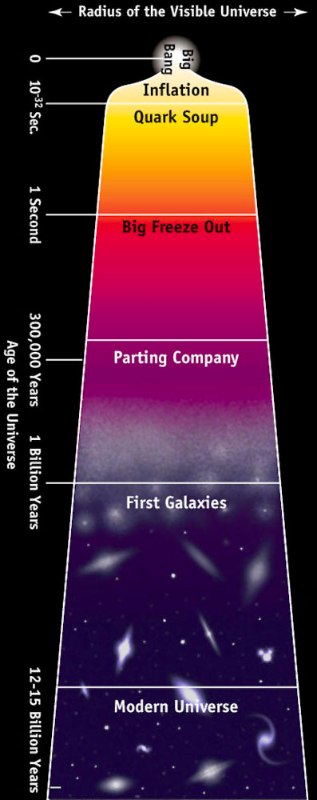
Evolution of the Universe
10⁻⁴⁴ sec Quantum Gravity Unification of all 4 forces 10³² K
10⁻³⁵ sec Grand Unification E-M/Weak = Strong force 10²⁷ K
10⁻³⁵ sec? Inflation universe exponentially 10²⁷ K
expands by 10²⁶
2 10⁻¹⁰ sec Electroweak E-M = weak force 10¹⁵ K
unification
2·10⁻⁶ sec p-p-bar pairs creation of nucleons 10¹³ K
6 sec e+e- pairs creation of electrons 6⋅10⁹ K
3 min Nucleosynthesis light elements formed 10⁹ K
10⁶ yrs Microwave recombination - 3000 K
Background transparent to photons
10⁹ yrs ? Galaxy formation bulges and halos of 20 K
normal galaxies form

Slide 4
Why study the Quark Soup?
Because we can study the Thermodynamics of the Strong Force.
The strong force exhibits intriguing phenomena.
Confinement.
Chiral-Symmetry breaking.
Strong interactions give rise to most of the mass we see!
We are only just beginning to understand how the strongest of all the forces behaves.

Slide 5
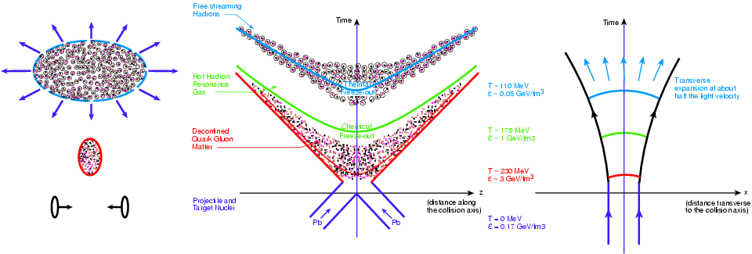
Space-time evolution of HI Collision
Longitudinal Expansion (left, middle)
Projectile and Target nuclei (forward/backward light cone)
Central region (z~0, y_{CM}): Deconfined QGP
Interactions bring system into local statistical equilibrium. Thermalization.
Evolution described by relativistic hydrodynamics.
Note: Hydrodynamic evolution needs to start at τ < 1 fm/c.
Surfaces of constant τ : hyperbolae, “hypersurfaces”
Transverse expansion (right)

Slide 6
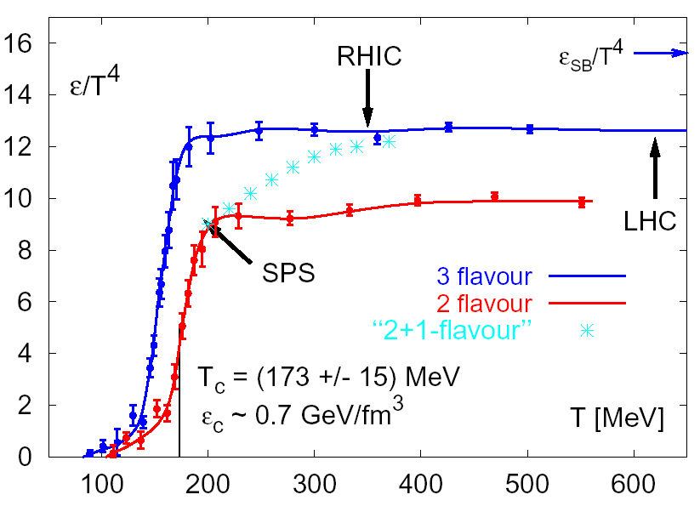
Comparison to Lattice QCD
Energy density ε ≥ 4 GeV/fm³ : ~ 7×ε_{C}.
Secondary particle spectra: T_{ch}~170 MeV
First evidence that we reached the high temperature phase of QCD.

Slide 7


New evidence in the past decade
Jet quenching
The system is opaque to fast partons.
Substantial collective flow
The system behaves more like a liquid than a gas.
The liquid has almost zero viscosity
Properties close to those of a “perfect” fluid.
Quark number scaling observed in flow of different particles
Suggestive of a quark intermediate state: “partonic collectivity”
Bottomonium is suppressed
A probe of Deconfinement at high temperature?

Slide 8
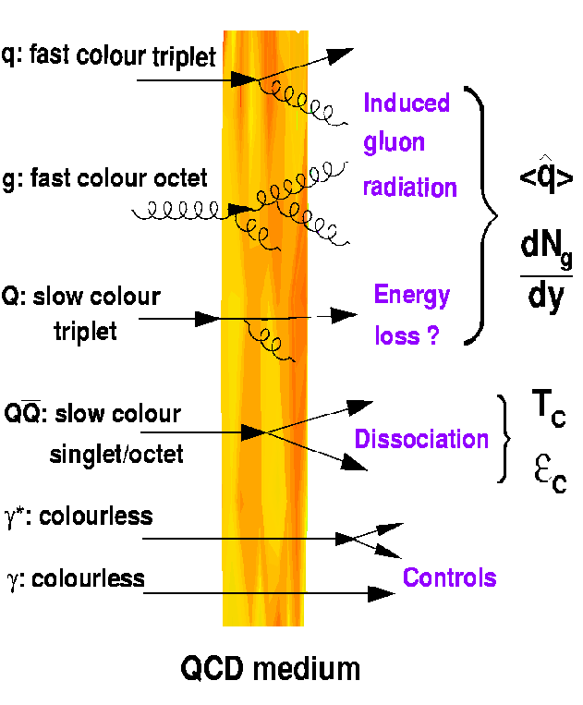
Hard Probes of the QGP
Hard Probes of QCD matter:
large Q²:jets, , QQ ...
well controlled exp. & theoretically (pQCD)
Early-time production:
generated in collision at <1/Q~0.1 fm/c
Probes of hottest & densest phases of medium.

Slide 9
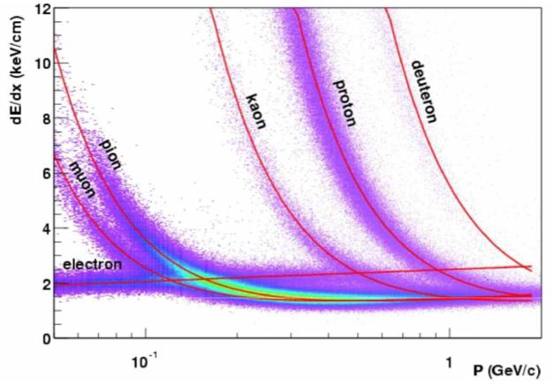
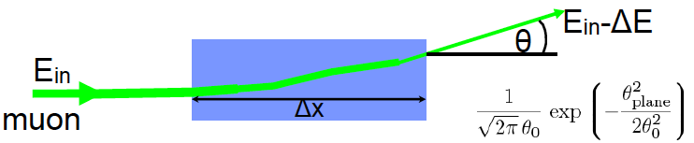
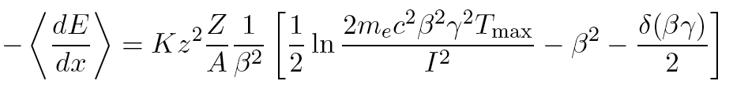
Jet Quenching: Motivation
Partonic energy loss.
Analogy: Ionization energy loss
Passage of charged particle
through matter (QED)
Bethe-Bloch Eq:
Goal: Achieve same level of understanding for partons traversing QCD matter.

Slide 10
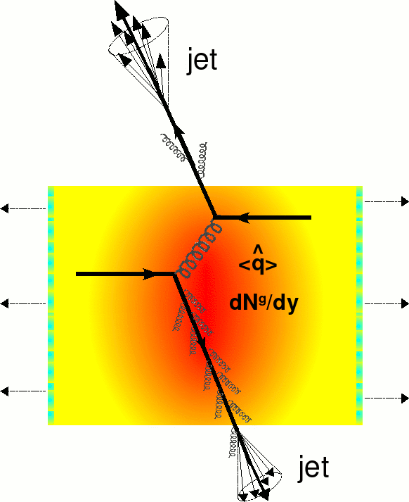




Jet Quenching and Medium Density
Parton radiative energy loss:
the produced hard parton undergoes multiple gluon radiation induced by the dense QCD medium
Energy loss ➠ Medium properties
Gyulassy, Levai, Vitev
Baier, Dokshitzer, Mueller, Peigne, Schiff,
Zakharov. Armesto, Salgado, Wiedemann.
ΔE:dN^{g}/dy, q-hat (transport coef.)
Debye mass ~ gT, medium density, parton cross section.
gluonsstrahlung

Slide 11
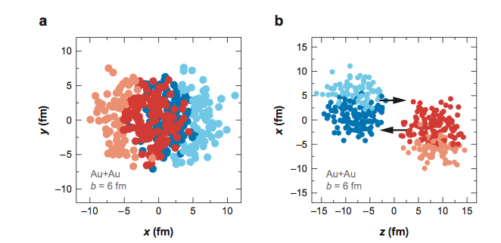
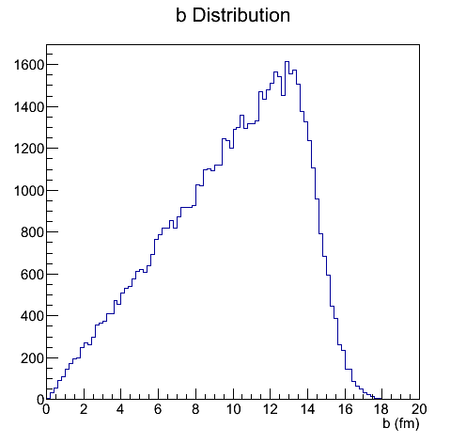
Aside: Centrality in HI Collisions
Au, Pb have radii ~ 7 fm.
Collisions have various impact parameters.
Each nucleon can collide with many others.
Each collision can produce particles.
Glauber Model
N_{part} (b)
N_{coll} (b)
Central Collision: b~0. Peripheral Collision: b~2R

Slide 12
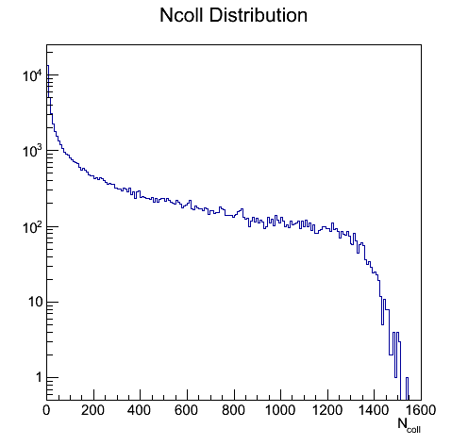
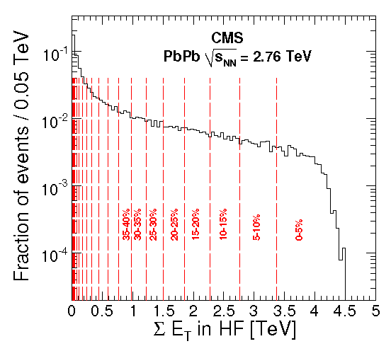
Centrality classes: Model and Experiment
Connect quantitites from Glauber model to experimental observables
STAR
Phys.Rev.Lett. 87 (2001) 112303
CMS
JHEP 1108 (2011) 141

Slide 13
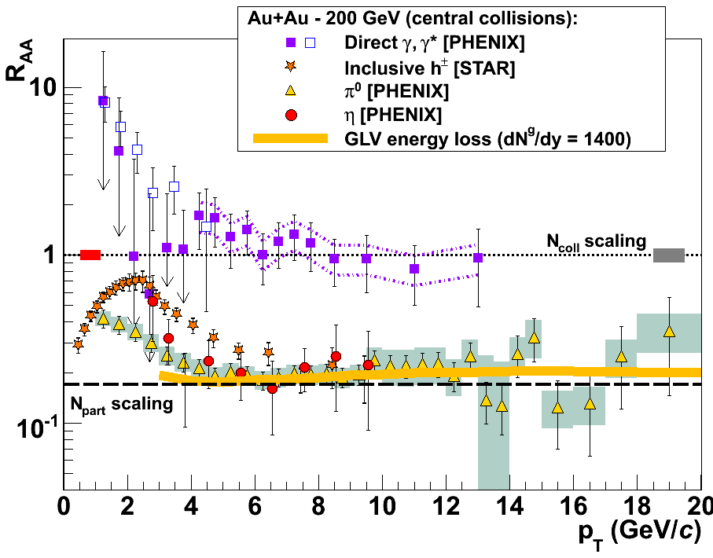

High-pT hadron suppression
Suppression relative to Ncoll scaling
Direct γ are not suppressed: Ncoll scaling works!
All other hadrons are suppressed by a factor of ~5.
PRL 96, 202301 (2006)

Slide 14
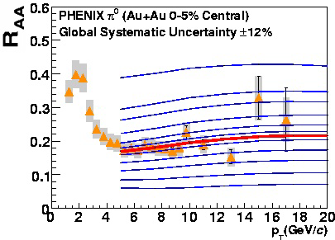
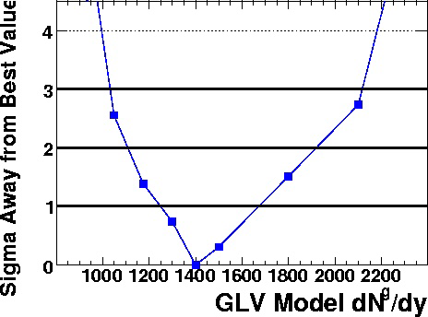
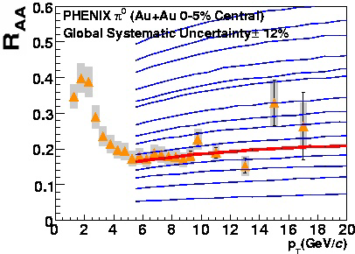
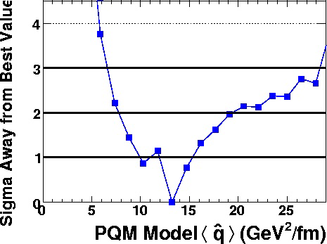
Quantifying the medium density
Gluon density
GLV
Transport coef.
BDMPS-Z
ASW.

Slide 15
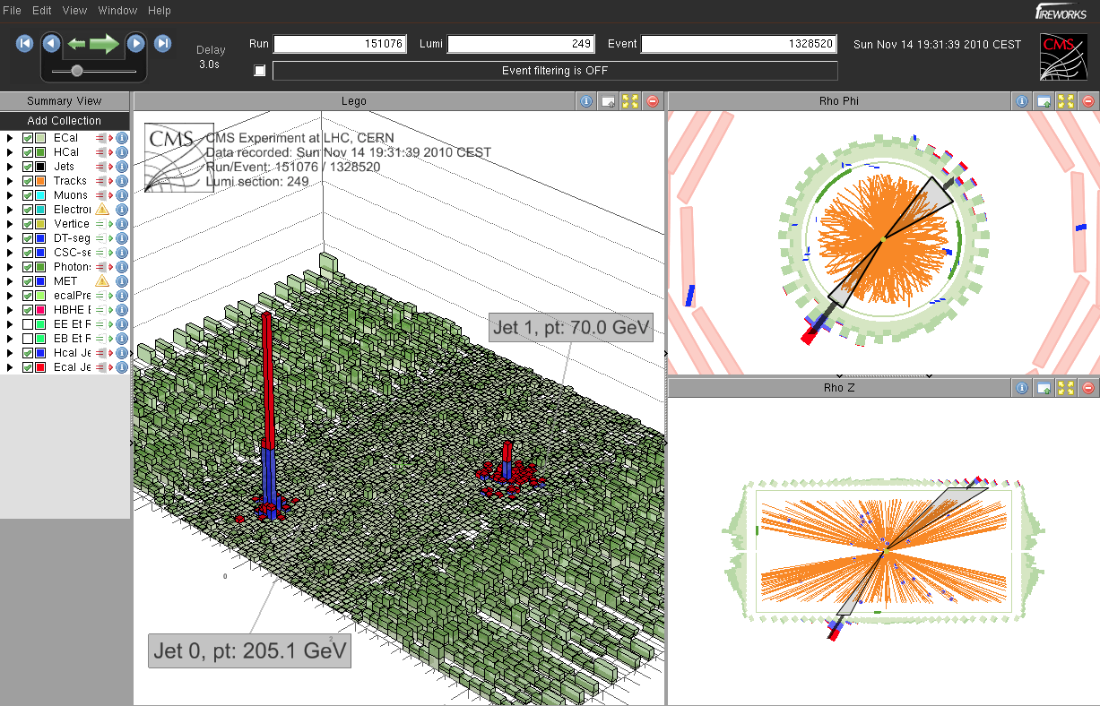
New tools: Dijets, Energy loss by eye
A

Slide 16

Parton Energy loss in Heavy Ion Collisions
Di-Jet Asymmetry
How large is the momentum imbalance in HI vs pp?
Is the fragmentation modified in HI?
Does it depend on the momentum imbalance?
Where does the Energy go? (E):
Study dijet and gamma jet momentum balance
Direct observation of parton energy loss

Slide 17
Di-Jet Asymmetry measurements
CMS
arXiv:1205.5872
Parton Energy loss
Dijet momentum imbalance
In pp: Asymmetry well described by PYTHIA.
In PbPb: Large imbalance in central collisions.

Slide 18
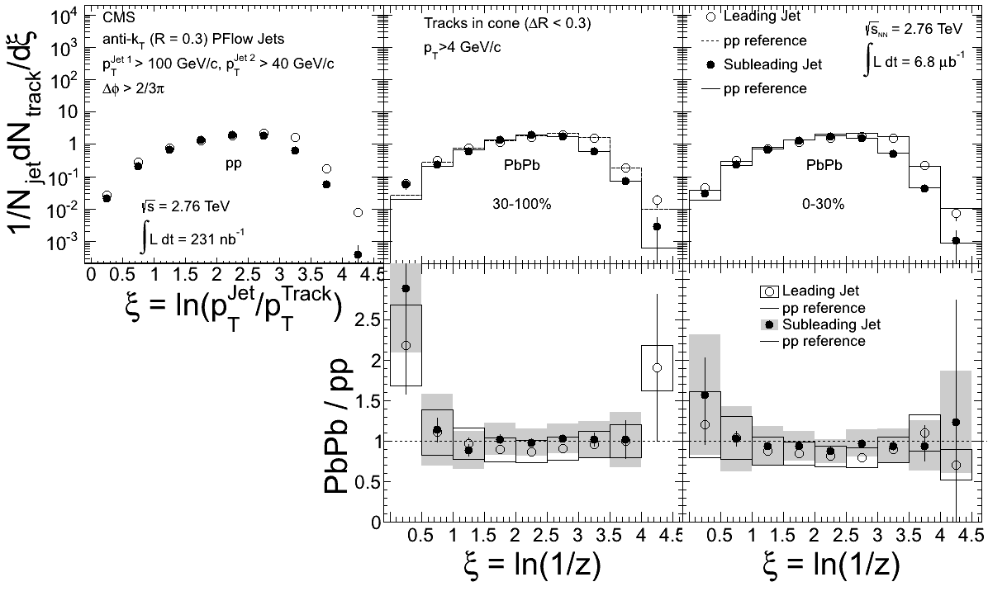

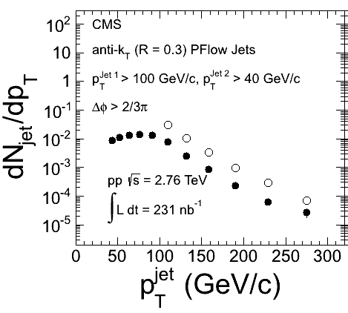
Jet Fragmentation for dijets: pp
Select dijets with
p_{T}^{Jet1}>100GeV/c
p_{T}^{Jet2}>40GeV/c
₁₂>2/3
Correlate reco. Jet p_{T} with track p_{T}
Tracks in R=0.3 cone
p_{T}> 4 GeV/c
z = p || ^{Track}/p^{Jet},  = log (1/z)
Compare Leading and Subleading Jet in pp and PbPb

Slide 19
Jet Fragmentation in PbPb: centrality
CMS
arXiv:1205.5872
Leading and subleading jets in PbPb fragment in same way as those in pp of corresponding energy.

Slide 20
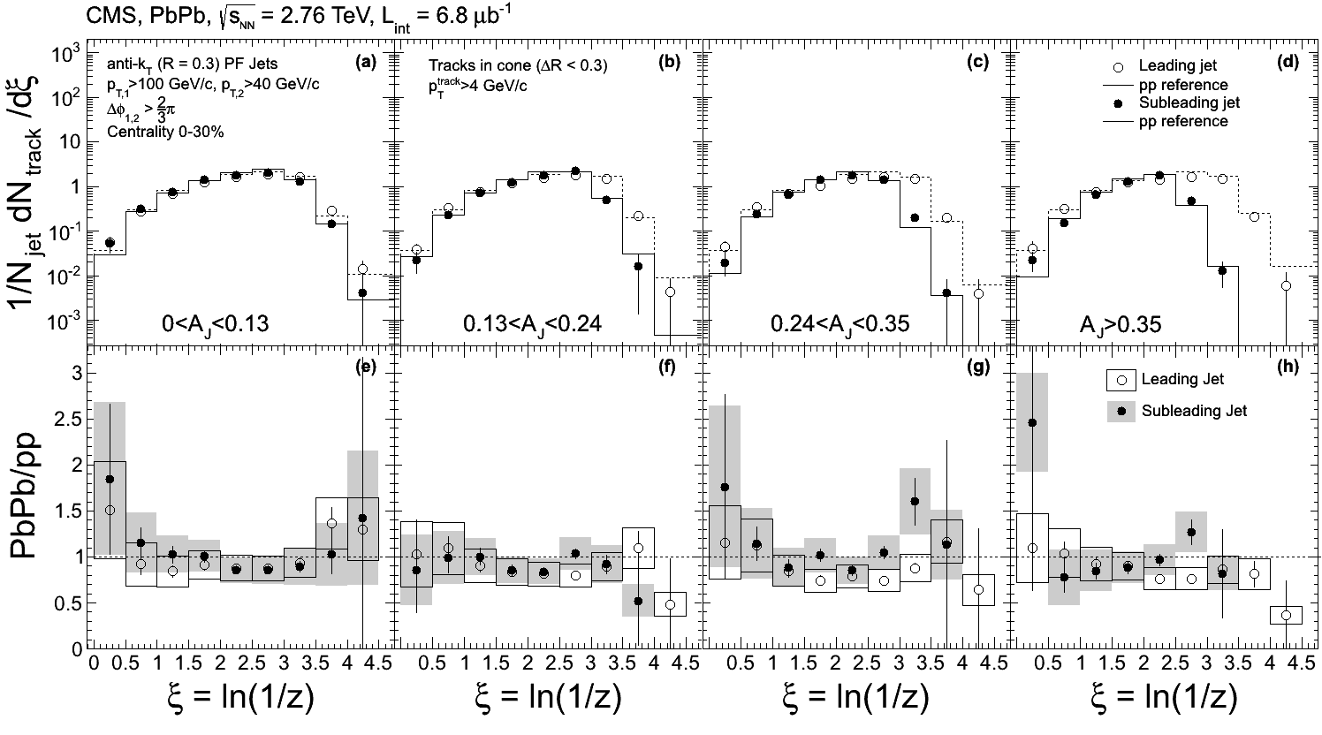
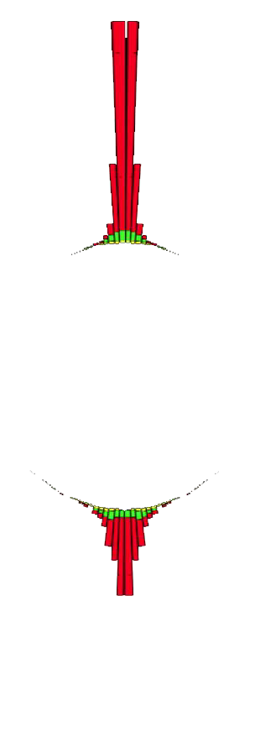
Jet Fragmentation in PbPb: vs. A_{j}
More balanced
Less balanced
CMS
arXiv:1205.5872
At the same reconstructed jet energy, jets in PbPb fragment like jets in pp, even for a large asymmetry between leading and subleading jet.
Can reliably reconstruct jets in PbPb. Can use jet energy scale corrections from MC.
Consistent with no modification of fragmentation. Energy is lost before?

Slide 21

Where did the Energy go?
E?
Medium Ionization

Slide 22
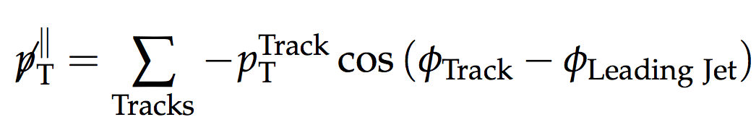
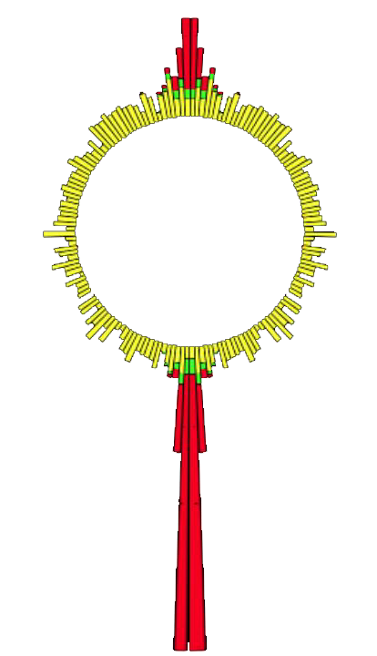
Missing p_{T}||
Define:
projection of track p_{T} on leading jet axis
Average over selected tracks
|η| < 2.4
starting at p_{T} > 0.5 GeV/c
and in ranges of track p_{T}.
Leading Jet defines azimuthal
direction for projection of
track transverse momentum

Slide 23
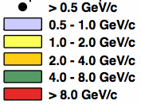
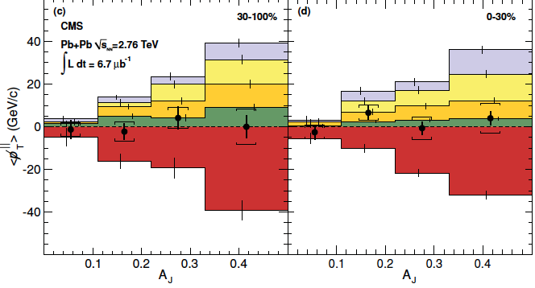
Missing p_{T}||
Excess away
from leading jet
Excess towards
leading jet
Integrating over ~whole event: restores momentum balance.
High pT imbalance: towards leading jet
Low pT imbalance: away from leading jet
Asymmetry is balanced by low p_{T} particles.

Slide 24
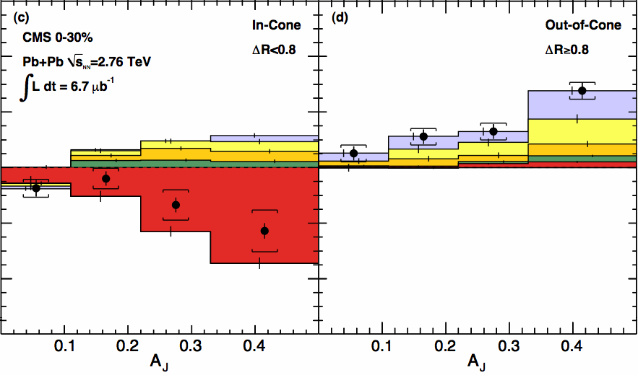
Missing p_{T}||, In and Out of Cone
Excess away
from leading jet
Excess towards
leading jet
The balancing low p_{T} particles appear at large angles relative to the jet axis.

Slide 25

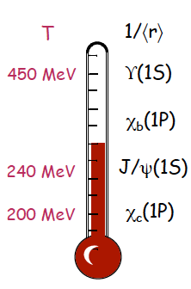
Quarkonia in the QGP
Heavy quarkonia:
Heavy quark bound state are probes of the hot QCD medium
Debye screening
Matsui & Satz, PLB 178 416 (1986)
Sequential Suppression
Digal et al., PRD 64 2001 094015
Landau damping: Im V.
(e.g. Laine et al., JHEP 03 2007 054)
Recent news: Heavy quark potential from (quenched) Lattice QCD
A.Rothkopf, et al. PRL 108 (2012) 162001
Broadening due to collisions with medium (Im V) possibly more important than screening (Re V).
ϒ
T=0
0<T<T_{C}
T_{C}<T

Slide 26
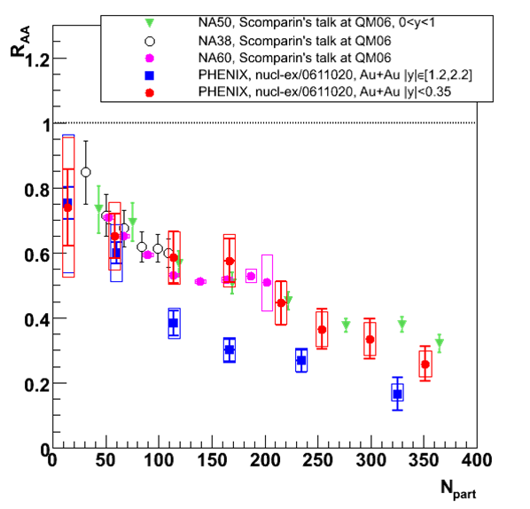
Puzzles from SPS and RHIC: Charmonium
Similar J/ψ suppression at the SPS and RHIC!
despite 10× higher √s_{NN}
Suppression does not increase with local energy density
R_{AA}(forward)<R_{AA}(mid)
Possible ingredients
cold nuclear matter effects
sequential melting
regeneration
What happens at the LHC?
higher energy + higher luminosity
more charm (more regeneration?)
more bottom → a new probe: ϒ

Slide 27
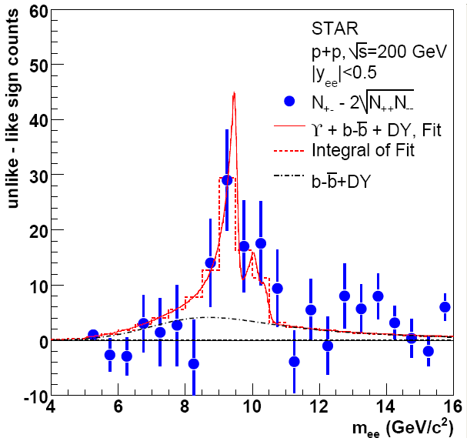
Go heavier! ϒ production
Bottomonium
Cleaner probe of screening, deconfinement.
Measuring multiple states: QGP thermometer.
Measurements are now available at RHIC and LHC.
pp Collisions, Reference data
2006: ∫L dt = 7.9 ± 0.6 /pb
N_{ϒ}(total)= 67±22(stat.)
2009 data: ∫L dt ~ 20 /pb
N_{ϒ}(total)= 145±26(stat.)
Improved statistics.
Phys. Rev. D 82
(2010) 12004

Slide 28
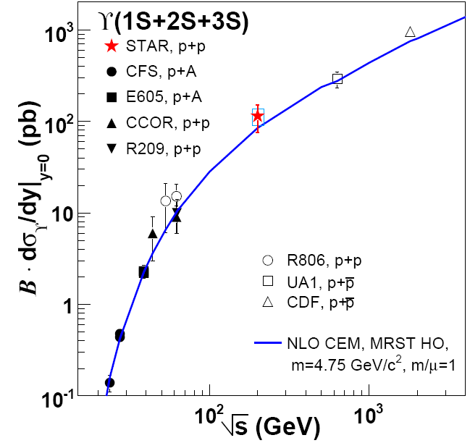
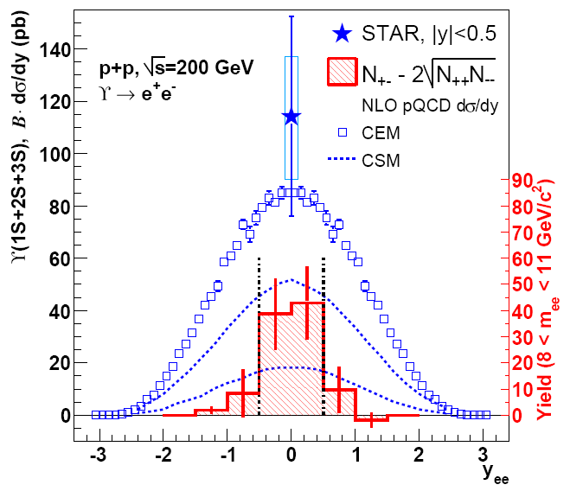
ϒ cross section in pp
Phys. Rev. D 82
(2010) 12004
STAR Preliminary
STAR Preliminary
ϒ(1S+2S+3S) cross section: consistent with NLO pQCD.
Good reference for studying nuclear effects.

Slide 29
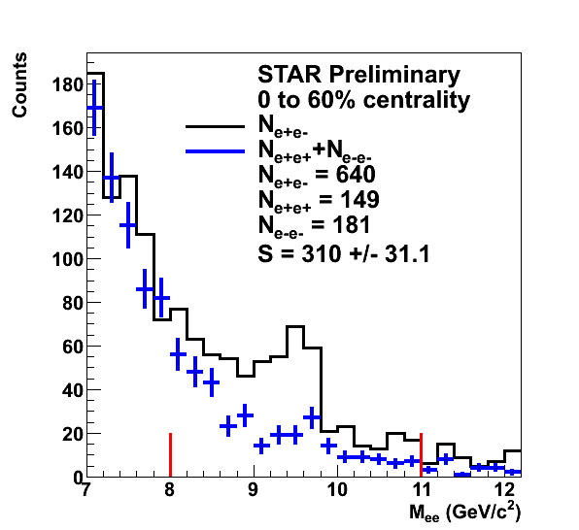
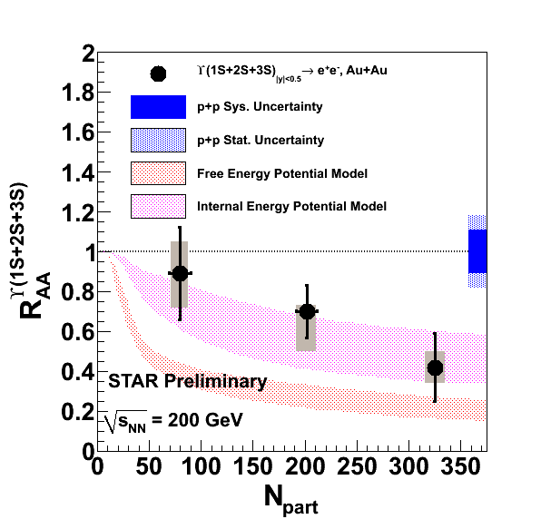
Beauty in a hot, perfect liquid
Models from M. Strickland and D. Bazow, arXiv:1112.2761v4
Raw yield in|y|<0.5 = 197 ± 36
∫L dt ≈ 1400 µb⁻¹
R_{AA}: Observation of Upsilon suppression. (Including 2009 pp Preliminary dσ/dy)
Expect: Recombination: negligible, Hadronic co-mover absorption: negligible.
Suppression observation: sensitive to deconfinement effects!

Slide 30
ϒ model comparison
Incorporating lattice-based potentials, including real and imaginary parts
A: Free energy (disfavored),
B: Internal energy (consistent with data vs. N_{part})
Includes sequential melting and feed-down contributions
Dynamical expansion, variations in initial conditions (T, η/S)
Data indicate:
428 < T₀ < 442 MeV, 1 < 4πη/S < 3
M. Strickland and D. Bazow,
arXiv:1112.2761v4

Slide 31
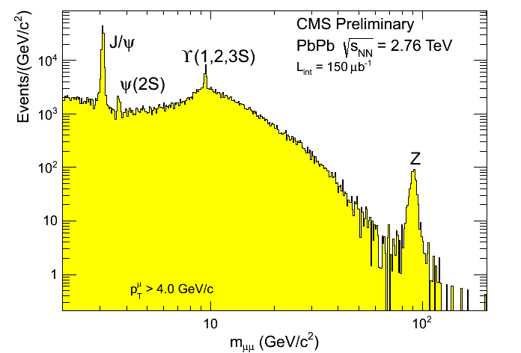
Bottomonium at LHC

Slide 32
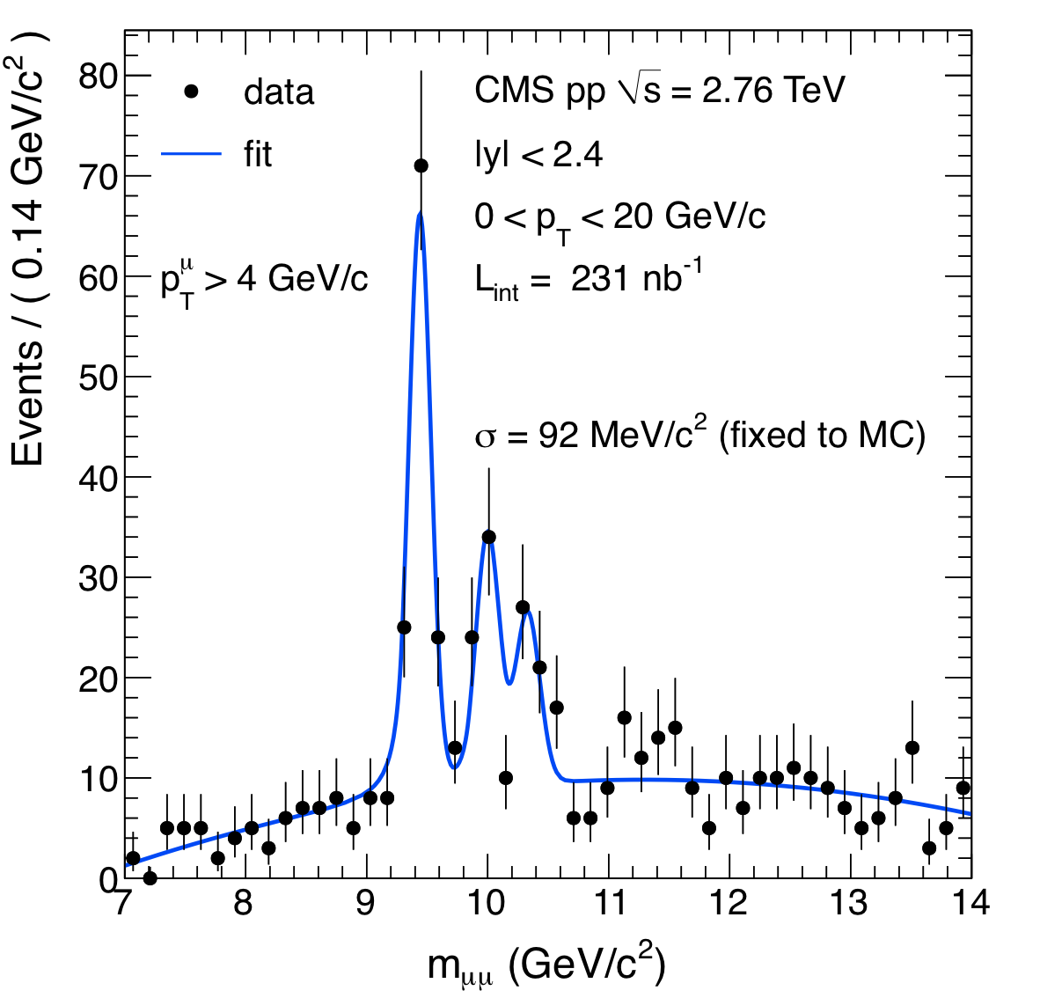
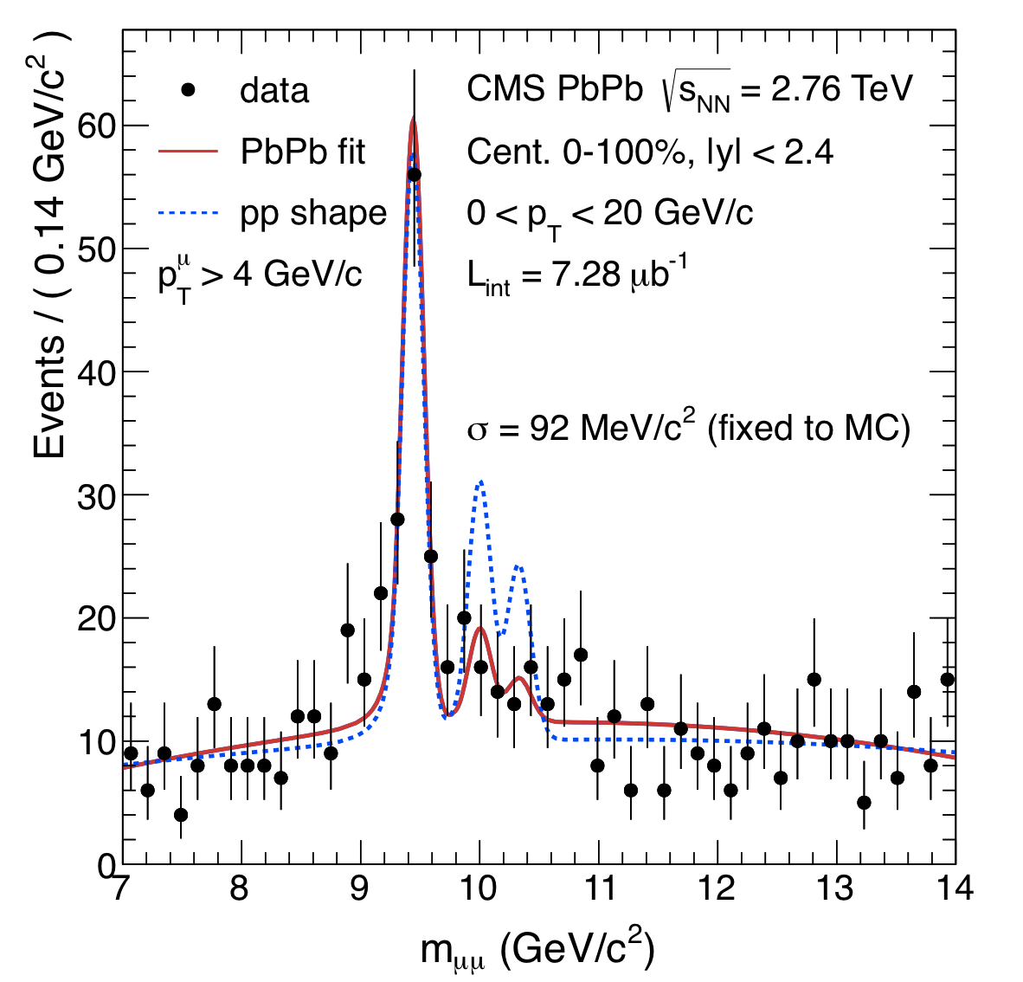
Bottomonia: 2010 data
pp
PRL 107 (2011) 052302
PbPb

Slide 33
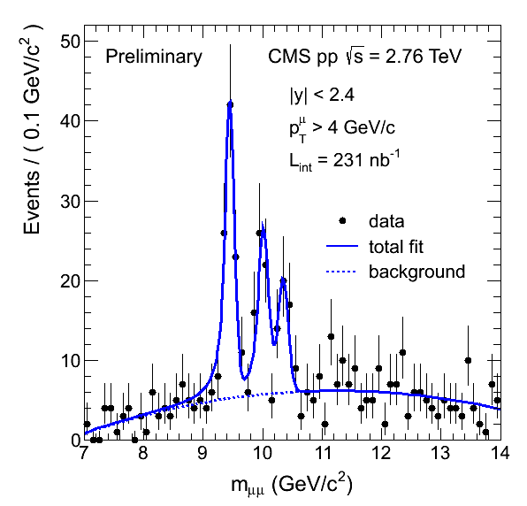
Bottomonia: 2011 data
pp
PbPb
Ratios not corrected for acceptance and efficiency

Slide 34
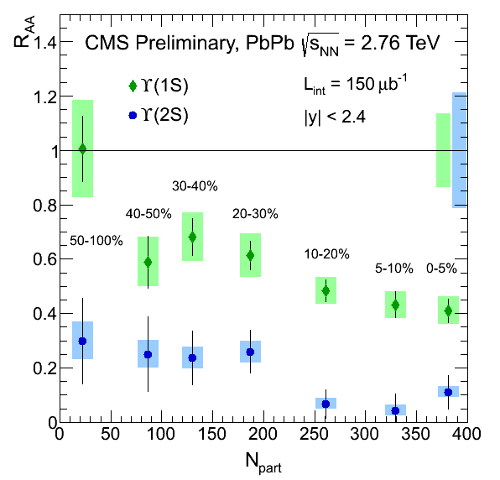
ϒ(1S) Nuclear Modification Factor: R_{AA}
In 2010: 7.28 µb⁻¹
ϒ(1S) R_{AA}, 3 centrality bins
JHEP 1205 (2012) 063
In 2011: 150 µb⁻¹
ϒ(1S) R_{AA}, 7 centrality bins
First results on ϒ(2S) R_{AA}
Clear suppression of ϒ(2S)
ϒ(1S) suppression
Consistent with excited state suppression only
~50% feed down

Slide 35
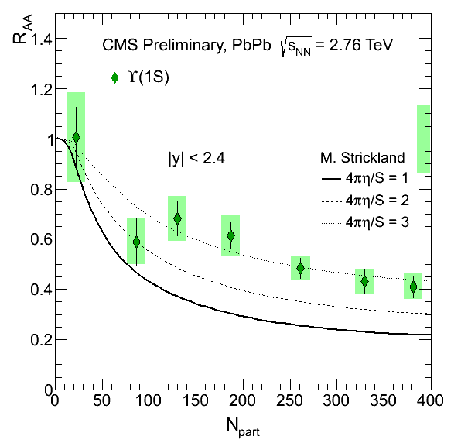
Comparison to models
Incorporating lattice-based potentials, including real and imaginary parts
A: Free energy
Disfavored, not shown.
B: Internal energy
Consistent with data vs. N_{part}
Includes sequential melting and feed-down contributions
~50% feed-down from χ_{b}.
Dynamical expansion, variations in initial conditions (T₀, η/S)
Data indicate:
552 < T₀ < 580 MeV,
for 1 < 4πη/S < 3
M. Strickland, PRL 107, 132301 (2011).

Slide 36
Conclusions
Hard probes of the QGP allow us to study its properties.
High pt particles and jets : probe the medium density
Full jet reconstruction: promising new tool
Fragmentation in PbPb is similar to pp for a fixed energy
Jet imbalance is recovered when integrating over all event.
Quarkonia: probe the medium temperature
Bottomonium excited states: promising new tool
Sequential suppression is observed
Suppression of 1S: consistent with suppression of excited states.

Slide 37
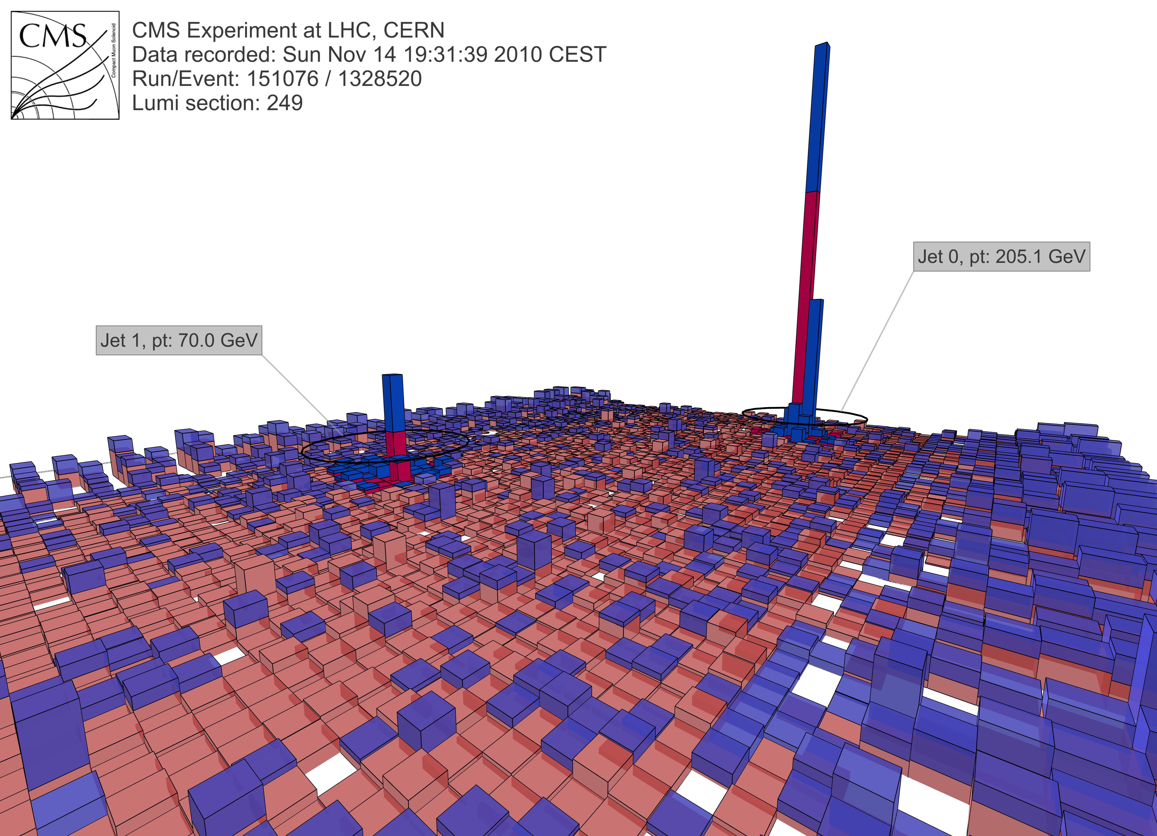
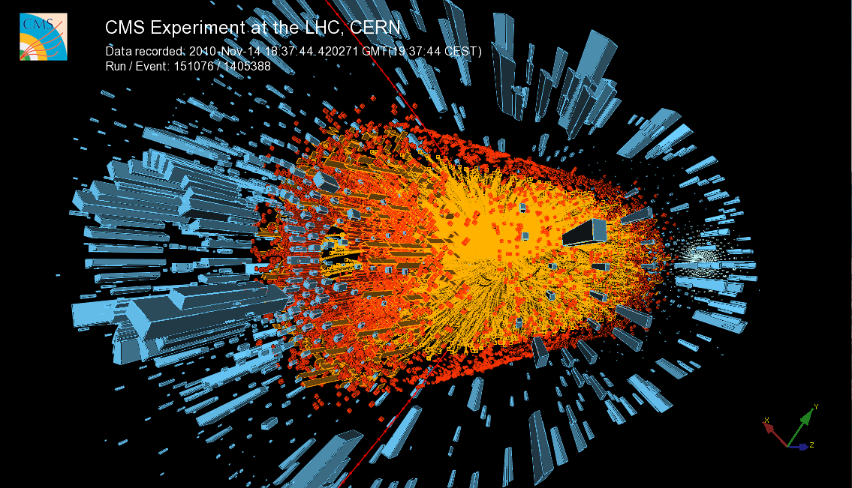
Thanks!
Dijet event in PbPb collisions.
Upsilon event in PbPb collisions.

Slide 38
Backup

Slide 39
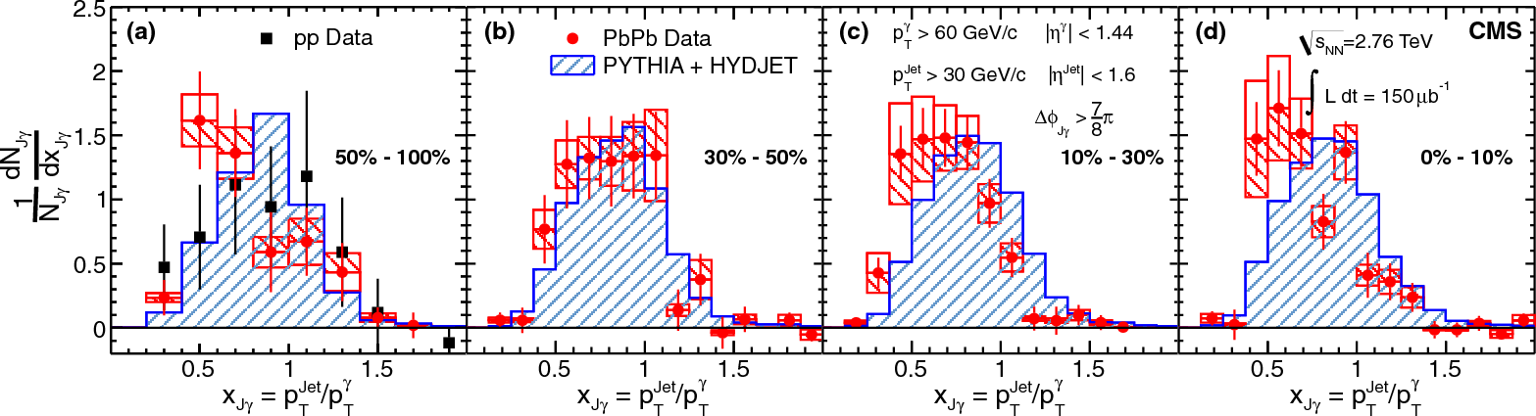
γ-Jet Measurements
Momentum ratio: p_{T}^{Jet}/p_{T}^{γ}
Average shifts/decreases for more central events.
Note: jets below 30 GeV not included.

Slide 40



q-hat Transport coefficient (estimate)
Estimate of q-hat
Consider a gluon plasma at T~0.4 GeV, s~0.5:
After including hbar c= 0.2 GeV.fm to get right units...

