Slide 1

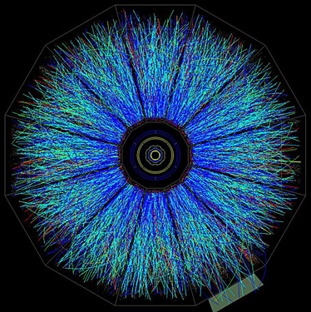
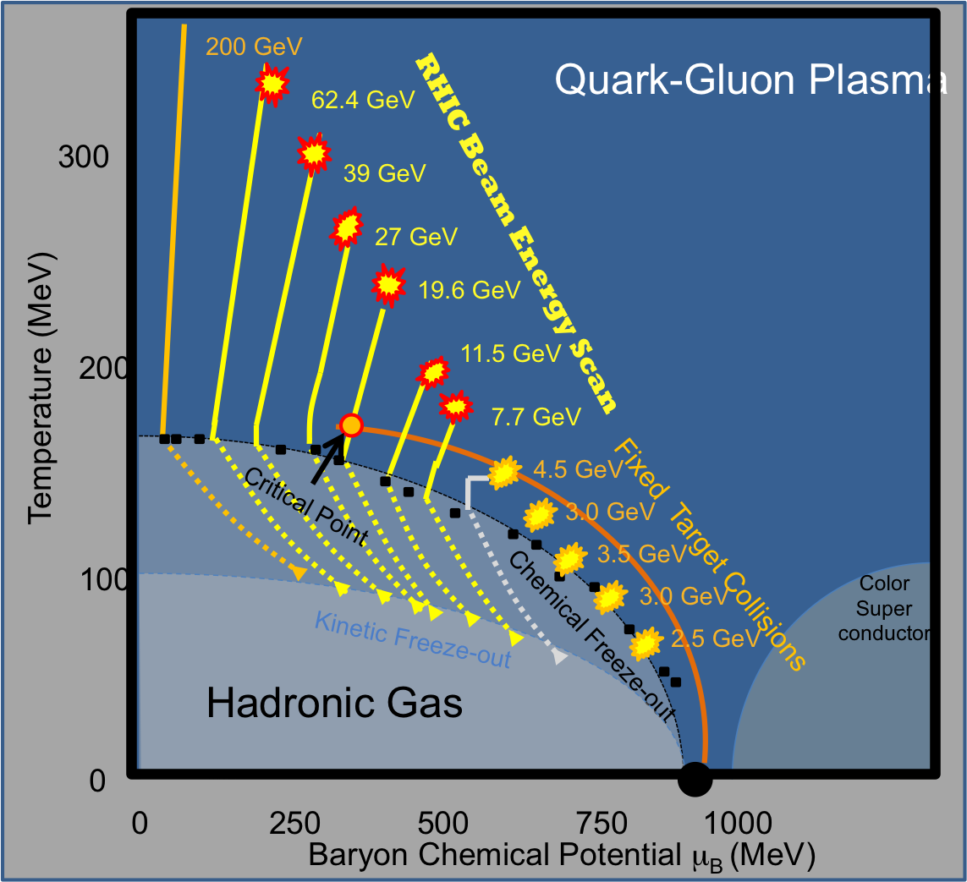
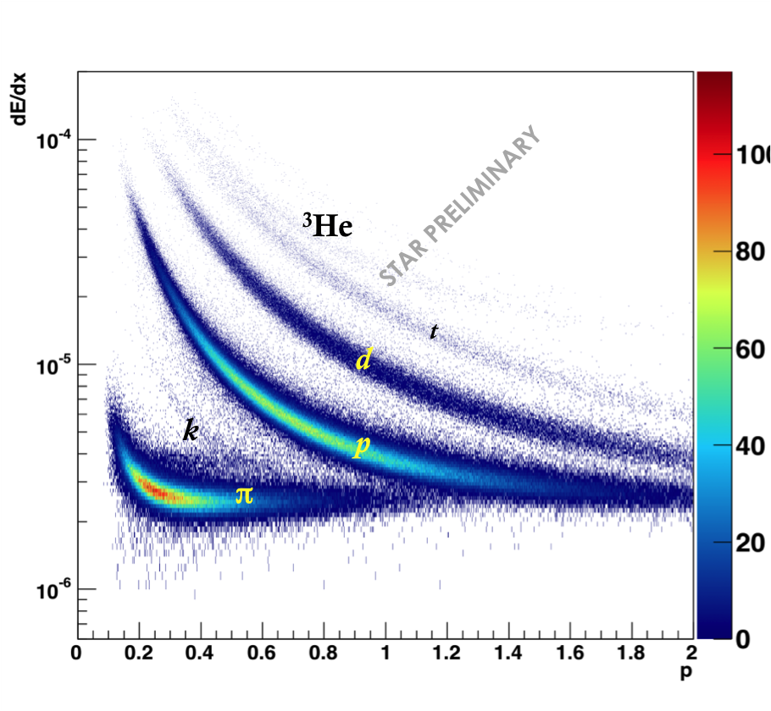
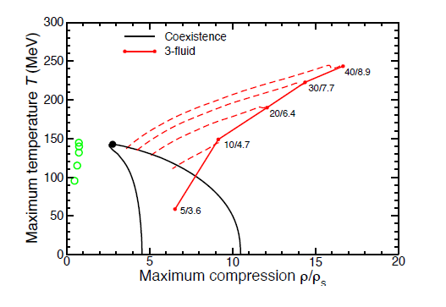
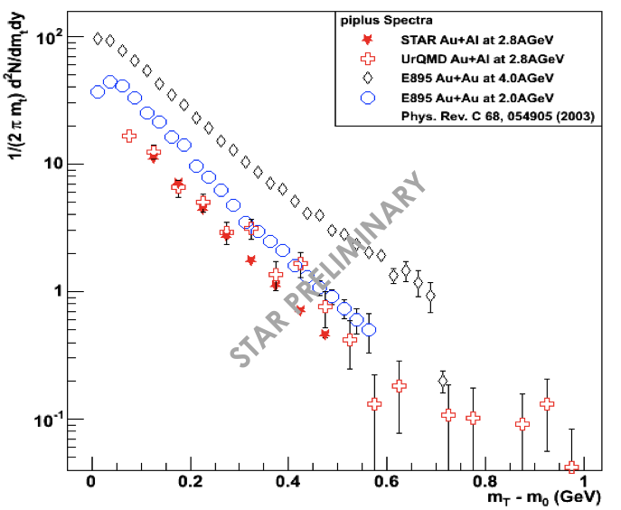
A Fixed Target Program at STAR:
Searching for the Onset of Deconfinement
Brooke Haag, Daniel Cebra, Sam Brovko, Chris Flores
University of California, Davis for the STAR Collaboration
Abstract
Event Selection
The RHIC Beam Energy Scan (BES) was proposed to search for the possible critical point and to study the nature of the phase transition between hadronic and partonic matter. However, several dynamical model simulations (UrQMD, PHSD, QGSM, GiBUU, 3-fluid) suggest that the partonic phase is entered for center-of-mass collision energies as low as 4-5 GeV. Collisions between beam halo nuclei and the aluminum beam pipe allow STAR to study fixed-target Au+Al collisions. The injection and sub-injection energy gold beams (kinetic energies of 8.8, 4.8 and 2.9 AGeV) produce Au+Al collisions at center-of-mass energies of 4.5, 3.5, and 3.0 GeV. Particle ratios will be presented and compared to earlier published results from the AGS. Fixed target acceptances and efficiencies for tracking in the TPC and particle identification in the Time of Flight system will be shown.
Motivation
Figure 5. Inclusive z vertex distribution from the 7.7 GeV Au+Au run. Note there are detector support structures at +/- 50 cm and and +/- 150 cm. Beryllium beam pipe resides between +/-70. Aluminum portion is located from 70 to 200 cm.
Figure 6. Sample XY vertex distribution for Au+Al 3.5 GeV beam pipe events selected from 7.7GeV Au+Au run. Note that the beam pipe is well imaged with these event vertices.
Using collisions of gold beam ions with aluminum nuclei inside the beam-pipe allows us to study fixed-target interactions with the STAR detector. This provides low energy collisions, which allows us to extend the reach of the RHIC Beam Energy Scan.
Particle Identification
Figure 2. The three fluid model suggests that the onset of deconfinement occurs at 4 GeV. In order to properly test this, we would need data both above and below this transition.
Figure 7. Particle Identification via ionization in the TPC. 3.0 GeV Au+Al events with 1.0 m < |V_{z}| < 2.0 m were selected for this figure.
Figure 8. Particle identification via TOF detector. Track matching is seen to be about 30%, although this has not been optimized to fixed target events.
Figure 1. A cartoon of the phase diagram of nuclear matter showing the fixed target points.
Proposal
During the summer 2013 shutdown, an annular gold target will be installed inside the beam pipe at z = –2 m. With a fixed-target trigger configuration, special fixed-target runs at and below injection energy will be taken. Normal collider operations will not be disrupted.
Figure 3. Illustration of proposed fixed target gold annulus. Proposal is for a 1% target. Au ions which pass through the target will lose energy and end up colliding in material in the of the central region of STAR.
Figure 9. TPC Acceptance of negative pions in p_{T} vs rapidity for beam pipe events.
Figure 10. TPC Acceptance of protons in p_{T} vs rapidity for beam pipe events.
Results
Figure 4. Schematic showing location of target within STAR.
Table 1. Estimated event statistics needed to carry out various physics analyses for a typical fixed target mode.
Figure 12. Uncorrected pion yields for Au+Al beam pipe events √s_{NN} = 3.0 GeV collisions
Figure 11. Uncorrected pion yields for Au+Al beam pipe events √s_{NN} = 4.5 GeV collisions. Slopes of STAR, AGS, and UrQMD spectra compare favorably, though AGS yields are predictably higher.
ACKNOWLEDGEMENTS
This material is based upon work supported by the National Science Foundation under Grant No. 0645773. Any opinions, findings, and conclusions or recommendations expressed in this material are those of the authors and do not necessarily represent the views of the National Science Foundation.

