Slide 1
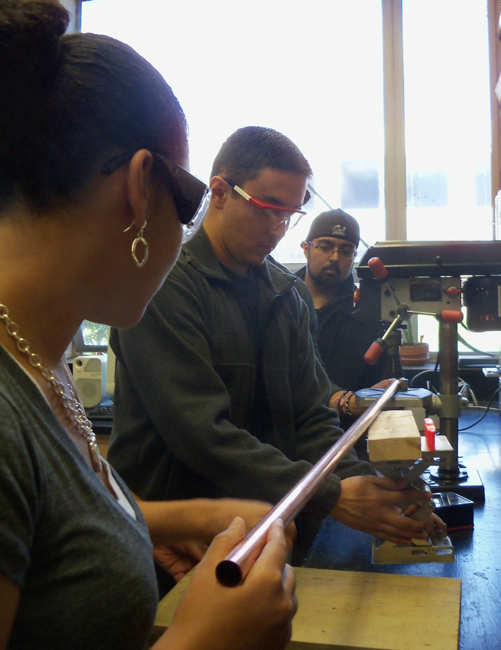
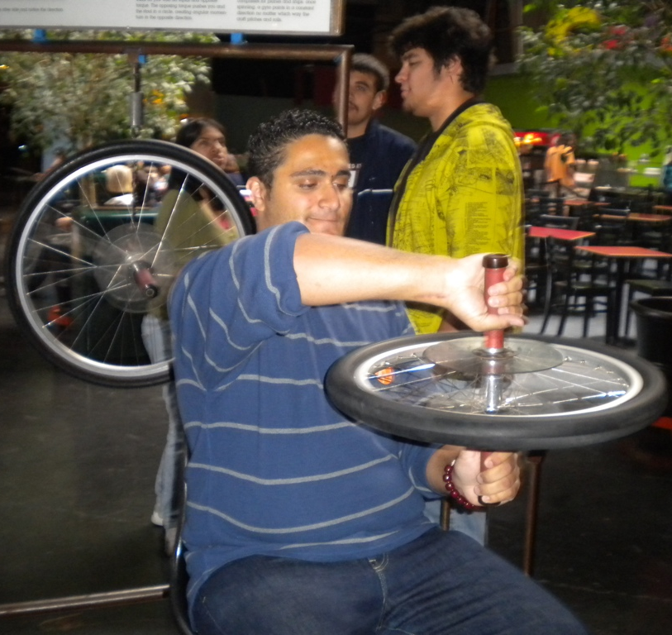
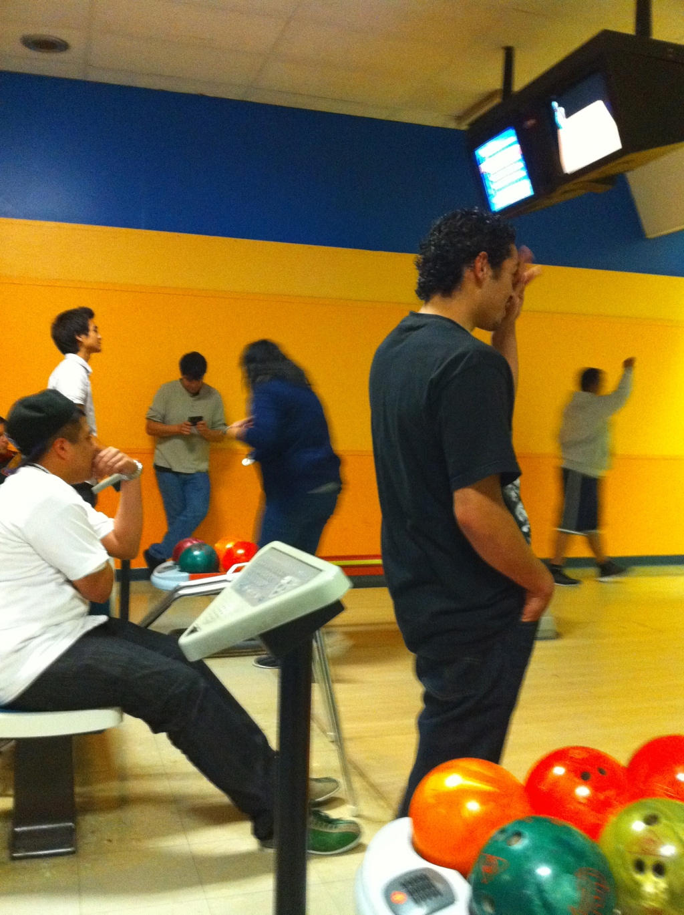
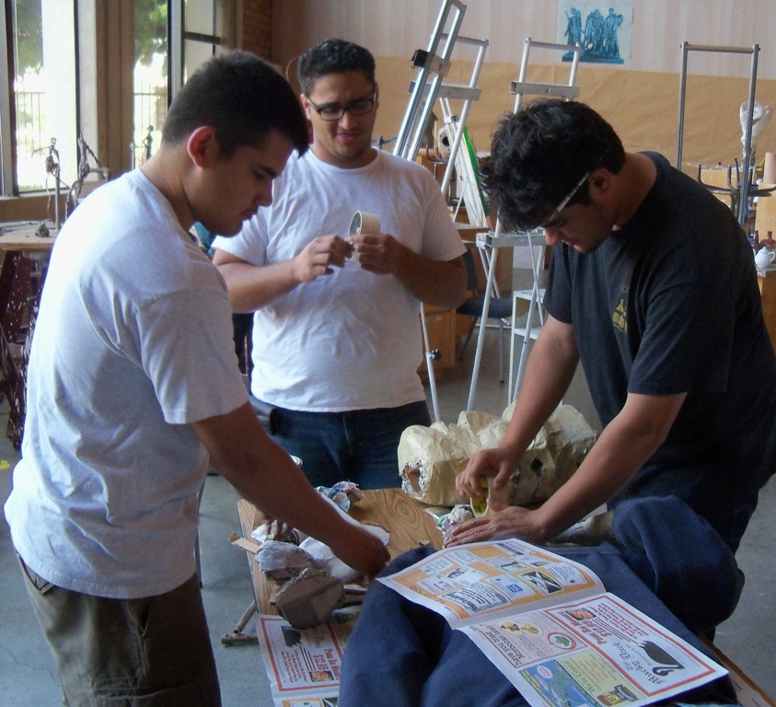
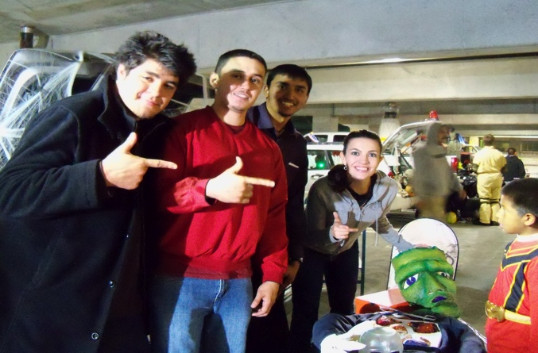
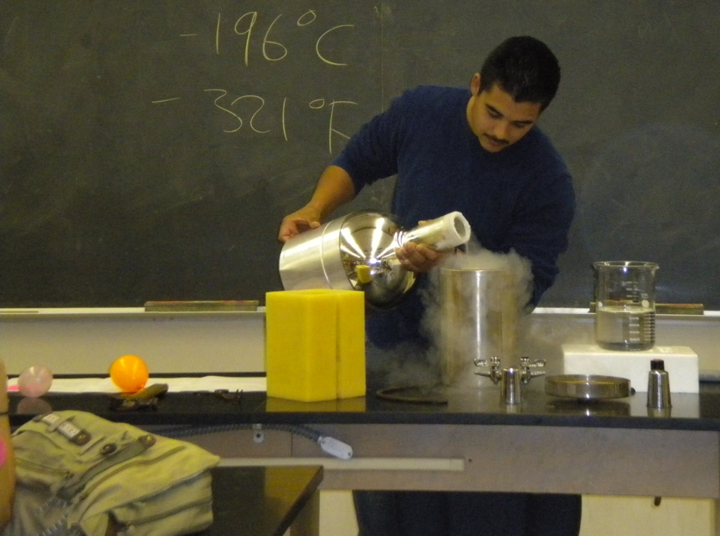
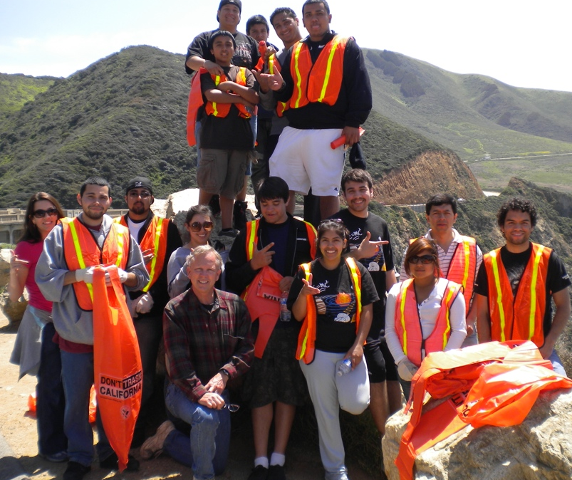
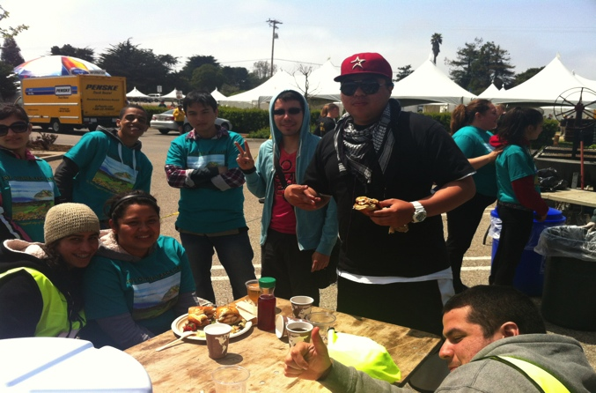
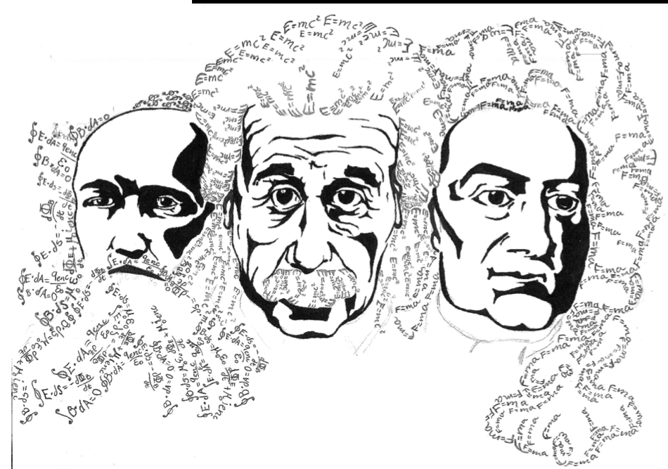
Proper Care and Feeding of a Dynamic SPS Chapter
Brooke Haag
Hartnell College
ABSTRACT
PROMOTE SCIENCE
SPECIAL PROJECTS
HAVE FUN
The Hartnell College physics club has thrived as an SPS chapter at a two-year college for twenty years through the efforts of several advisors and a number of enthusiastic students devoted to outreach. It has earned national recognition as well as a local reputation as one of the most dynamic and longest–lived clubs on campus. With a focus on several specific goals including outreach, fundraising and project construction, the club consistently attracts a following of students led by a core of dedicated officers willing to expend the time and energy necessary for a robust program. In this poster, we present an overview of our outreach, fundraising, and project construction efforts. We also offer recommendations for guiding a successful SPS chapter.
Figure 2. Leo Osornio involves a middle school student in the demonstration of how an electromagnet works.
VITAL STATISTICS
Figure 7. Francisco Gutierrez, Mrugesh Patel, Miguel Flores and Jose Rico work hard on a new bed of nails demonstration for the Physics Olympics show, partially funded through the Marsh White Award. www.spsnational.org/programs/awards/white.htm.
Figure 8. Edgar Collazo, Jose Rico and another physics club member work on drilling the holes in a copper pipe for a new Reuben’s Tube demonstration.
Figure 12. Nour Daas tests out the conservation of angular momentum at the exploratorium in San Francisco. A number of club members enjoyed this end of year field trip.
– Hartnell College is located in California’s Salinas Valley – Agriculture is the primary industry of the Salinas Valley. The student population of Hartnell is 50% Hispanic – The Hartnell College Physics department consists of: – 1 full–time instructor – 1 adjunct instructor – 1 lab technician
Figure 13. Andres DeLeon tries to pickup the split while Jose Hinojosa looks on during Tuesday night bowling with the club.
Figure 3. Hartnell students pose with Dr. Enrico Ruiz-Ramirez after his lecture detailing his career evolution. The event was funded through the Future Faces of Physics Award. www.spsnational.org/programs/futurefaces/
CONCLUSIONS
There are many keys to the success of Hartnell College’s SPS Chapter : – maintaining long standing traditions (e.g. more than thirty years of the annual Hartnell College Physics Olympics)
– holding weekly club student run meetings with free food for special events – doing community outreach regularly, especially participating in opportunities as identified by club members – holding officer elections in the spring semester to set the club up for success the following fall
- raising money to fund club projects, fun events, and scholarships
Running a chapter of the SPS is a very rewarding adventure. Giving students the opportunity to belong to a nationally based professional organization is very important. Seeing students develop maturity through responsibility and a sense of public service is truly wonderful. Finally, it offers a context for getting to know students outside of the classroom in a meaningful way and vice versa.
Figure 8. Alex Cota, Nour Daas and Ignacio Maravilla construct a paper mache Frankenstein’s monster for the annual Halloween Spooktacular.
HARTNELL SPS CHAPTER GOALS
Figure 4. Kayla Vuong demonstrates electromagnetic induction for high school students during the North Salinas High School Hartnell STEM fair.
Figure 9. Ignacio Maravilla, Edgar Collazo, Mrugesh Patel and Brooke Haag pose with the finished Frankenstein’s monster during the Halloween Spooktacular.
The club has several primary goals: – To promote science at Hartnell and in the wider community
– To perform community service – To raise money for scholarships and other club activities – To stimulate interest in physics through special projects – To be social and have fun!
COMMUNITY SERVICE
Figure 1. Hartnell SPS t-shirt logo as drawn by Jaime DeAnda. Selling t-shirts is a popular fundraiser and method of promoting the club.
Figure 5. Former club members Josh Ferroni and Justin Andrade return to a club meeting to speak about their summer internship experiences with Pacific Scientific.
ACKNOWLEDGEMENTS
Figure 6. Rodrigo Sanchez explores the properties of liquid nitrogen for the weekly demonstration at a Friday afternoon SPS meeting.
Figures 10, 11. The Big Sur Marathon and Half Marathons draw a number of generous SPS members each year to work the litter crew for the races. Their tremendous efforts in keeping the race course clean are much appreciated by the race organizers and the community of the Monterey Peninsula.
This poster is dedicated to the hard work and dedication of the many generations of Hartnell College SPS members over the years. It is also dedicated to the hard work and dedication of Dr. Jesse Cude, the original faculty mentor of the club who laid the foundations for a tremendously successful club. And finally, to Tito Polo, physics lab technician extraordinaire, club co-advisor, and outreach specialist. The club would absolutely not function without his steady and constant guidance.

