Slide 1


Cosmic Ray Physics at
Hartnell College: A Case Study in Successful Undergraduate Research at a Two-Year College
Leo Osornio
Hartnell College
Presented at the 2012 AAPT Summer Meeting, Philadelphia
July 30, 2012

Slide 2
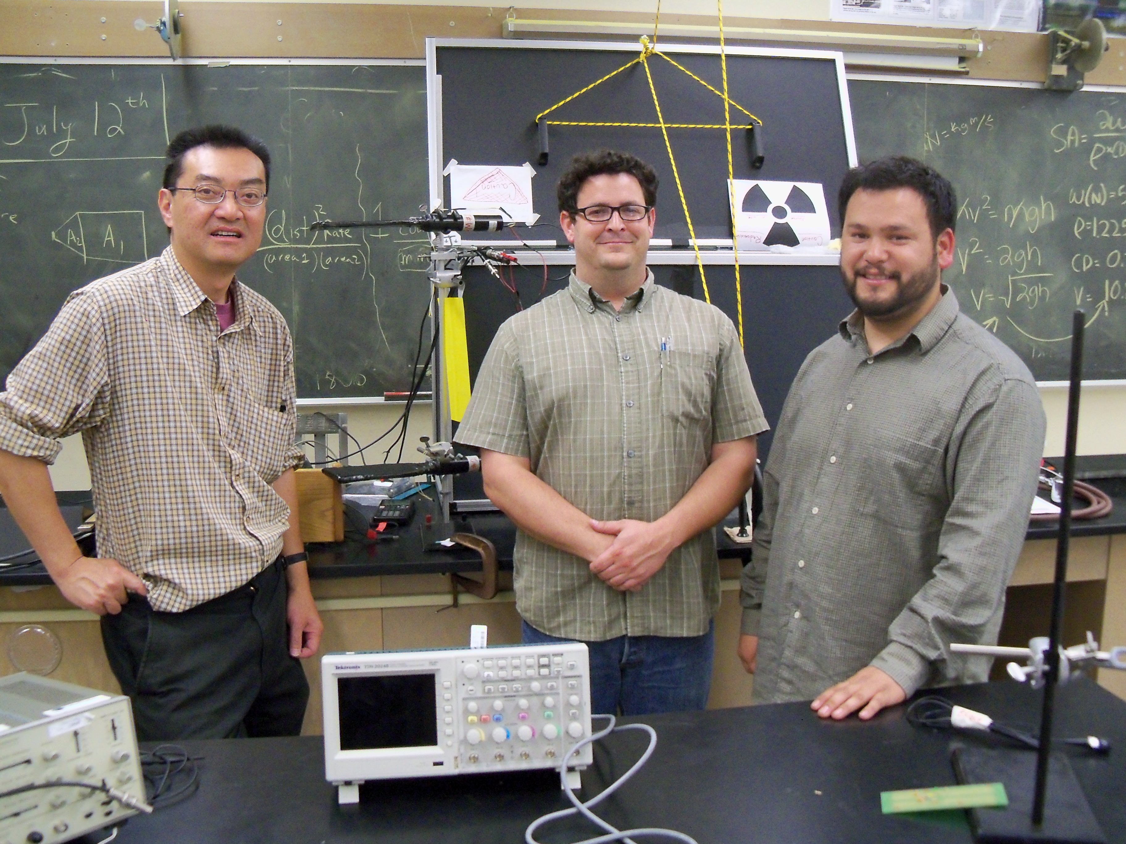
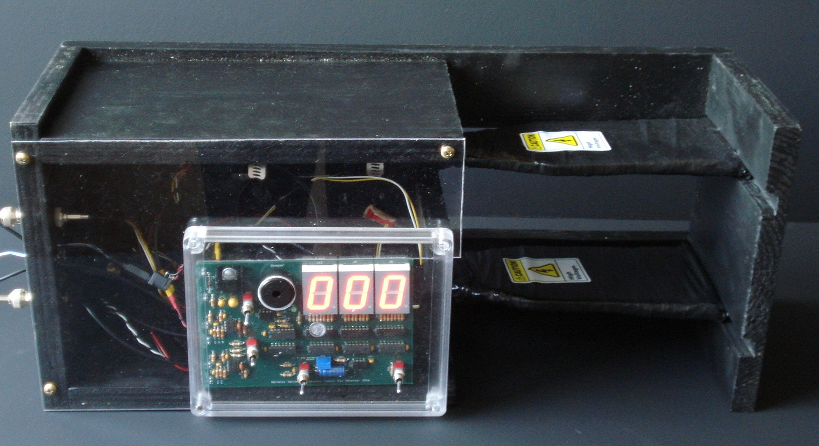
Background
Hartnell College Salinas, CA
Prospective Physics Teacher
Lawrence Berkeley National Lab (LBNL) Cosmic Telescope Project
20 weeks and counting
Most recently 8 weeks at LBNL testing Silicon Photomultiplier
Cosmic Ray Fan ? What does this comment mean ?

Slide 3
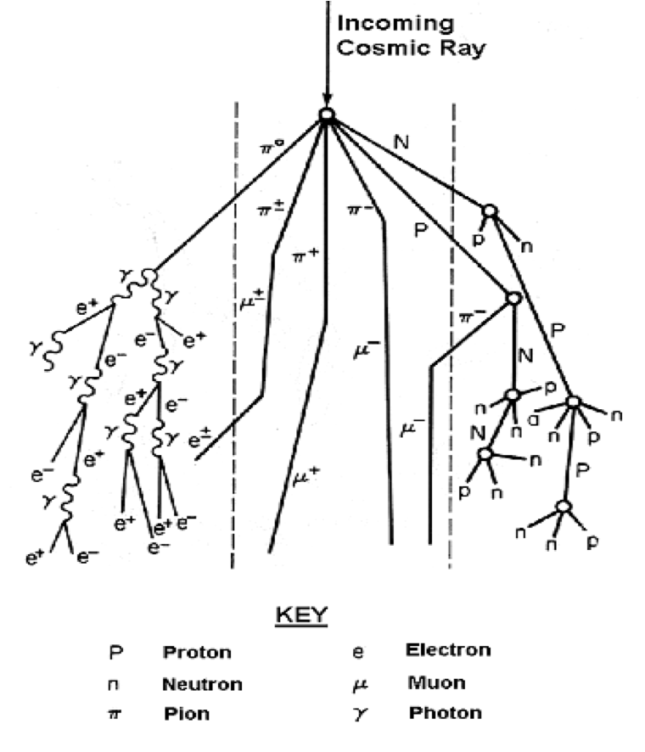
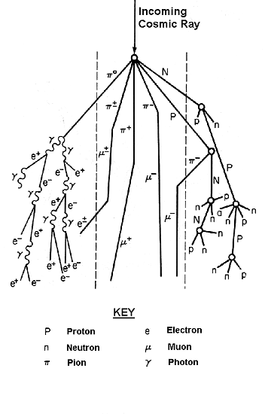
What is a cosmic ray?
High Energy Particles
Originate in Outer Space
Create “cosmic showers” upon entering the atmosphere
Focus on detecting the muons

Slide 4
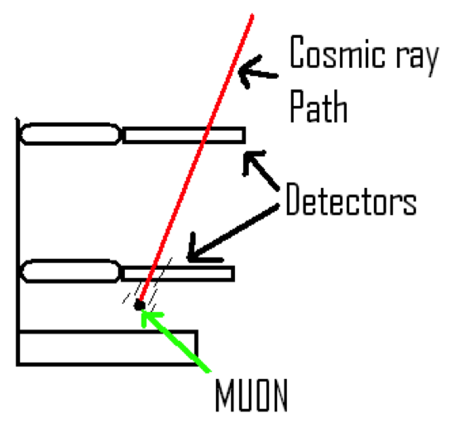
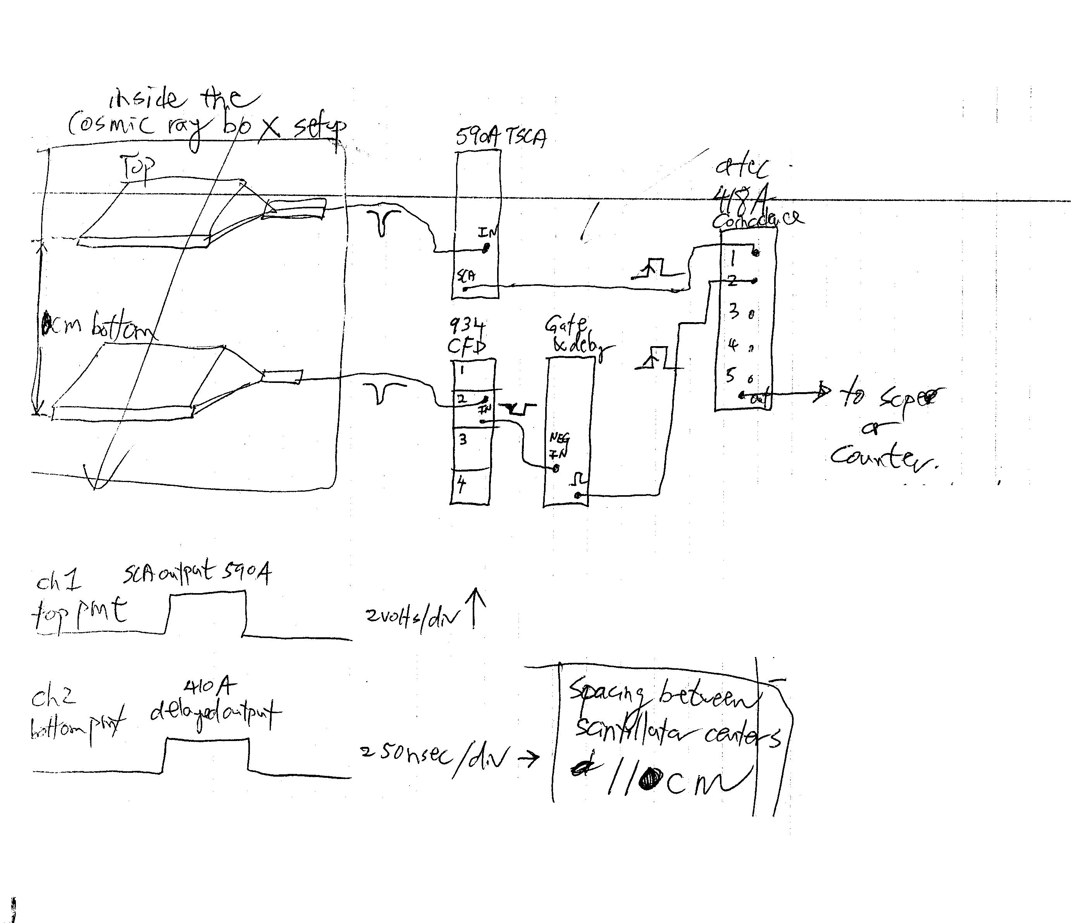
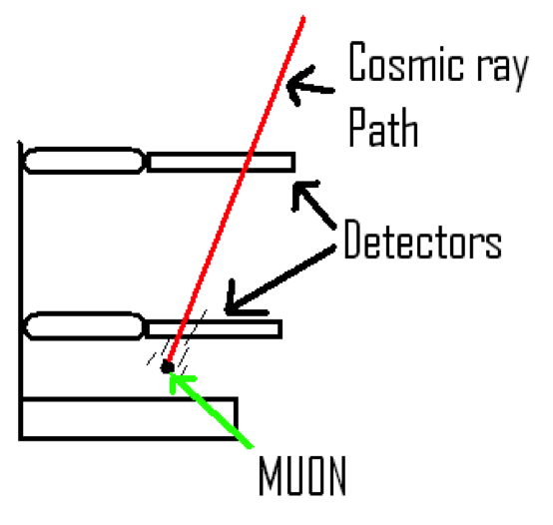
How the rays are detected
Two Sensors
“Coincidence” Counting
Uses the electronics to find simultaneous events
Helps eliminate some background noise
You already know I’m not a fan of this diagram –
I thought there was a better one somewhere
It’s unprofessional looking … the audience can’t
Make out the details.

Slide 5
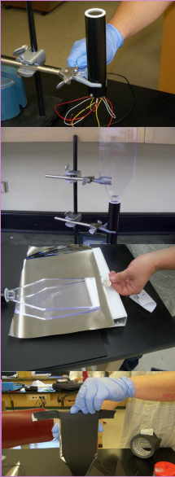
Detector Construction
Three phases:
  Sensor, Circuit board, Housing
Sensor
  Photomultiplier tube (PMT) and scintillator
  Light proof wrapping
Consolidate Detector Construction
And Testing
ONE MORE PICTURE WILL GO HERE

Slide 6
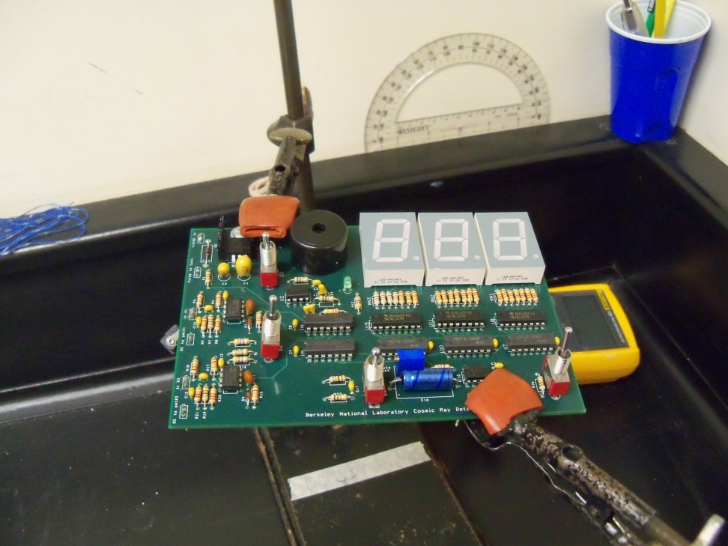
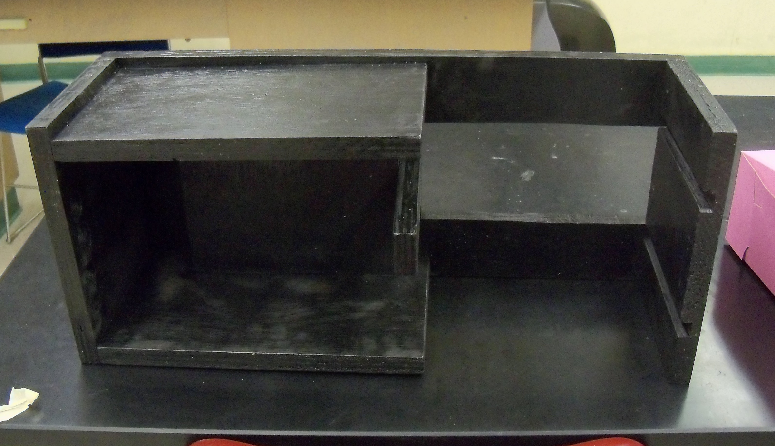
Detector Construction
Circuit Board
  Determines which counts happen in coincidence
Housing
  Protects equipment and ensures consistent data
Consolidate Detector Construction
And Testing

Slide 7
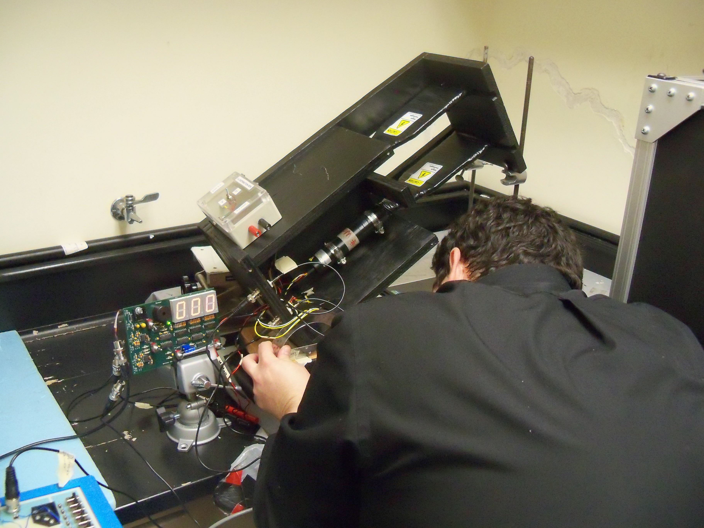
Testing
Consolidate Detector Construction
And Testing
TWO OR THREE MORE PICTURES WILL GO HERE

Slide 8
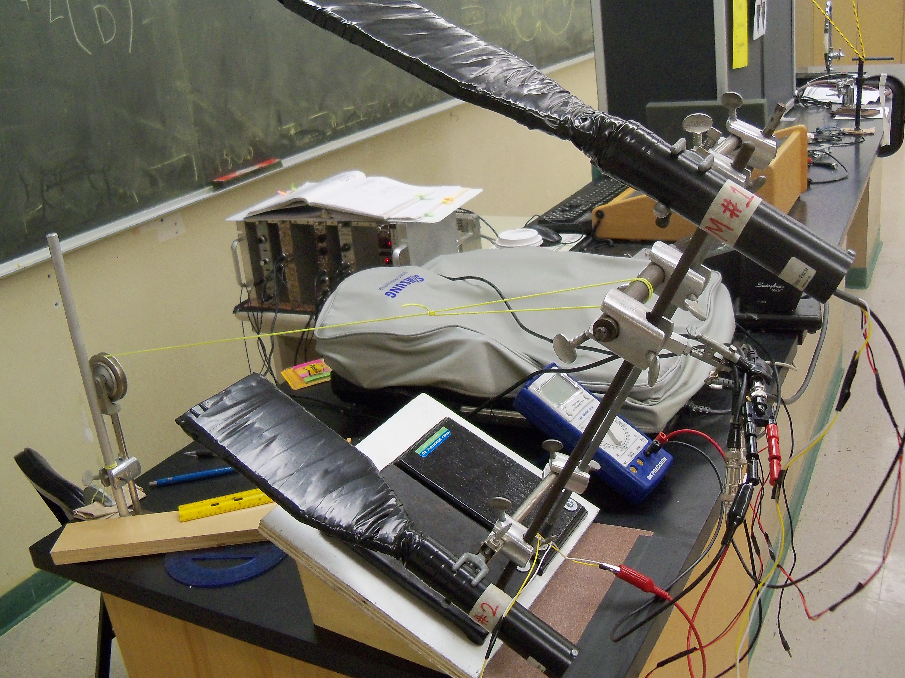
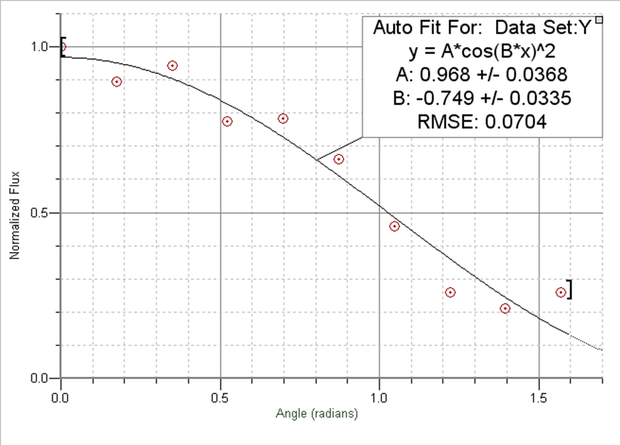
Results
Zenith Angle Test
  Angular Dependence
Used to test sensors
Baseline for fully assembled detector
It works!
Consolidate Slides 8 + 9

Slide 9
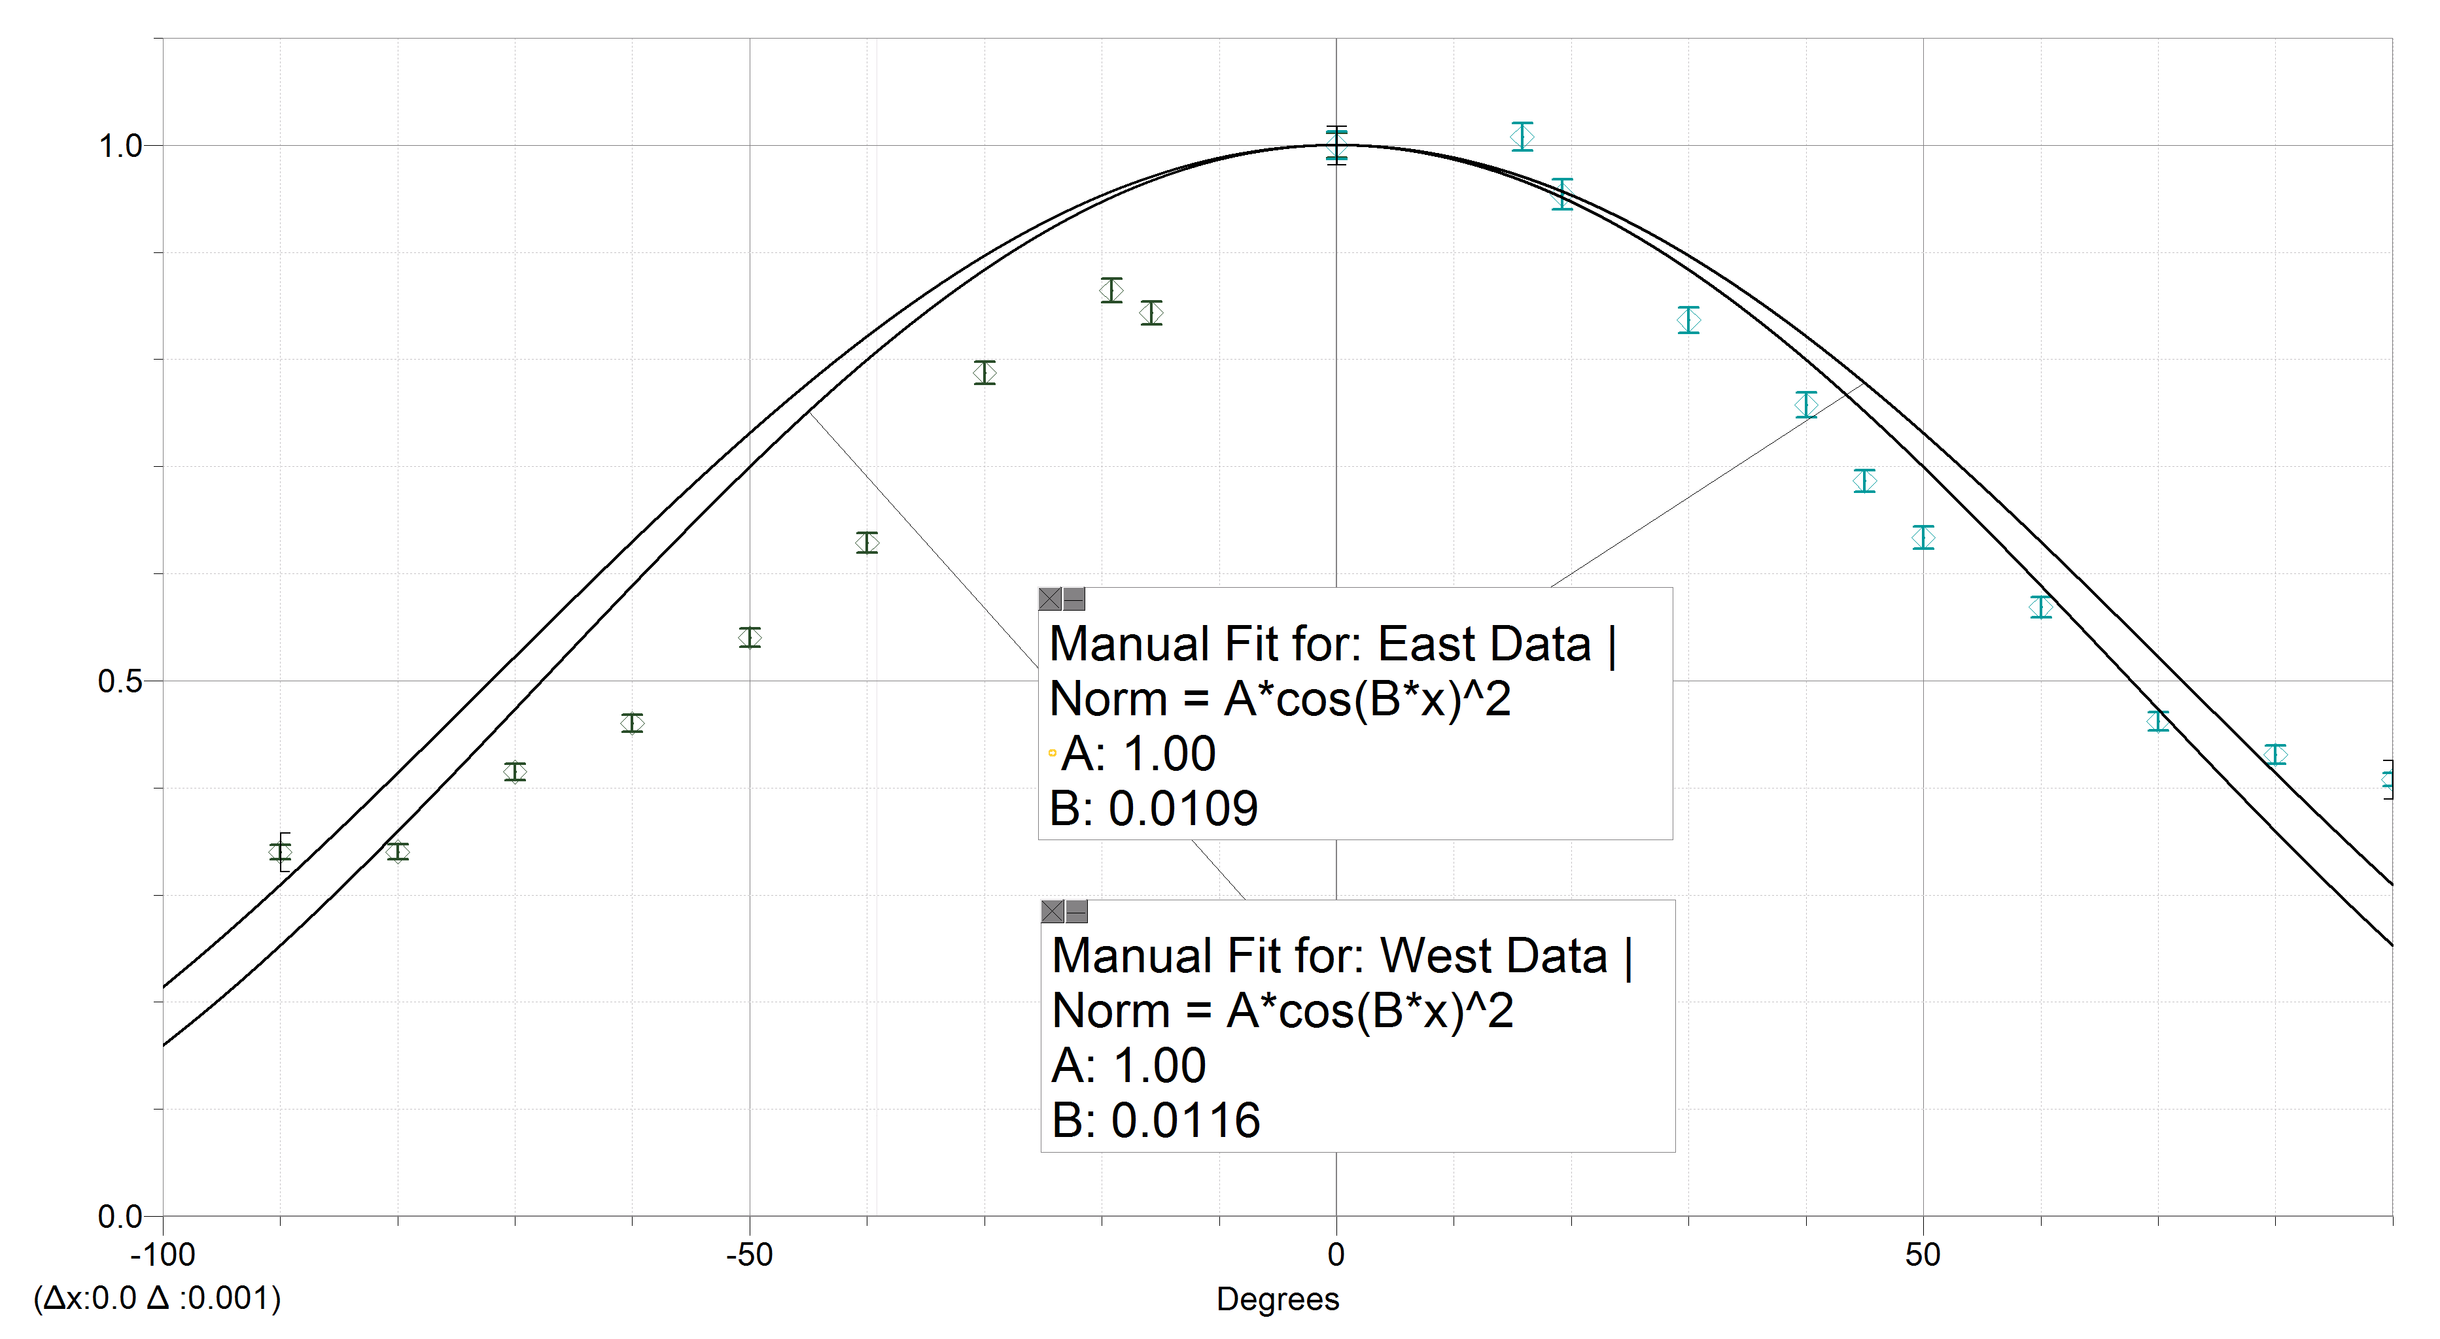
Results
Consolidate Slides 8 + 9;
Do you have the data points /
Can you get the data points?
I’m tempted to try a different
Cosine fit.
Zenith Angle Test for Detector Only (No NIM)

Slide 10
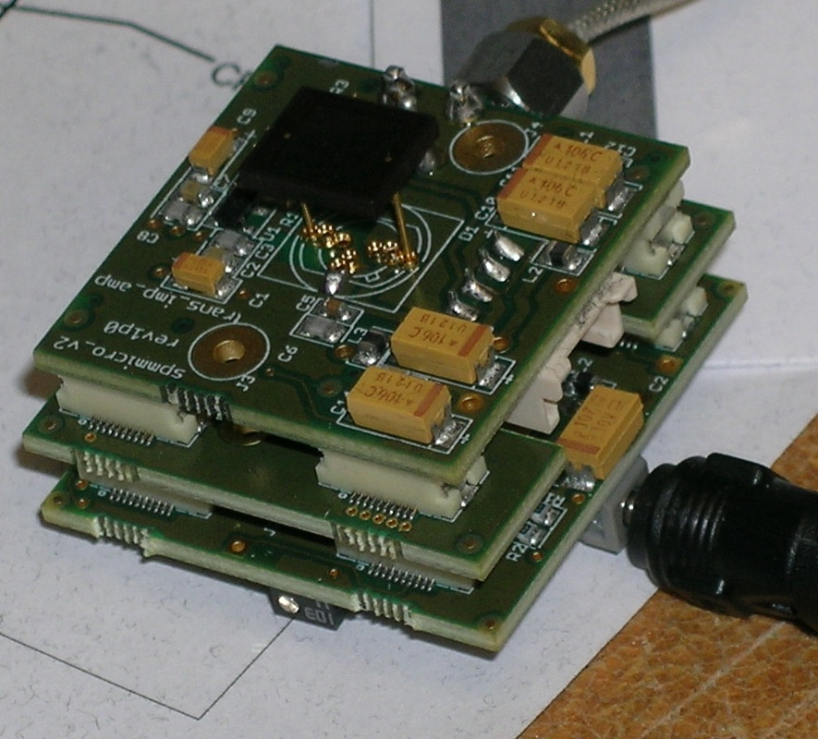
Silicon Photomultiplier (SiPM)
SenL Product
Less Voltage
Less Noise
Cheaper
Possible replacement
Testing needed

Slide 11
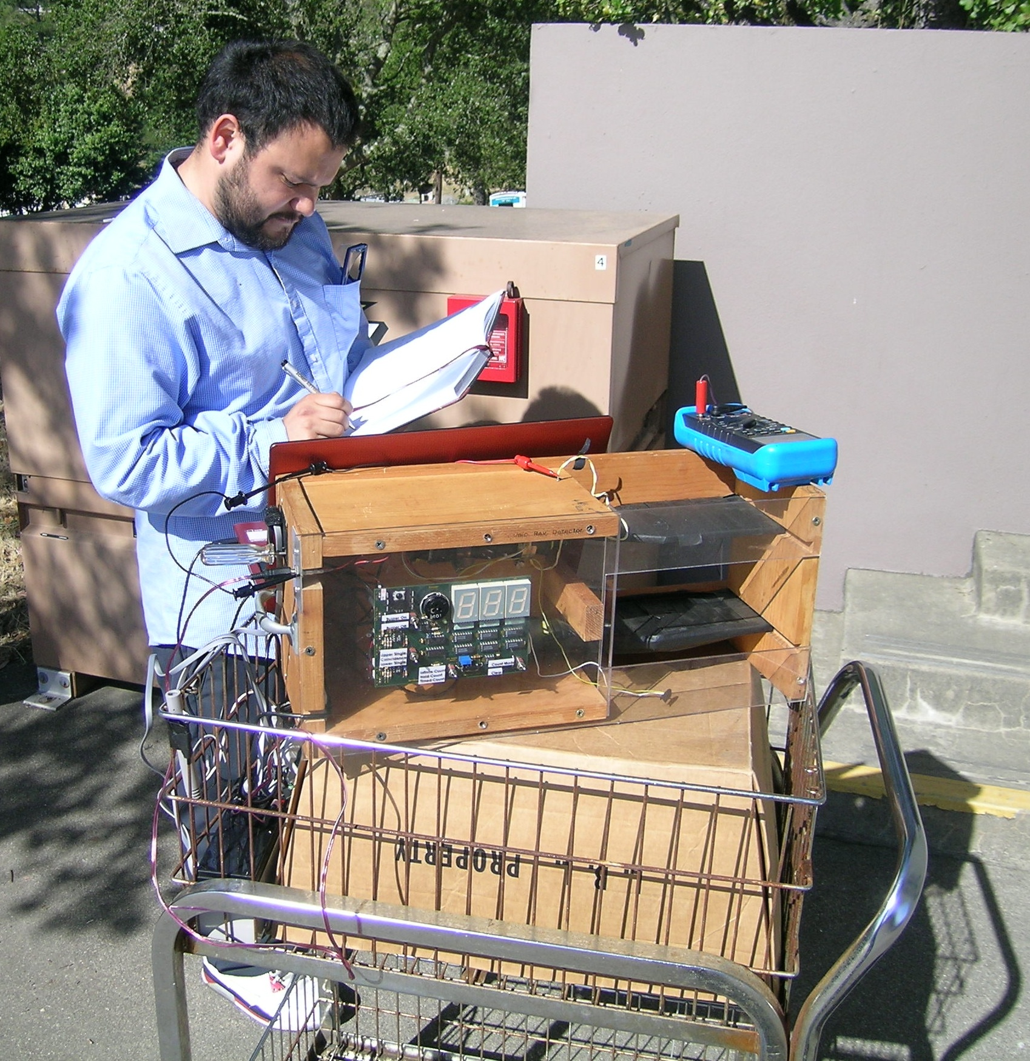
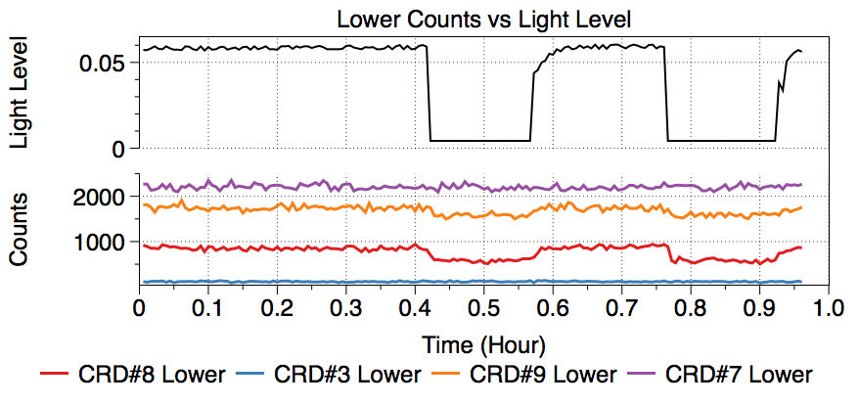
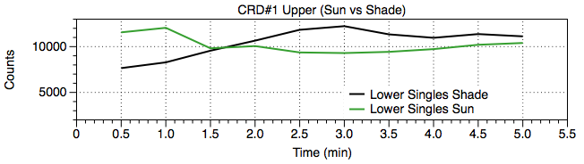
Rewrap/Light Testing
Text smaller – move
title higher if you need to
make middle plot bigger
Preparation for the SiPM
Focused on how the detectors are wrapped
Vernier LabQuest unit
Outdoor tests
  Identified detectors in need of wrapping
  Checked the rewrap.

Slide 12
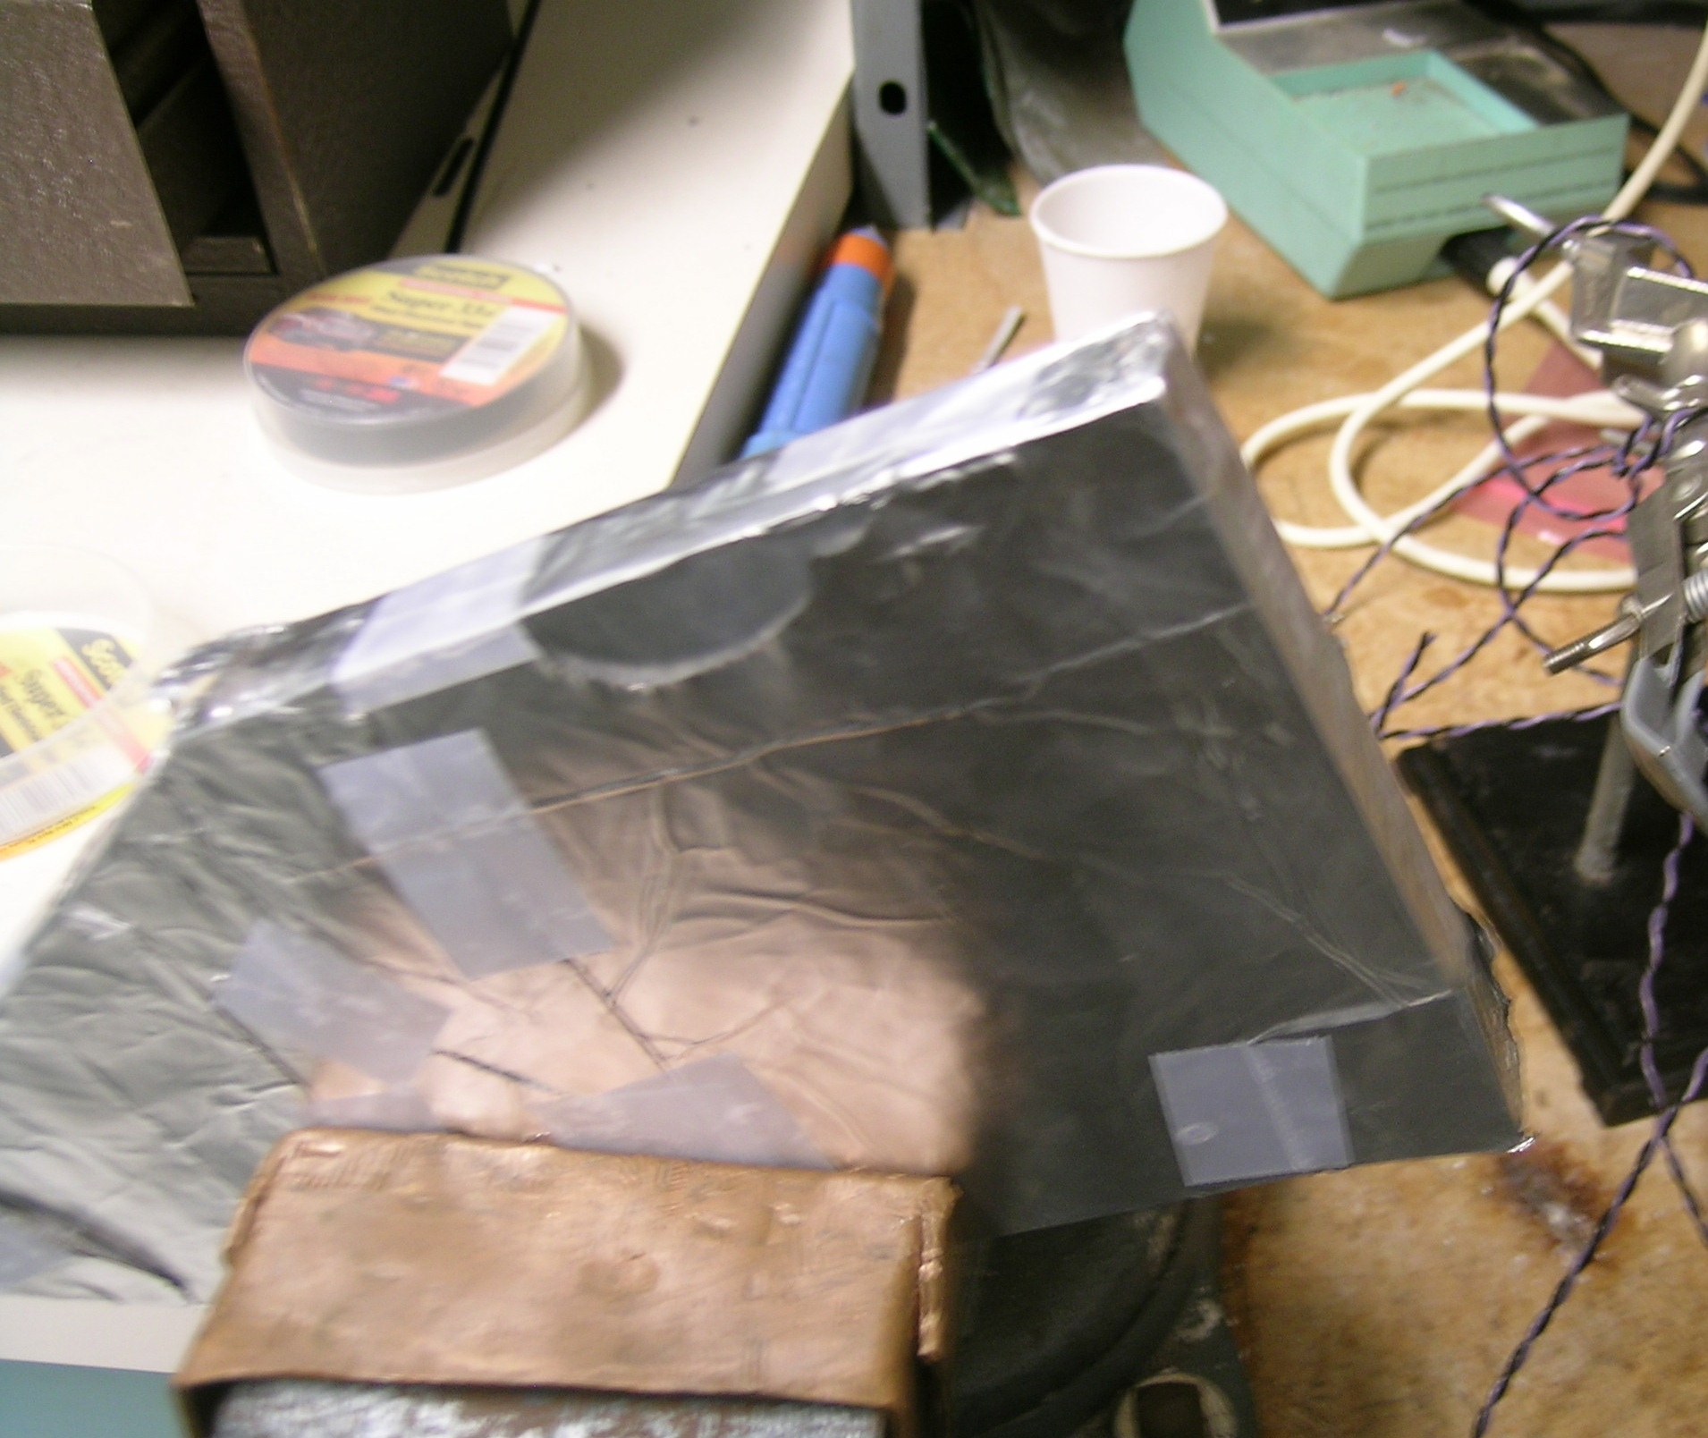
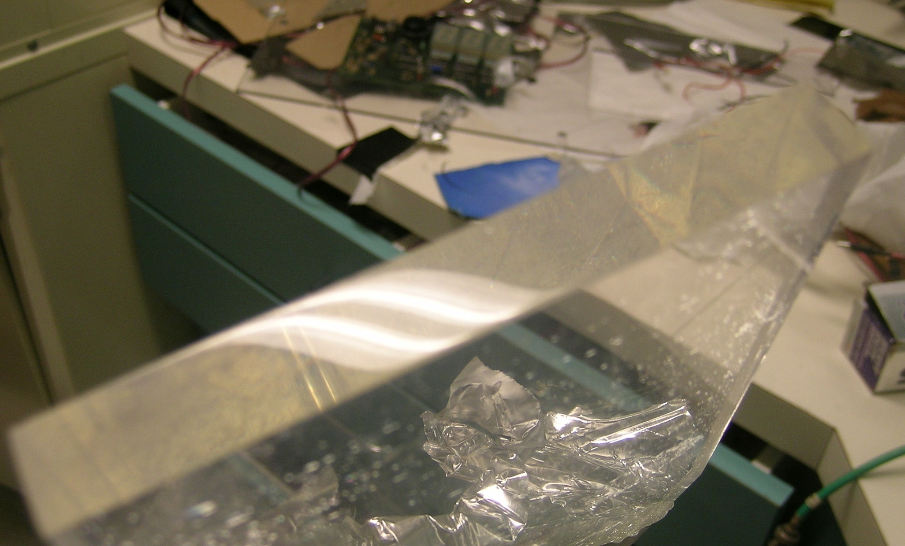
Polishing/Paddle Creation
SiPM needed a custom scintillator
Studied how it is polished
Combined with wrapping techniques discussed earlier to make paddle
Set in coincidence with a PMT for final testing

Slide 13
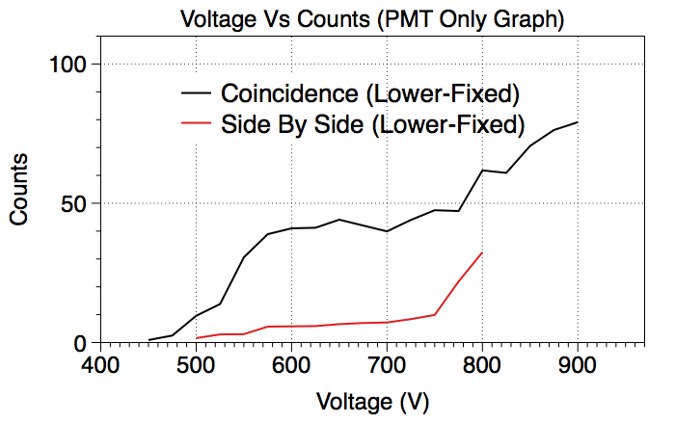
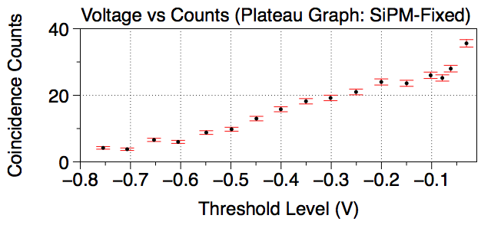
Plateau Graph
Text smaller – move
title higher if you need to
make plots bigger
Interested in noise
Test done in coincidence
First trial with PMTs only
Final test with SiPM and PMT
Inconclusive
  Threshold level of NIM equipment

Slide 14
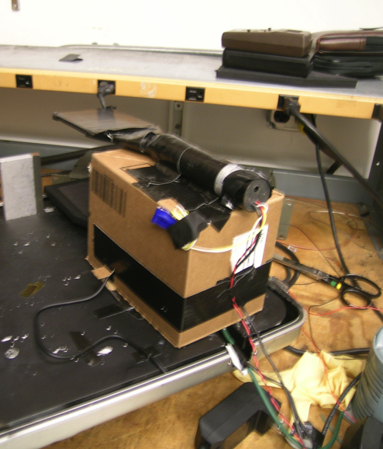
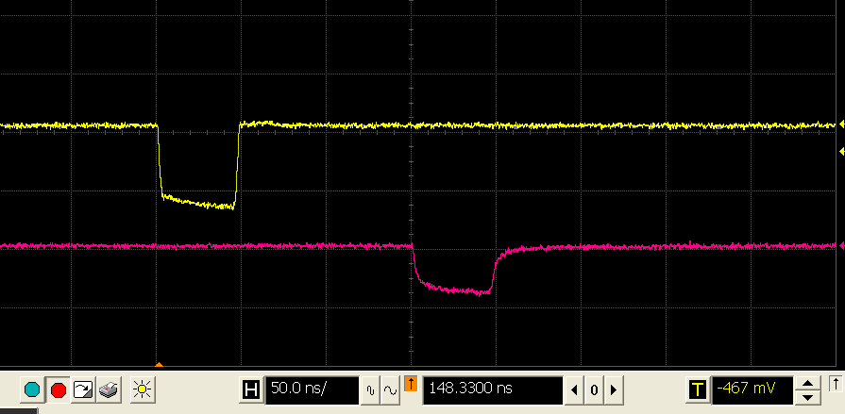
Delay Testing
Other SiPM test
Also in coincidence
Delayed one signal by 150ns
Determined counts of noise
Compared to baseline counts
Verified counting ability
Can you add arrows
+ labels: what are the
scope curves showing?

Slide 15
Conclusions/Outlook
SiPM can “see” cosmic rays
More testing needed
Will look at increasing gain
Using two SiPMs in coincidence
Possible Replacement
Help with Expansion
A great tool

Slide 16
Acknowledgements
Original Partner : Scott Davis
Mentors : Dr. Howard Matis, Dr. Sewan Fan,
Dr. Brooke Haag,
Grant Director : Dr. Kelly Locke
Lawrence Berkeley National Lab
  Mario Cepeda
  Pete Chavez
Department of Education Grant
  HSI-STEM P031C110168

Slide 17
Thank you for you time
For more information visit http://cosmic.lbl.gov/

