Slide 1
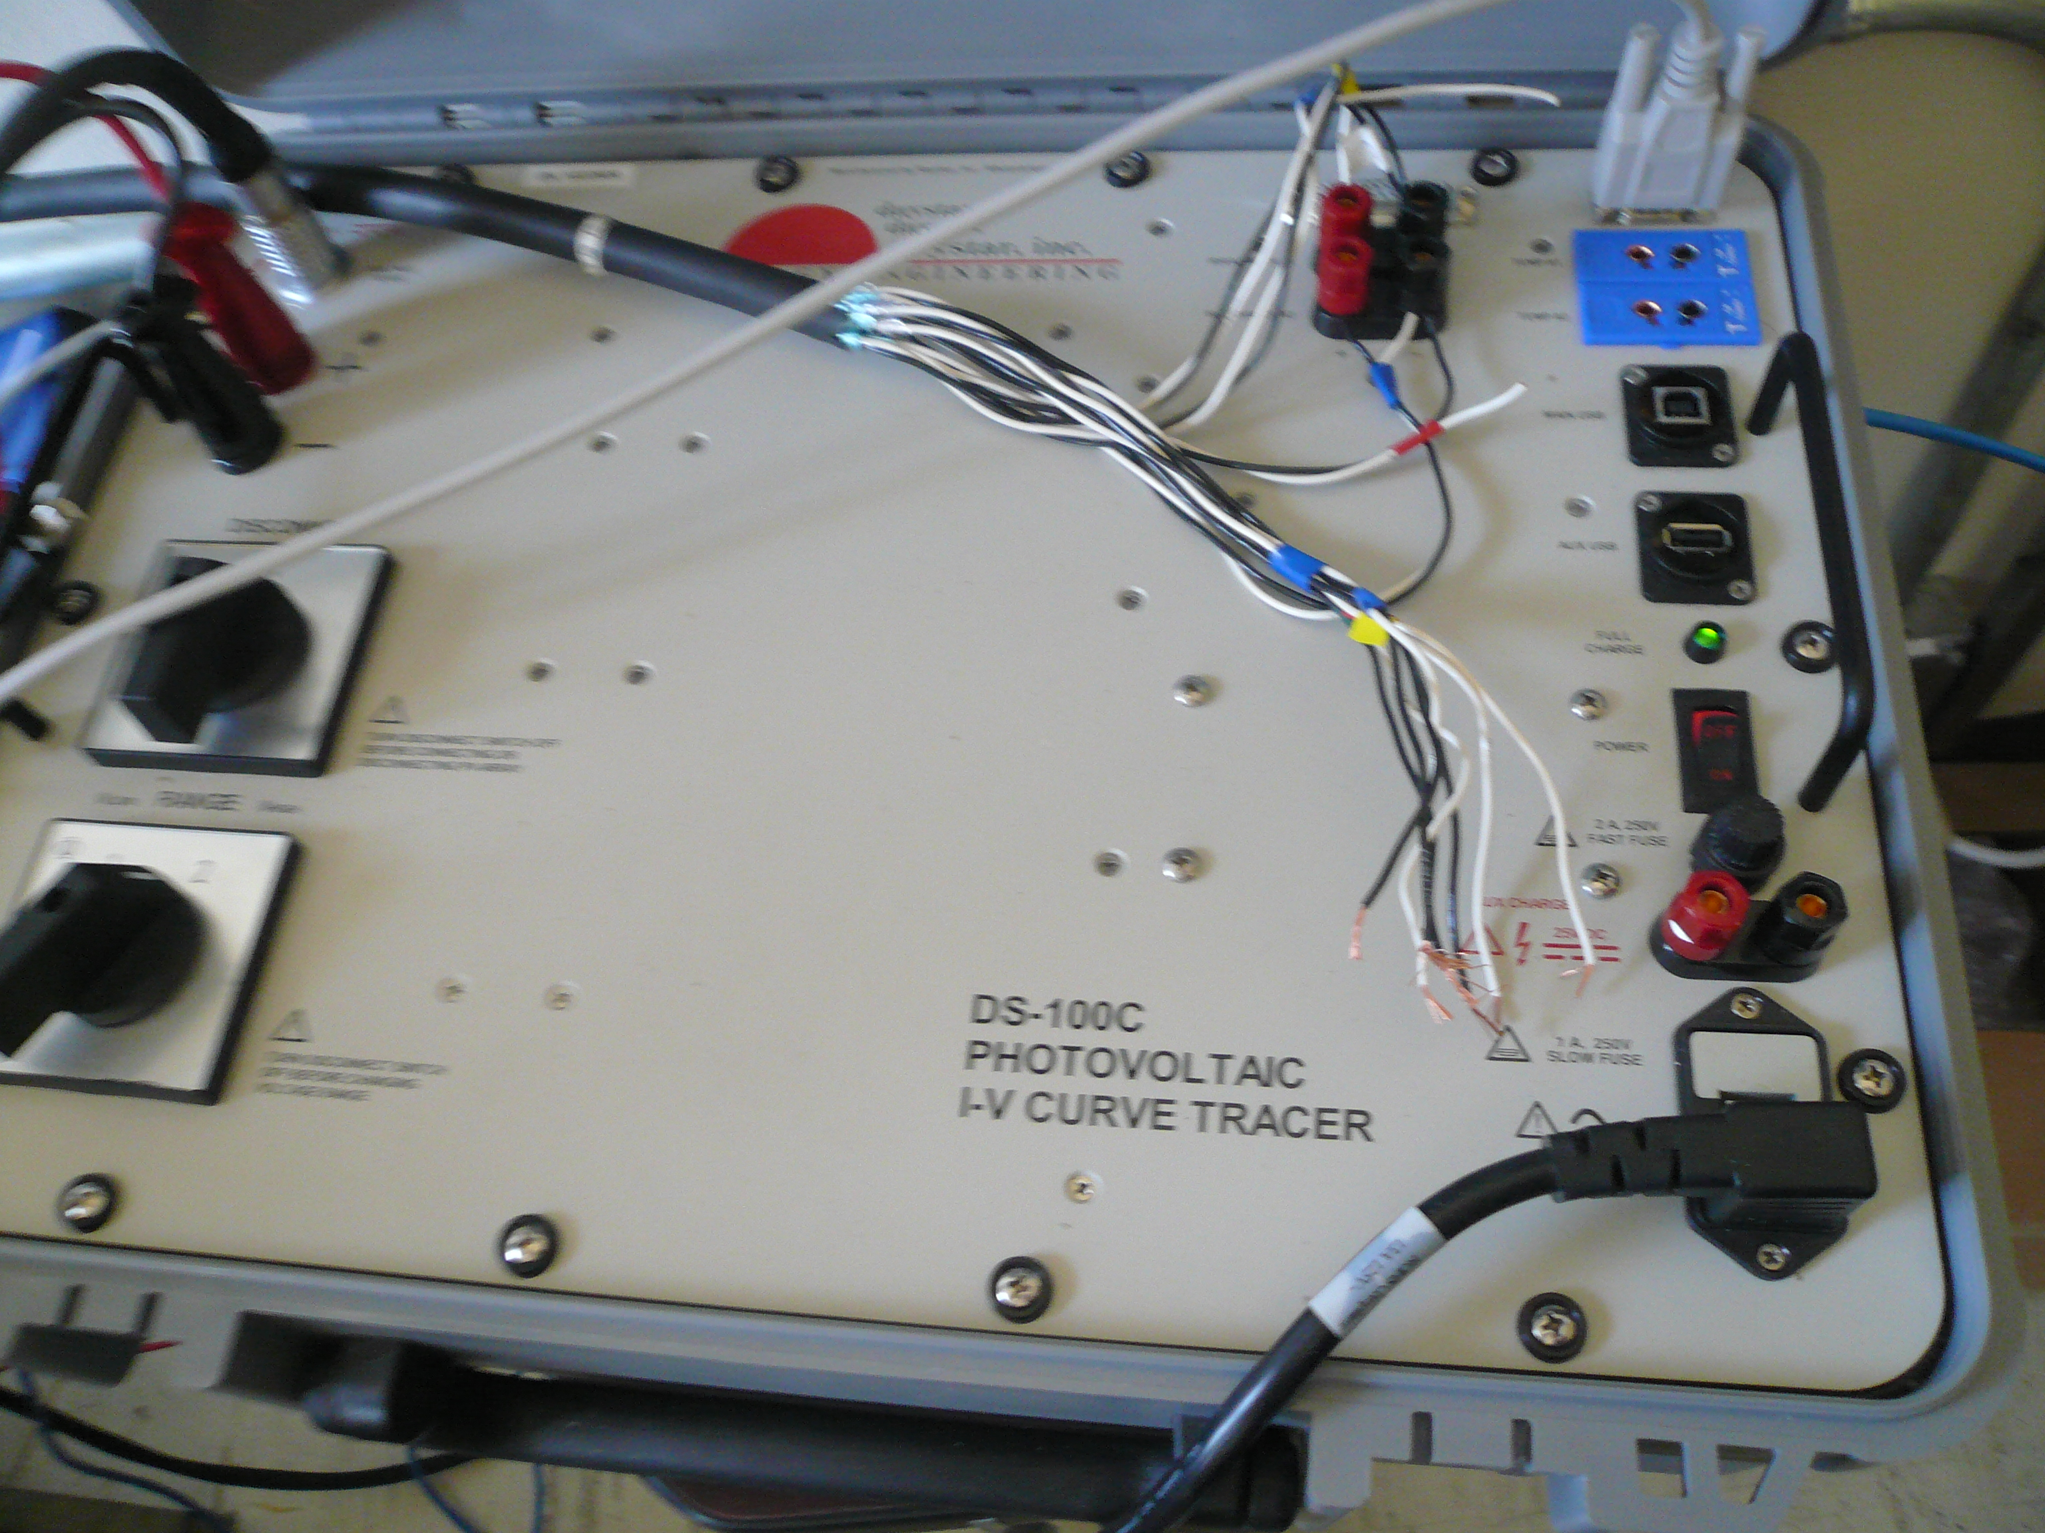
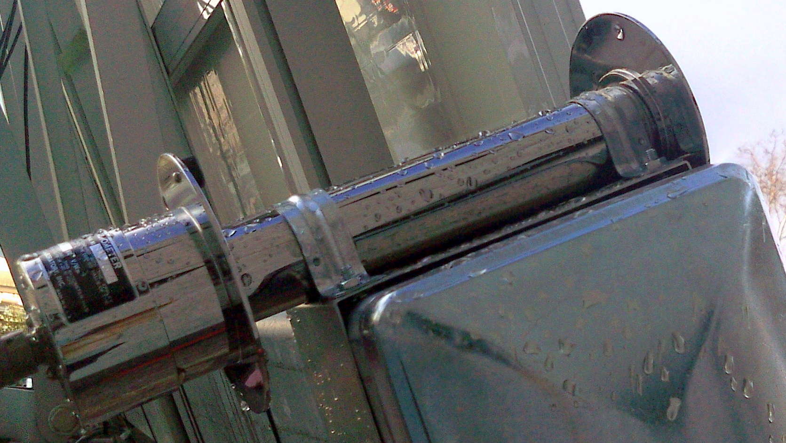
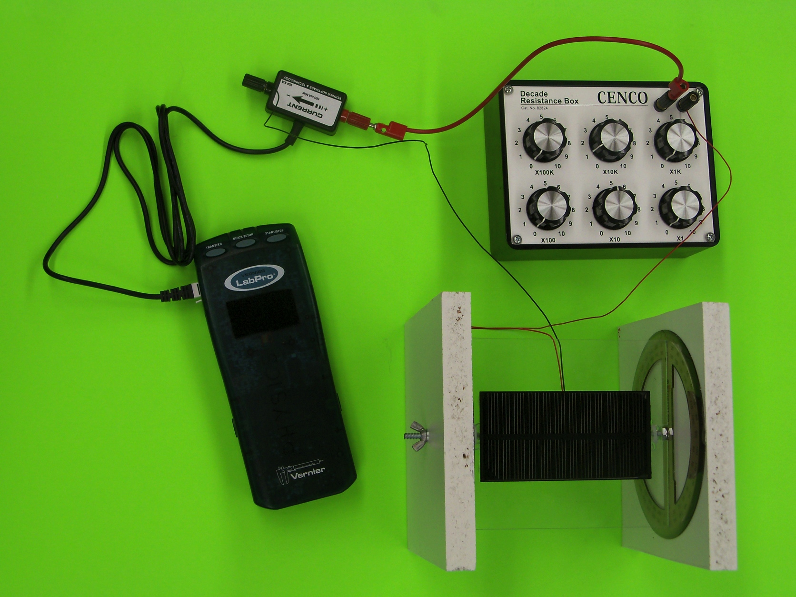
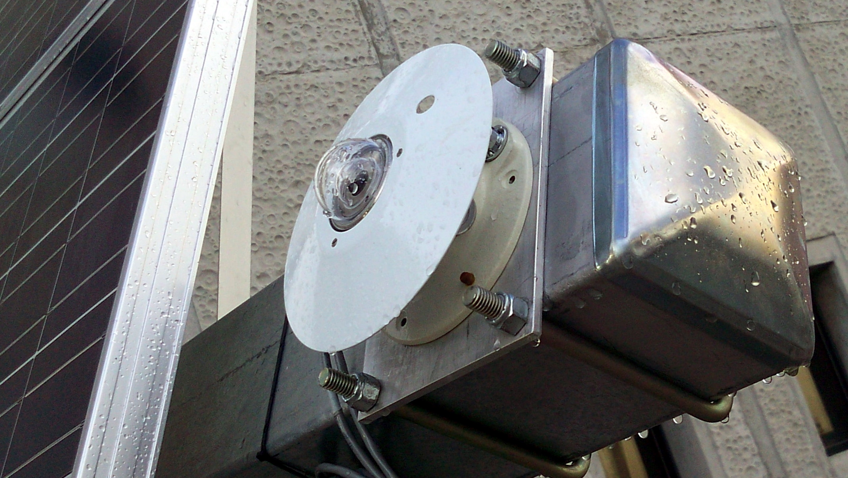
Implementation of a Web-Enabled Interactive Renewable Energy Laboratory
Steven Vuong
Hartnell College; NASA Ames; University of California, Santa Cruz
Abstract
Figure 3. The IV-Curve Tracer is a capacitive load that varies its impedance to change voltage and current. With this instrument we measure the different amounts of power which the solar panel produced.
Since the summer of 2011, I have collaborated on the Course Curriculum and Laboratory Improvement (CCLI) grant project at Hartnell College in partnership with the University of California, Santa Cruz. We have worked to implement a web-enabled renewable energy laboratory to include a remotely operated solar panel. I have assisted in the development of the lab modules, instruction of the labs, and assessment of learning outcomes. In this poster, I present assessment results as of spring 2012 and prospects for future project improvement.
Figure 9. The histograms show pre-quiz and post-quiz scores for: which students ???. The students clearly improved after doing the web enabled activity and in conjunction with the solar module lab. Can you instead express these numbers as percentages – one chart with two bars per question: % correct pre-quiz + % correct post-quiz
Also include in the caption that ~ 150 students participated in the pre/post quizzes. What population of students is this? Hartnell only?
Objectives
My main tasks in improving the Renewable Energy Laboratory and associated website were:
To improve the solar cell instructional module which teaches students about how the amount of light a solar cell is affected by its orientation.
To help program an associated website to display data collected by instruments associated with a remotely operated solar panel via programming in JavaScript, HTML and Python.
Figure 4. The students were asked in the pre and post-quizzes how to find power. Also they were asked where the max power point would be on the graph to the right. [Explain max power point]
Max Power Point
Figure 6. The plot above data collected from the PSP in blue and the NIP in red. The NIP detects the amount of direct light and the PSP gathers indirect light. We asked the students if it was a sunny or cloudy day in the Pre and post quiz. Can you explain how you would know if it was sunny or cloudy according to this figure?
Materials and Methods
To create the solar module for the lab activity, I used protractors, acrylic glass, a solar cell, resistor box in series with an ammeter and Vernier LabPro. [Explain what you did here: i.e. did you mount the solar cell on a piece of acrylic glass … drill holes in the protractors, etc.]
Results
Figure 7 + 8. The plots to the right show the students (Hartnell physics students? Which class?) scores on pre and post-quizzes. The students improved after doing the web enabled activity and doing the solar module lab. Can you add some detail about how many students improved their scores, and by what fraction? For example: 20% of students improved by 2 points, etc.
Figure 1.With this solar module, students can see how the current changes when the solar cell is moved towards and away from the sun as represented by a desk lamp (not pictured).
Conclusions
In its second year, the goals of the CCLI interactive laboratory project are well in hand. The web interface is organized with all hardware documented. It has been successfully tested with multiple cohorts of students. The effectiveness of the lab has been demonstrated with data collected, some of which is shown in the results section of this poster. In the immediate future, efforts will be made to give access to any students interested in taking data via a web appointment system.
Can you put a sample of the plot that the students make during the lab activity here? I think Tito has one –
Make that figure 2, and move the IV Curve tracer (now figure 3) to the next column.
Figures 5 + 6. Normal Incidence Pyrheliometer and Precision Spectral Pyranometer. The NIP and PSP are used to collect direct and indirect light which falls on the solar panel. (Can you make these pictures smaller and fit in a picture of the solar panel? )
Acknowledgements
I’d like to thank Dan O’Leary and NASA Ames for providing hardware and helping me with my research on solar panels, Dr. Brooke Haag and Tito Polo for guiding me with my research. Also, this internship would not have been possible without the generous funding of the NSF grant No. DUE-0942439

