Slide 1
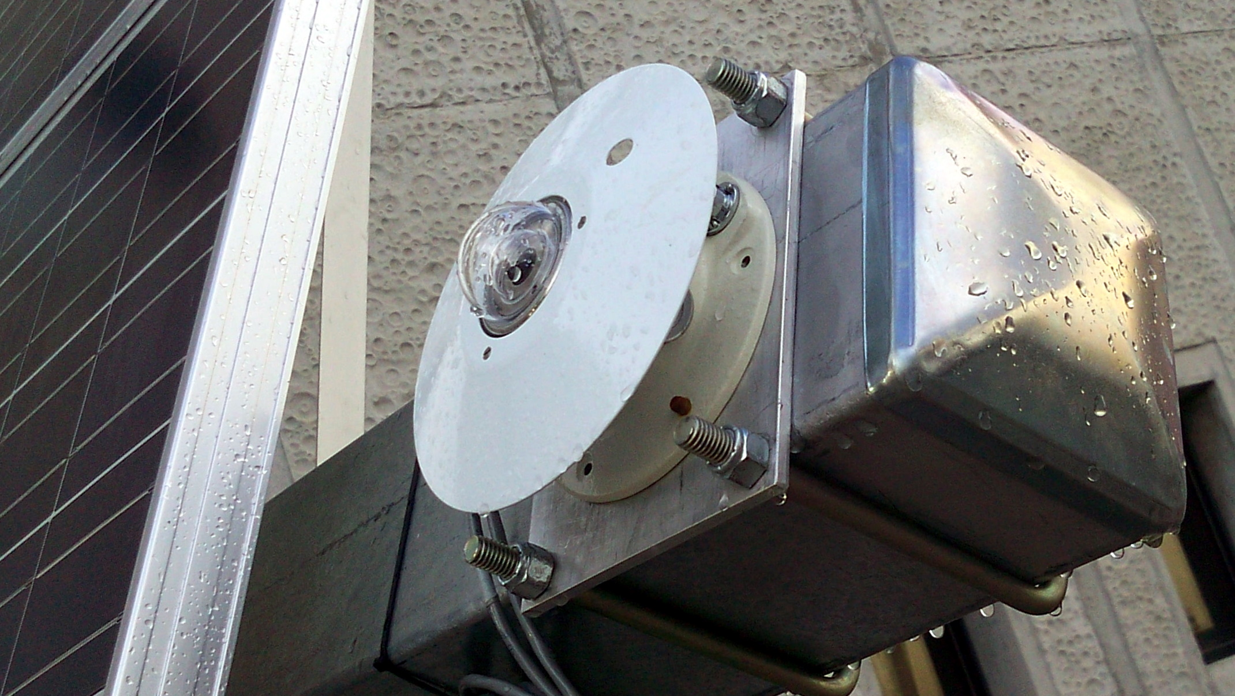
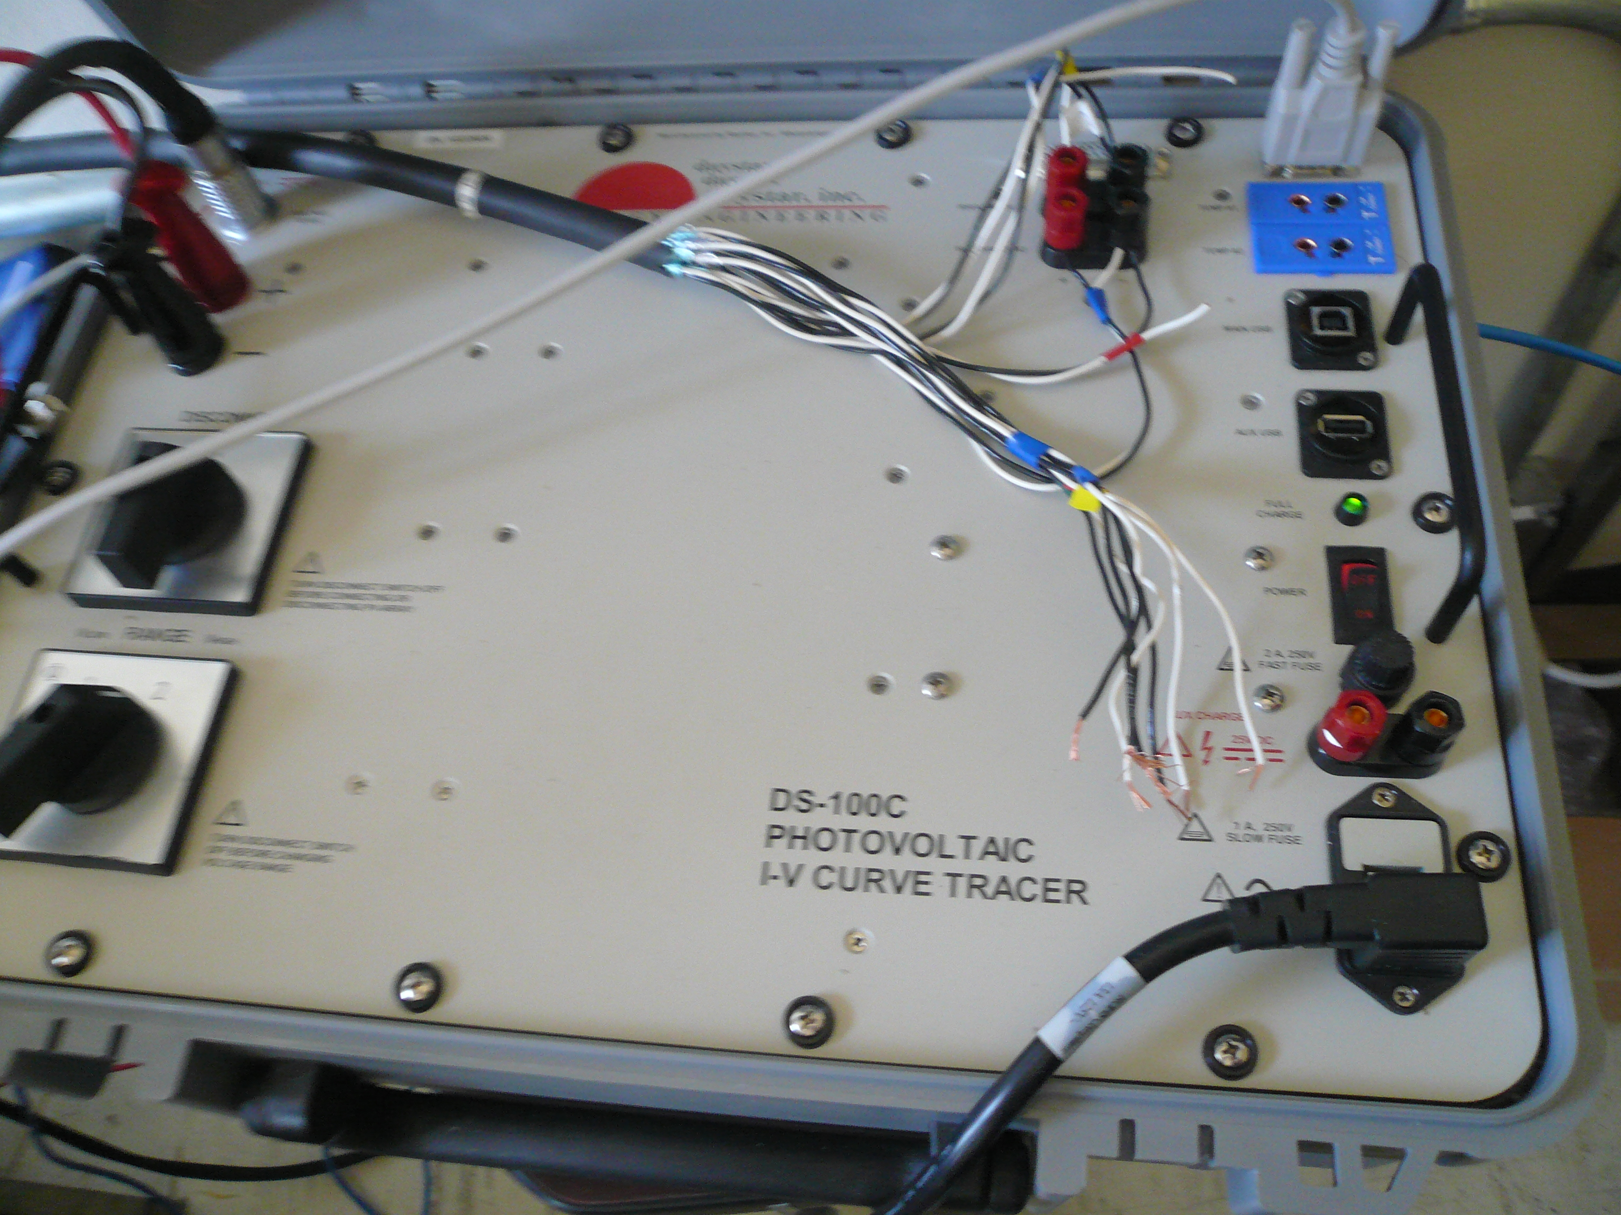
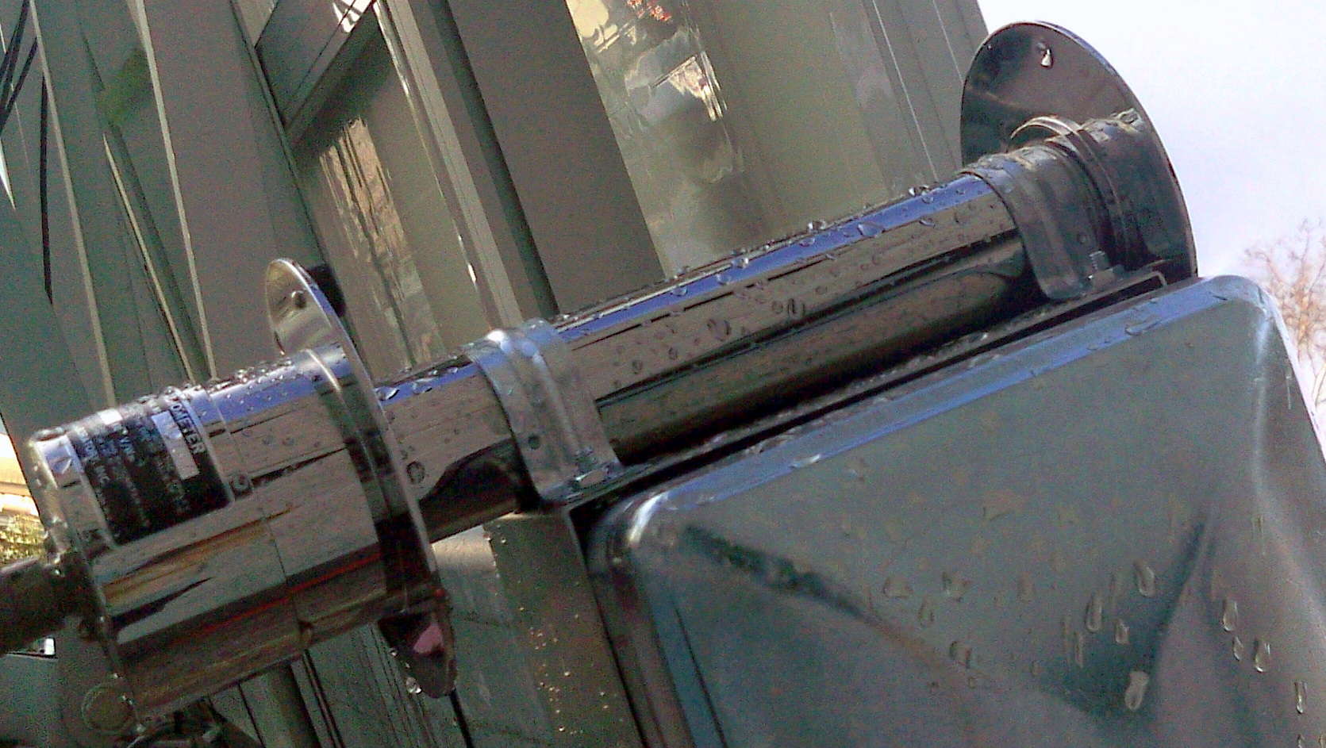
Implementation of a Web-Enabled Interactive Renewable Energy Laboratory
Steven Vuong
Hartnell College; NASA Ames; University of California, Santa Cruz
Abstract
Figure 3. Precision Spectral Pyranometer – put some text here about the PSP
Results
Conclusions
Since the summer of 2011, I have collaborated on the Course Curriculum and Laboratory Improvement (CCLI) grant project at Hartnell College in partnership with the University of California, Santa Cruz. We have worked to implement a web-enabled renewable energy laboratory to include a remotely operated solar panel. I have assisted in the development of the lab modules, instruction of the labs, and assessment of learning outcomes. In this poster, I present assessment results as of spring 2012 and prospects for future project improvement.
Figure 7. The chart on the right shows the data collected from the Precision Spectral Pyranometer (PSP) in blue and the Normal Incidence Pyrheliometer (NIP) in red. The NIP detects the amount of direct light and the PSP gathers indirect light. We asked the students if it was a sunny or cloudy day in the Pre and post quiz. They can determine this with the data collected from the PSP and NIP
In its second year, the goals of the CCLI interactive laboratory project are well in hand. The web interface is organized with all hardware documented. It has been successfully tested with multiple cohorts of students. The effectiveness of the lab has been demonstrated with data collected, some of which is shown in the results section of this poster. In the immediate future, efforts will be made to give access to any students interested in taking data via a web appointment system.
Objectives
Results
My main tasks in improving the Renewable Energy Laboratory and associated website were:
Goal 1
Goal 2
Goal 3 …
Figure 4. Include some detail about what the students learned.
Figure 8. The histogram to the left shows the students scores when they took the prequiz and post quiz. As you can see , the results show that the students improved after doing the web enabled activity and doing the solar module lab. I like the idea of this figure, but it’s a little difficult to see how each student is doing better or worse. Is there a different way of displaying the data?
Materials and Methods
To create the solar module, I used a drill, protractors, acrylic glass, a solar cell, resistor box and an ammeter. In addition to these materials, I also helped in programming the website to gather a list of data from the IV-Curve Tracer. Also I was able to place a chart on this website that plotted the solar panel’s orientation.
Figure 1. Picture and text showing the solar module used with the lab activity.
Figure 5. Include some detail about what the students learned. Do we need this chart?
Chart 1 + 2. The histogram to the left shows the students scores when they took the prequiz and post quiz. As you can see , the results show that the students improved after doing the web enabled activity and doing the solar module lab. Can You remake these charts with larger labels ? They should be easy to see at 200%. Right now they’re a bit small
Figure 2. The IV- Curve Tracer is a capacitive load that varies its impedance to change voltage and current. With these varied current and voltages, we could measure the different amounts of power the solar panel produced.
Figure 6. Also I was able to program a chart on this website that plotted the solar panel’s orientation. The solar panel can change its angle horizontally from 30 to 230 degrees and and vertically from 20 to 70 degrees.
Include some detail about what the students learned. Do we need this chart? If so, it needs to be remade with bigger labels and you need to use a different scale so that there’s not so much white space.
Figure 3. Normal Incidence Pyrheliometer – put some text here about the NIP
Acknowledgements
I’d like to thank Dan O’Leary and NASA Ames for providing hardware and helping me with my research on solar panels, Dr. Brooke Haag and Tito Polo for guiding me with my research. Also, this internship would not have been possible without the generous funding of the NSF grant No. DUE-0942439

